Slide 1






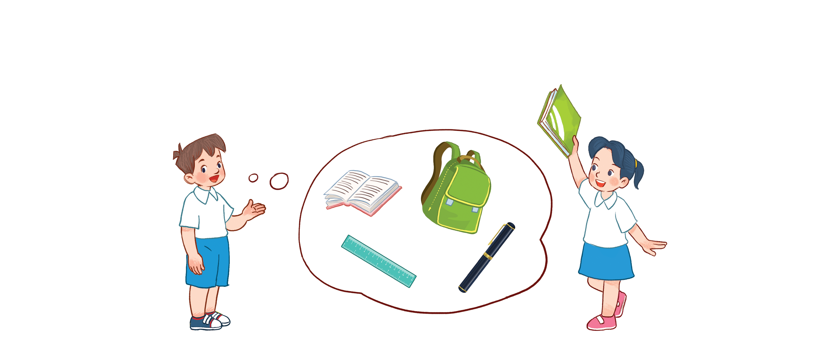



Unit 8
My school things
Lesson 1 - period 1

Slide 2
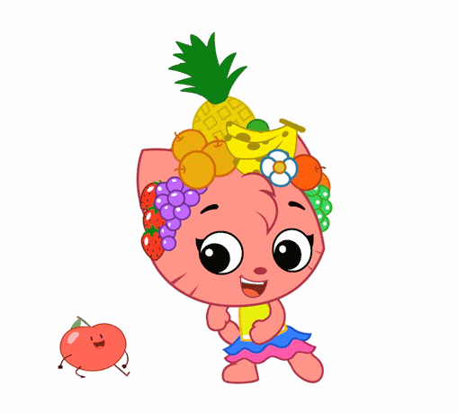
Warm - up
Play

Slide 3
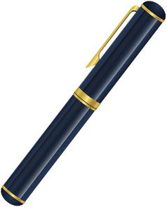
Vocabulary
pen
/pen/
Cái bút

Slide 4
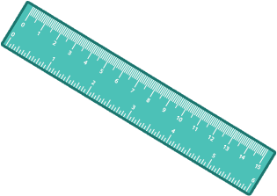
Vocabulary
ruler
/ˈruːlər/
Thước kẻ

Slide 5

Vocabulary
book
/bʊk/
Quyển sách

Slide 6
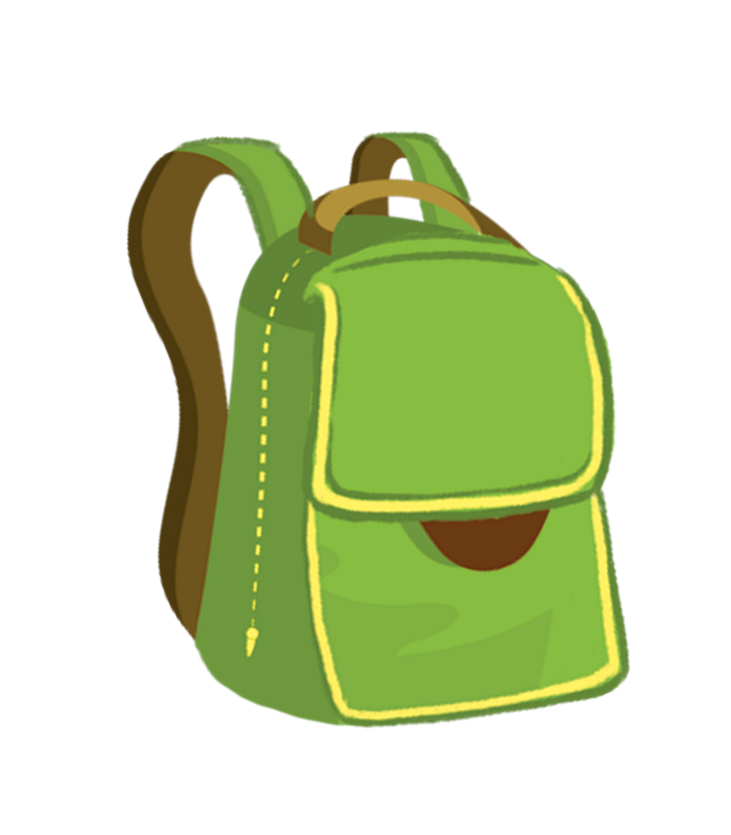
Vocabulary
school bag
/kuːl bæɡ/
Cái cặp

Slide 7
Vocabulary
pen
: Cái bút
/pen/
ruler
: Thước kẻ
/ˈruːlər/
book
: quyển sách
/bʊk/
school bag
: cặp sách
/kuːl bæɡ/

Slide 8


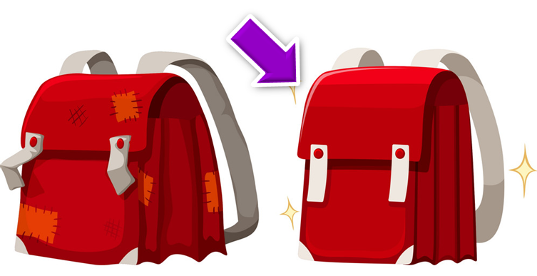
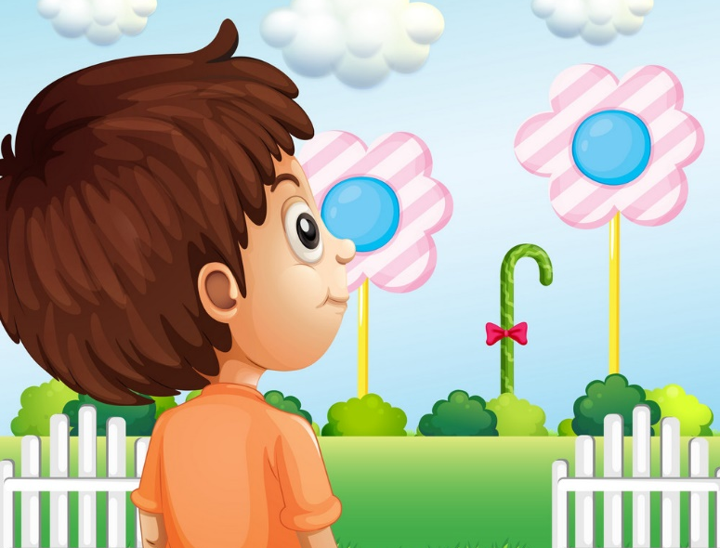
Vocabulary
like
: Thích
/laɪk/
nice
: tốt, đẹp
/naɪs/
look
: nhìn
/lʊk/

Slide 9
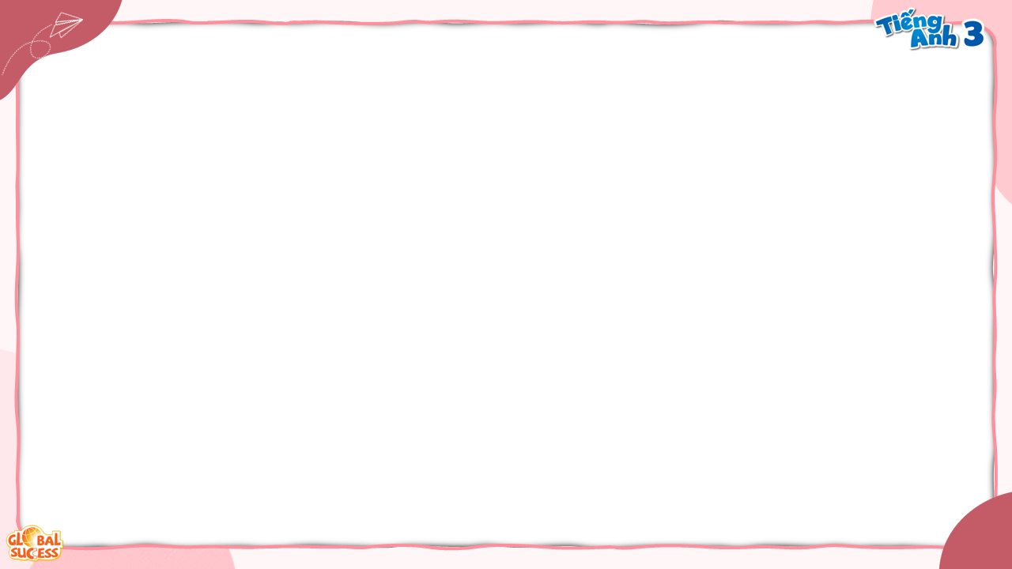
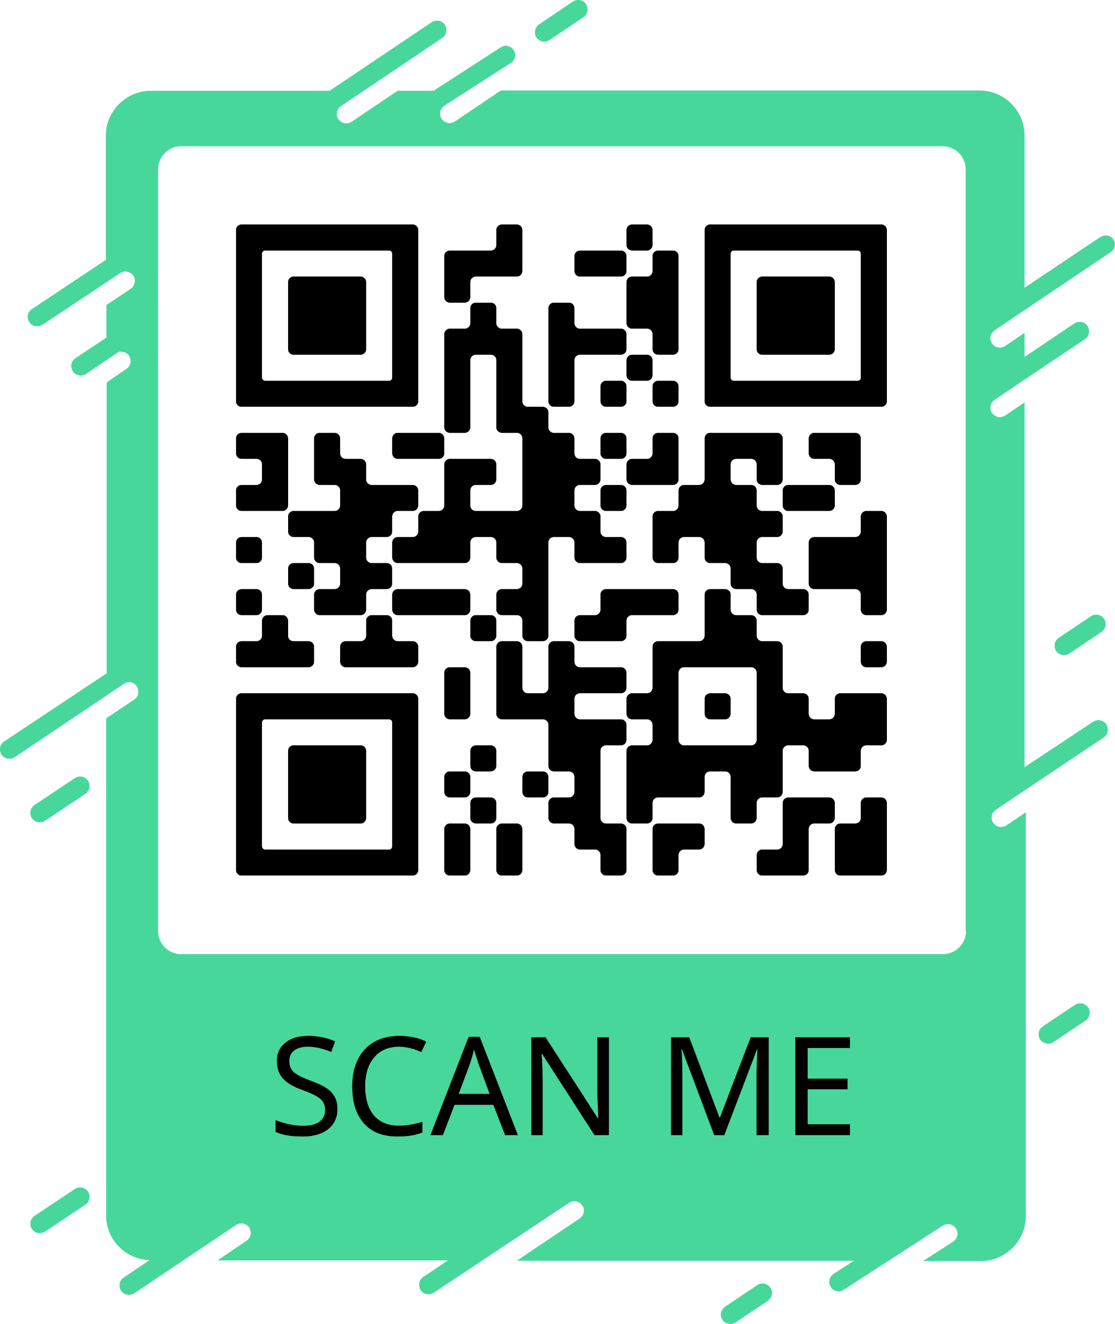
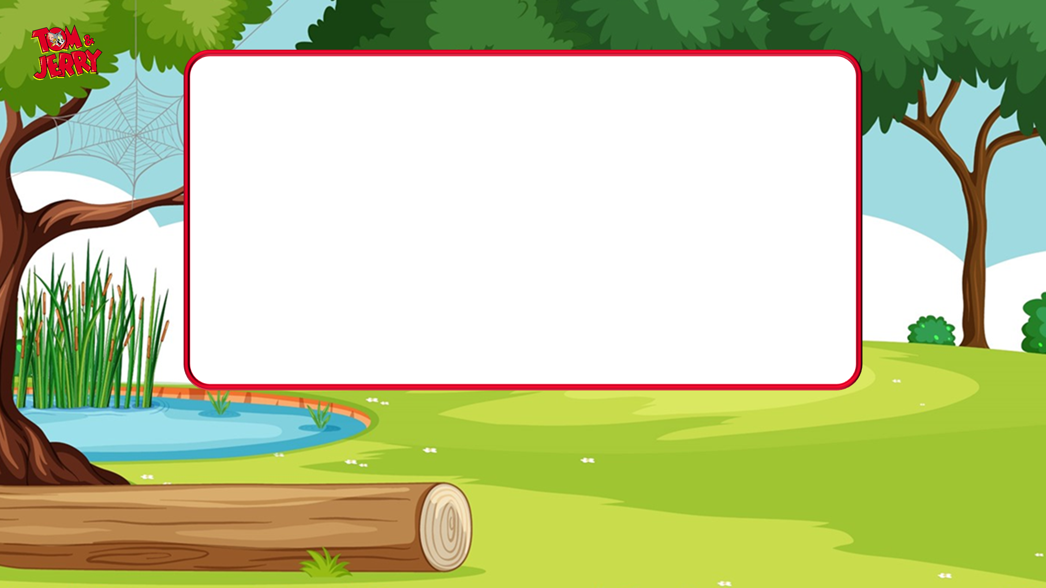
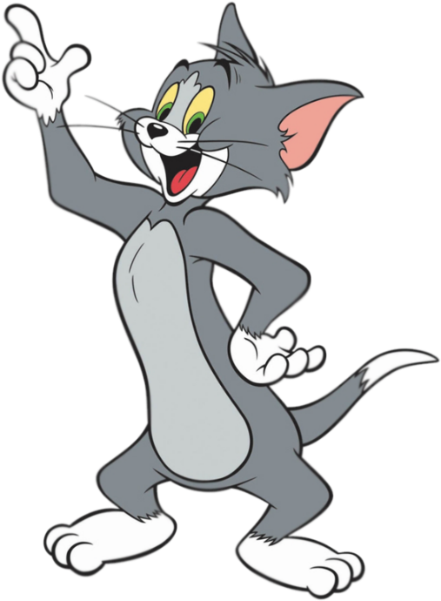
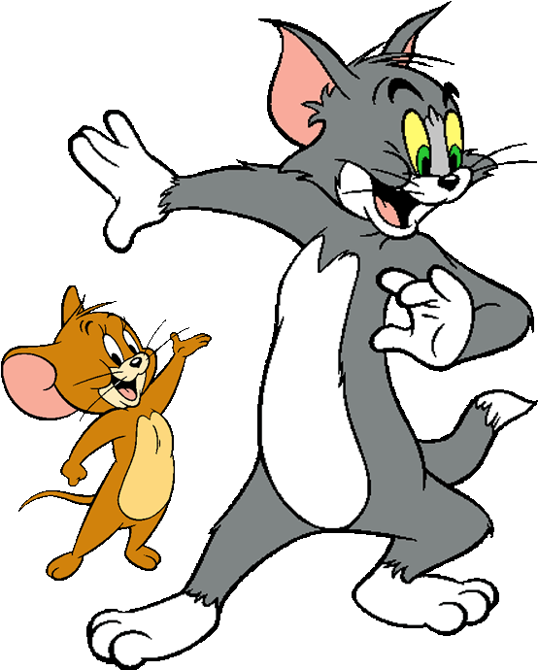




I have a school bag.
Next

Slide 10

I have a ruler .
Next

Slide 11

I have a book.
Next

Slide 12
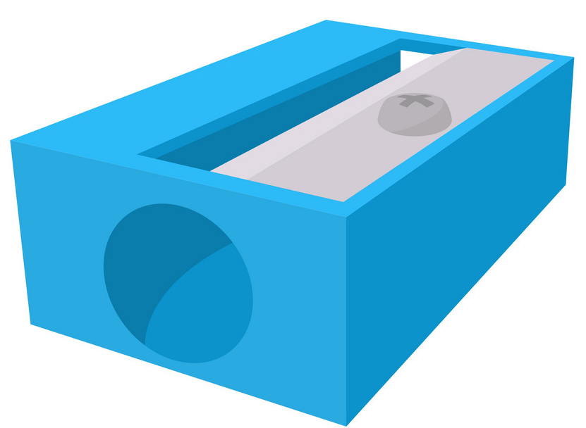
I have a pen.
Next

Slide 13
I have a book.
Next

Slide 14
I have a ruler.
Next

Slide 15
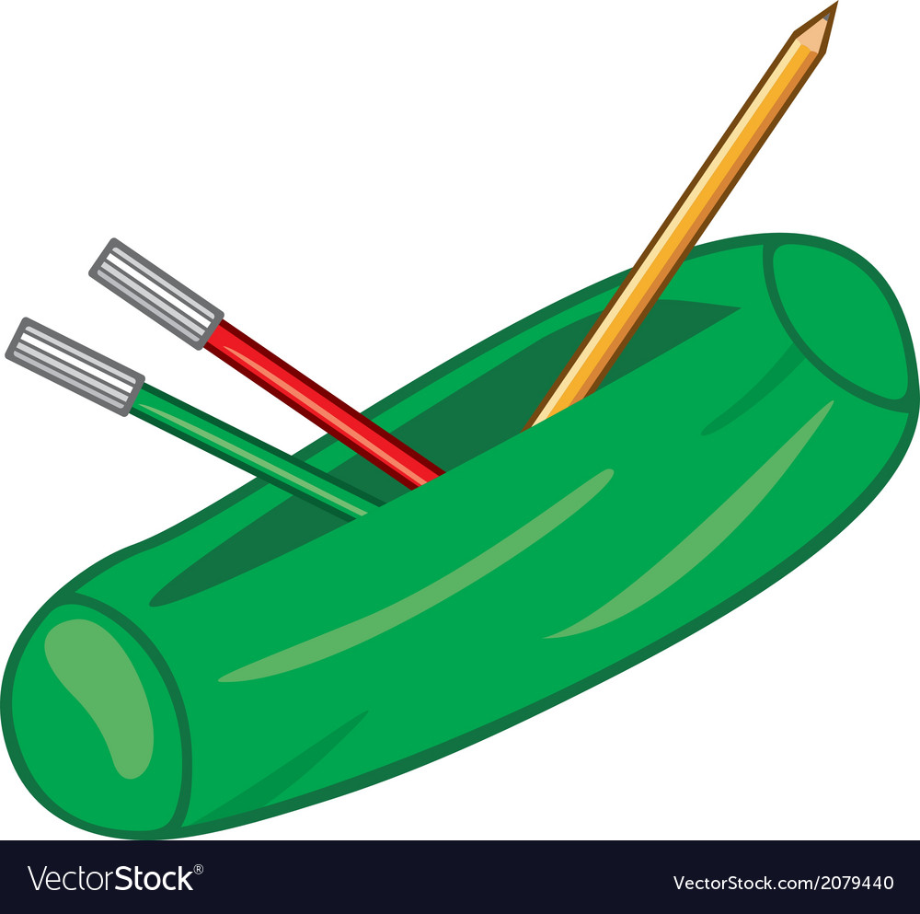
I have a school bag.
Next

Slide 16
I have a pen.
Next

Slide 17
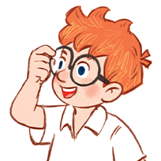
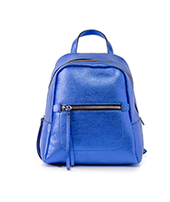

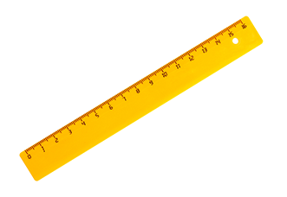
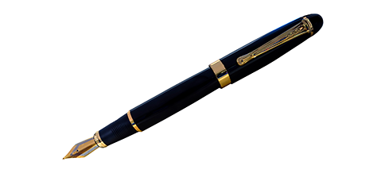
2
Listen, point and say.
I have _____.
a pen
a book
a ruler
a school bag

Slide 18

Structures
Cách nói mình có cái gì đó:
I have a/an _______?
(Tôi có một ________.)

Slide 19
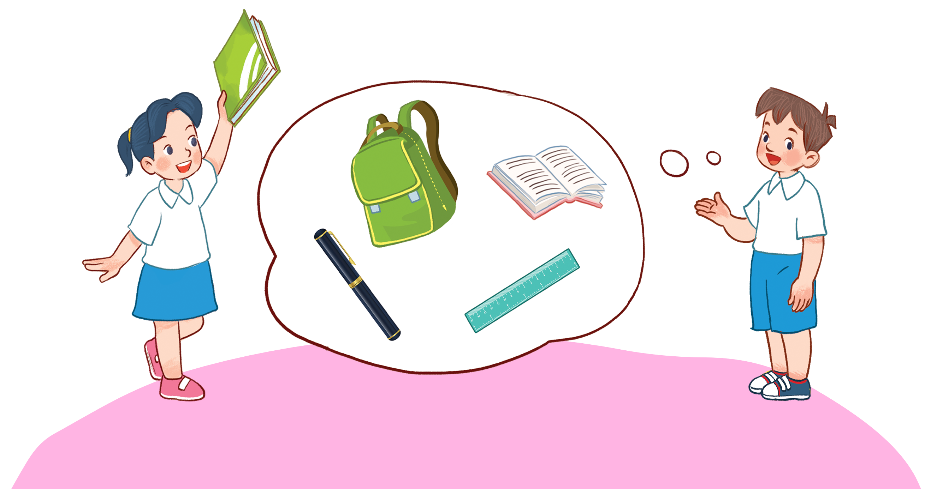
3
Let’s talk.

Slide 20
Thank you!

