Slide 1






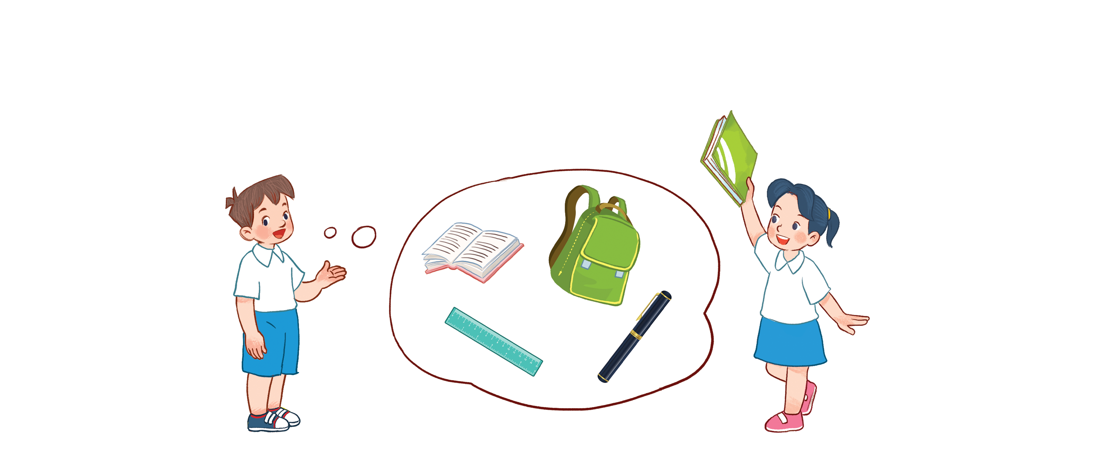



Unit 8
My school things
Lesson 1 - period 2

Slide 2



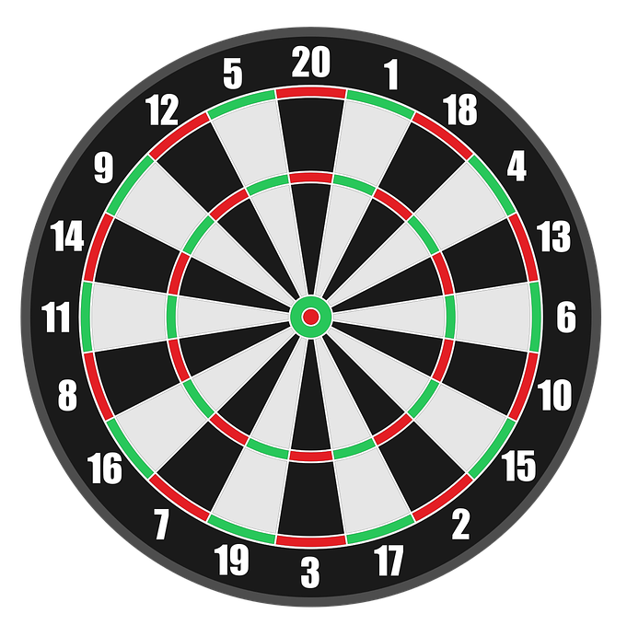


I have _______.
+50
a book
an book
books
Next
Abc.xyz789
Notes:
Ms Huyền Phạm - 0936.082.789 – YOUTUBE: MsPham. Facebook: Dạy và học cùng công nghệ.

Slide 3
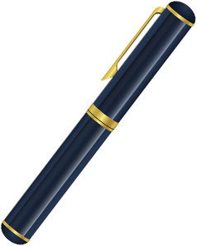
I have _______.
+25
an pen
pen
a pen
Next
Abc.xyz789
Notes:
Ms Huyền Phạm - 0936.082.789 – YOUTUBE: MsPham. Facebook: Dạy và học cùng công nghệ.

Slide 4
I have ___ book.
+25
a
is
an
Next
Abc.xyz789
Notes:
Ms Huyền Phạm - 0936.082.789 – YOUTUBE: MsPham. Facebook: Dạy và học cùng công nghệ.

Slide 5
I have _____ eyes.
+50
a
an
two
Next
Abc.xyz789
Notes:
Ms Huyền Phạm - 0936.082.789 – YOUTUBE: MsPham. Facebook: Dạy và học cùng công nghệ.

Slide 6




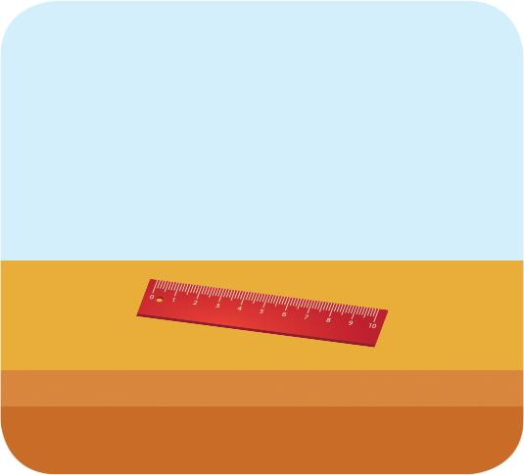

4
Listen and tick.
1
2
a
b
a
b

Slide 7
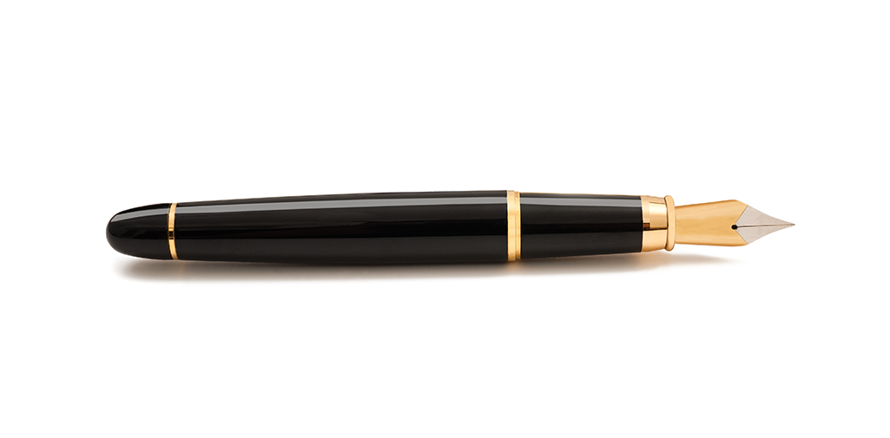
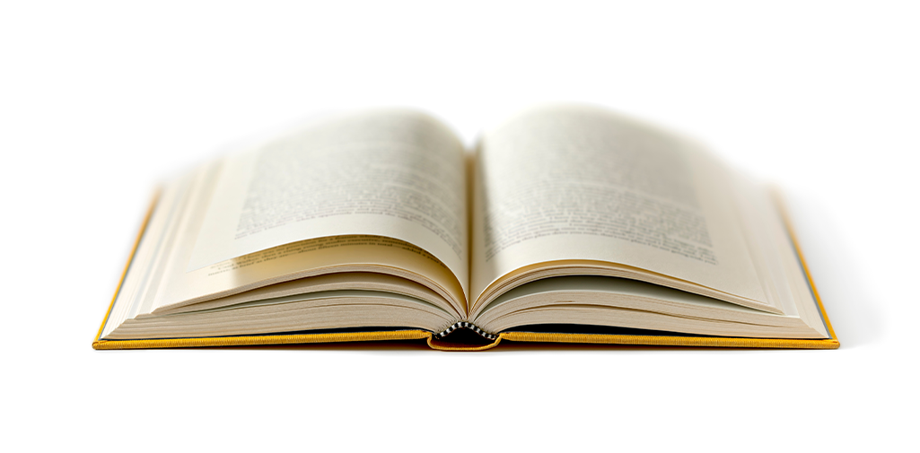
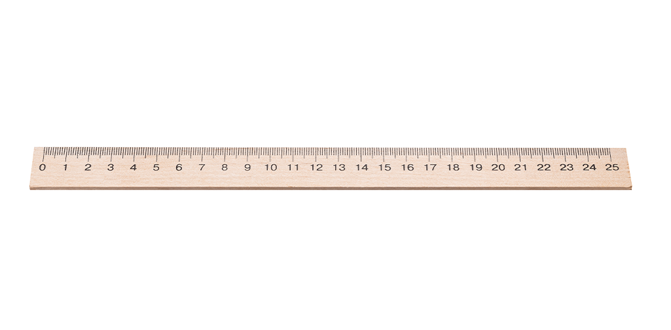
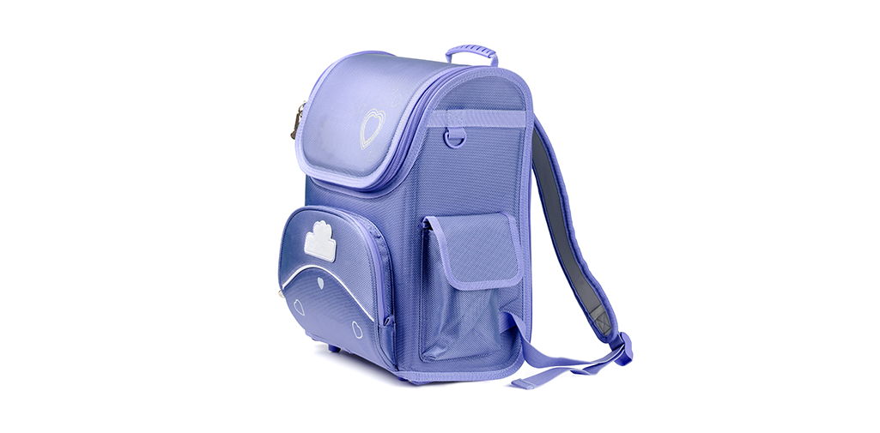
5
Look, complete and read.
1
2
I have a pen .
________
I have a book .
________
3
4
I have a ruler.
________.
I have a bag.
________.

Slide 8

Thank you!

