Slide 1






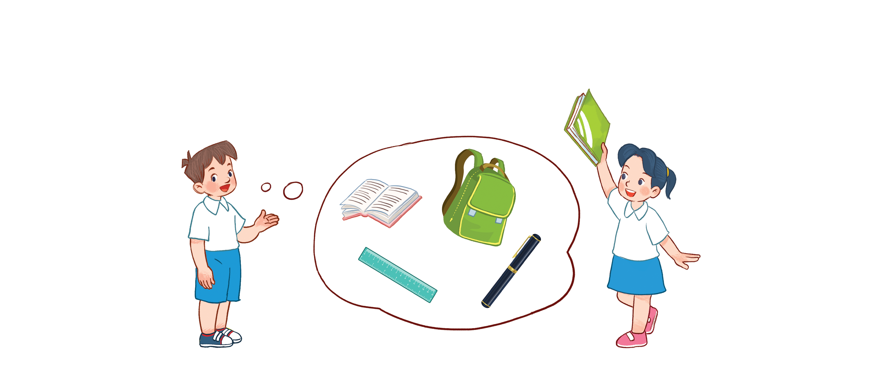



Unit 8
My school things
Lesson 2 - period 2

Slide 2
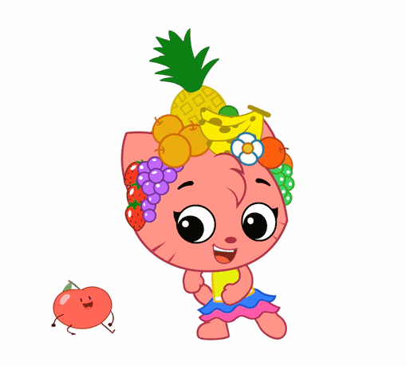
Warm - up
Play

Slide 3
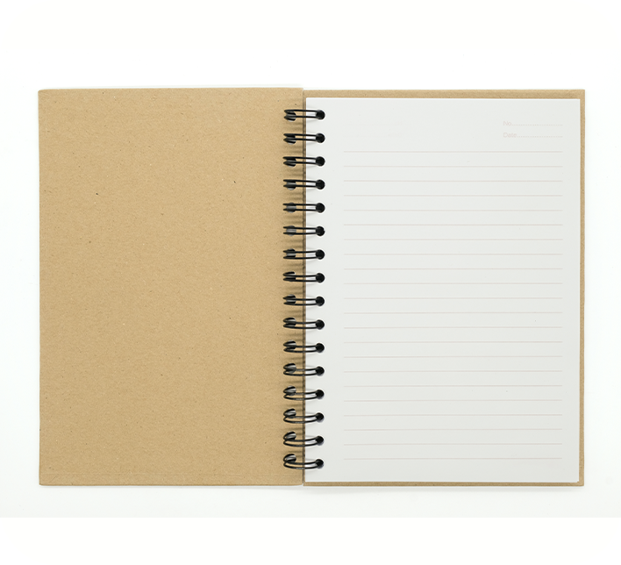
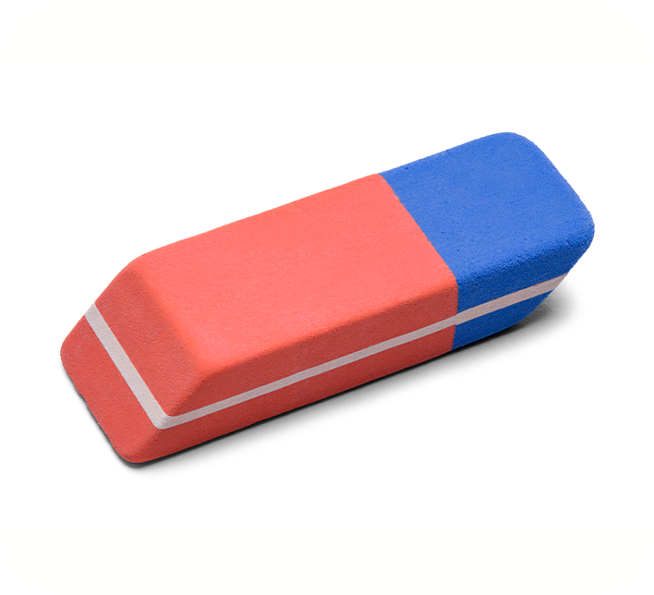
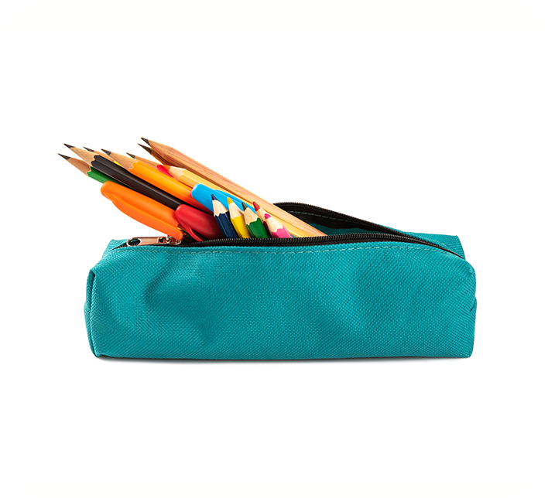
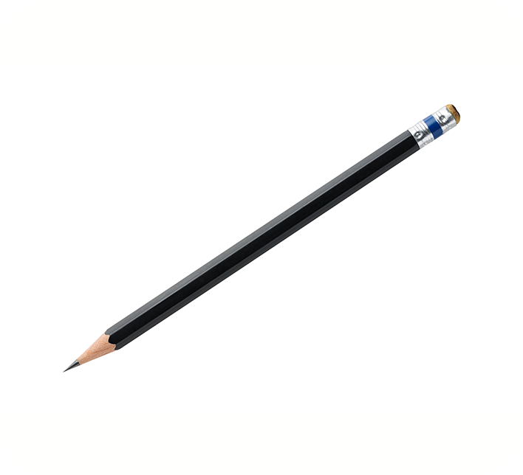

4
Listen and number.
a
3
b
4
a
1
b
2
1
2
3
4

Slide 4
6
Let’s play.

Slide 5



Look and say
Yes, I do.
Do you have a pencil?
Answer
Notes:
Ms Huyền Phạm - 0936.082.789

Slide 6

Look and say
No, I don’t.
Do you have an eraser?
Answer
Notes:
Ms Huyền Phạm - 0936.082.789

Slide 7
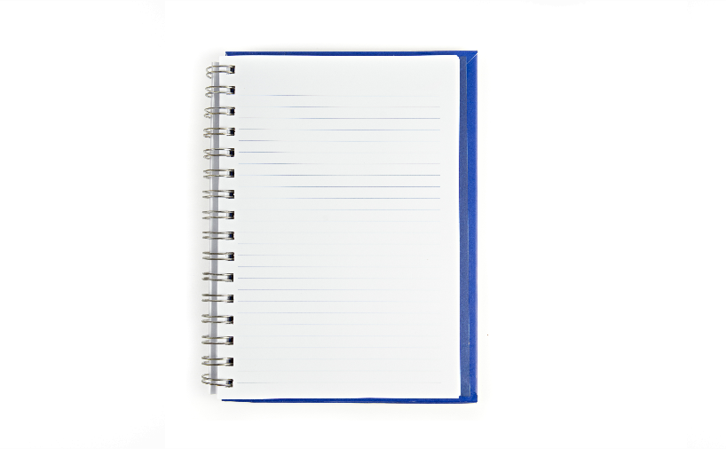
Look and say
a notebook
Do you have________?
Yes, I do.
Answer
Notes:
Ms Huyền Phạm - 0936.082.789

Slide 8
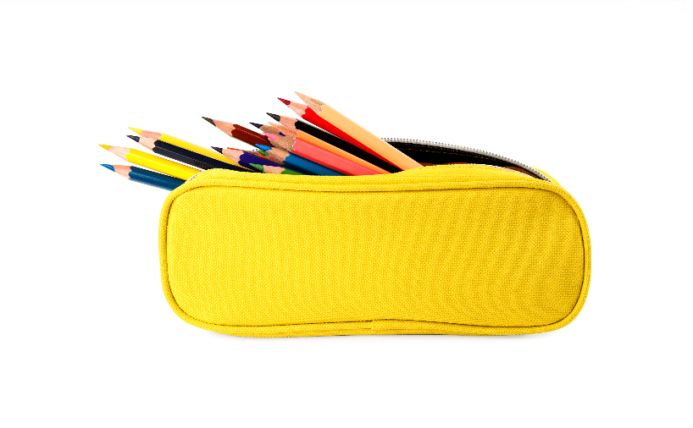
Look and say
a pencil case
Do you have________?
Yes, I do.
Answer
Notes:
Ms Huyền Phạm - 0936.082.789 –

Slide 9
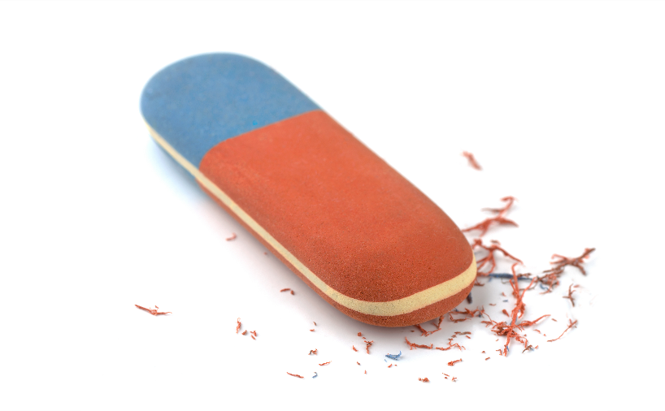
Look and say
an eraser
Do you have ________?
No, I don’t.
Answer
Notes:
Ms Huyền Phạm - 0936.082.789 –

Slide 10

Thank you!

