Slide 1






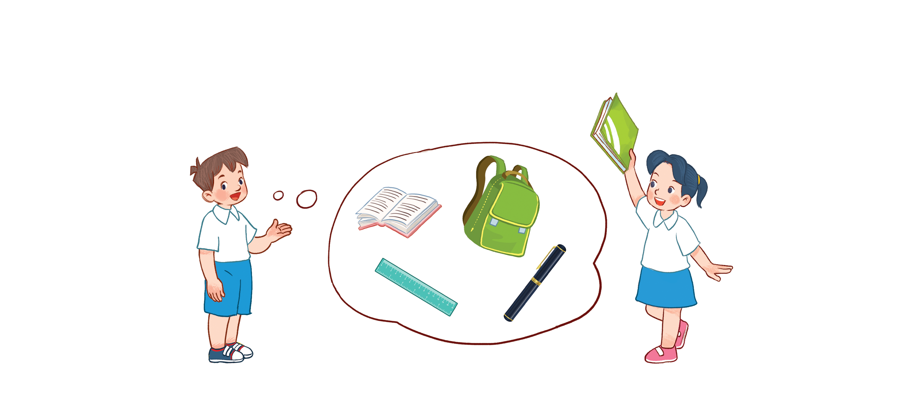



Unit 8
My school things
Lesson 3 - period 2

Slide 2
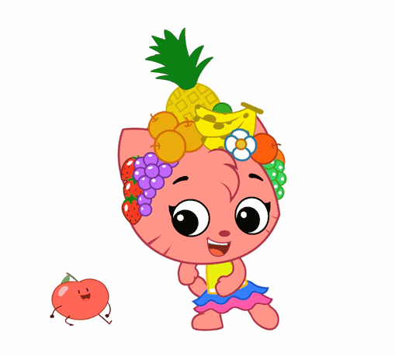
Warm - up
Play

Slide 3




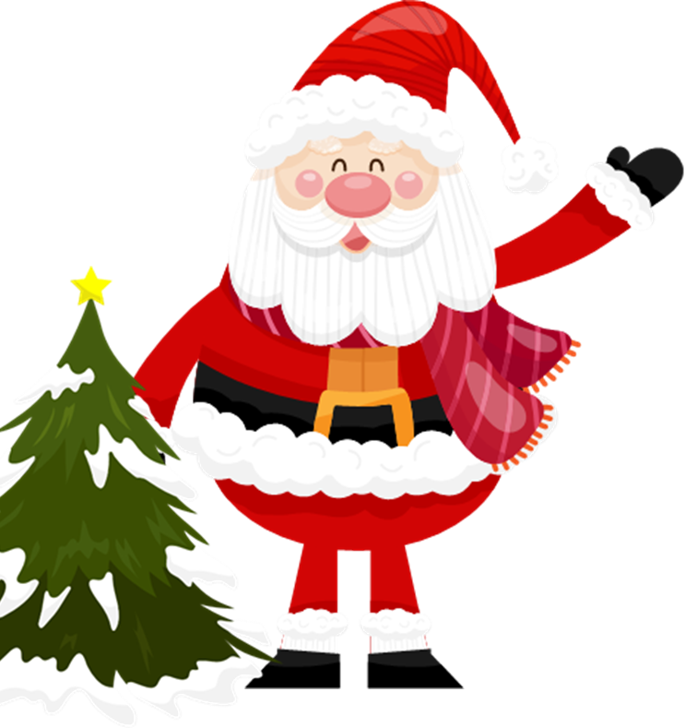

Keep or give
The box
Next

Slide 4
HOW TO PLAY
Make 2 teams
Answer the question
Then you must choose:
KEEP or GIVE THE GIFT to the other team.
BE CAREFUL!
The points in the gift can be GOOD or BAD.
Start

Slide 5

you
Do
an
have
?
eraser
Check

Slide 6
Do
you
have
an
eraser
?
Keep/ give the gift?

Slide 7
+10 point
Next

Slide 8
an
No
I
,
.
don’t
Check

Slide 9
?
No
,
I
don’t
.
Keep or give the gift?

Slide 10
+10 point
Next

Slide 11
an
No
I
,
.
don’t
Check

Slide 12
?
No
,
I
don’t
.
Keep or give the gift?

Slide 13
-5 point
Next

Slide 14
an
I
notebook
have
.
a
Check

Slide 15
?
I
have
a
notebook
.
Keep or give the gift?

Slide 16
-5 point
Next

Slide 17
Do
have
?
a
ruler
you
Check

Slide 18
Do
you
have
a
ruler
?
Keep or give the gift?

Slide 19
+10 point
Next

Slide 20
an
,
do
Yes
I
.
Check

Slide 21
?
Yes
,
I
do
.
Keep or give the gift?

Slide 22
+10 point
Next

Slide 23
an
a
have
I
book
.
Check

Slide 24
?
I
have
a
book
.
Keep or give the gift?

Slide 25
+10 point
Next

Slide 26
an
school bag
a
.
I
have
Check

Slide 27
?
I
have
a
school bag
.
Keep or give the gift?

Slide 28
-5 point
Next

Slide 29
an
pen
I
.
have
a
Check

Slide 30
?
I
have
a
pen
.
Keep or give the gift?

Slide 31
+10 point
Next

Slide 32
a
?
you
Do
have
pencil
Check

Slide 33
Do
you
have
a
pencil
?
Keep or give the gift?

Slide 34
+10 point
Next

Slide 35
GOOD JOB!
Exit

Slide 36
4
Read and complete.
eraser have my pen
Look at my school things. I (1) have a notebook, a (2) pen , a pencil case, an (3) eraser and an English book.
I like (4) my school things. Do you have any school things?

Slide 37
5
Let’s write.
My name is __________. Look at my school things.
I have ______ and ________.

Slide 38
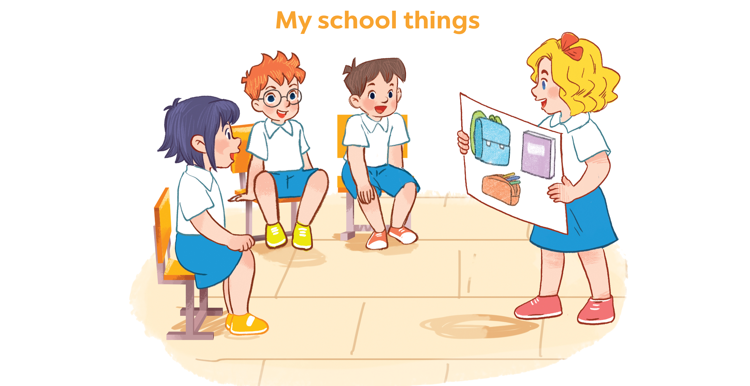
6
Project

Slide 39
Thank you!

