Slide 1

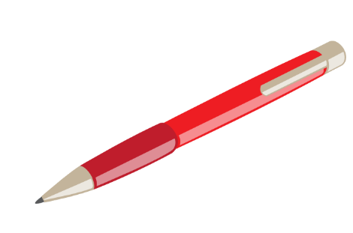



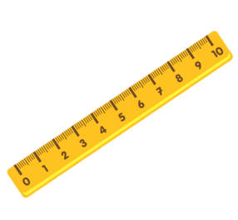

Unit 8:
This is my pen
Lesson 1

Slide 2

VOCABULARY
pen

Slide 3

VOCABULARY
rubber
eraser

Slide 4

VOCABULARY
school bag

Slide 5

VOCABULARY
pencil

Slide 6
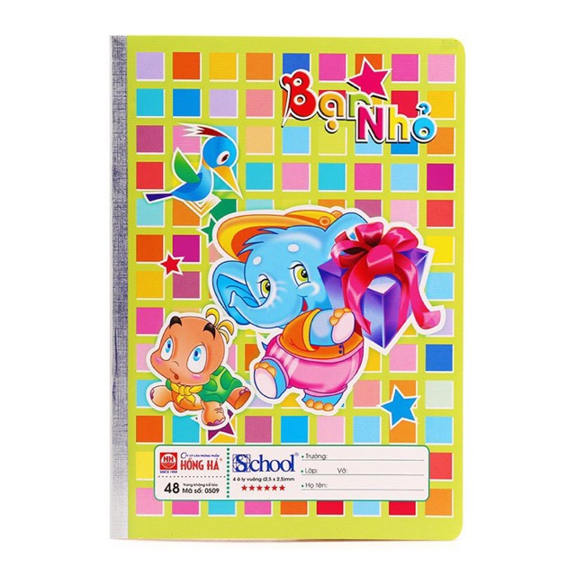
VOCABULARY
notebook

Slide 7

VOCABULARY
pencil sharpener

Slide 8
VOCABULARY
ruler

Slide 9

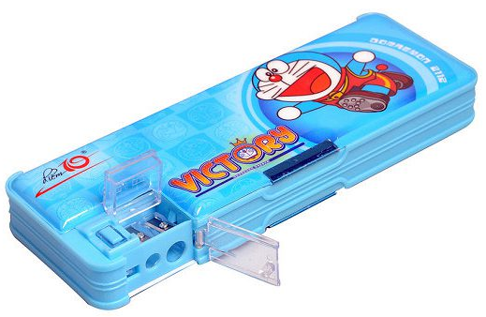

Review
eraser/ rubber
pencil sharpener
notebook
pen
pencil
pencil case
school bag

Slide 10
GRAMMAR

Slide 11

2. Point and say
This is my _____.
pencil sharpener
pencil
pencil case
school bag
notebook

Slide 12
2. Point and say
That is my _____.
pencil sharpener
pencil
pencil case
school bag
notebook

Slide 13








A
B
That is my pencil sharpener.
This is my pencil sharpener.
Notes:
Ms Huyền Phạm - 0936.082.789 – YOUTUBE: MsPham. Facebook: Dạy và học cùng công nghệ.

Slide 14


A
B
That is my notebook.
This is my notebook.
Notes:
Ms Huyền Phạm - 0936.082.789 – YOUTUBE: MsPham. Facebook: Dạy và học cùng công nghệ.

