Slide 1

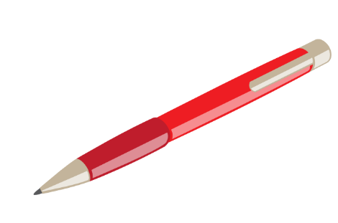

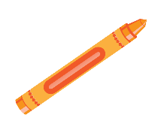

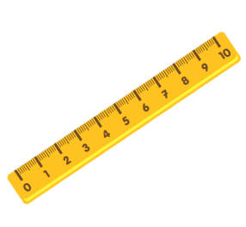
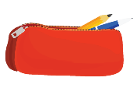
Unit 8:
This is my pen
Lesson 2

Slide 2
VOCABULARY

Slide 3
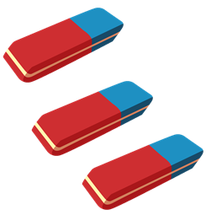
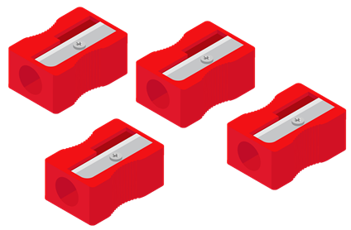
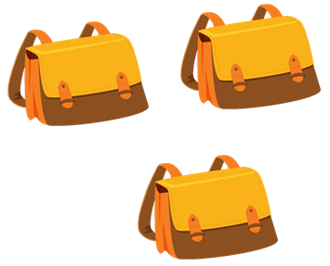
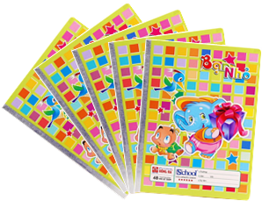
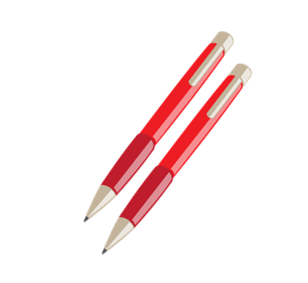
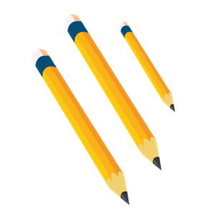
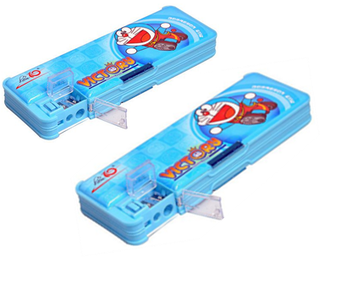
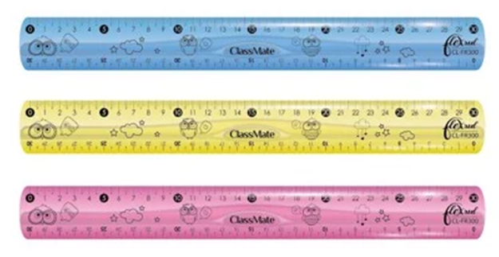

Vocabulary
rubbers
pencil sharpeners
school bags
notebooks
pens
pencils
pencil cases
rulers
books

Slide 4
GRAMMAR

Slide 5

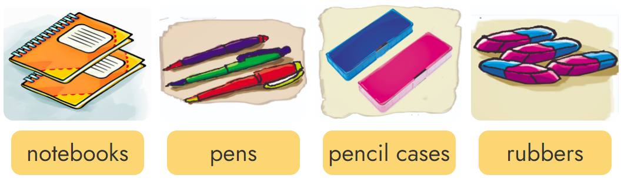
2. Point and say
These are my _______.

Slide 6

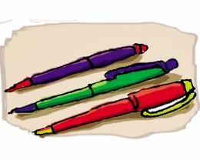
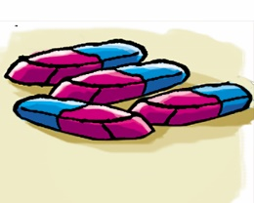
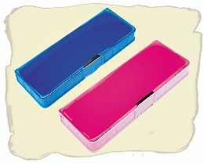
2. Point and say
Those are my _______.

Slide 7
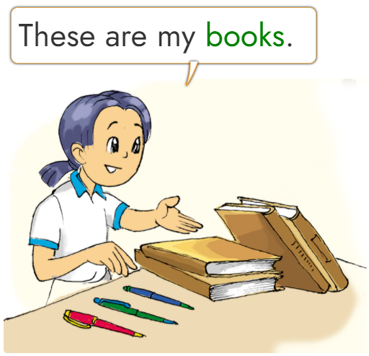
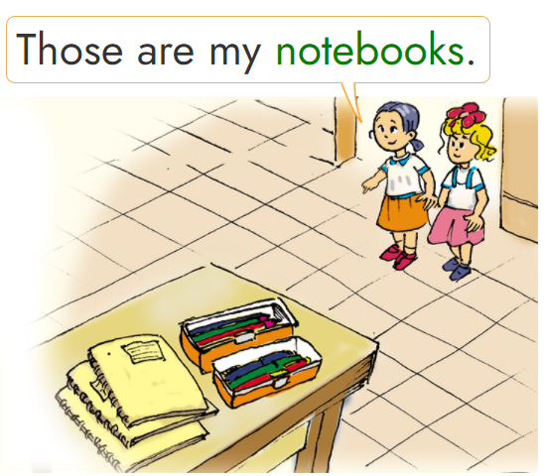


3. Let’s talk
________________.
my notebook
books
my pencil cases
pens
_________.
3
1
4
2

Slide 8



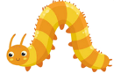









_______ my pencils.
These are
Next
Notes:
Ms Huyền Phạm - 0936.082.789 – YOUTUBE: MsPham. Facebook: Dạy và học cùng công nghệ.

Slide 9

____ pencil sharpener.
Those are
Next
Notes:
Ms Huyền Phạm - 0936.082.789 – YOUTUBE: MsPham. Facebook: Dạy và học cùng công nghệ.

Slide 10
These are my _____.
rubbers
Next
Notes:
Ms Huyền Phạm - 0936.082.789 – YOUTUBE: MsPham. Facebook: Dạy và học cùng công nghệ.

Slide 11
Those are my_____.
notebooks
Next
Notes:
Ms Huyền Phạm - 0936.082.789 – YOUTUBE: MsPham. Facebook: Dạy và học cùng công nghệ.

Slide 12

Those are my_____.
pens
Next
Notes:
Ms Huyền Phạm - 0936.082.789 – YOUTUBE: MsPham. Facebook: Dạy và học cùng công nghệ.

Slide 13
These are my_____.
rulers
Next
Notes:
Ms Huyền Phạm - 0936.082.789 – YOUTUBE: MsPham. Facebook: Dạy và học cùng công nghệ.

