Slide 1


An Thang Primary School
WELCOME TO
OUR CLASS 3C
Teacher: Nguyen Thi Canh
Notes:
MADE BY FACEBOOK :TRAN THI THANH TAM

Slide 2


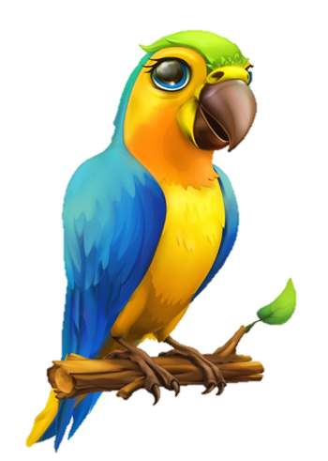

Back

Slide 3
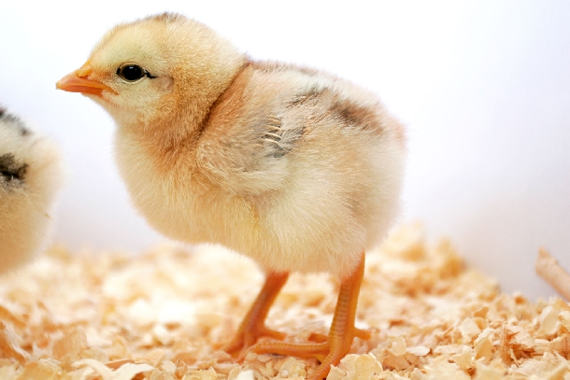
Back

Slide 5
UNIT 16: MY PETS
LESSON 3(4.5.6)

Slide 6

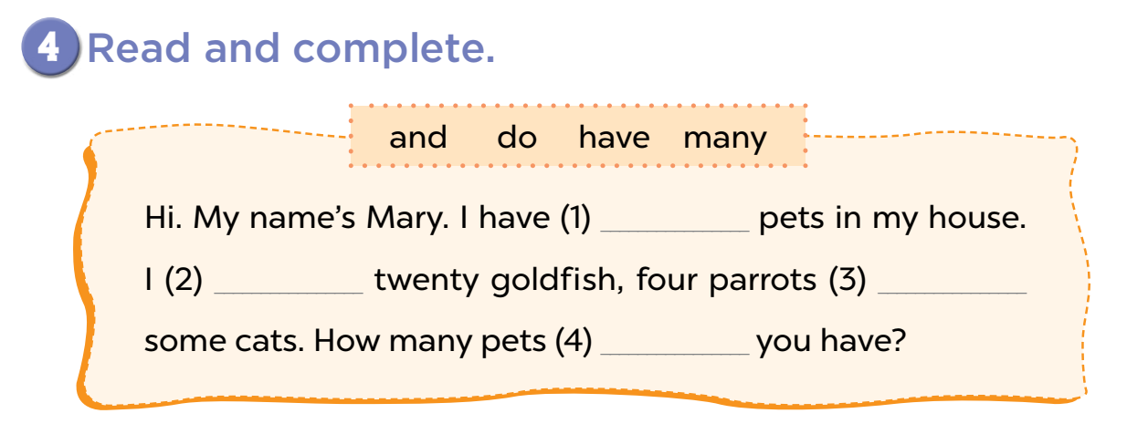
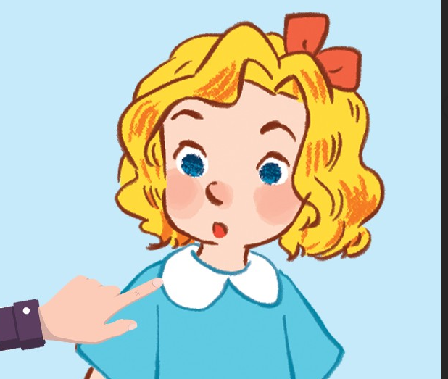
and
do
have
many

Slide 8
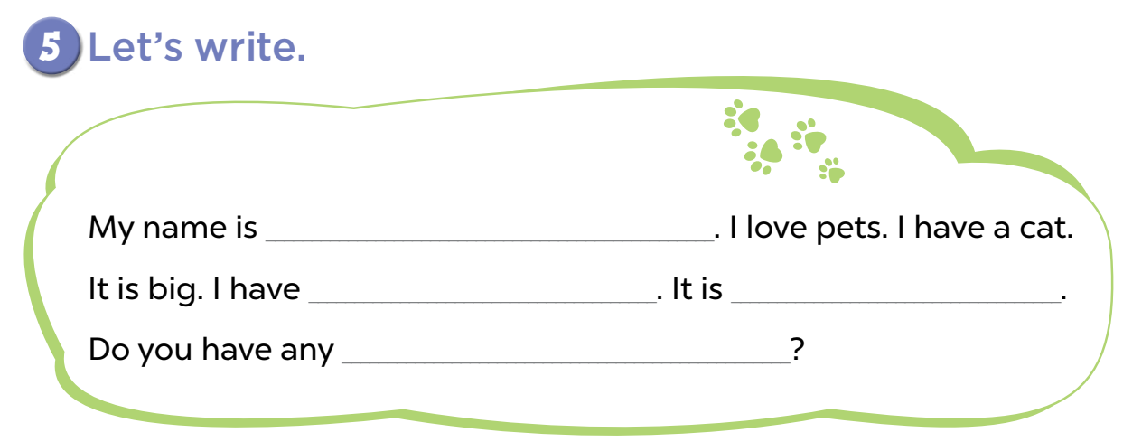
Canh
a dog
black
pets

Slide 10
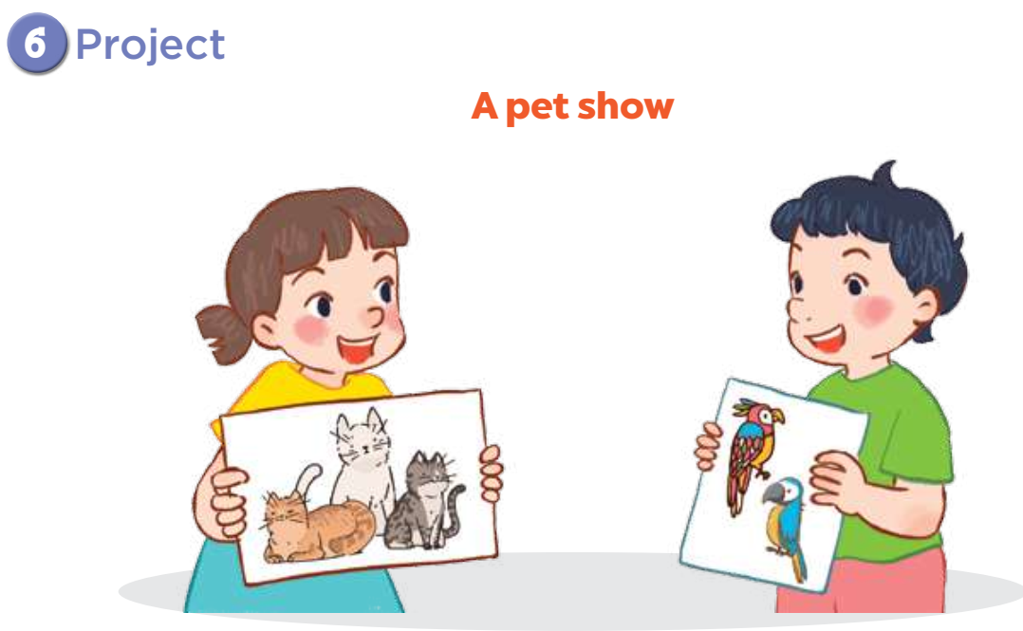

Slide 11
PASSING BALL

Slide 12
