Slide 1


An Thang Primary School
WELCOME TO
OUR CLASS 3C
Teacher: Nguyen Thi Canh
Notes:
MADE BY FACEBOOK :TRAN THI THANH TAM

Slide 2

Warm up-Rivision

Slide 3





8
Part 4.5.6

Slide 4
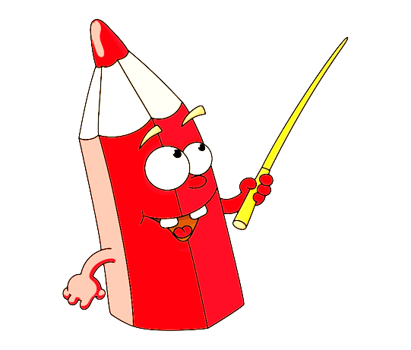

4
Listen and tick.

Slide 5
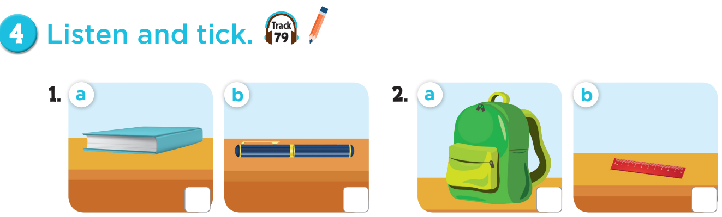

✓
✓

Slide 6

Let’s play:
Who says fast?
I have a book!
Notes:
Game: Who says fast? Teacher points to the picture, pupils say it as fast as they can. This can be played individually or in teams.

Slide 7
5
Look, complete and read.

Slide 8
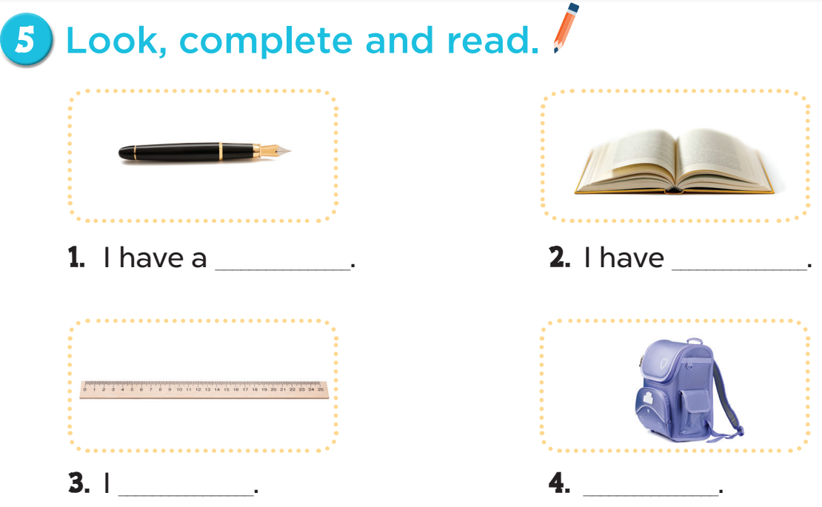
pen
a book
have a ruler
I have a school bag

Slide 9


Let's play
CHOOSE PRESENTS
Notes:
MADE BY FACEBOOK :TRAN THI THANH TAM

Slide 10

Can you tell me about yourself?
BACK
Notes:
MADE BY FACEBOOK :TRAN THI THANH TAM

Slide 11
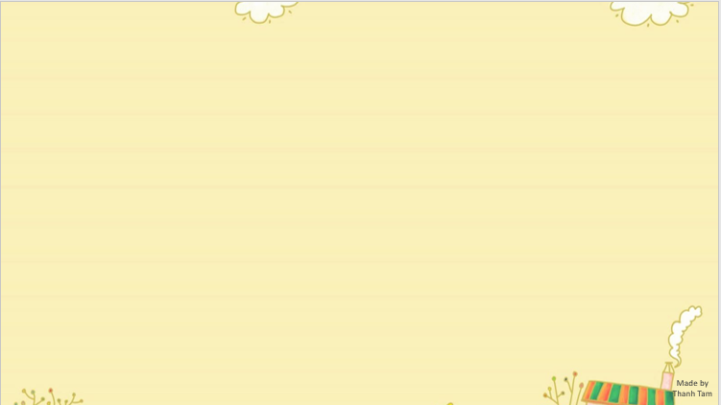


BACK
Notes:
MADE BY FACEBOOK :TRAN THI THANH TAM

Slide 12
Can you tell me about yourself?
BACK
Notes:
MADE BY FACEBOOK :TRAN THI THANH TAM

Slide 13
Can you tell me about yourself?
BACK
Notes:
MADE BY FACEBOOK :TRAN THI THANH TAM

Slide 14

BACK
Notes:
MADE BY FACEBOOK :TRAN THI THANH TAM

Slide 15
Can you tell me about yourself?
BACK
Notes:
MADE BY FACEBOOK :TRAN THI THANH TAM

Slide 16
6
Let’s sing.

Slide 17
Game: Let’s sing and move!
Notes:
Play music – audio track 80, then ask pupil to sing and dance along with the song, when the music stops, every body has to stop moving. Who can make it is the winner.

Slide 18
music

