Slide 1








Unit 6
Our school
facilities
Lesson 3 – Period 2
MsPham
0936082789

Slide 2
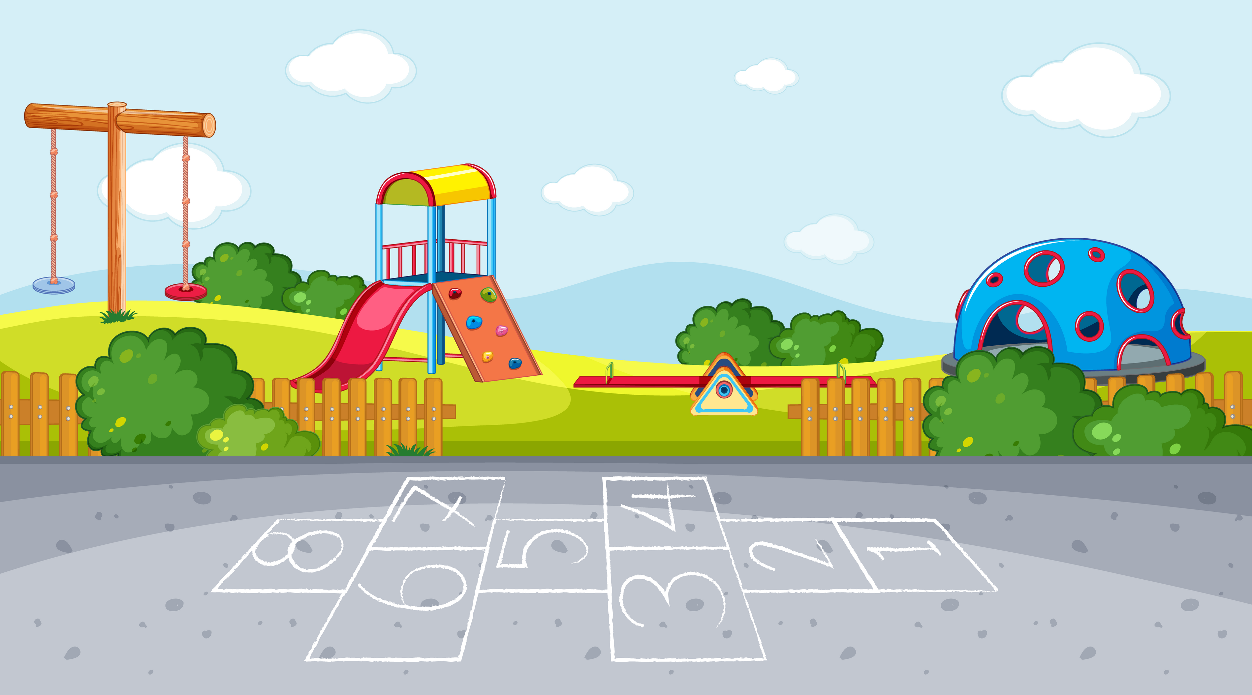



Warm-up

Slide 3


Playing with the seal!
Play

Slide 4
your
?
Where
school
is
Answer

Slide 5
Where
is
your
school
?
Next

Slide 6
My
the
is
in
village.
school
Answer

Slide 7
My
school
is
in
the
village.
Next

Slide 8
there
are
at
rooms
How
school
many
your
?
Answer

Slide 9
How many rooms are there at your school?
Next

Slide 10
buildings
at
school.
four
Lan’s
is
Answer

Slide 11
There are four buildings at my school.
Next

Slide 12
Welldone !
Next

Slide 13

MsPham
0936082789
Review

Slide 14

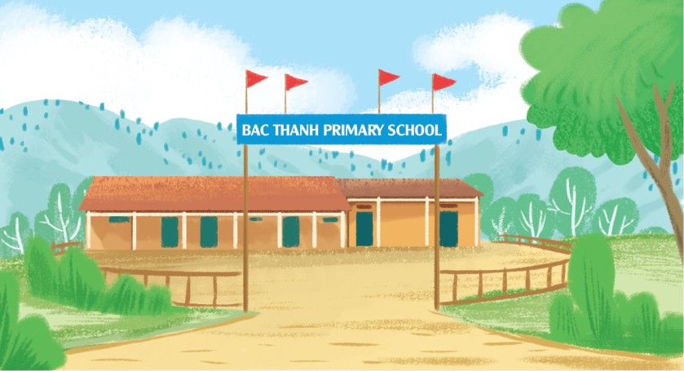
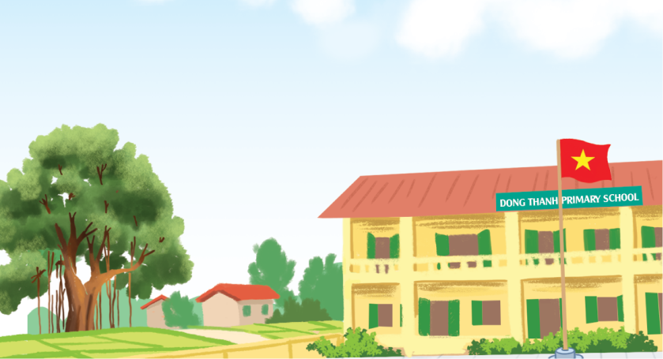
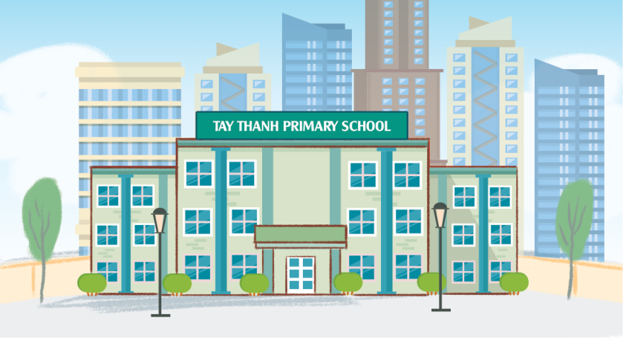
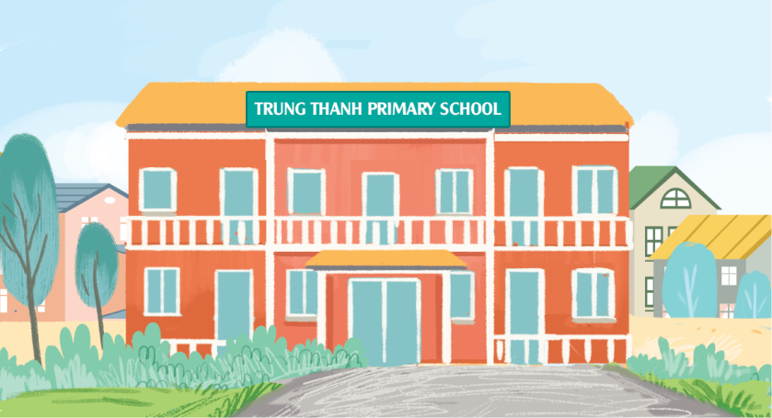
Where’s your school?
MsPham
0936082789
It’s in the ________.
MsPham
0936082789
mountains
village
city
town

Slide 15
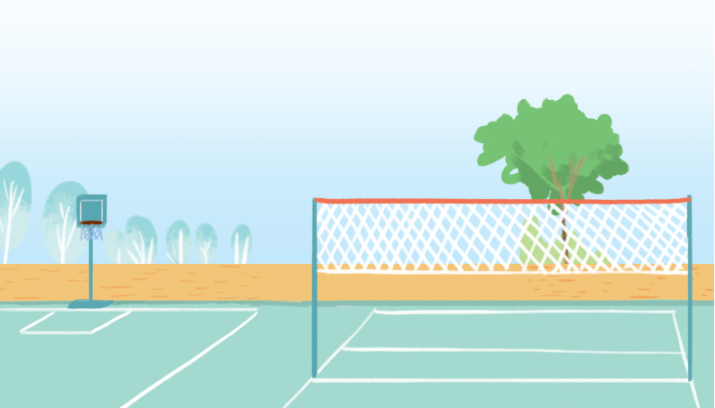
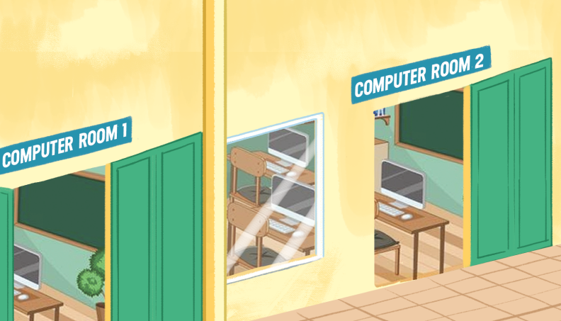
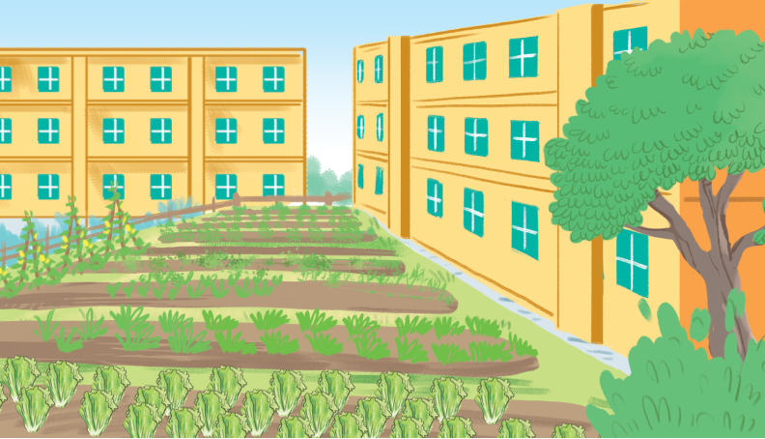
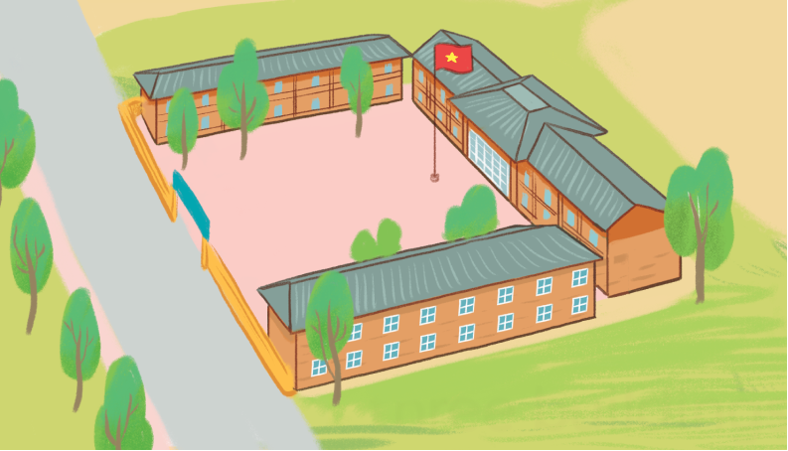
How many _________ are there
at your school?
MsPham
0936082789
There is/are ______.
MsPham
0936082789
playgrounds
computer rooms
gardens
buildings

Slide 16
MsPham
0936082789
Practice

Slide 17
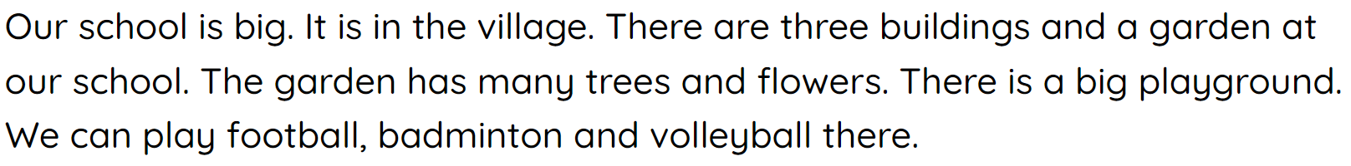
4
Read and complete.
MsPham
0936082789
1. Our school is in the village.
2. There are three buildings at our school.
3. There is a garden with many trees and flowers.
4. We can play sports in the big playground .
___________.
______
__________
_________________

Slide 18
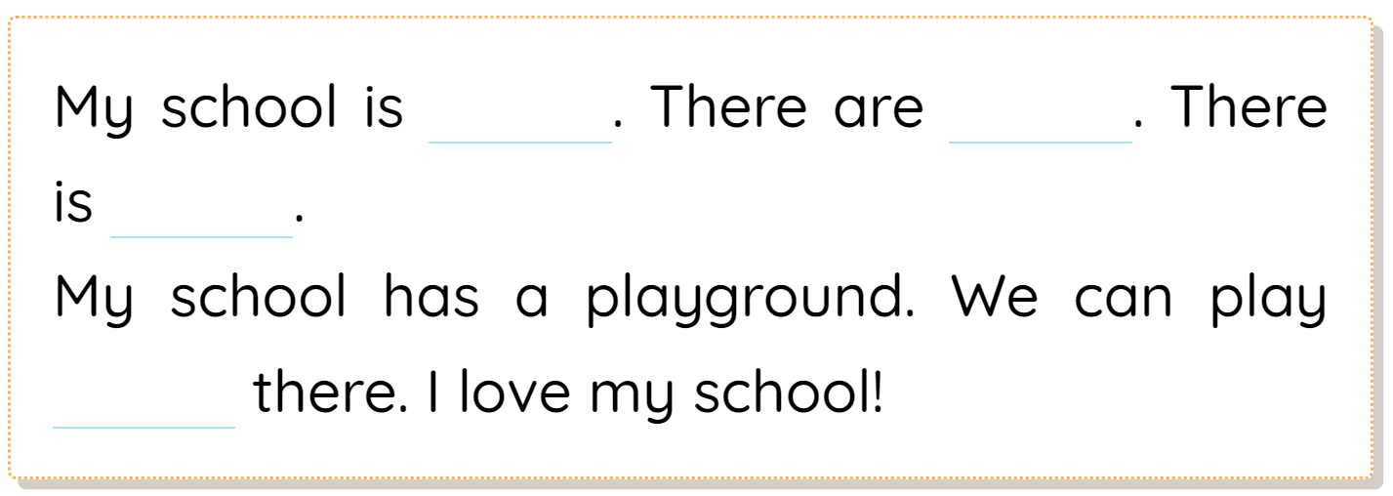
5
Let’s write
MsPham
0936082789

Slide 19
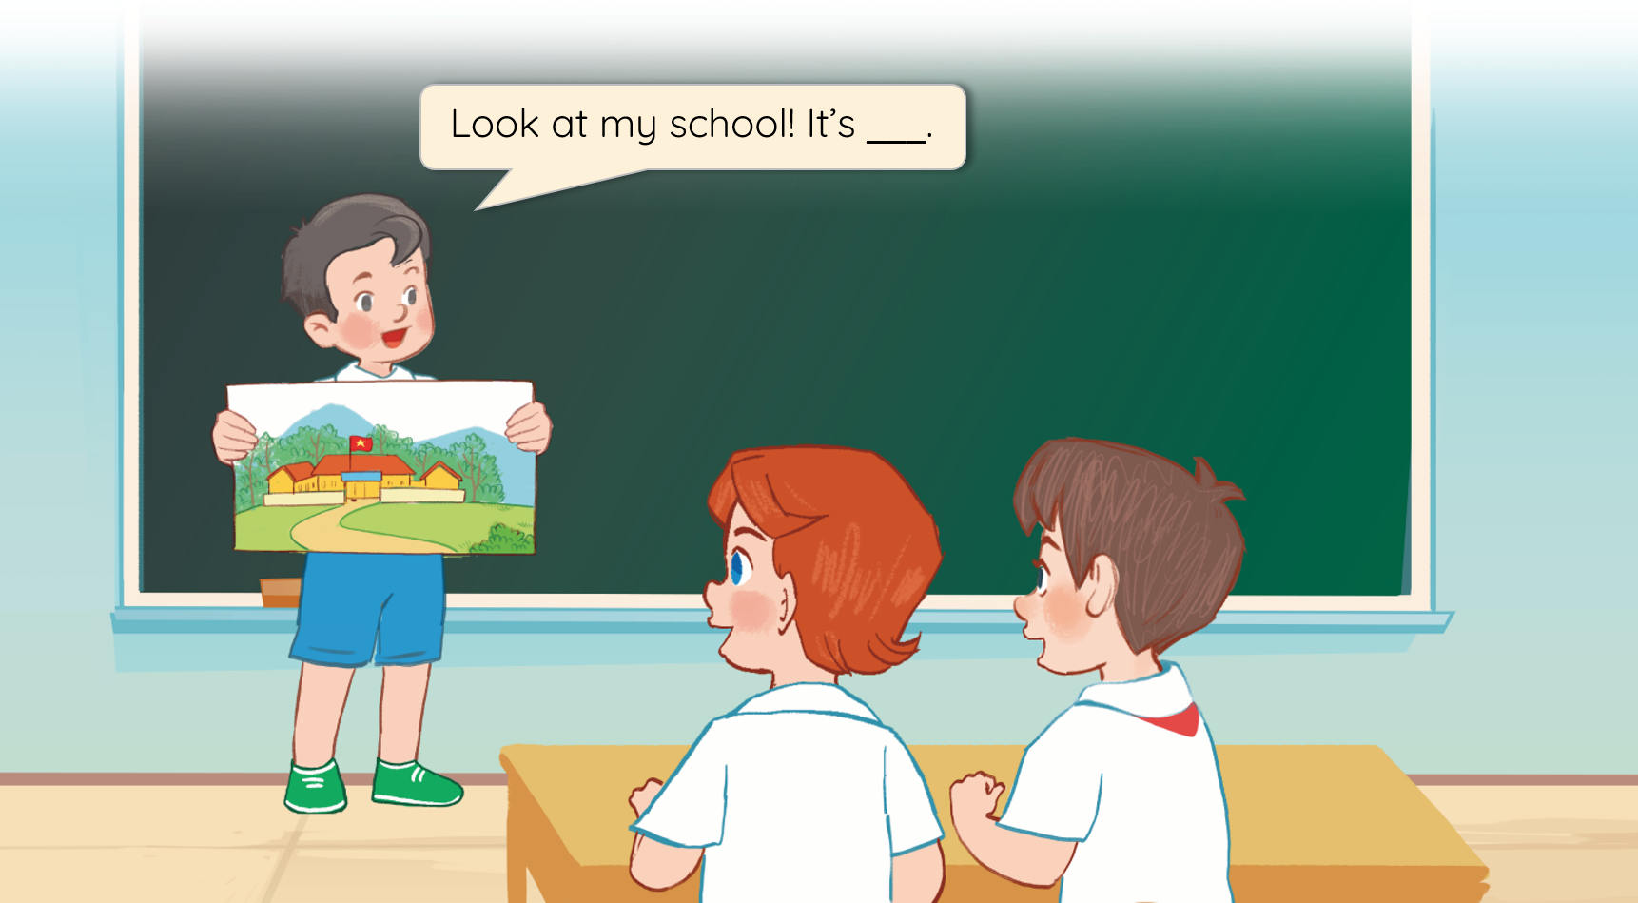
5
Project
Our school
MsPham
0936082789

Slide 20
Thank you!
MsPham
0936082789

