Slide 1



My week
3
LESSON 2 - PERIOD 3
SUNDAY
SUNDAY
MONDAY
TUESDAY
WEDNESDAY
THURSDAY
FRIDAY
SATURDAY

Slide 2
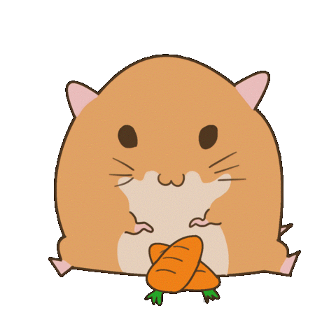
LISTEN AND GUESS WHAT DAY IT IS.
O
I
ED
TH
S
NOT SUNDAY
MONDAY
FRIDAY
WEDNESDAY
THURSDAY
SATURDAY
Notes:
TEACHER SPELLS THE FIRST LETTER OF ANY DAY/ OR SPELLS ANY LETTER IN A DAY, PUPILS GUESS.

Slide 3
02
Activity 1 Look, listen and repeat.

Slide 4
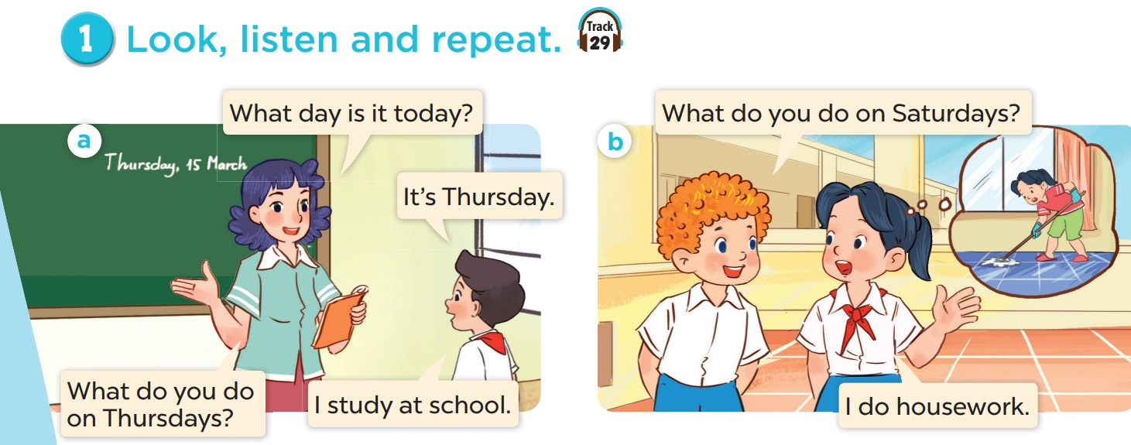
Explore the dialogues.
Notes:
EXPLORE THE QUESTIONS

Slide 5
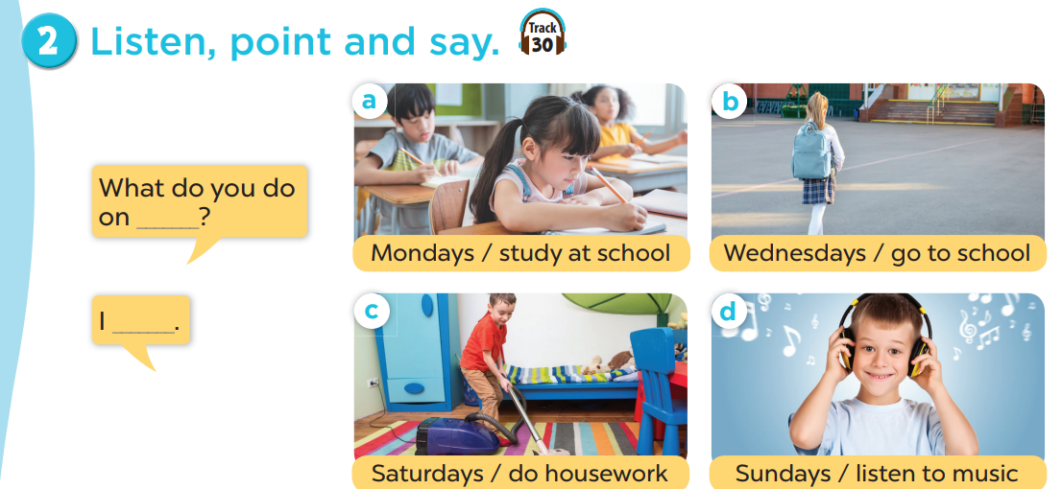


Slide 6
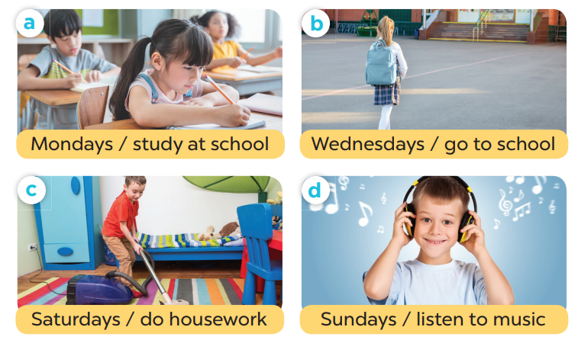
Point and say.
What do you do on _______?
- I _______.
Notes:
EXPLORE PICTURES

Slide 7
04
Activity 3 Let’s talk.

Slide 8
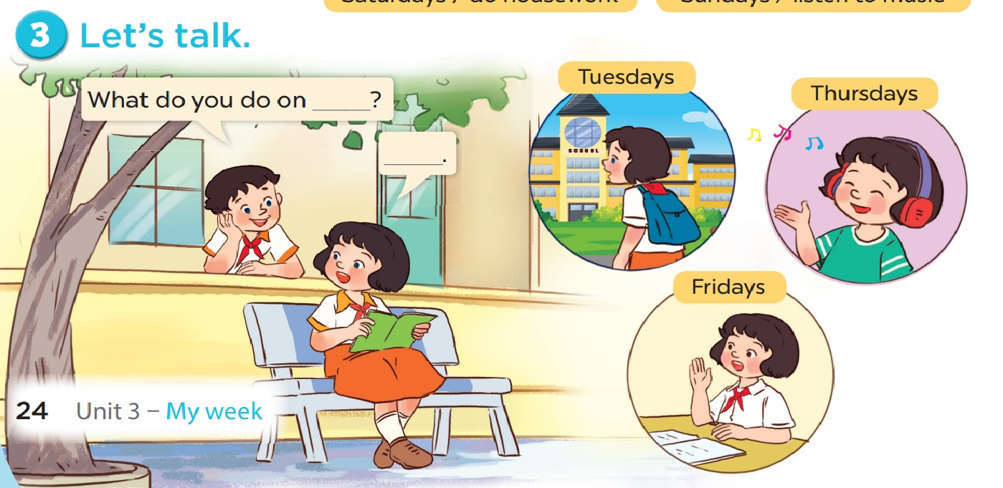

Slide 9
Spelling game
MONDAYS
CAN YOU SPELL
STUDY
CAN YOU SPELL
HOUSEWORK
CAN YOU SPELL
CAN YOU SPELL
LISTEN TO MUSIC

