Slide 1
Unit 5: In the classroom
Lesson 1 – Period 1

Slide 2







6
R
2
O
S
3
5
R
A
I
N
B
O
W
A
4
S
A
N
D
1
R
I
V
E
R
L
A
Score

Slide 3















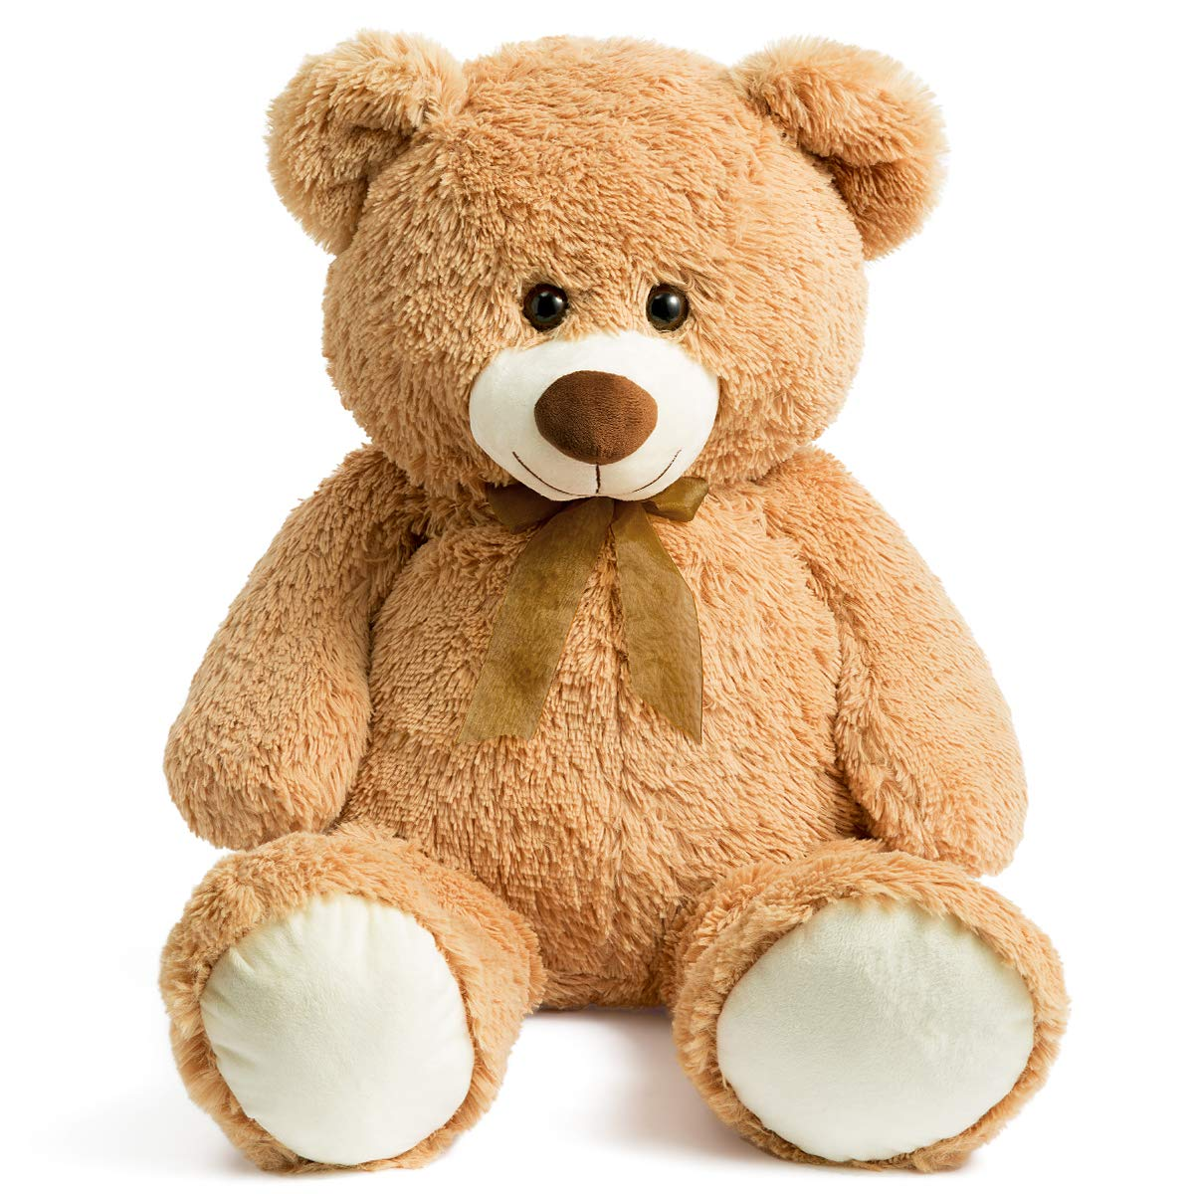
SCORE
Team 1
Team 2
Winner
1
2
Notes:
Click Team 1/ 2 to get point (presents)

