Slide 1

Unit 5 – Lesson 2
At the fish and chip shop
Notes:
Goals: By the end of the lesson, pupils will be able to:
say the sound of the letter I/i and the words chicken, chips, fish and milk in a chant correctly.
listen, recognize the words and tick the correct boxes.
trace the letter I/i (upper case and lower case).

Slide 2
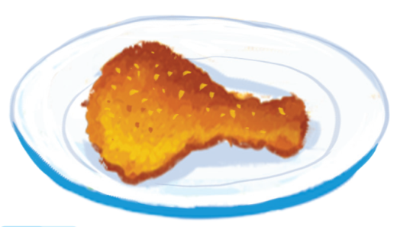
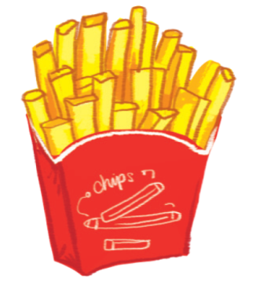
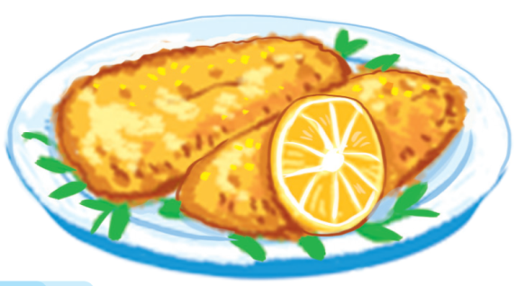
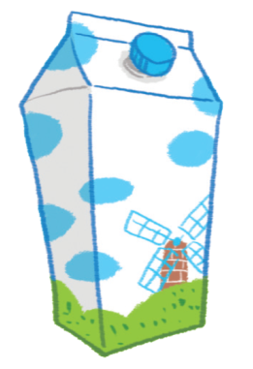
chicken
chips
fish
milk
3
1
4
2

Slide 3


Listen and chant
Notes:
Goal:
- Pupils will be able to say the sound of the letter I/i and the words chicken, chips, fish and milk in a chant correctly.

Slide 4

Listen and chant
I, i, fish.
I, i, chips.
Fish and chips.
Fish and chips.
I, i, milk.
I, i, chicken.
Milk and chicken.
Milk and chicken.
Notes:
Step 1: Read. Listen and repeat the chant.
Time limit: 4 mins
- Teacher shows the chant on slide. Whole class read together.
- Teacher plays the audio. Pupils listen through, then listen and repeat.
- Pupils then chant and clap along.
- Pupils chant in teams.

Slide 5
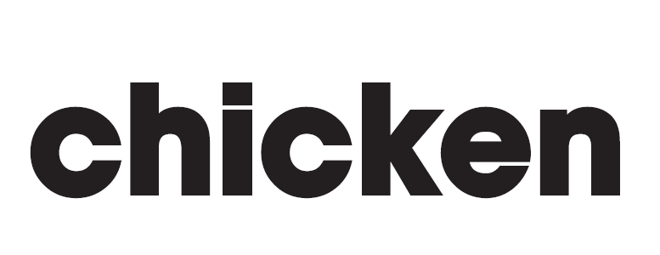
Notes:
Step 2: Pupils chant and do actions.
Time limit: 4 mins
- Teacher shows pupils how to do actions to describe the vocabulary.
- Pupils do the actions as teams. Then pupils chant and do the actions along.
Example:
i (clap), i (clap), fish. (action)
i (clap), I (clap), chips. (action)
Fish (action) and chips. (action)

Slide 6
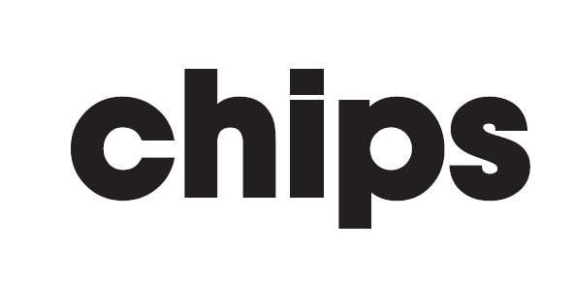

Slide 7
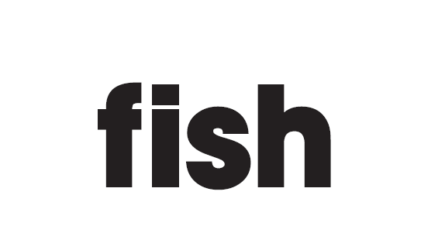

Slide 8
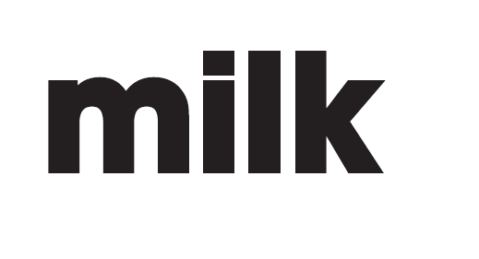

Slide 9
I, i, fish.
I, i, chips.
Fish and chips.
Fish and chips.
I, i, milk.
I, i, chicken.
Milk and chicken.
Milk and chicken.
Notes:
Step 3: Quick check
Time limit: 4 mins
Pupils chant as teams and individually.

Slide 10

Listen and tick
Notes:
Goal:
- Pupils will be able to listen, recognize the words and tick the correct boxes.
Step 1: Listen and tick the correct picture.
Time limit: 5 mins
Teacher says Listen and tick and writes words on the board.
Teacher says and does actions: Listen (put hands on one ear) and tick (write a tick in the air). Pupils follow.
Teacher plays audio. Pupils do the tasks.
When pupils finish, Teacher plays the audio again, pause at each question and checks answer.
Step 2: Quick check
Time limit: 3 mins
Teacher says a word, pupils go to the board and touch the correct picture.

Slide 11
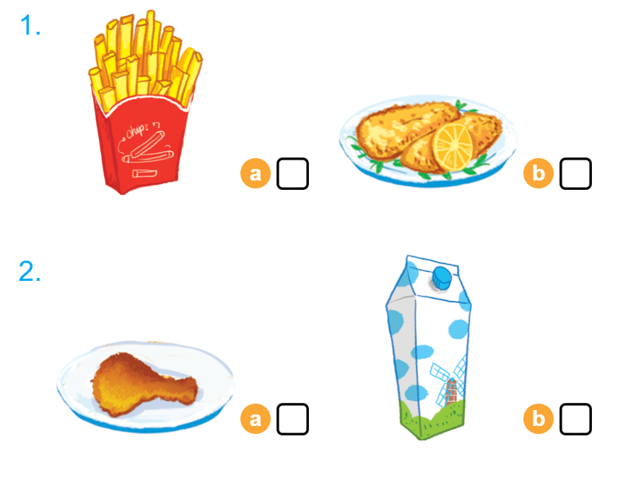

Listen and tick

Slide 12


Look and trace
Notes:
Goal:
- Pupils will be able to trace the letter I/i (upper case and lower case).
Step 1: Pupils write letter in the air
Time limit: 3 mins
Teacher and pupils write letter “i” in the air. (Teacher can make it fast or slowly)
Teacher models the writing.
Step 2: Look and trace
Time limit: 4 mins
- Teacher writes letter on the board.
- Pupils look and trace in their books.
- The first team to finish can get bonus stars.

Slide 13
i, i, fish

Slide 14
i, i, chips

Slide 15
i, i, milk

Slide 16
Fish and chips

Slide 17
Milk and chicken

Slide 18
i, i, chicken

