Slide 1



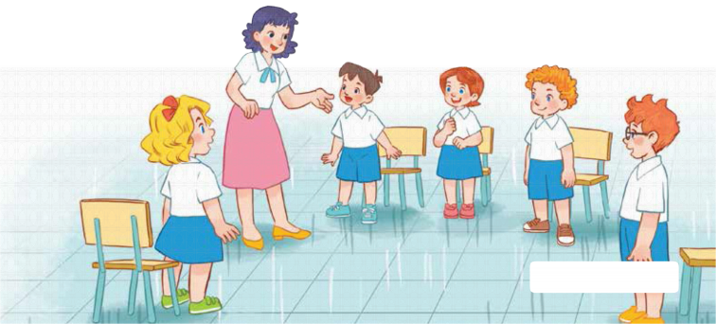
7
Classroom instructions
LESSON 1 – PERIOD 1

Slide 2





Pick the carrots
Warm-up and review
Notes:
- Divide the class into 2 teams. Each team chooses one carrot to go to the question.
- Have pupils listen and choose the right answer.
- Back to the menu for another question.
- Pupils take turns to play the game until there are no carrots left.
- The team who gets the most carrots is the winner.

Slide 3

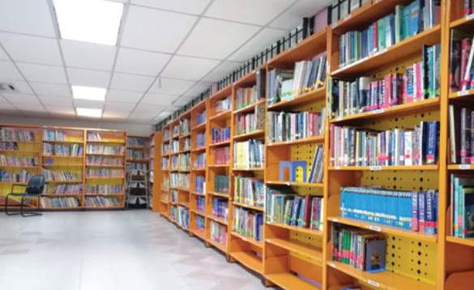
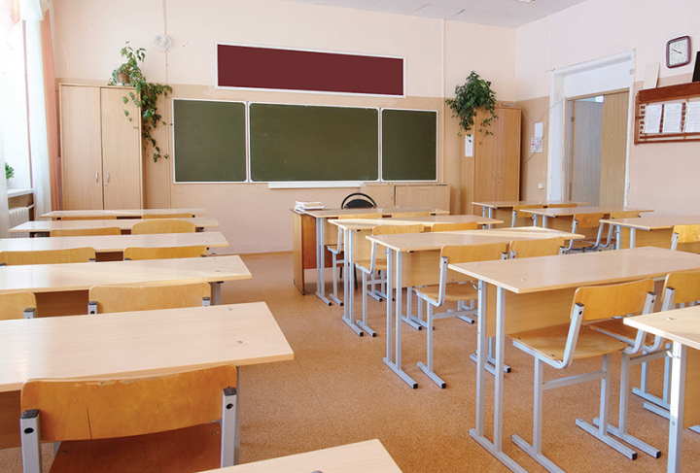
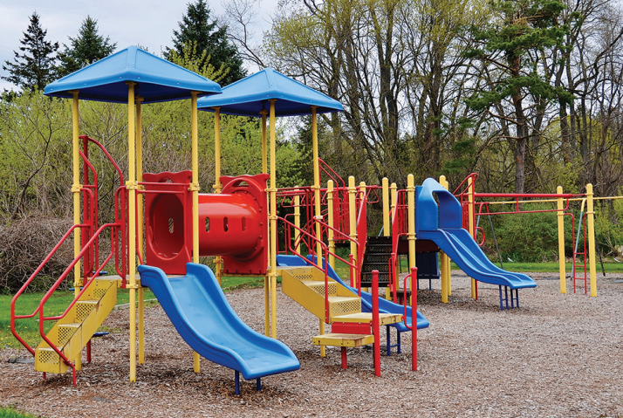
Listen and choose.
library
classroom
playground
Back
Notes:
- Click “Listen and choose” to play the audio.
- Teacher can click each answer to check.
- Click the “Back” button on the bottom right to go back to the game.

Slide 4
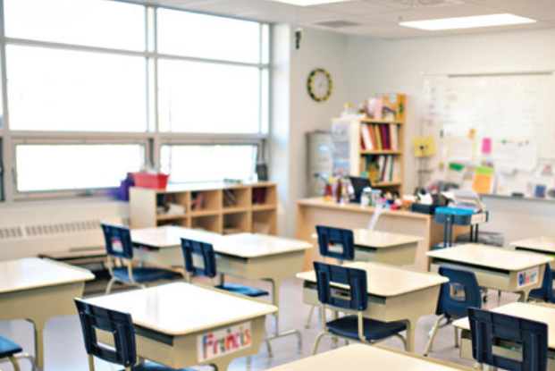
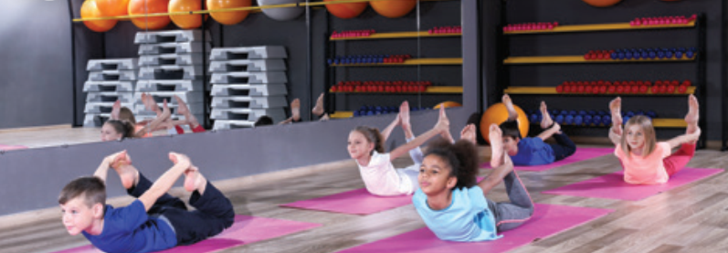
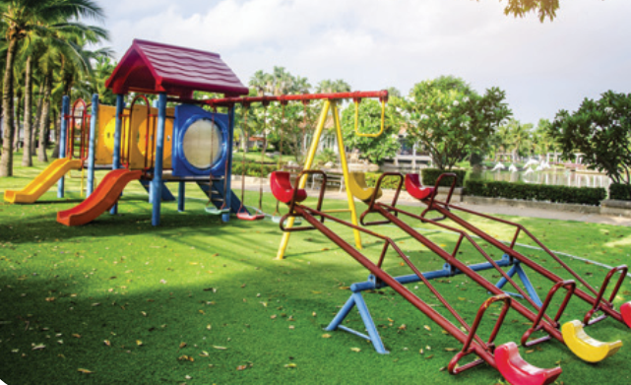
Listen and choose.
classroom
gym
playground
Back
Notes:
- Click “Listen and choose” to play the audio.
- Teacher can click each answer to check.
- Click the “Back” button on the bottom right to go back to the game.

Slide 5
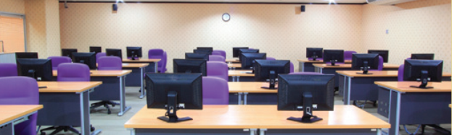
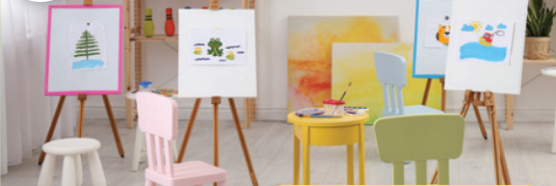
Listen and choose.
Let’s go to the _____.
OK, let’s go.
computer room
gym
art room
Back
Notes:
- Click “Listen and choose” to play the audio.
- Teacher can click each answer to check.
- Click the “Back” button on the bottom right to go back to the game.

Slide 6
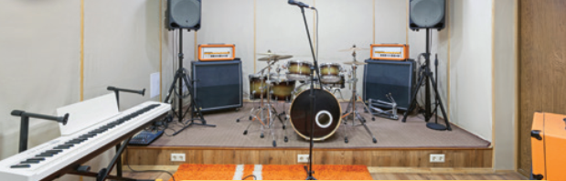
Listen and choose.
Let’s go to the _____.
OK, let’s go.
computer room
art room
music room
Back
Notes:
- Click “Listen and choose” to play the audio.
- Teacher can click each answer to check.
- Click the “Back” button on the bottom right to go back to the game.

Slide 7
Listen and choose.
Let’s go to the _____.
OK, let’s go.
music room
gym
art room
Back
Notes:
- Click “Listen and choose” to play the audio.
- Teacher can click each answer to check.
- Click the “Back” button on the bottom right to go back to the game.

Slide 8
Listen and choose.
Let’s go to the _____.
OK, let’s go.
music room
computer room
art room
Back
Notes:
- Click “Listen and choose” to play the audio.
- Teacher can click each answer to check.
- Click the “Back” button on the bottom right to go back to the game.

Slide 9
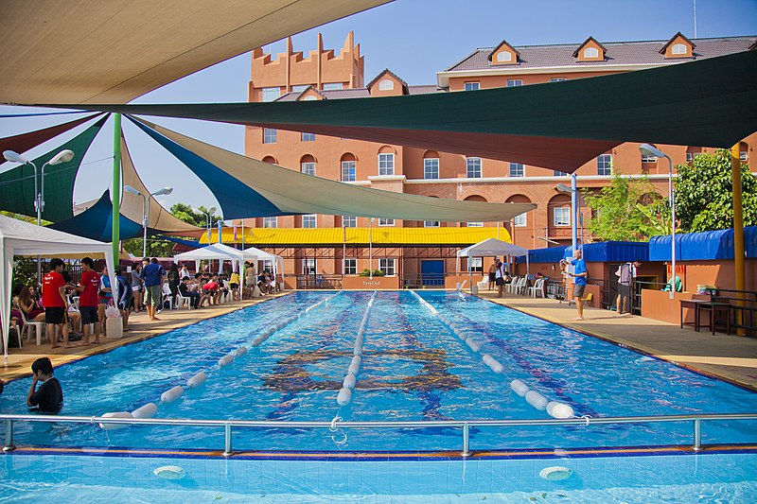
Is this our swimming pool?
Yes, it is./ No, it isn’t.
No, it isn’t.
Yes, it is.
Back
Notes:
- Teacher asks the question then show the picture. - Ask the students if the picture is correct.

Slide 10






A
B
60
10
70
45
90
30
20
100
35
80
40
50
Notes:
- Divide the class into 2 teams.
- Each team chooses one umbrella to go to the question.
- Have pupils unscramble the sentences.
- Back to the menu for Wheel of Fortune.
- The pupils can spin the wheel to get points if they answer correctly.
- The team who gets more points is the winner.

