Slide 1



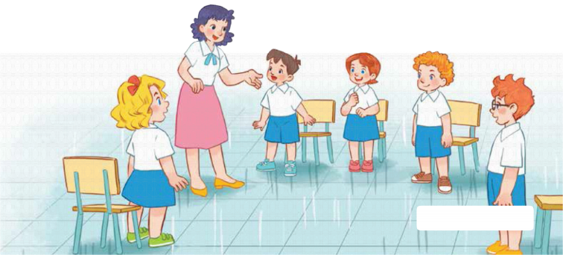
7
Classroom instructions
LESSON 2 – PERIOD 3

Slide 2
CONTENTS
Let’s talk.
Look, listen and repeat.
Listen, point and say.
Fun corner and wrap- up
Warm-up and review

Slide 3
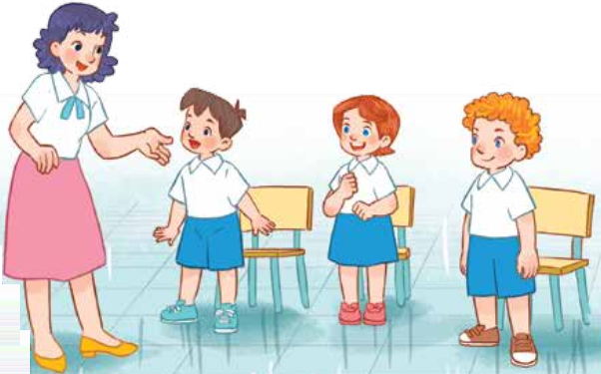
Warm-up and review
Notes:
- Divide the class into 2 teams.
- Have pupils guess, complete the jigsaw puzzle pictures and say the right sentences.
- This game is just for fun, not for competition.

Slide 4

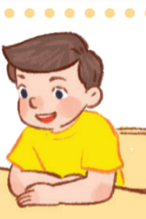
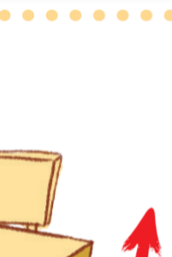



Can you guess?
Stand up, please!

Slide 5



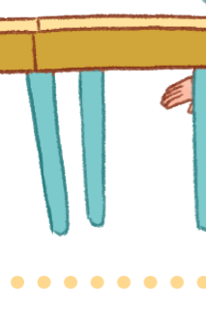
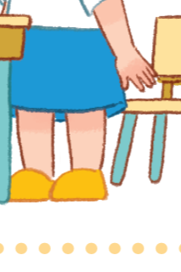
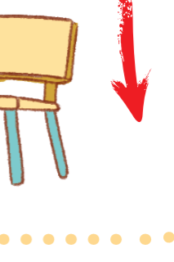
Can you guess?
Sit down, please!

Slide 6

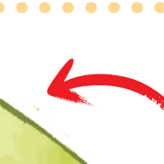




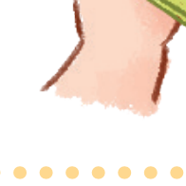


Can you guess?
Open your book, please!

Slide 7






Can you guess?
Close your book, please!

Slide 8

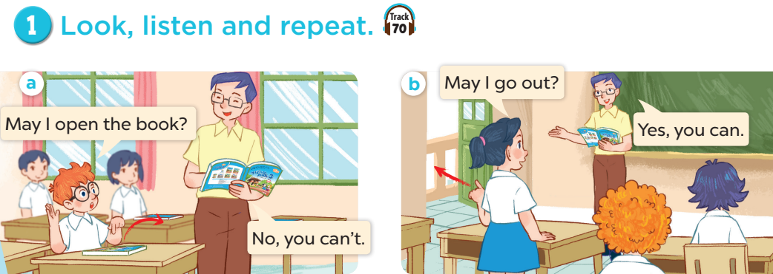



Slide 9
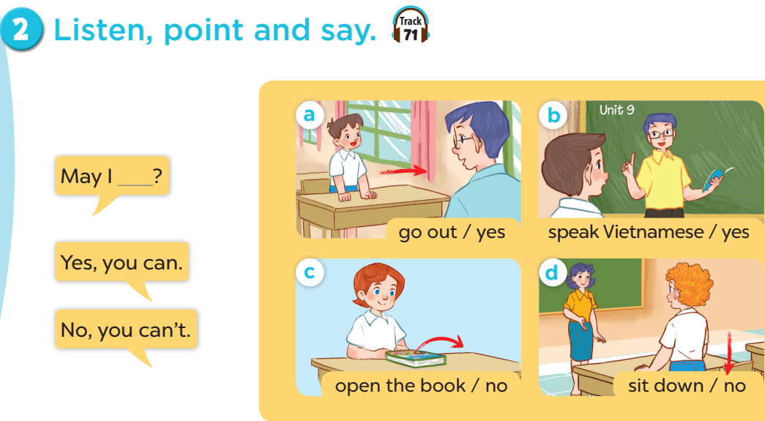

Slide 10
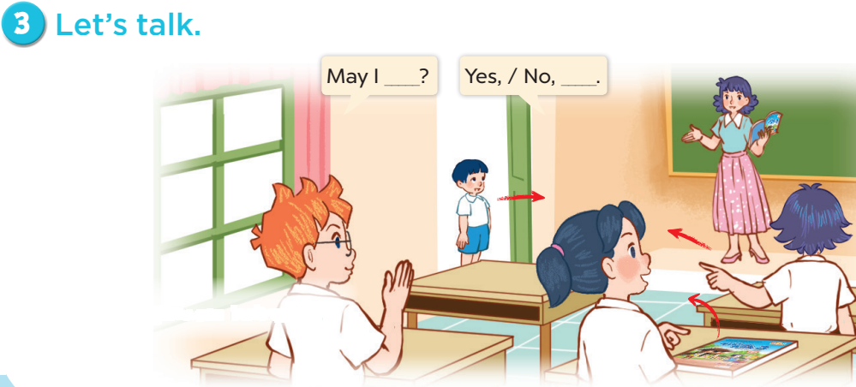

Slide 11










Candy or chilly?
Fun corner and wrap-up
A
B
C
 | A | B | C
1
2
3
+ 50
- 20
Notes:
- Divide the class into 2 teams.
- Each team chooses one square to go to the question.
- Have pupils look, read and choose the right option.
- Back to the menu for another question.
- Pupils continue taking turns to play until all the squares are revealed.
- The team with more points is the winner.

Slide 12
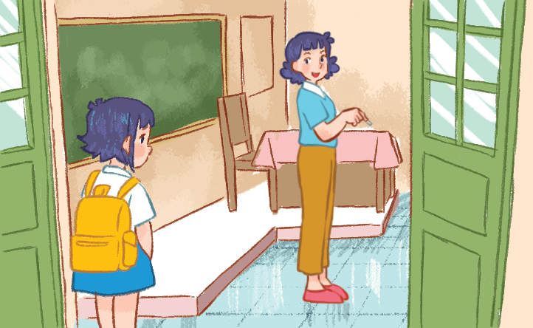
Yes, you can.
A. May I sit down?
B. May I go out?
C. May I come in?
Notes:
Click each answer to check.
Click the red button to go back to the game.

Slide 13
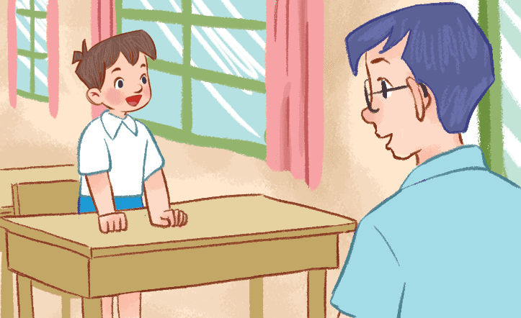
No, you can’t.
A. May I go out?
B. May I come in?
C. May I sit down?
Notes:
Click each answer to check.
Click the red button to go back to the game.

Slide 14
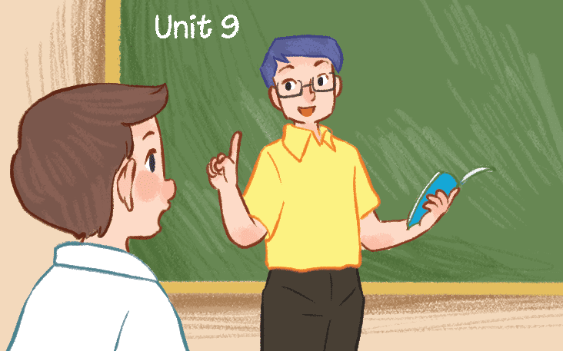
No, you can’t.
Speak English, please!
A. May I speak English?
B. May I speak Vietnamese?
C. May I stand up?
Notes:
Click each answer to check.
Click the red button to go back to the game.

Slide 15
May I speak Vietnamese?
A. No, you can’t.
Speak Vietnamese, please!
B. No, you can’t.
Speak English, please!
C. May I stand up?
Notes:
Click each answer to check.
Click the red button to go back to the game.

Slide 16
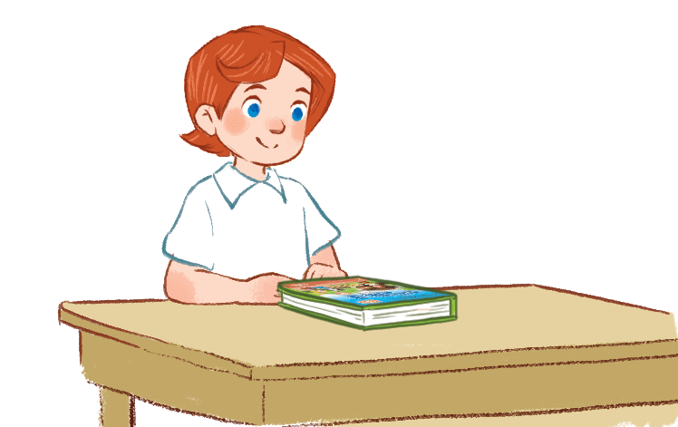
Yes, you can.
A. May I open the book?
B. May I close the book?
C. May I sit down?
Notes:
Click each answer to check.
Click the red button to go back to the game.

Slide 17

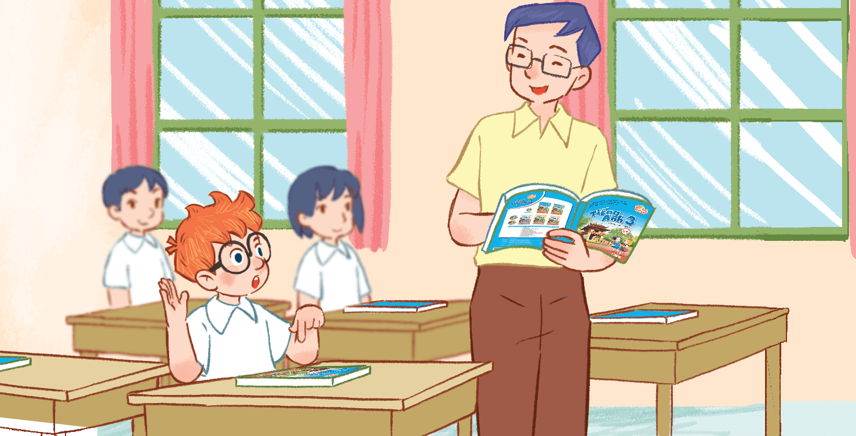
May I open the book?
A. Sit down, please!
B. No, you can’t.
C. Yes, you can.
Notes:
Click each answer to check.
Click the red button to go back to the game.

Slide 18

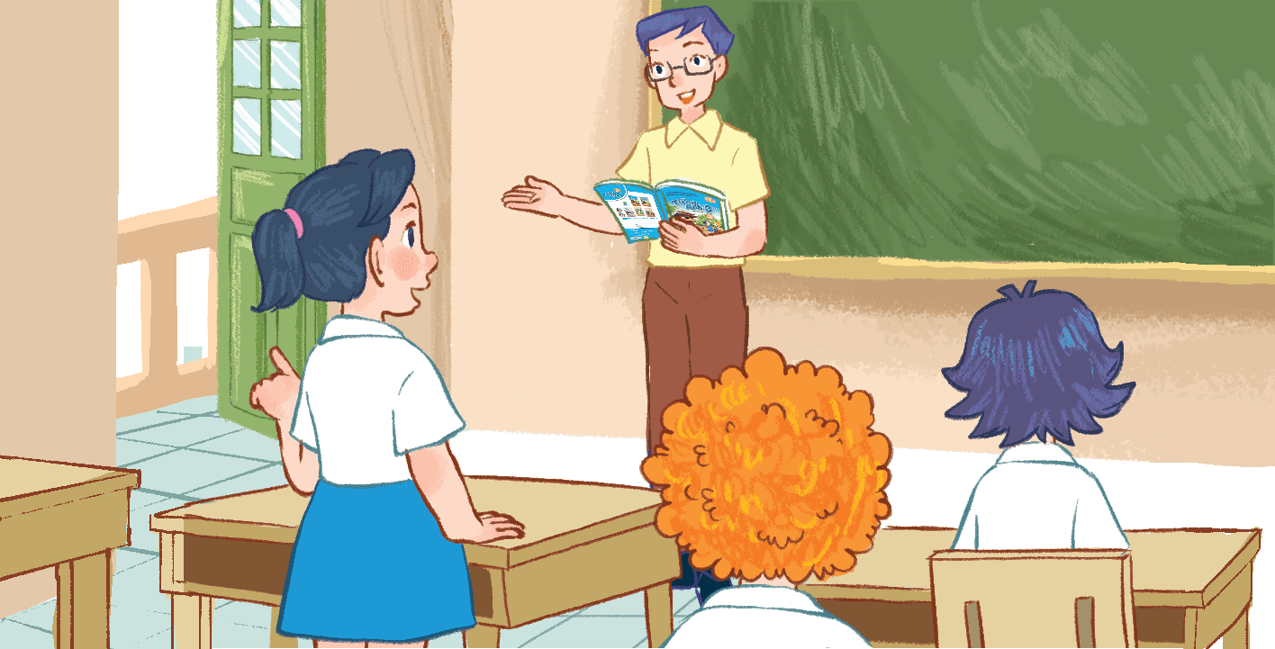
May I go out?
A. Yes, you can.
B. No, please.
C. No, you can’t.
Notes:
Click each answer to check.
Click the red button to go back to the game.

Slide 19
May ________ in?
I come
A. I speak
B. I come
C. I stand
Notes:
Click each answer to check.
Click the red button to go back to the game.

Slide 20
May I ________book?
open the
A. out the
B. open the
C. close the
Notes:
Click each answer to check.
Click the red button to go back to the game.

