Slide 1



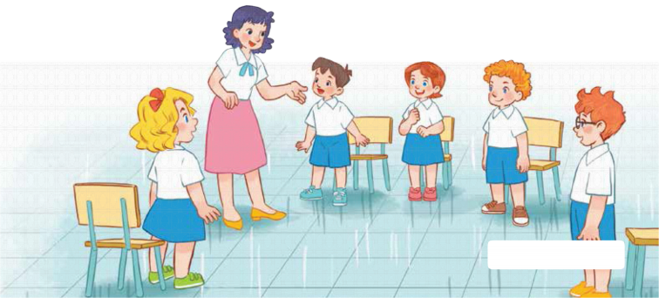
7
Classroom instructions
LESSON 3 – PERIOD 6

Slide 2
CONTENTS
Let’s talk.
Look, listen and repeat.
Listen, point and say.
Fun corner and wrap up
Warm-up and review

Slide 3
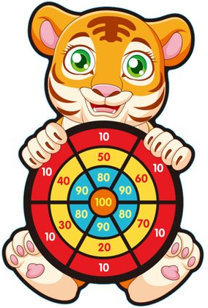

Listen and
choose!
Warm-up and review
0
1
2
3
4
5
6
7
8
0
9
1
2
3
4
5
6
7
8
0
9
1
2
3
4
5
6
7
8
9
GIRLS
0
1
2
3
4
5
6
7
8
0
9
1
2
3
4
5
6
7
8
0
9
1
2
3
4
5
6
7
8
BOYS
9
Notes:
- Divide the class into 2 teams. Each team chooses one arrow to go to the question. Have pupils listen and choose the right sentence. They will get points for the right answers.
- Back to the menu for another question.
- Pupils take turns to play until they get all the arrows.
- The team with more points is the winner.

Slide 4




Listen and choose.
A. May I open the book?
B. May I close the book?
C. May I read the book?
Notes:
Click the headphone to play the recording.
Click each answer to check.
Click the arrow to go back.

Slide 5
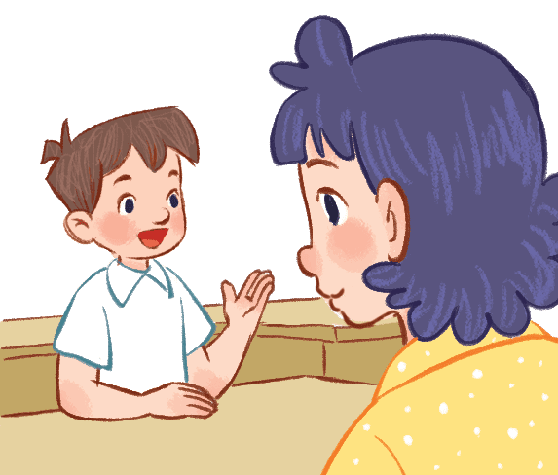

Listen and choose.
A. May I speak English?
B. May I speak Vietnamese?
C. May I come in?
Notes:
Click the headphone to play the recording.
Click each answer to check.
Click the arrow to go back.

Slide 6
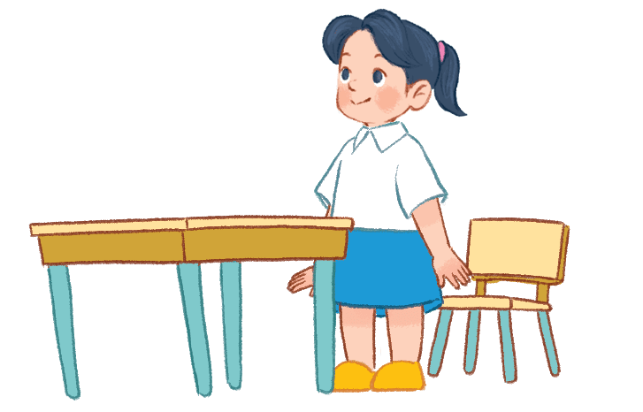

Listen and choose.
A. May I come in?
B. May I stand up?
C. May I sit down?
Notes:
Click the headphone to play the recording.
Click each answer to check.
Click the arrow to go back.

Slide 7


Listen and choose.
A. Speak English, please!
B. Speak Vietnamese, please!
C. Speak aloud, please!
Notes:
Click the headphone to play the recording.
Click each answer to check.
Click the arrow to go back.

Slide 8


Listen and choose.
A. May I come in?
B. May I stand up?
C. May I sit down?
Notes:
Click the headphone to play the recording.
Click each answer to check.
Click the arrow to go back.

Slide 9
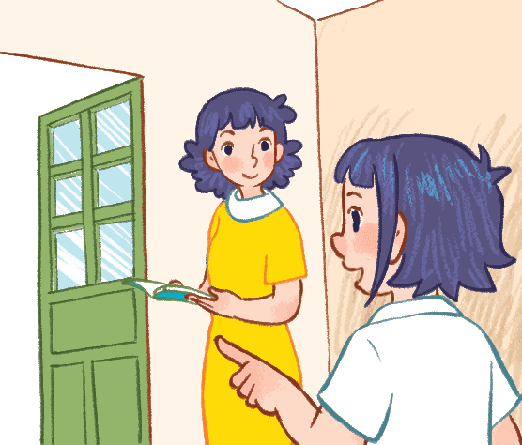


Listen and choose.
A. May I sit down?
B. May I come in?
C. May I go out?
Notes:
Click the headphone to play the recording.
Click each answer to check.
Click the arrow to go back.

Slide 10

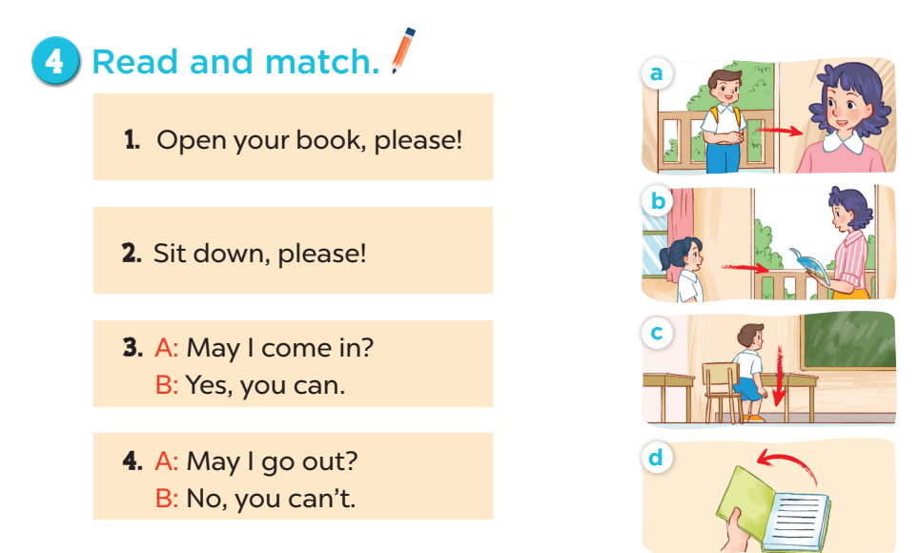


Slide 11
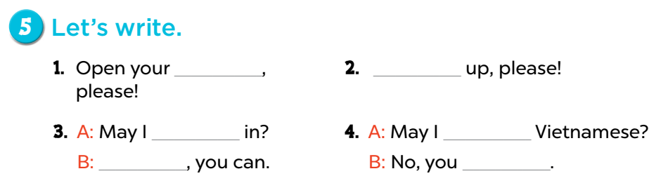
books
Stand
come
speak
Yes
can’t

Slide 12
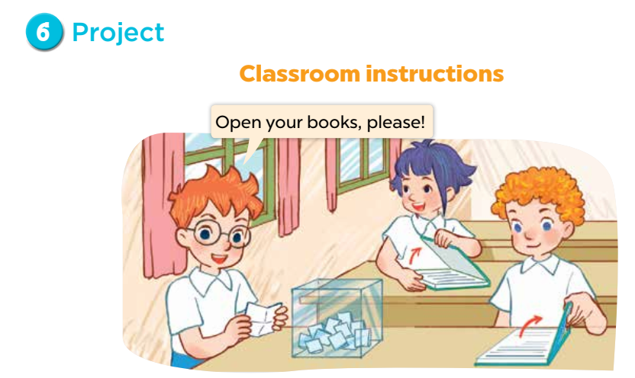

Slide 13
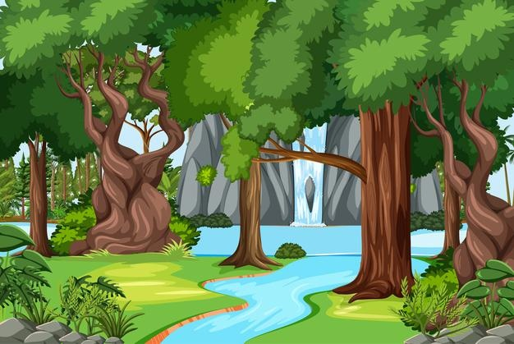

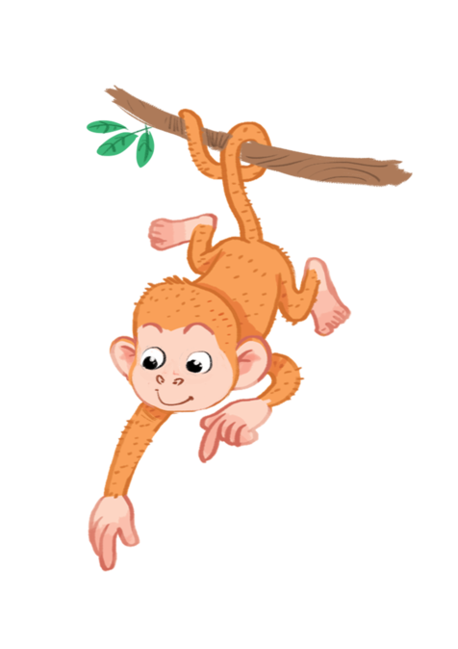



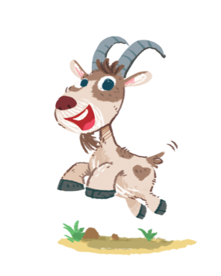





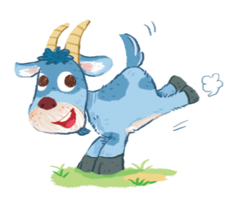







Let’s clean up!
Fun corner and
wrap- up
Notes:
- Divide the class into 2 teams.
- Each team chooses one rubbish thing to go to the question.
- Have pupils look, read and choose the right word/phrase to complete the sentence.
- Back to the menu for another question.
- The team who cleans the environment better is the winner.

Slide 14






Open your ____________, please!
A. book
B. pen
C. desk

Slide 15
________________ up, please!
A. Read
B. Sit
C. Stand

Slide 16
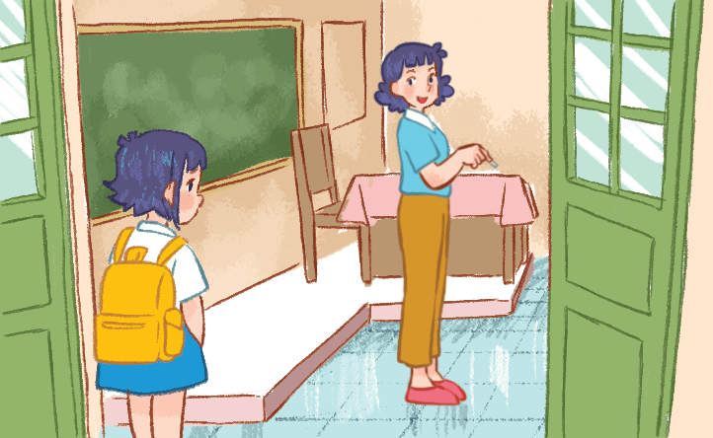
May I ________________ in?
A. go
B. come
C. study

Slide 17
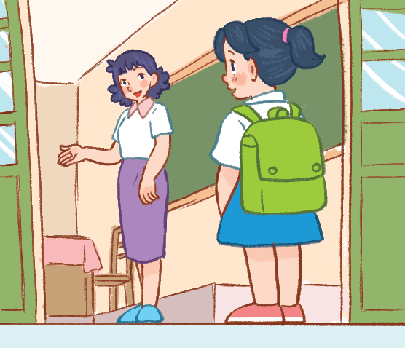
May I come in?
________, you ____.
A. Yes, ___ can.
B. Yes, ___can’t
C. Yes, ___ can.

Slide 18
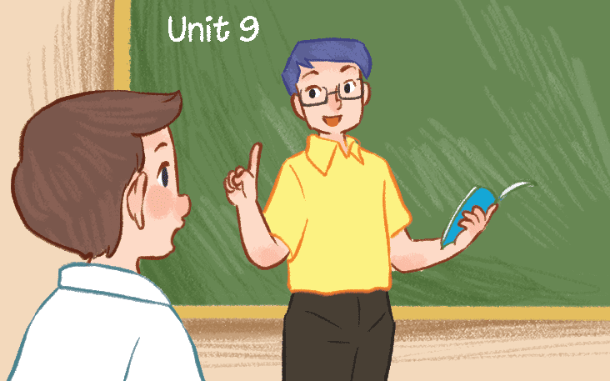
May I ___________ Vietnamese?
A. say
B. speak
C. stand

Slide 19
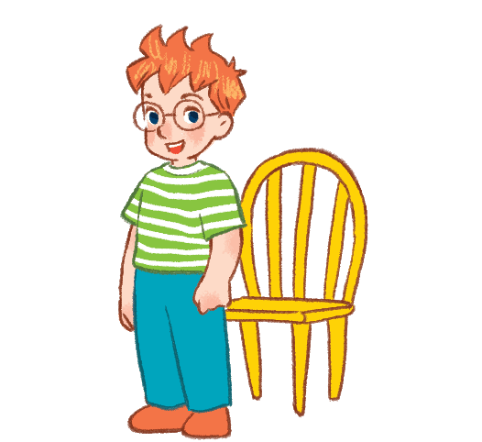
May I sit down?
______, you ________________.
A. Yes, ____can not
B. No, ____can
C. No, ____can’t

Slide 20
May I __________?
Yes, you can.
A. come in
B. speak English
C. sit down

Slide 21

May I____________?
Yes, you can.
A. stand up
B. sit down
C. study

