Slide 1



Slide 2
Unit 4: In the countryside
Lesson 1 – Period 1

Slide 3
TABLE OF CONTENTS
Warm-up and Review
2. Activity 1: Listen and repeat.
3. Activity 2: Point and say.
4. Fun corner and Wrap-up

Slide 4
01
Warm-up
and Review

Slide 5














Game: Fishing
_ea
s_nd
s
a
+ 2
point
sa_l
i
Notes:
Click the fish to see the words
Click the words to see the missing letters

Slide 6

CONGRATULATIONS!

Slide 7
02
Activity 1
Listen and repeat.

Slide 8

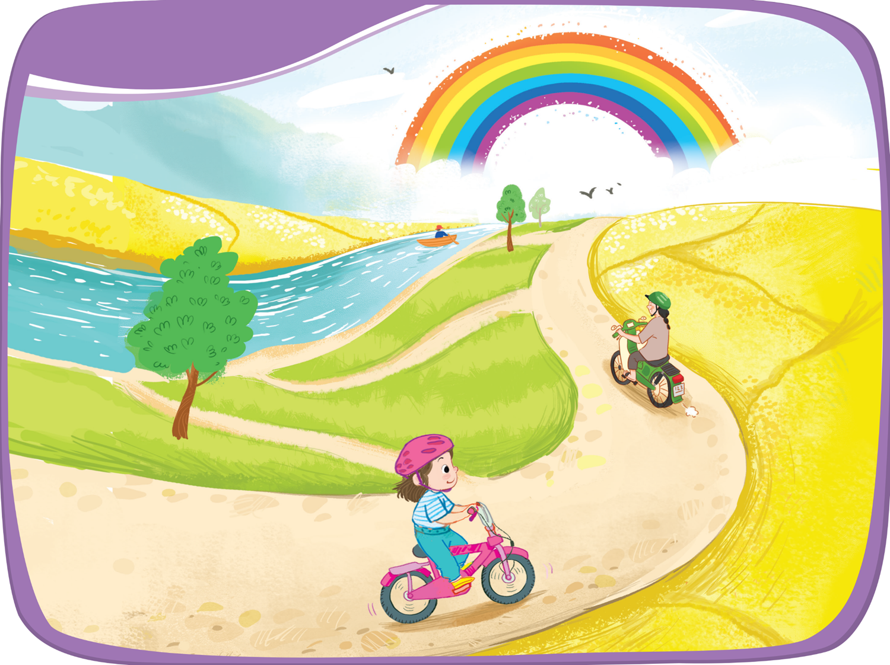
1. Listen and repeat.

Slide 9


1. Listen and repeat.
rainbow
river
road

Slide 10



1. Listen and repeat.
r
_iver
_oad
r
r
_ainbow
r
r
r
Notes:
Click to see the words without R
Click to see letter R appearing
Click the words to hear the sound

Slide 11
03
Activity 2
Point and say.

Slide 12

2. Point and say.
rainbow
river
road

Slide 13

Pairwork

Slide 14

Pairwork
Play “Rock, Paper, Scissors” game.
The winner will say the sound “r”.
The loser will say aloud the words with that sound.

Slide 15
04
Fun corner
and Wrap-up

Slide 16


Game: BOARD RACE
Team 1
Winner
Team 2
Task 1
Task 2
Task 3
Task 4
Task 5
Task 6
Notes:
Click the task to move to other slides
Click the Team 1/ 2 to get flags
Click winner to congratulation

Slide 17




ran
bow
rain
ball
Notes:
Click the pieces to match the words

Slide 18


ad
ed
ro
ver
Notes:
Click the pieces to match the words

Slide 19


re
ler
od
ru
Notes:
Click the pieces to match the words

Slide 20


ri
van
re
ver
Notes:
Click the pieces to match the words

Slide 21


ed
re
ri
d
Notes:
Click the pieces to match the words

Slide 22



Slide 23


