Slide 1





8
Period 1

Slide 2
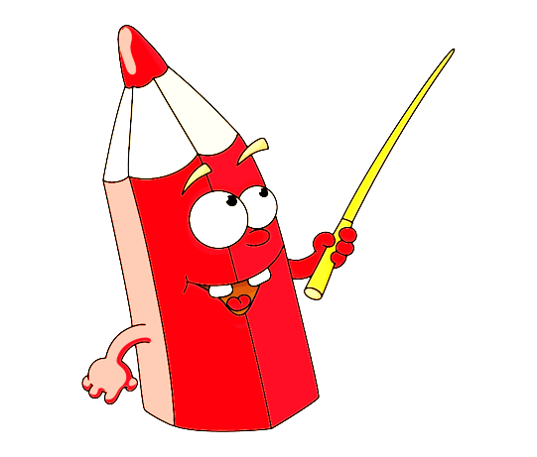

①
Warm-up and review

Slide 3



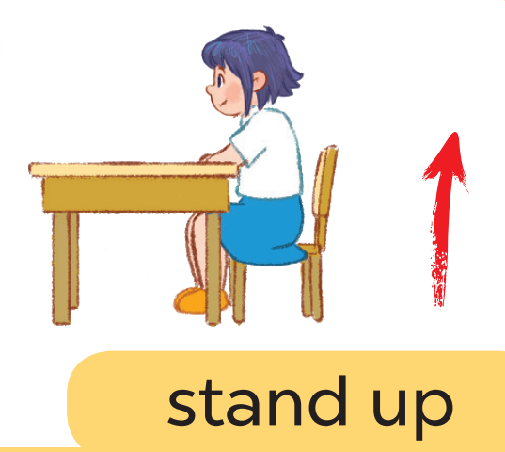


Game: Listen and choose

Slide 4
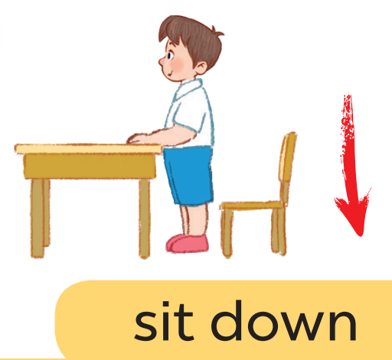
Game: Listen and choose

Slide 5
Game: Listen and choose

Slide 6
Game: Listen and choose

Slide 7
Game: Listen and choose

Slide 8
Game: Listen and choose

Slide 9
Game: Listen and choose

Slide 10
Game: Listen and choose

Slide 11
②
Look, listen and repeat.

Slide 12
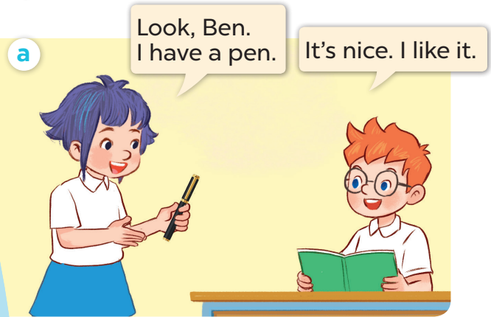
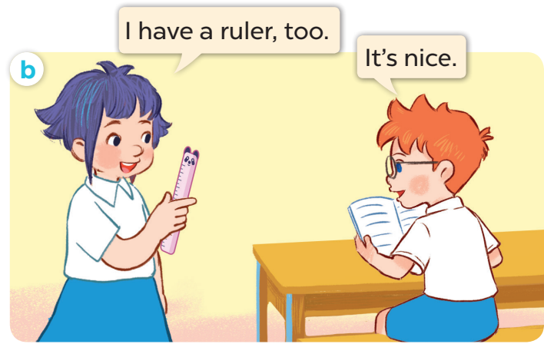

Slide 13
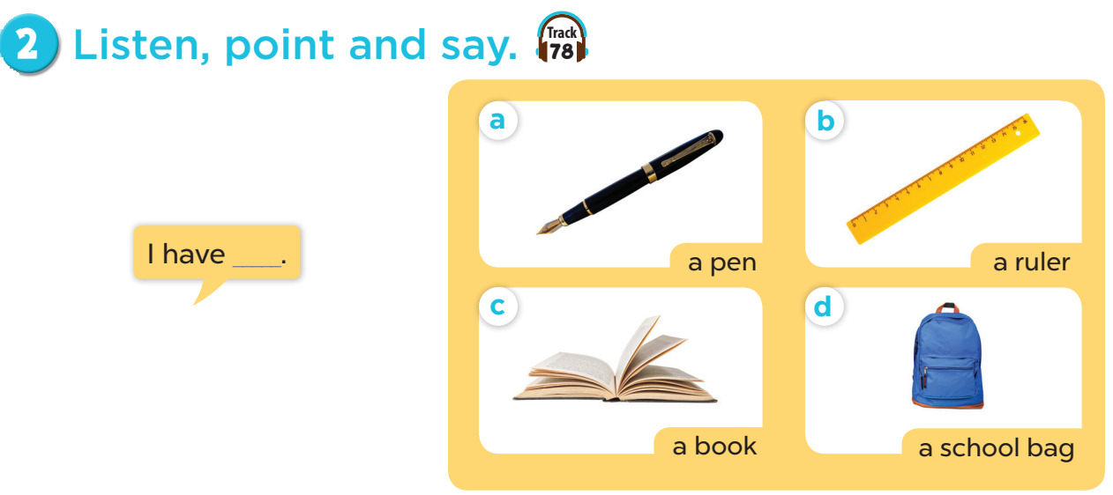

Slide 14


Slide 15
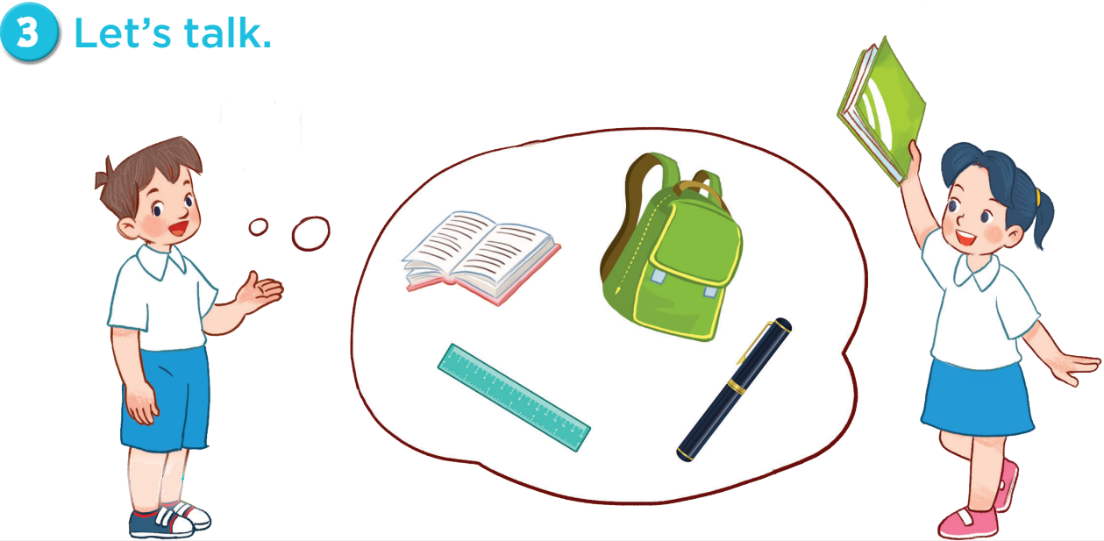
I have a school bag!
I have a book!

