Slide 1



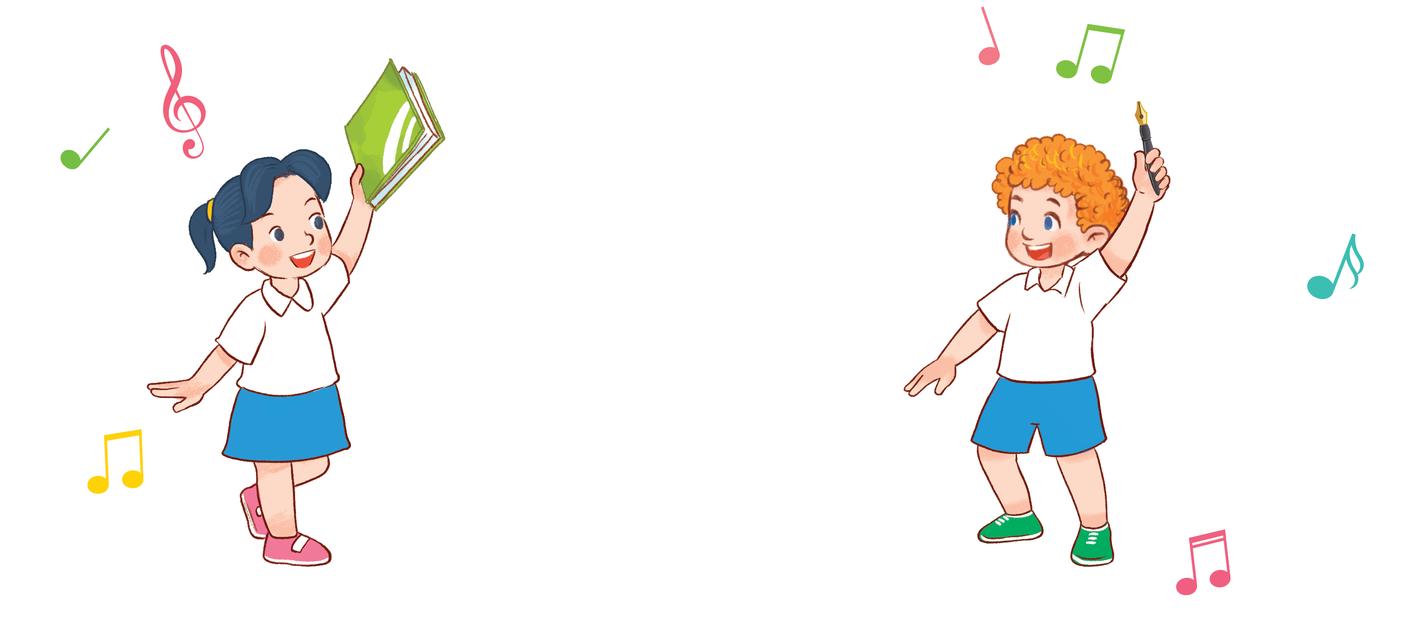

8
Period 2

Slide 2
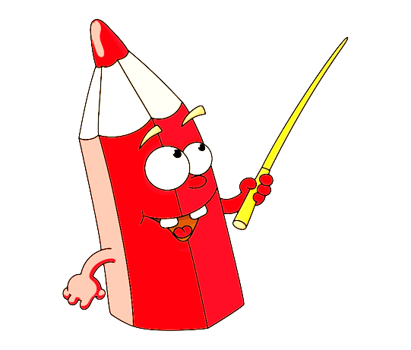


Game: Sentence puzzle
pen.
have
I
a
I
have
a
pen.
Notes:
Wait for the clock to count down.
Click anywhere to show the answer.

Slide 3

Game: Sentence puzzle
book.
have
a
I
I
have
a
book.
Notes:
Wait for the clock to count down.
Click anywhere to show the answer.

Slide 4
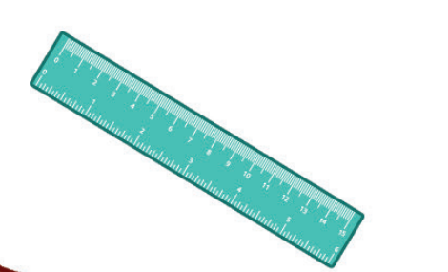
Game: Sentence puzzle
I
have
a
ruler.
I
have
a
ruler.
Notes:
Wait for the clock to count down.
Click anywhere to show the answer.

Slide 5

②
Listen and tick.

Slide 6
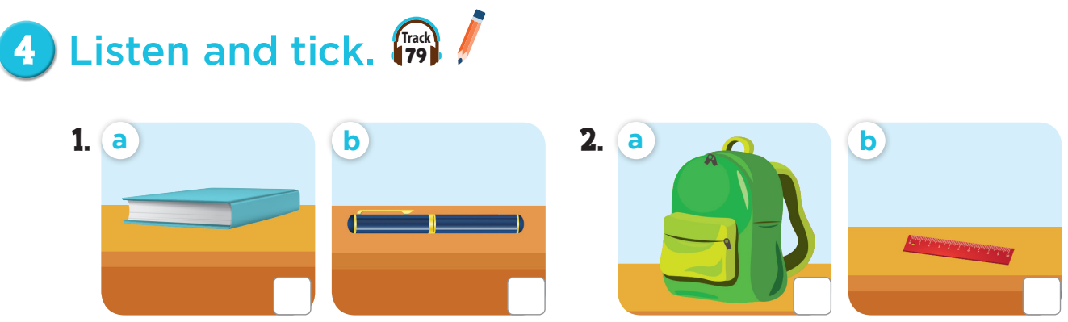


Slide 7
✓
✓

Slide 8

Let’s play:
Who says fast?
I have a book!
Notes:
Game: Who says fast? Teacher points to the picture, pupils say it as fast as they can. This can be played individually or in teams.

Slide 9
③
Look, complete and read.

Slide 10
Game: Choose the right pairs!
Notes:
Game: Choose the right pairs!
- Divide the class into two teams.
- Each pupil from each team comes to the board, choose a card from the left, then choose one from the right. If they match, he/she gets points for their team.

Slide 11
④
Let’s sing.

Slide 12
⑤
Fun corner and wrap-up

Slide 13
Game: Let’s sing and move!
Notes:
Play music – audio track 80, then ask pupil to sing and dance along with the song, when the music stops, every body has to stop moving. Who can make it is the winner.

Slide 14
music

