Slide 1



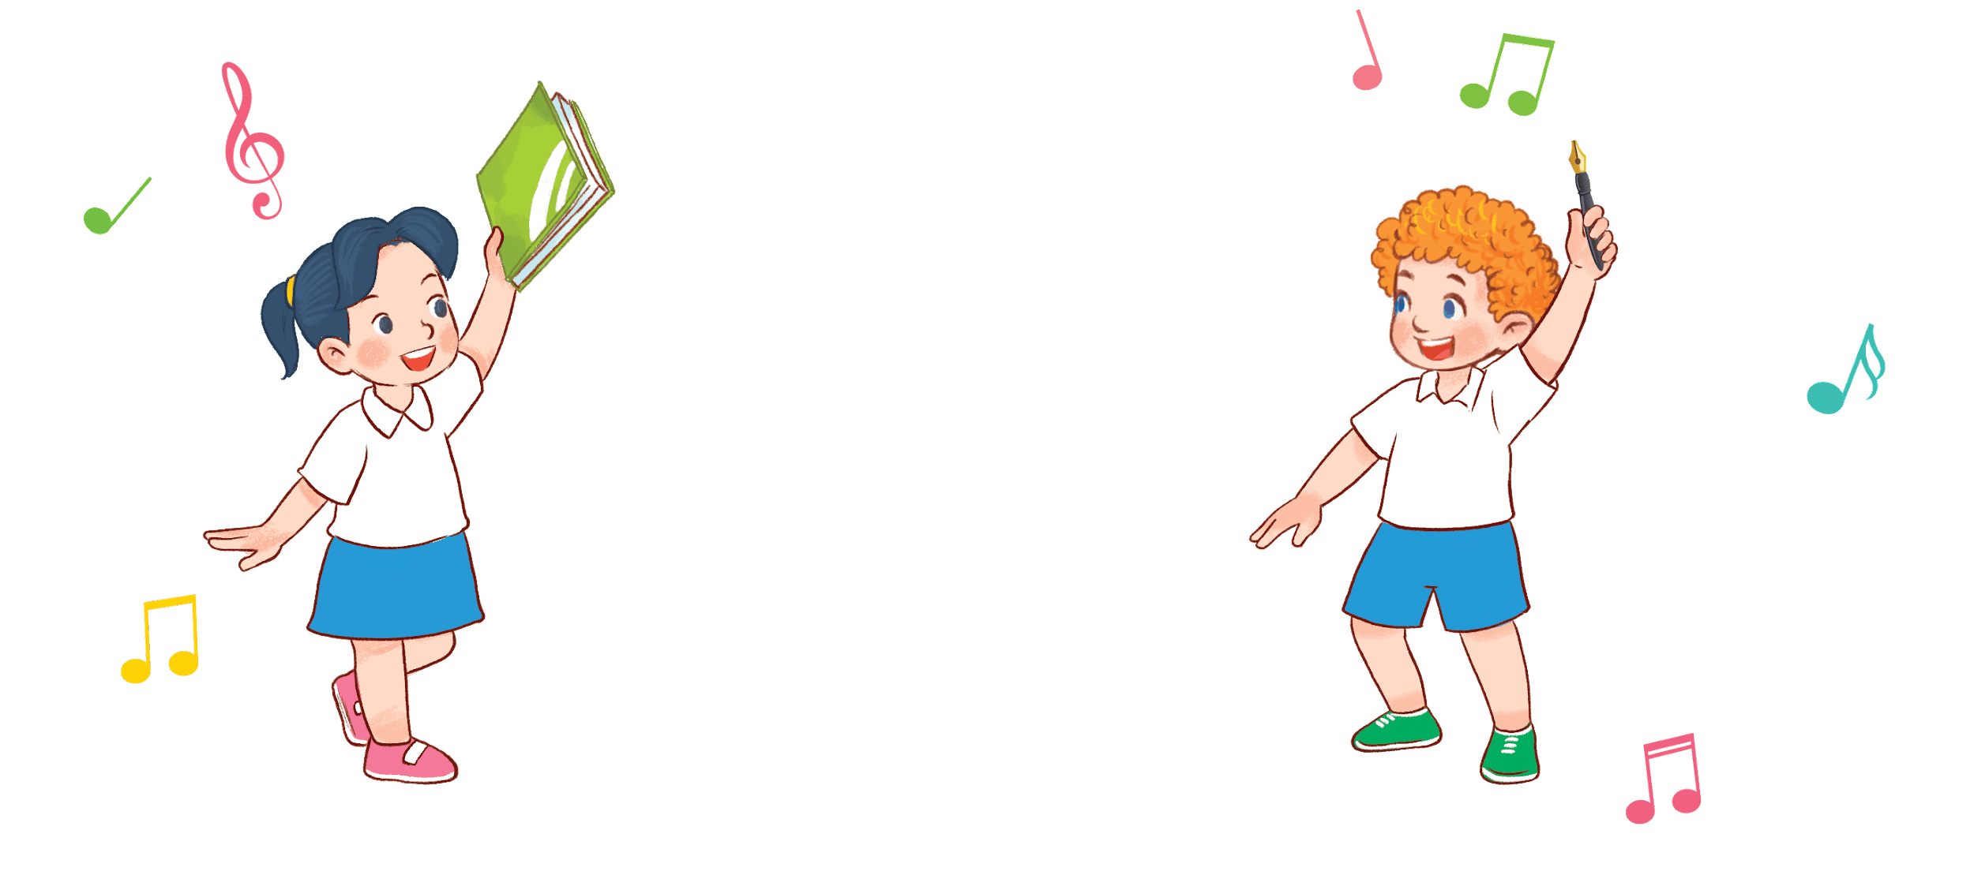

8
3
Period 5

Slide 2
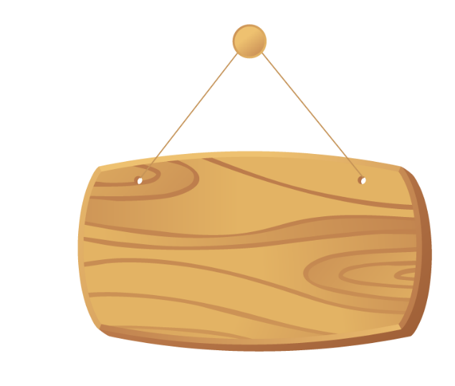

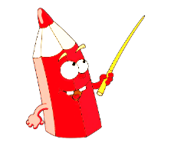
①
Warm-up and review
Contents
②
Listen and repeat.
③
Listen and circle.
④
Let’s chant.
⑤
Fun corner and wrap-up

Slide 3


①
Warm-up and review

Slide 4
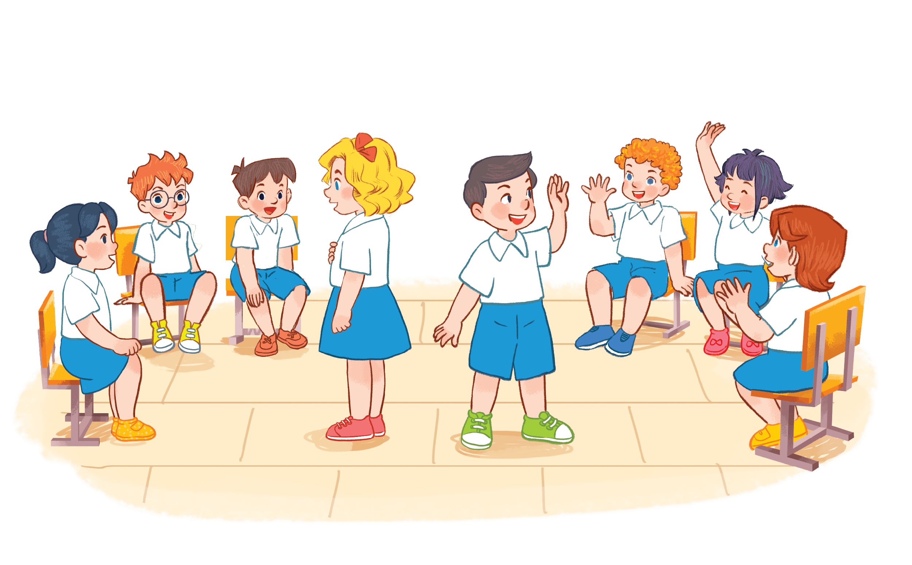


I have a book.
Notes:
Game: Pass the school things.
Review the previous lesson by having the class pass the school things (a book, a pencil, a pen…) while playing the music. When the music stops, those who have the school things have to say the sentence: I have a …

Slide 5

I have a pen.

Slide 6
②
Listen and repeat.

Slide 7
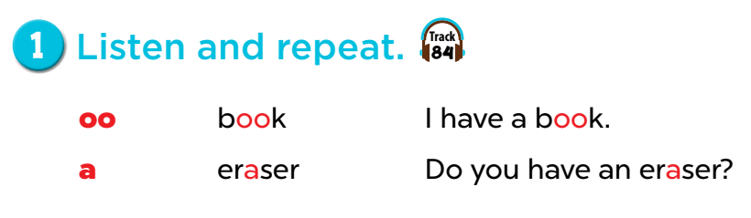

Slide 8
Game: Listen and choose!
Notes:
Divide the class into 2 groups.
Let the pupils listen to the recording, then choose the correct moving shapes.

Slide 9

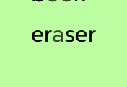


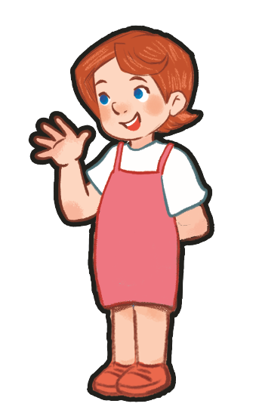
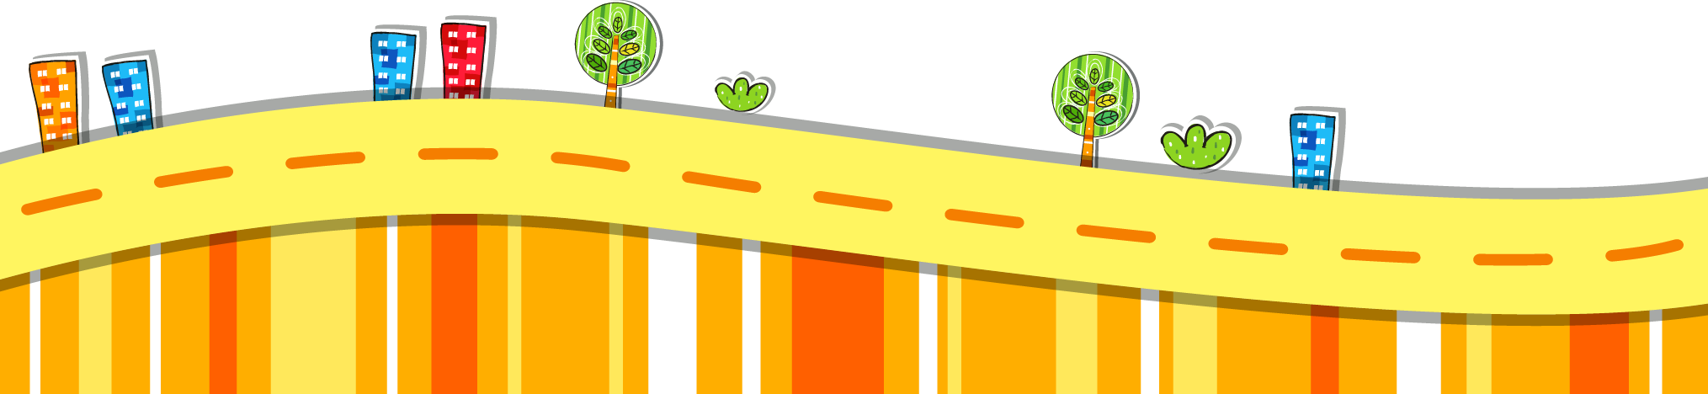

Slide 10


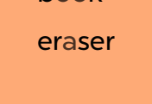

Slide 13
Do you have an eraser?
book
eraser
I have a book.

Slide 14
I have a book.
Do you have an eraser?
eraser
a

Slide 15
③
Listen and circle.

Slide 16
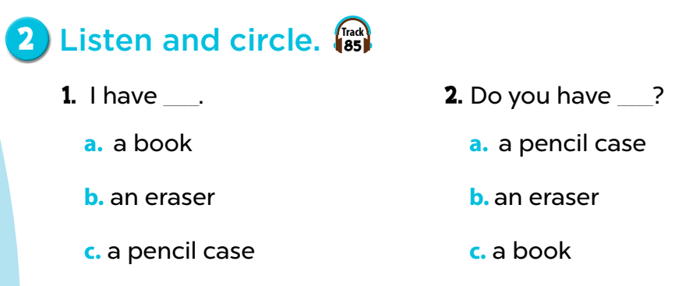

Slide 17
Game: Listen and tick the box!
Notes:
Play the recording for pupils to choose a correct answer and tick the box.

Slide 18
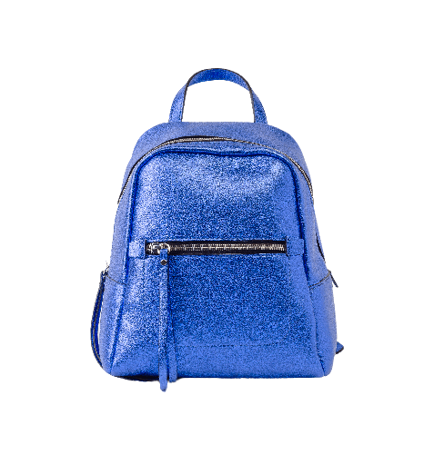
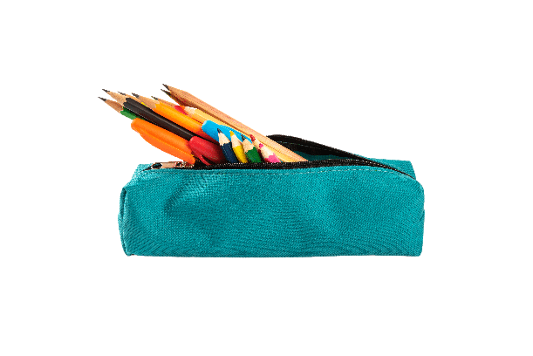
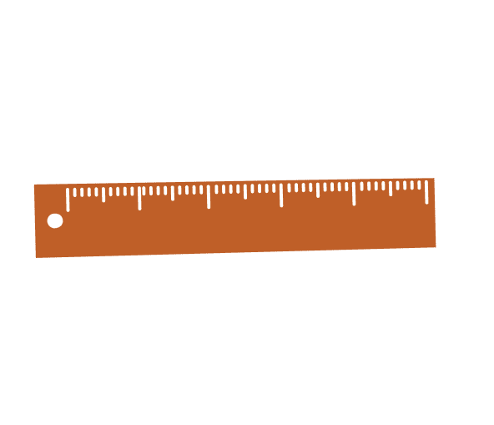

Good job!
✔
A
B
C

Slide 19


Well done!
✔
A
B
C

Slide 20
Way to go!
✔
A
B
C

Slide 21
Great job!
✔
A
B
C

Slide 22
Way to go!
✔
A
B
C

Slide 23
Great job!
✔
A
B
C

Slide 24
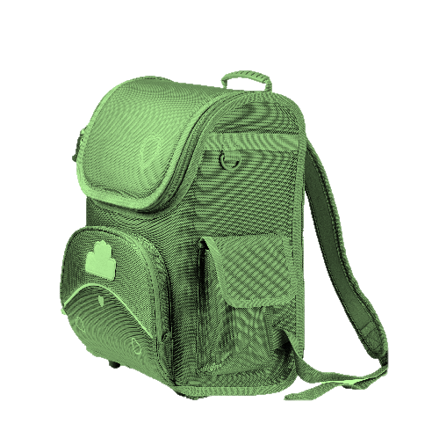
Well done!
✔
A
B
C

Slide 25
④
Let’s chant.
.

Slide 26
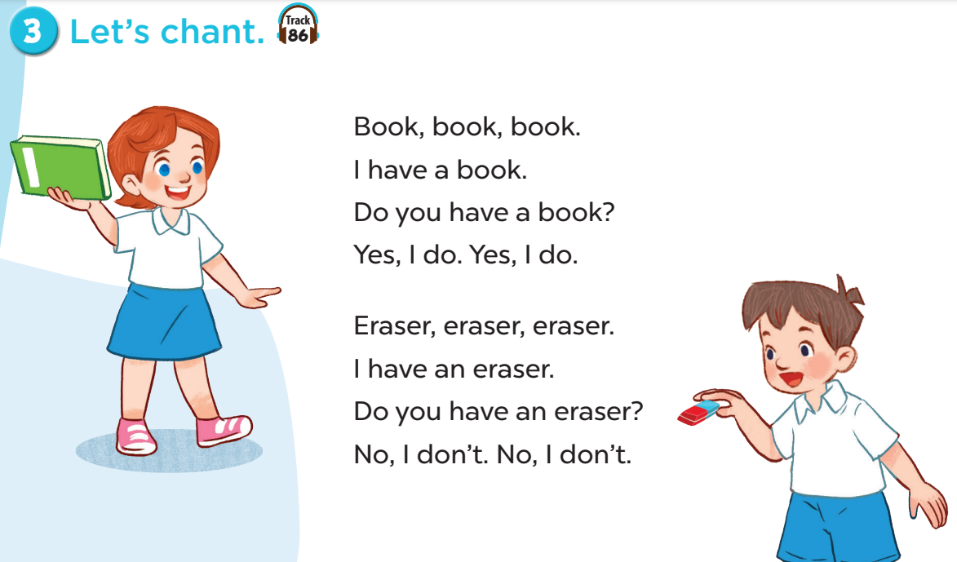

Slide 27
⑤
Fun corner and wrap-up

Slide 28
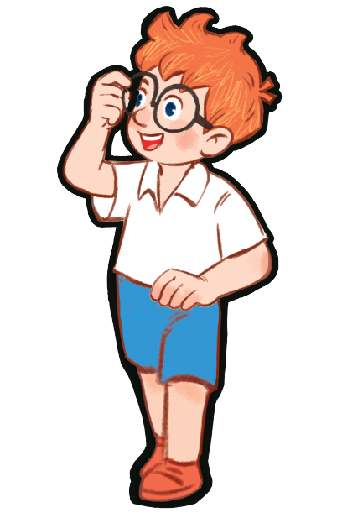
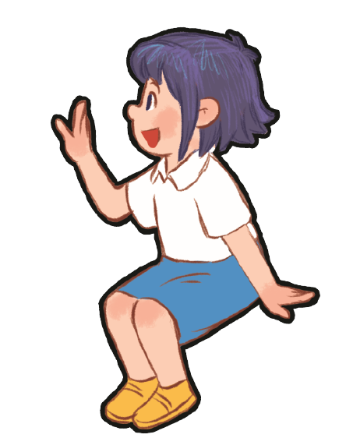


Book, book, book.
I have a book.
Do you have a book?
Yes, I do. Yes, I do.
Notes:
Game: Show me!
- Divide the class into four groups. Ask pupils to say the chant again, then show their school things as they say the chant.
- T can change the name of school things for pupils to chant and show theirs as they chant.

Slide 29
Eraser, eraser, eraser.
I have an eraser.
Do you have an eraser?
No, I don’t.
No, I don’t.

Slide 30
Bag, bag, bag.
I have a bag.
Do you have a bag?
Yes, I do. Yes, I do.

Slide 31
Ruler, ruler, ruler.
I have a ruler. Do you have a ruler?
No, I don’t.
No, I don’t.

Slide 32
Pencil case, pencil case, pencil case.
I have a pencil case.
Do you have a pencil case?
Yes, I do. Yes, I do.

Slide 33
Pen, pen, pen.
I have a pen.
Do you have a pen?
Yes, I do. Yes, I do.

Slide 34
Pencil, pencil, pencil.
I have a pencil.
Do you have a pencil?
Yes, I do. Yes, I do.

