Slide 1





8
3
Period 6

Slide 2



①
Warm-up and review
Contents
②
Read and complete.
③
Let’s write.
④
Project
⑤
Fun corner and wrap-up

Slide 3
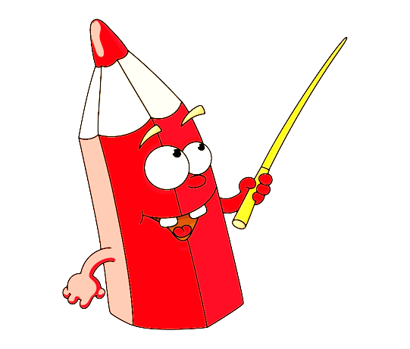

①
Warm-up and review

Slide 4
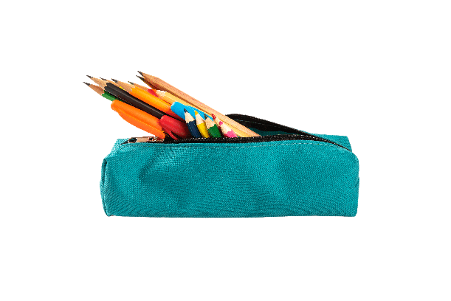



①
②
③
④
eraser pencil case book pen

Slide 5
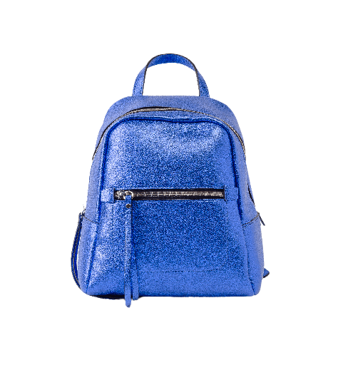

①
②
③
④
ruler eraser school bag book

Slide 6
Way to go

Slide 7
②
Read and complete.

Slide 8
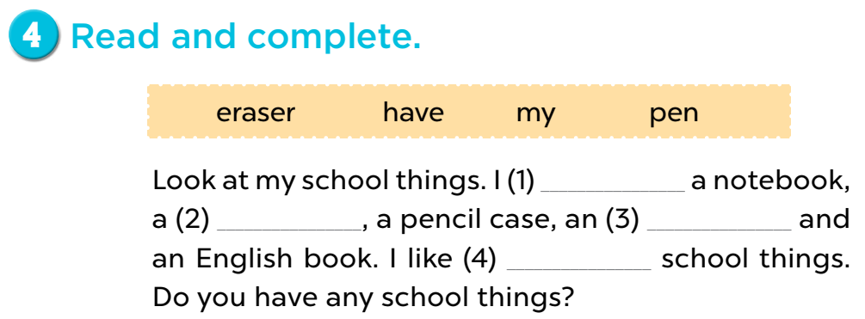
have
pen
eraser
my

Slide 9
③
Let’s write.

Slide 10
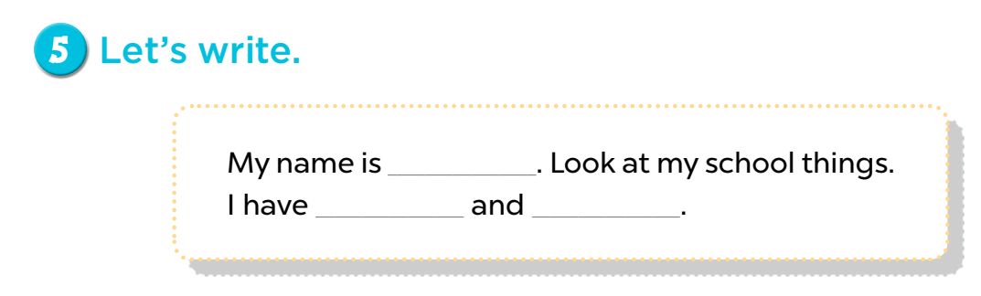



Mary
a book
a pencil

Slide 11
Game: Spin the wheel
Notes:
- Divide the class into 4 groups.
- A pupil from each group comes to the board, spin the wheel, look at the chosen picture, then write the answer on the board.

Slide 12
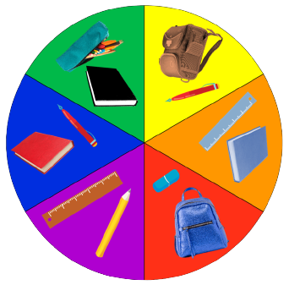
SPIN THE WHEEL
I have ……… and ……… .

Slide 13
④
Project

Slide 14

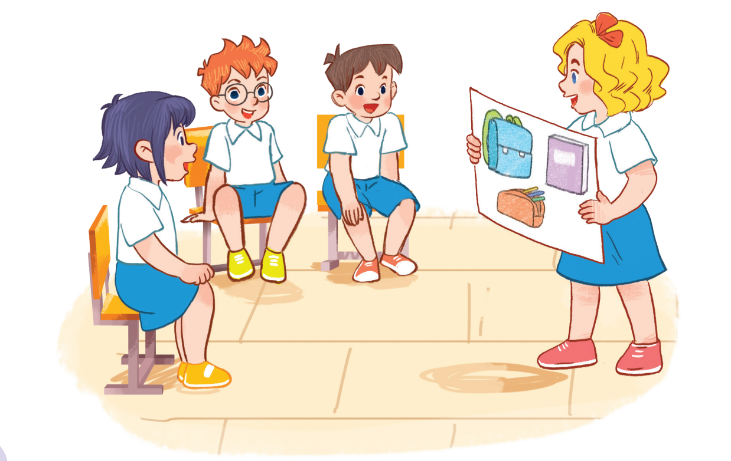

Slide 15
⑤
Fun corner and wrap-up

Slide 16
Game: HOW DO YOU SPELL…?
Notes:
Game: HOW DO YOU SPELL…?
Divide the class into four groups. Ask pupils to look at the letters and spell the words.

Slide 17

HOW DO YOU SPELL…?
BOOK
?

Slide 18
HOW DO YOU SPELL…?
PEN
?

Slide 19
HOW DO YOU SPELL…?
PENCIL
?
?

Slide 20
HOW DO YOU SPELL…?
ERASER
?
?

