Slide 1







9
Colours
LESSON 1
Period 1

Slide 2



CLASSROOM RULES

Slide 3
Put your hands On my desk. Who’s the best? It’s me!

Slide 4
01
Warm-up and review

Slide 5

WHAT’S IN THE BOX?
Notes:
- School things including: a pen, a pencil, a ruler, an eraser.
- Teacher invites one pupil to the front.
- Teacher shows a word card and has the rest of the class say the word. The pupil in the front listens to the word and finds the object from the mystery box.

Slide 6

Look, listen and repeat.

Slide 7

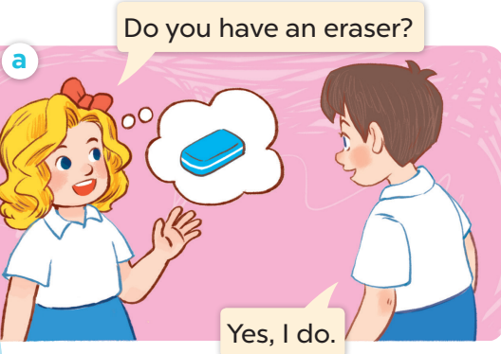
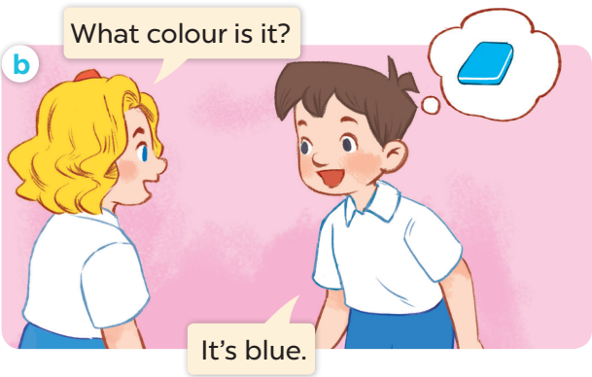
Notes:
- sau slides này chuyển sang sachmem.vn

Slide 8




COLOURS

Slide 9

Listen, point and say.

Slide 10

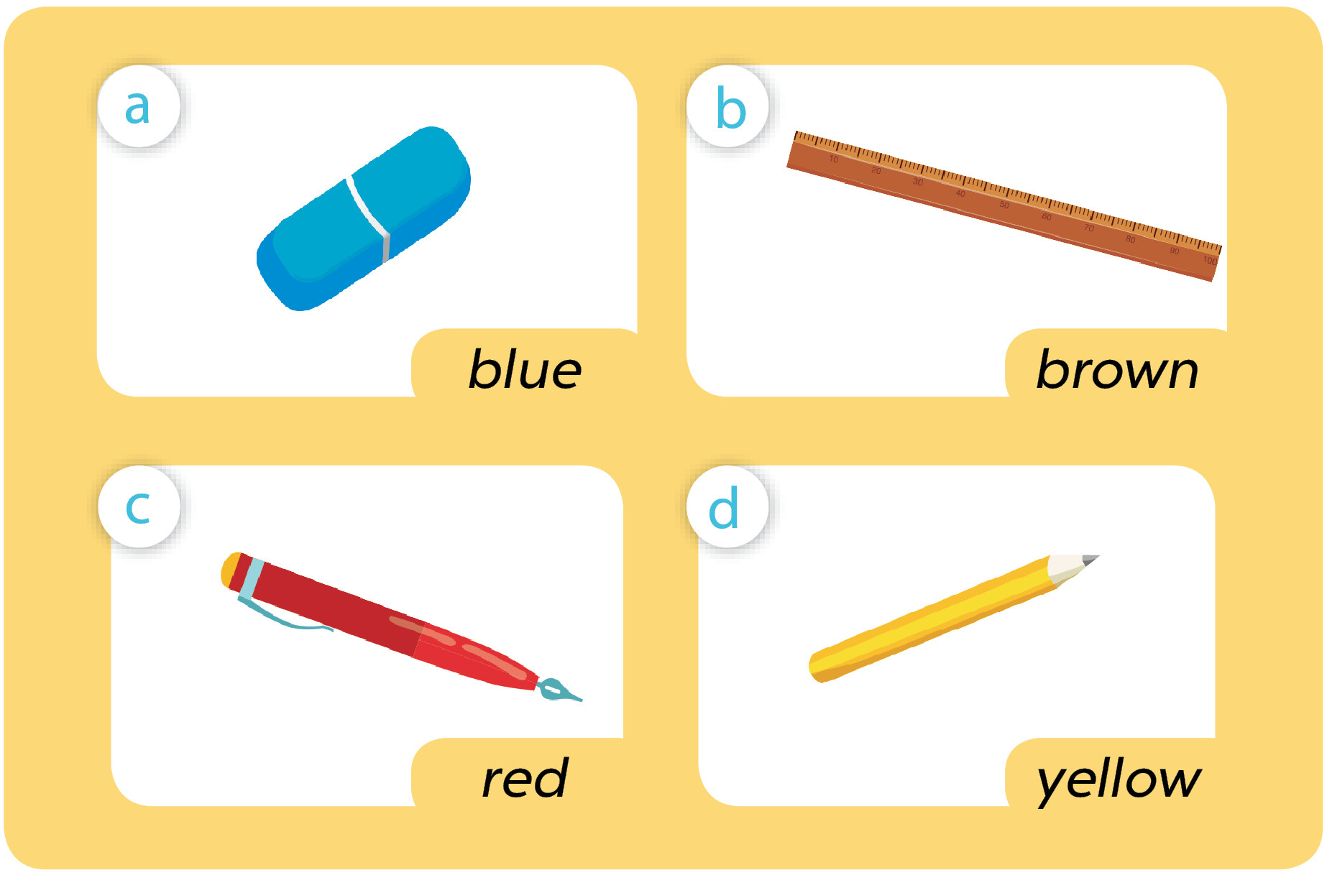
Notes:
- sau slides này chuyển sang sachmem.vn.

Slide 11

What colour is it?
blue
It’s ____ .

Slide 12

What colour is it?
brown
It’s ____ _____ .

Slide 13

What colour is it?
red
It’s ____ _____ .

Slide 14

What colour is it?
yellow
It’s ____ _____ .

Slide 15

Let’s talk.

Slide 16

3
Let’s talk.
What colour is it?
It’s ___.

Slide 17

Fun corner and wrap-up

Slide 18

Memory Game
Notes:
- Divide the class into 2 teams (team 1 and team 2).
- Each team prepares a set of school things with different colours and takes turns to bring them to the front and shows them to the class.
- The other team has 30 seconds to look at the objects and remember their colours.
- The pupils in the front hide the objects and secretly pick one for each.
- Pupils in the other team guess the secret object by asking: What colour is it?
- In 10 seconds, if the other team can guess the object correctly, they get points.

