Slide 1


Unit 7
In the kitchen
Lesson 1 - Period 1

Slide 2
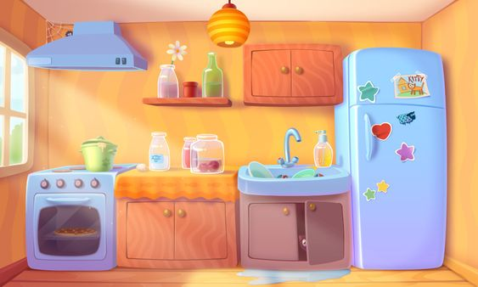

BEHIND THE BINOCULARS

Slide 3








cake

Slide 4
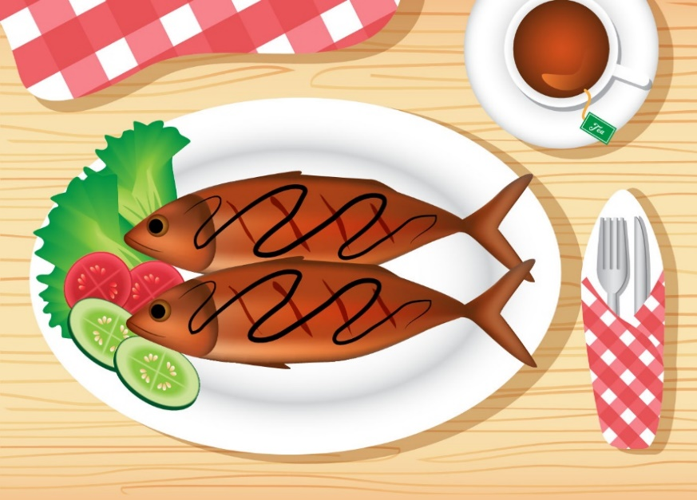


fish

Slide 5
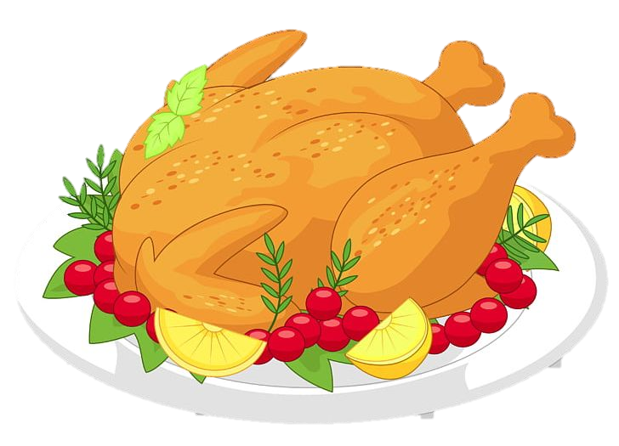

chicken

Slide 6


chips

Slide 7


popcorn

Slide 8
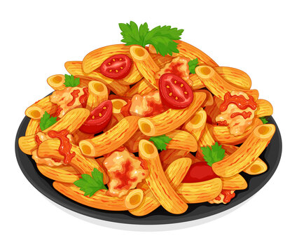
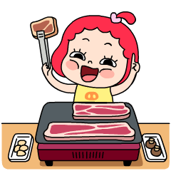
pasta

Slide 9
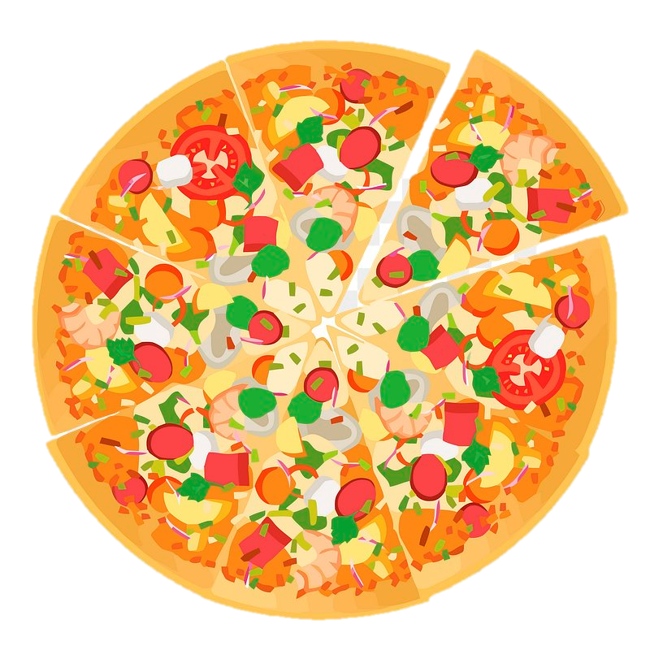

pizza

Slide 10
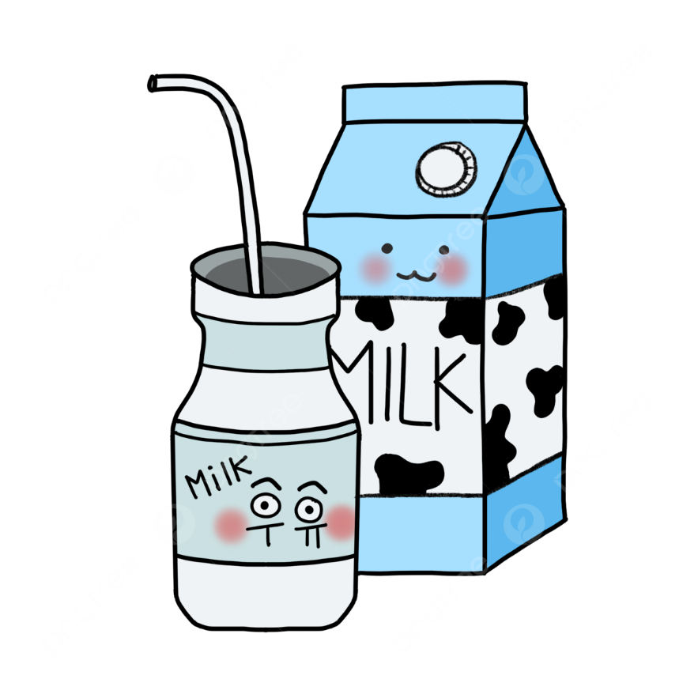

milk

