Slide 1
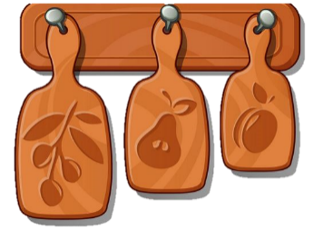

Unit 7
In the kitchen
Lesson 2- Period 2

Slide 2



y
j
____
____
l
e
____
l
9
10
8
7
6
5
4
3
2
1
0

Slide 3
____
a
t
e
____
r
w
____
9
10
8
7
6
5
4
3
2
1
0

Slide 4
p
a
____
s
t
a
____
9
10
8
7
6
5
4
3
2
1
0

Slide 5
p
____
i
z
z
____
a
____
9
10
8
7
6
5
4
3
2
1
0

Slide 6
p
o
p
c
o
r
____
____
____
____
n
9
10
8
7
6
5
4
3
2
1
0

Slide 7
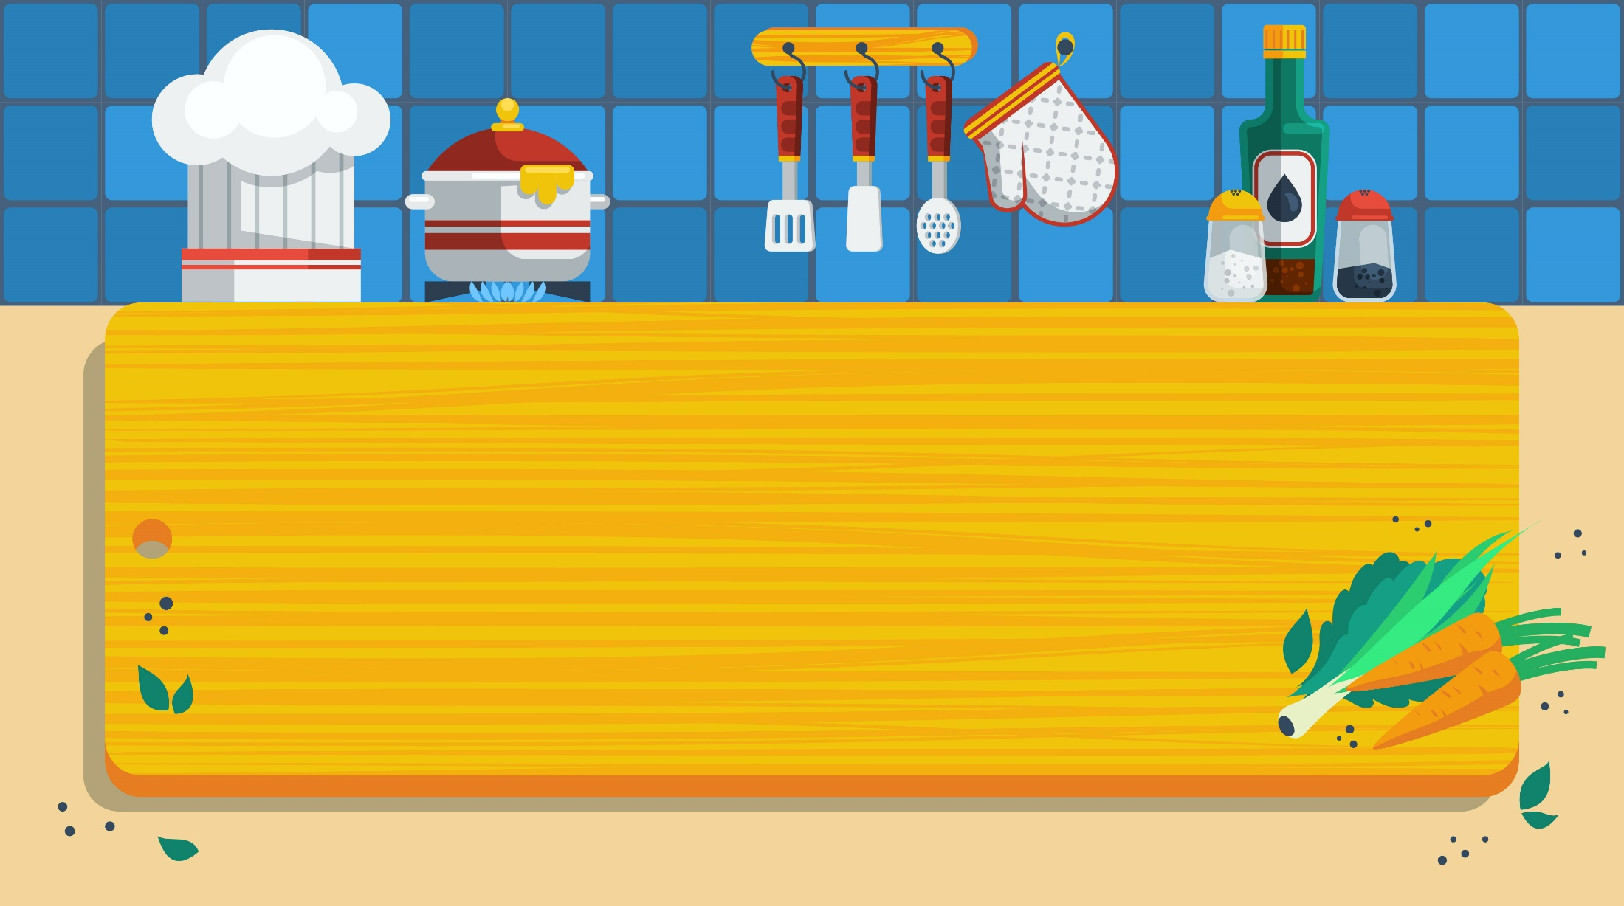
02
Activity 3
Listen and chant.

Slide 8
03
Activity 4
Listen and tick.

Slide 9



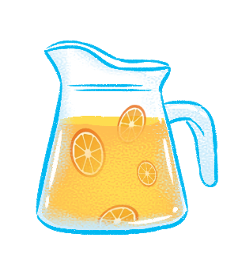
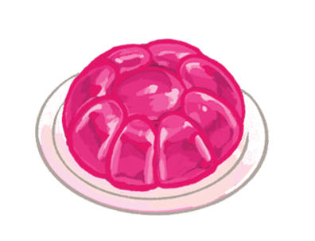
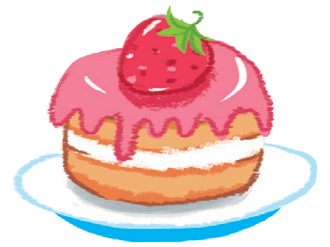
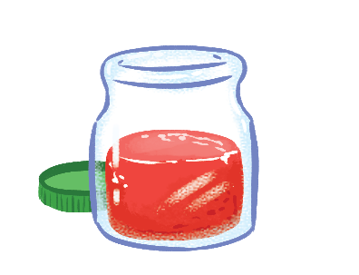


Listen and tick.
1
2

Slide 10
Listen and tick.
1


Slide 11
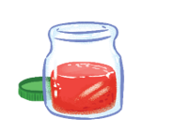
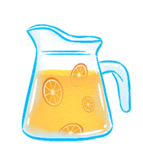
Listen and tick.
2


Slide 12
04
Activity 5
Look and write.

Slide 13
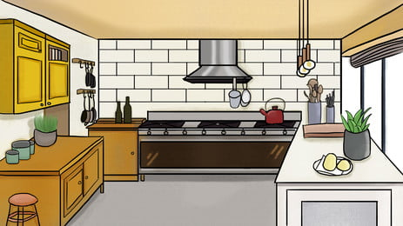
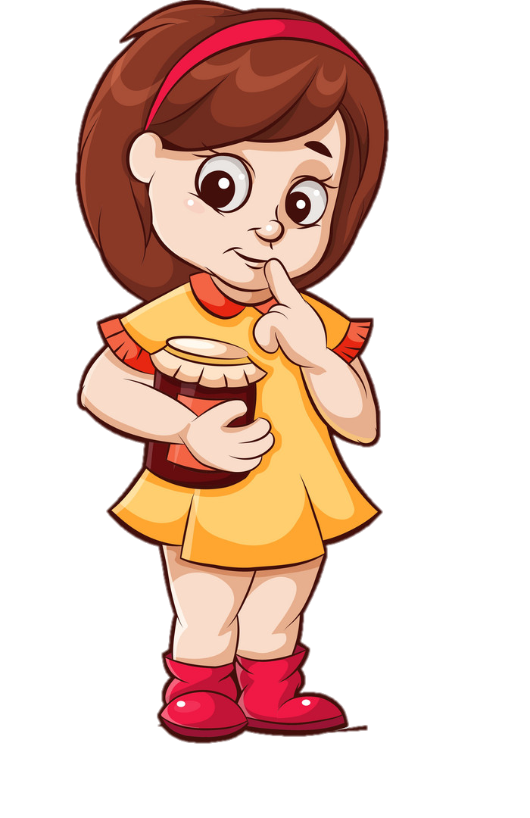
I like jam.

Slide 14
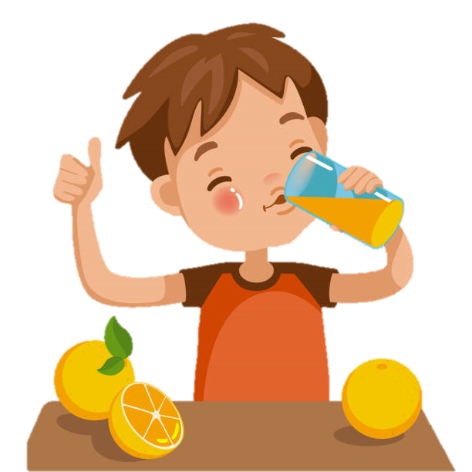
I like juice.

Slide 15
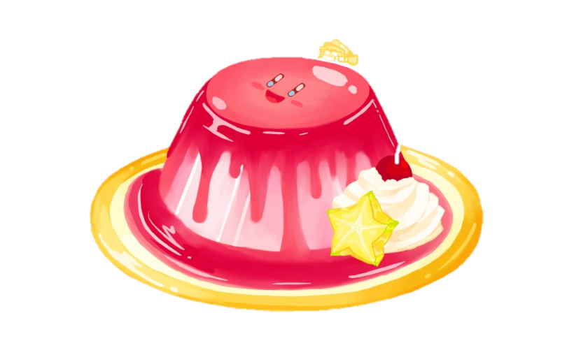

I like jelly.

