Slide 1









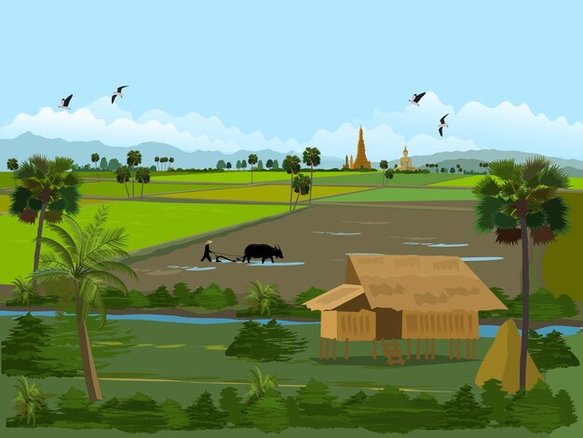
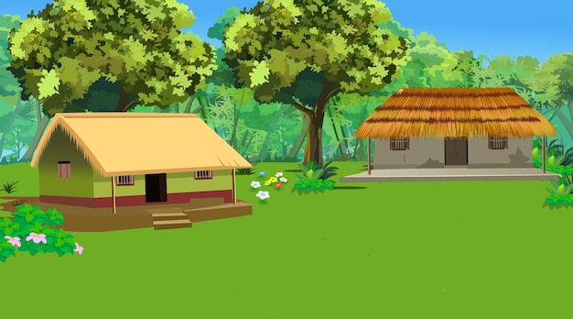

Unit
Lesson 3 - Period 3

Slide 2

Table of contents
1. Warm-up and Review
2. Activity 6: Listen and repeat.
3. Activity 7: Let’s talk.
4. Activity 8: Let’s sing!
5. Fun corner and Wrap-up

Slide 3
01
Warm-up
and
Review

Slide 4

Hot seat

Slide 5
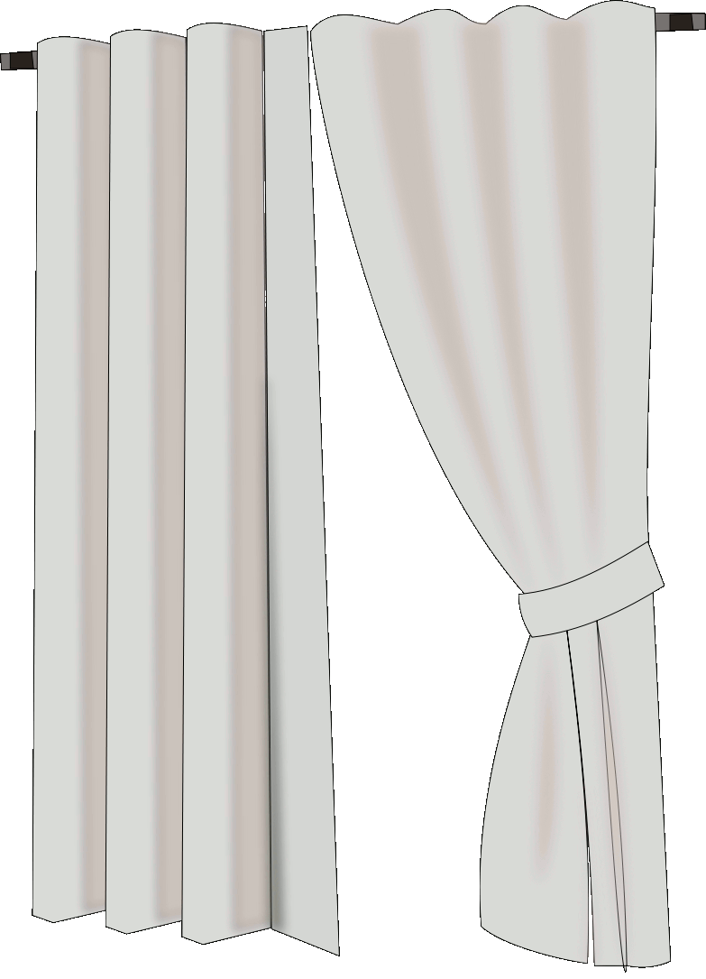


Ready !
van

Slide 6

Ready !
volleyball

Slide 7
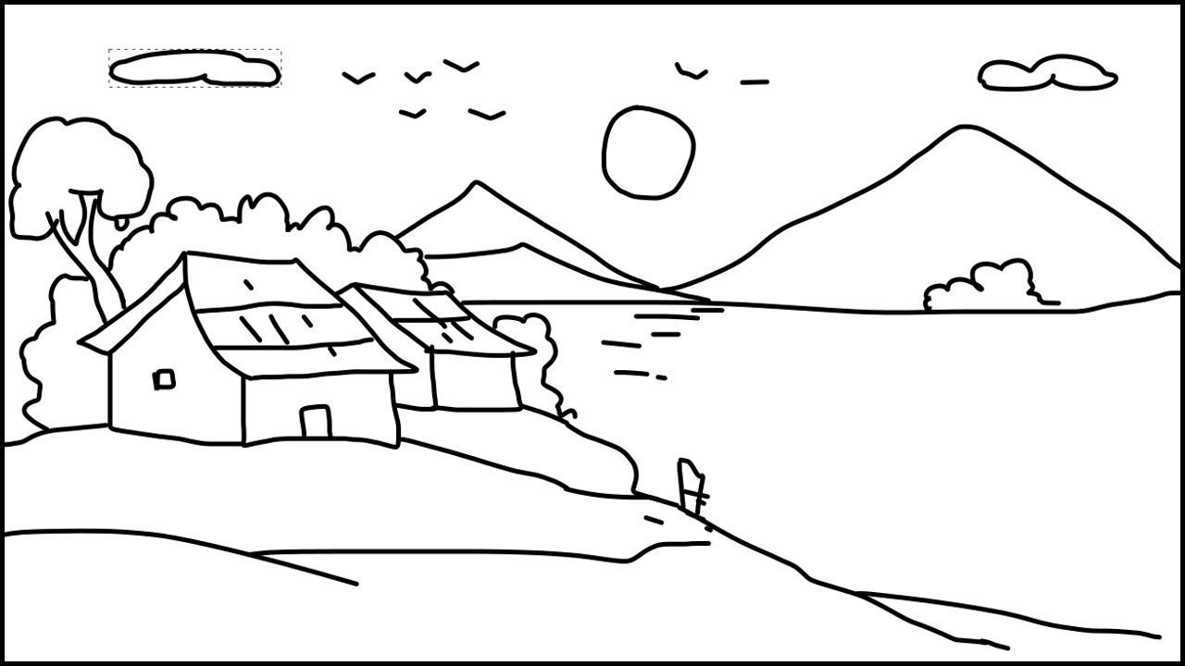
Ready !
village

Slide 8
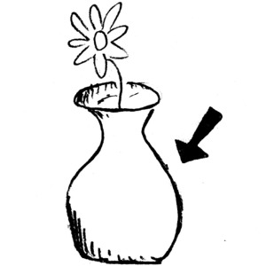
Ready !
vase

Slide 9

Ready !
violin

Slide 10


Slide 11
02
Activity 6
Listen and repeat.

Slide 12



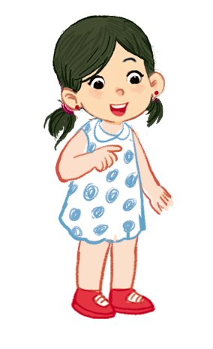

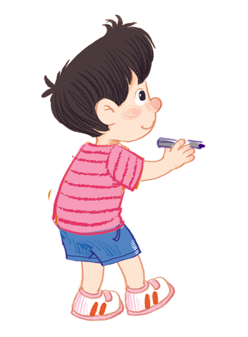

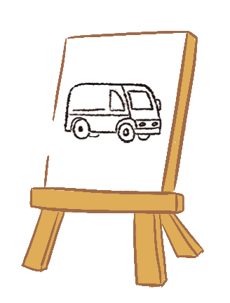



Listen and repeat.
Can you draw a van?
Can you draw a van?
Can you draw a van?
Can you draw a van?
No, I can’t.
No, I can’t.
No, I can’t.
No, I can’t.
Yes, I can.
Yes, I can.
Yes, I can.
Yes, I can.

Slide 13
03
Activity 7
Let’s talk.

Slide 14



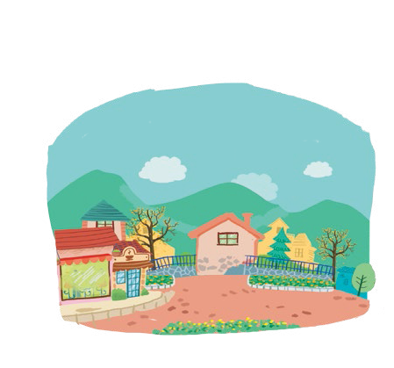
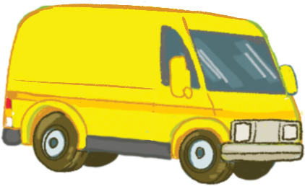


Let’s talk.
Can you draw a _____?
Yes, ______.
No, ______.
a
b
c
d

Slide 15
Can you draw a _____?
Yes, ______.
No, ______.
a

Slide 16

Can you draw a _____?
Yes, ______.
No, ______.
b

Slide 17
Can you draw a _____?
Yes, ______.
No, ______.
c

Slide 18
Can you draw a _____?
Yes, ______.
No, ______.
d

Slide 19
04
Activity 8
Let’s sing!

Slide 20
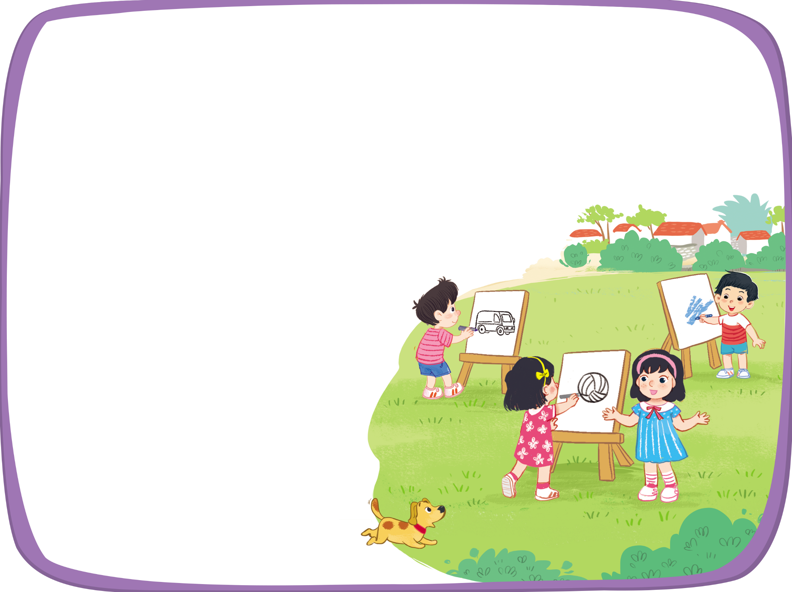


Let’s sing!
Can you draw a van?
Can you draw a van?
Can you draw a van?
Can you draw a van?
Yes, I can.
Yes, I can.
Yes, I can.
Yes, I can.
Can you draw a volleyball?
Can you draw a volleyball?
Can you draw a volleyball?
Can you draw a volleyball?
Yes, I can.
Yes, I can.
Yes, I can.
Yes, I can.
Can you draw a village?
Can you draw a village?
Can you draw a village?
Can you draw a village?
No, I can’t.
No, I can’t.
No, I can’t.
No, I can’t.

Slide 21
05
Fun corner
and
Wrap-up

Slide 22


Option 1
Option 2

Slide 23




Notes:
- Step 1: Ask pupils to say the word correct with the picture (van, village, volleyball).
- Step 2: Click on the right can.
- Step 3: Keep the game until pupils say the correct words.

Slide 24
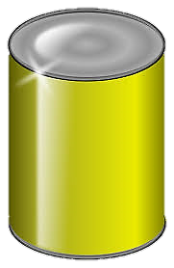
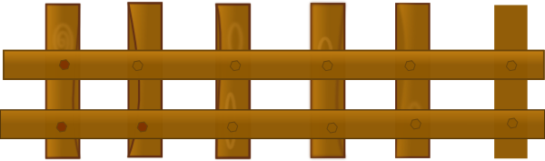


1/6
van
volleyball
village
NEXT
Click on the right can

Slide 25
2/6
village
volleyball
van
NEXT
Click on the right can

Slide 26
3/6
village
vase
volleyball
NEXT
Click on the right can

Slide 27
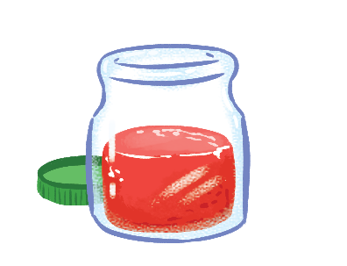
4/6
juice
jelly
jam
NEXT
Click on the right can

Slide 28

5/6
cake
pizza
milk
NEXT
Click on the right can

Slide 29
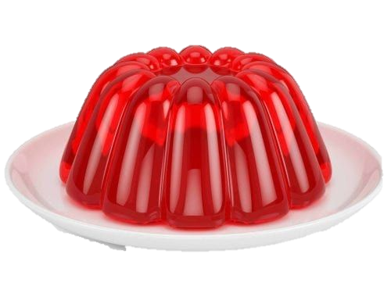
6/6
juice
jelly
jam
Click on the right can

Slide 31



Team boys
Ask & Answer
Team girls
9
8
7
5
6
4
0
1
3
9
2
8
7
5
6
4
0
1
0
1
2
9
8
7
6
5
4
9
8
7
5
6
4
1
3
3
0
2
3
1
2
3
4
5
2
SPIN AGAIN
12
1
11
2
10
SPIN STOP
3
9
4
8
5
7
6
Click twice the SPIN/STOP button to stop the pointer
Notes:
GV click vào nút spin để ghi điểm cho hai đội chơi. VD: team boy quay vào ô số 10 thì sẽ được 10 điểm
Divide the class into two teams (boys and girls) to complete the task.
- Hold up a flashcard about the letter V/v for Team A making a question, and say “Yes/ No” for Team B answering the question.
- Ask Team A to make the question “Can you draw a van?” to ask Team B when the teacher shows them a flashcard.
- Have Team B answer the question from Team A “Yes, I can. / No, can’t.”.
- Ask two teams to take turns asking and answering the questions.
- Check pupils’ pronunciation as the class.

Slide 32






Can you draw a ____?
Yes, ____ / No, ____

Slide 33


Can you draw a ________?
Yes, ____ / No, ____

Slide 34

Can you draw a _________?
Yes, ____ / No, ____

Slide 35

Can you draw a _______?
Yes, ____ / No, ____

Slide 36

Can you draw a ________?
Yes, ____ / No, ____

Slide 38
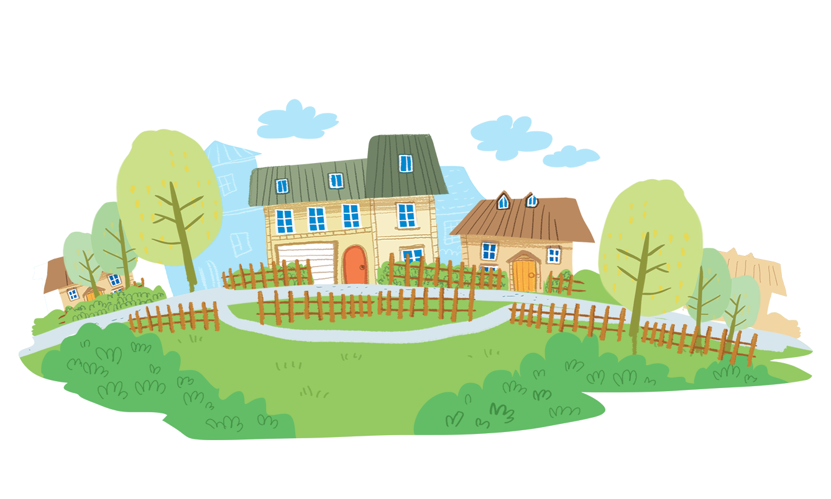
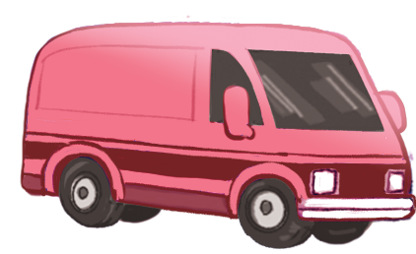
Time to say goodbye!
v

