Slide 1

Unit 8 – Lesson 3 In the park
Notes:
Goals: By the end of the lesson, pupils will be able to:
listen and repeat the sentence “Touch your hair.”
express a command, using “Touch your _____. “
sing a song with the structure “Touch your _____.”

Slide 2

Warm-up
Notes:
Goal: Review the chant of Lesson 2.
Time limit: 5 mins.
- Teacher has Pupils look at the pictures and say all the words.
- Teacher gives letter “h” cards and flashcards to some Pupils.
- Teacher plays the chant. Whole class chant. Pupils who have the card stand up when it comes to the word or letter they have.

Slide 3


Listen and repeat
Notes:
Goal:
- will be able to listen and repeat the sentence Touch your hair.
Step 1: Getting to know the structure “Touch your _____”
- Teacher does the action and says Touch your head. Pupils follow.
- Teacher does the same with Touch your hair and Touch your hand.
- Teams take turn to say and do.
- Teacher shows the structure Touch your …. Teacher says, pupils repeat
- Teacher shows the word “hair” together with the structure. Pupils say the structure. Teacher does the same with head and hand.
- Team check: Teacher holds up flashcards, team say and do.
Teacher does the same for individual check.
Step 2: Pupils listen and repeat.
Time limit: 2 mins
- Pupils open to the Listen and repeat part in their books.
Teacher plays the audio, pupils listen and repeat.
Step 3: Quick check.
Time limit: 4 mins
- Quick check as teams: Teacher holds up flashcard head and says Team 1. Pupils of team 1 says Touch your head. Teacher does the same with the other teams.
- Teacher does the same for individual check.

Slide 4
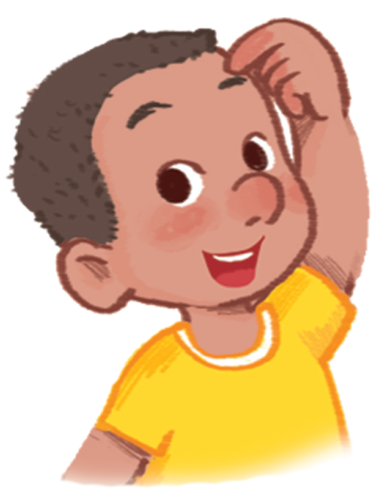
Touch your .
head

Slide 5
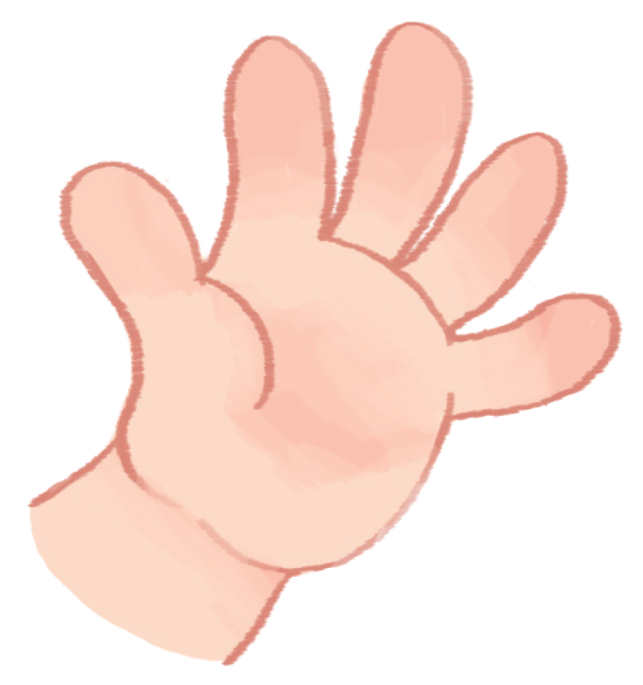
Touch your .
hand

Slide 6
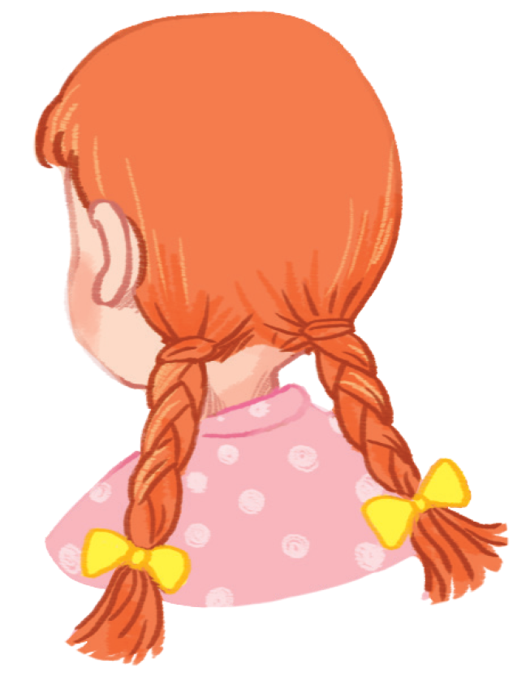
Touch your .
hair

Slide 7
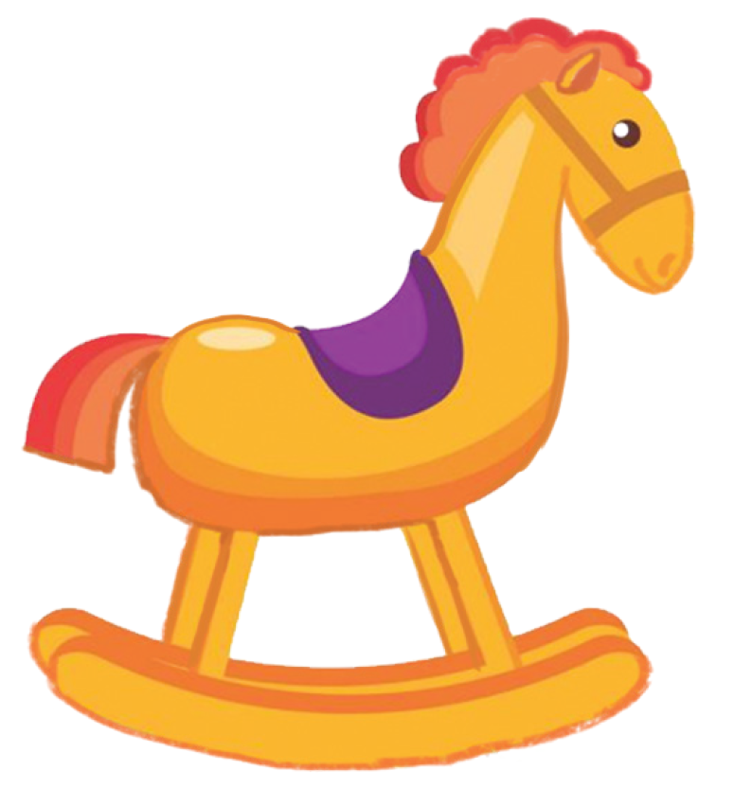
Touch your .
horse

Slide 8

Let’s talk
Notes:
Goal:
- will be able to express a command, using Touch your _____.
Step 1: Point and say
Time limit: 3 mins
- Pupils open to the Let’s talk! part.
Pupils point to the pictures and say using the structure Touch your _____.
Step 2: Practice
Game: Simon says
Time limit: 6 mins
- When teacher says Simon says Touch your hair, pupils do the action.
- If teacher doesn’t say Simon says, pupils don’t do the action.
- Pupils who do wrong will have to sit down.

Slide 9
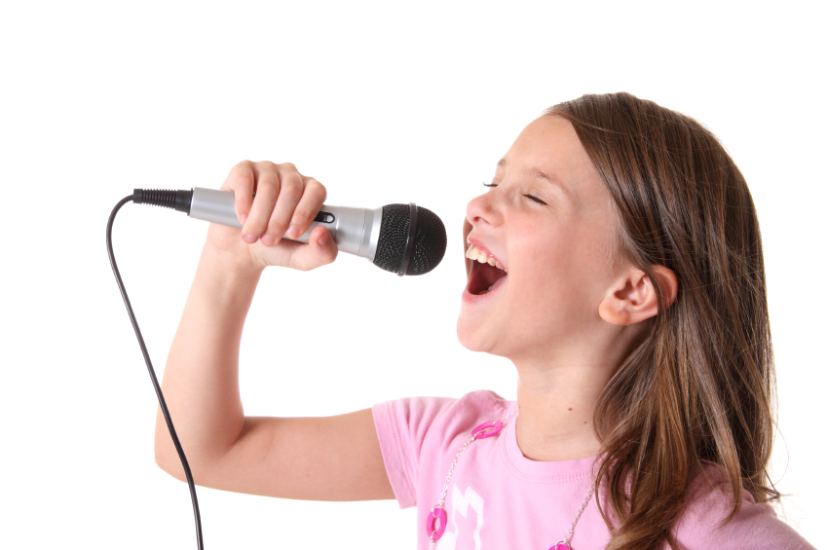


Let’s sing
Notes:
Step 1: Getting to know the song
Time limit: 4 mins
- Teacher and pupils read the song lyrics together.
- Teacher plays the audio.
1st time: Pupils only listen.
2nd time: Pupils listen and sing.
Step 2: Sing and do
Time limit: 5 mins
Teacher plays the audio, shows pupils some actions to do when singing the song.
Step 3: Quick check
Time limit: 4 mins
Pupils sings and do in teams. Better team gets more stars.

Slide 10
GAME
Notes:
Game: Back to the board
Time limit: 7 mins
- Teacher has Pupils stand with their backs turning to the board.
- Teacher holds up a flashcard behind them.
- Whole class say using the structure Touch your _____, pupils do the corresponding action.
- Faster student gets more stars.

Slide 11
Goodbye
Notes:
- Teacher shows the vocabulary of the lesson on slide.
- Pupils say goodbye.

Slide 12
Goodbye

Slide 13
Goodbye

Slide 14
Goodbye

