Slide 1
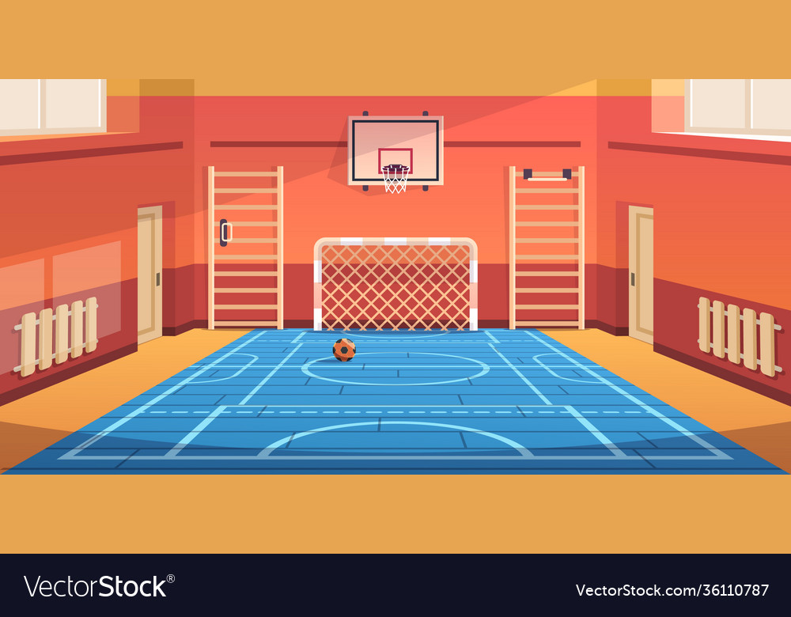

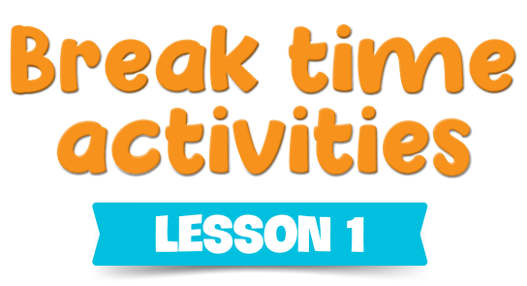

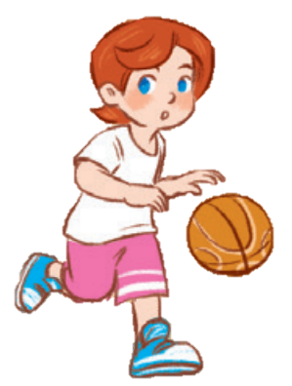
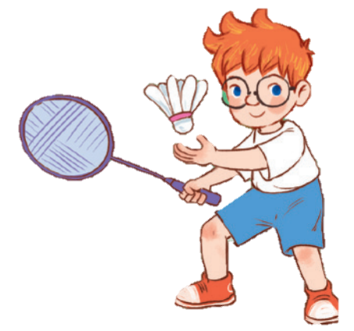
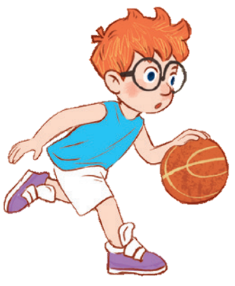
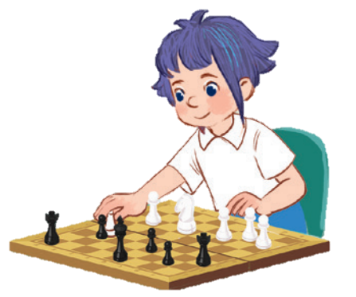
10
Period 2

Slide 2

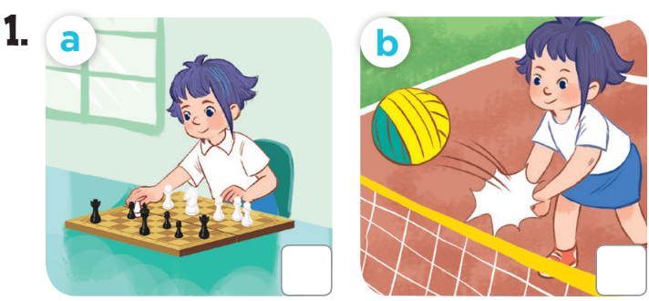

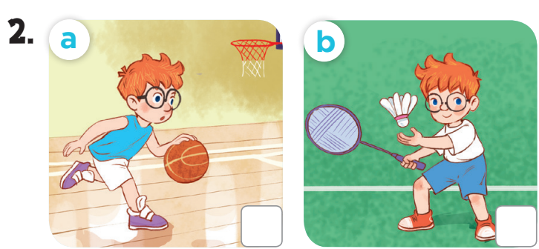

Slide 3
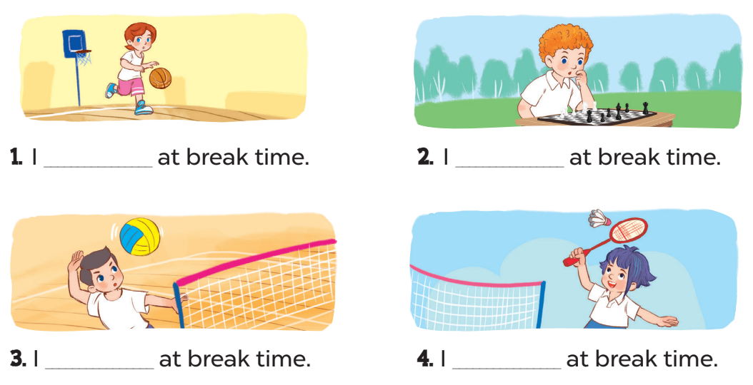
play basketball
play chess
play volleyball
play badminton

Slide 4
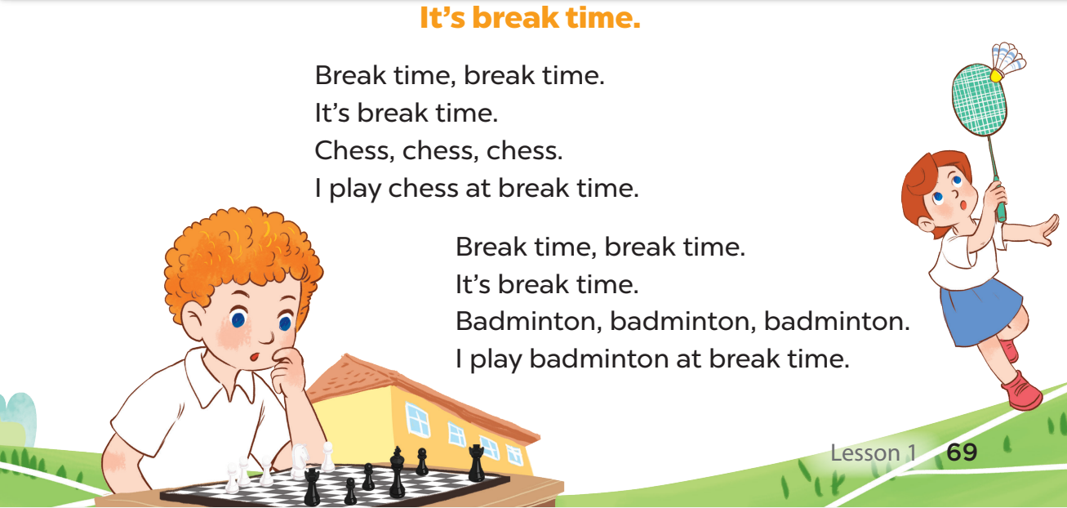

Slide 6
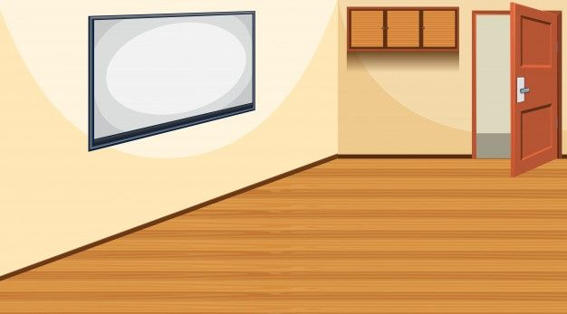
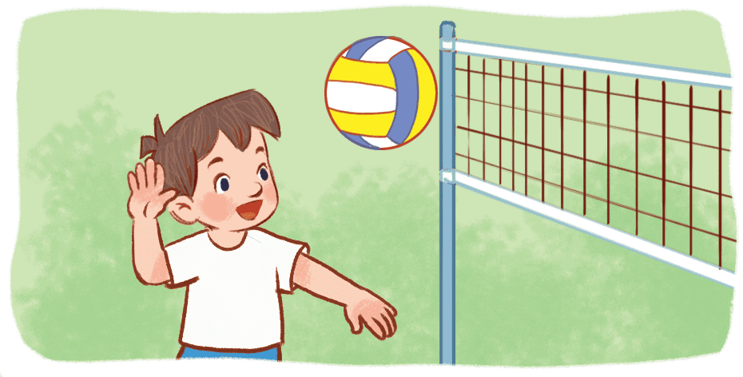
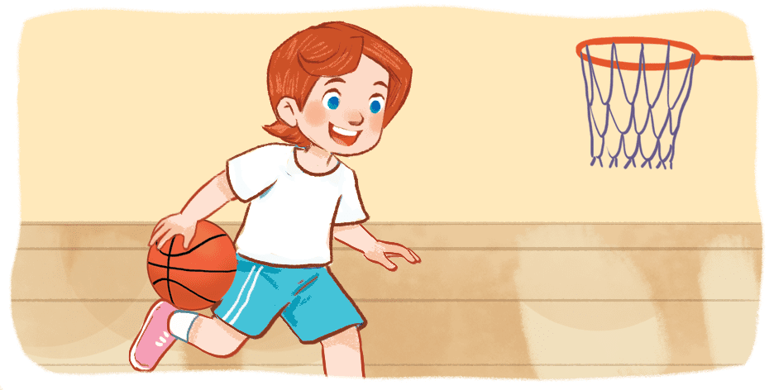
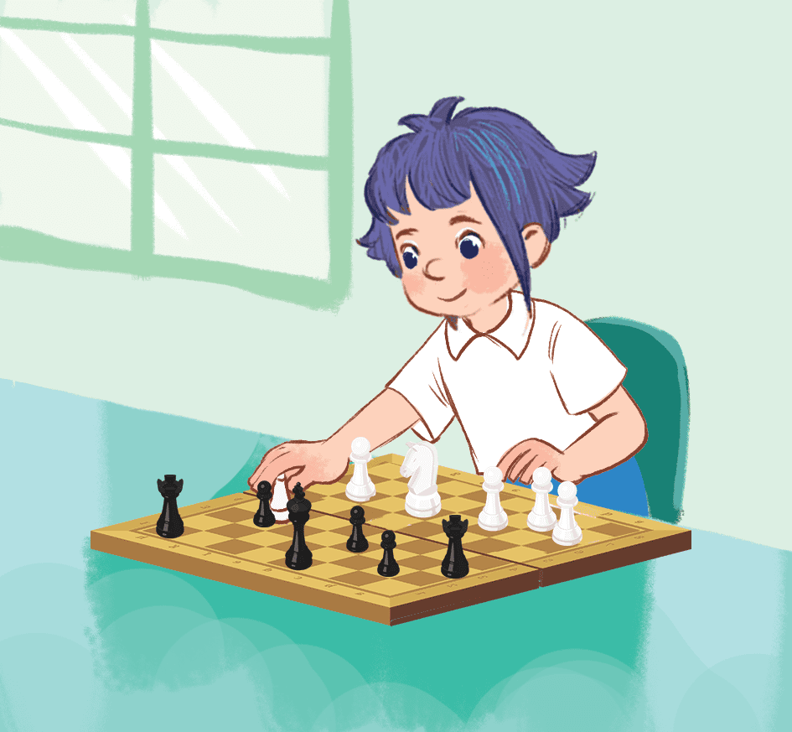


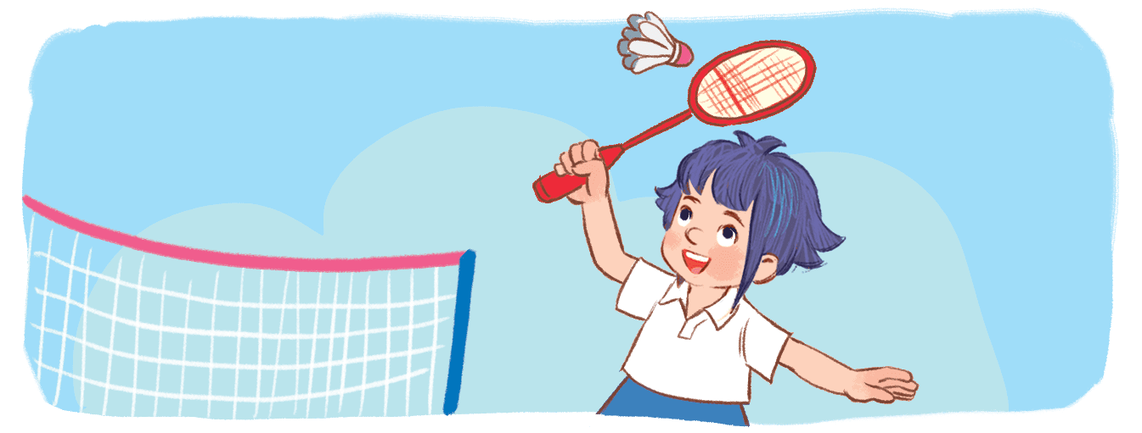


play volleyball
play basketball
play chess
play badminton
I play volleyball at break time.
Yes.
+1
play volleyball

Slide 7
play volleyball
I play chess at break time.
play basketball
play chess
play badminton
No.
play chess
+1
play basketball
play volleyball
play chess

Slide 8
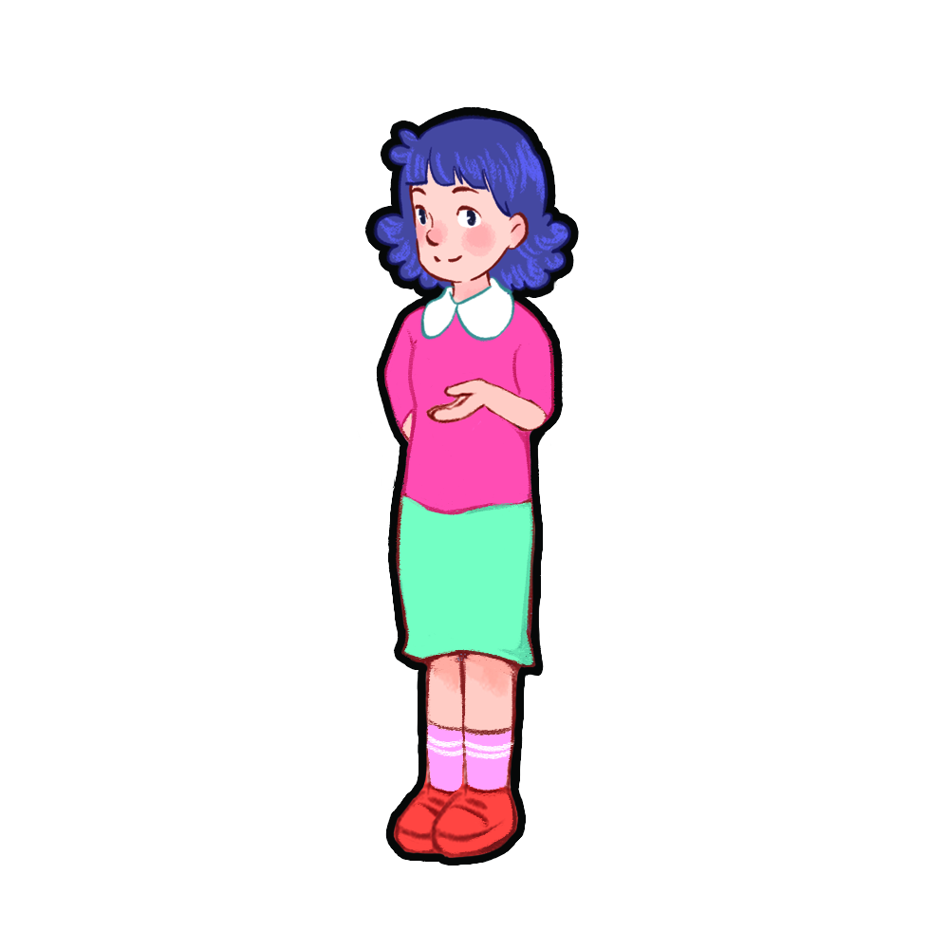

play
basketball
play
chess
play
volleyball
play
badminton
I ………. at break time.
Notes:
Teacher shows 4 pictures of break time activities on the board and asks pupils to use the model structure to make sentences.

