Slide 1
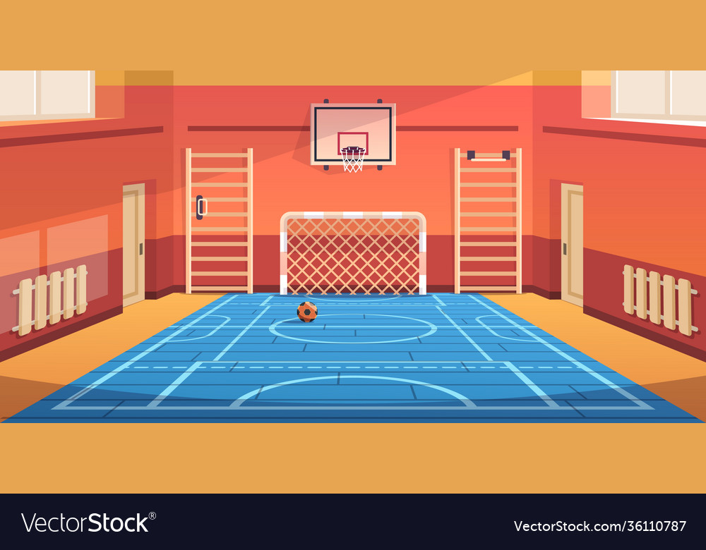




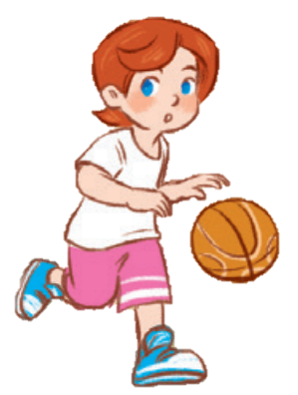
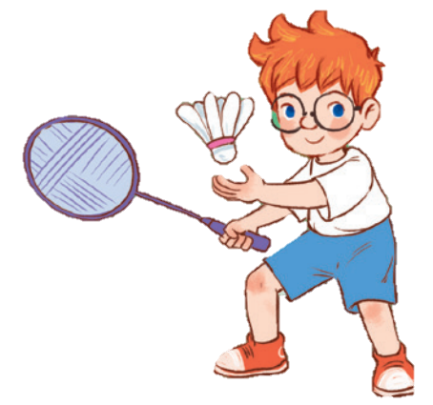
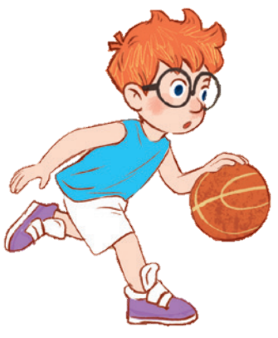
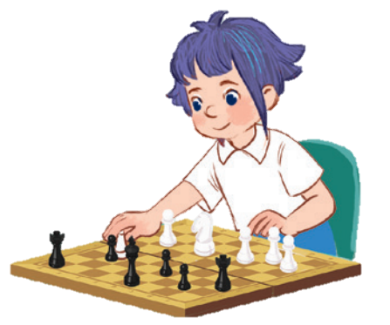
10
Period 3

Slide 2
Contents
1
5
Fun corner and wrap-up
Warm-up and review
4
2
3
Let’s talk.
Look, listen and repeat.
Listen, point and say.

Slide 3
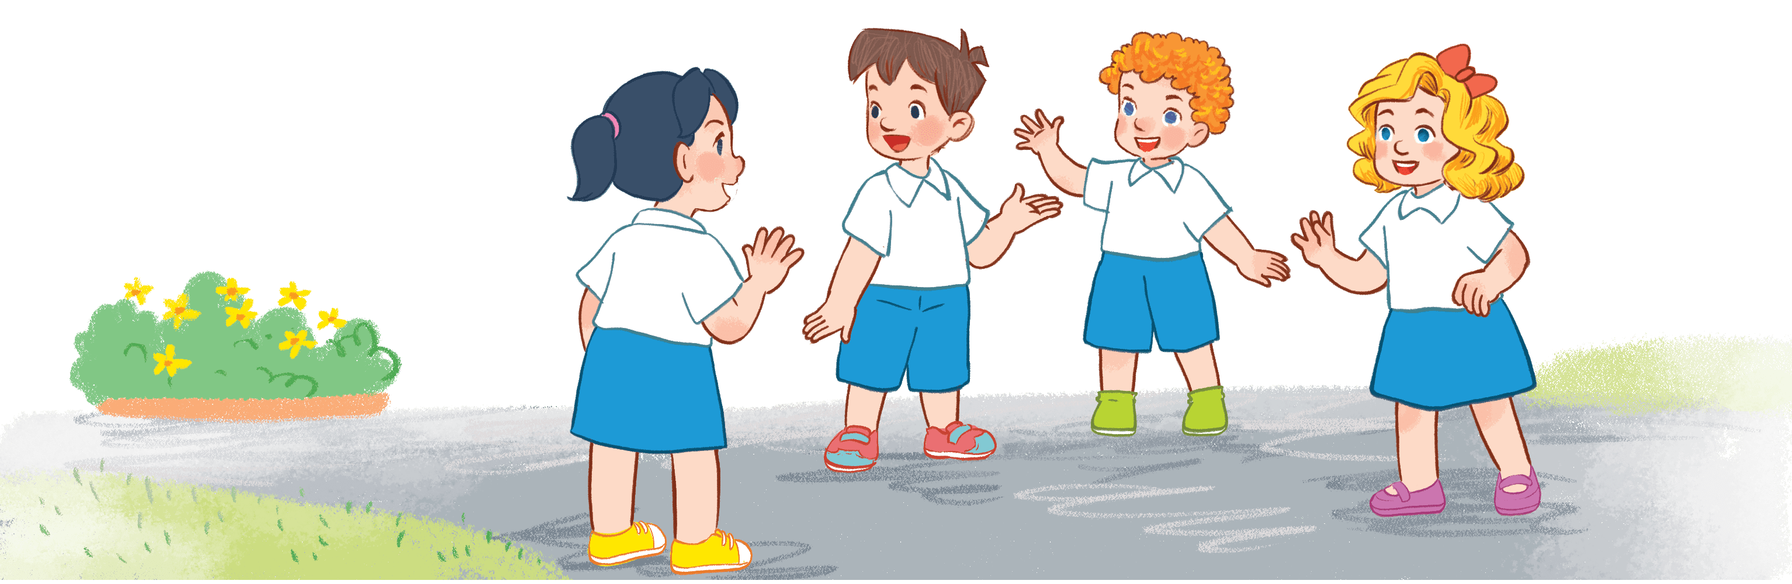
Warm-up AND REVIEW

Slide 4
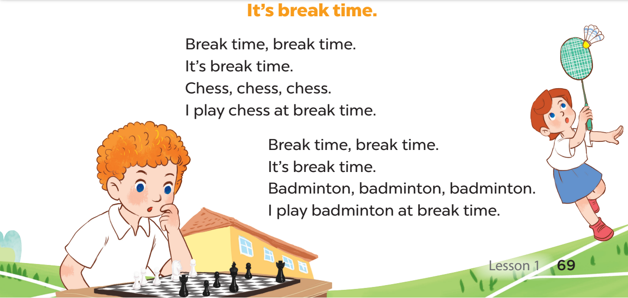

Notes:
- Have the pupils listen to the song of period 2 and each pupil chooses 1 activity in the song.
- When they hear the names of activities they’ve chosen, they have to stand up, then sit down again.
- Play the recording 3-4 times.

Slide 5
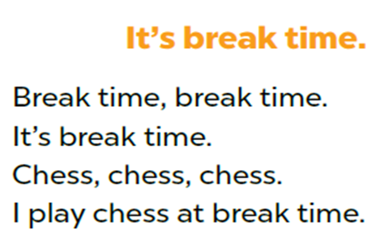

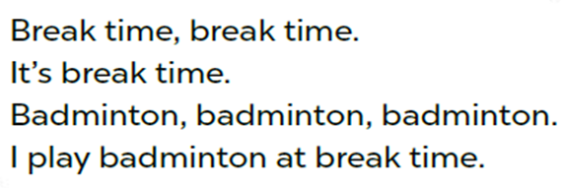
play chess
play badminton
Notes:
- Have the pupils listen to the song of period 2 and each pupil chooses 1 activity in the song.
- When they hear the names of activities they’ve chosen, they have to stand up, then sit down again.
- Play the recording 3-4 times.

Slide 6
play badminton
play chess
Notes:
- Have the pupils listen to the song of period 2 and each pupil chooses 1 activity in the song.
- When they hear the names of activities they’ve chosen, they have to stand up, then sit down again.
- Play the recording 3-4 times.

Slide 7
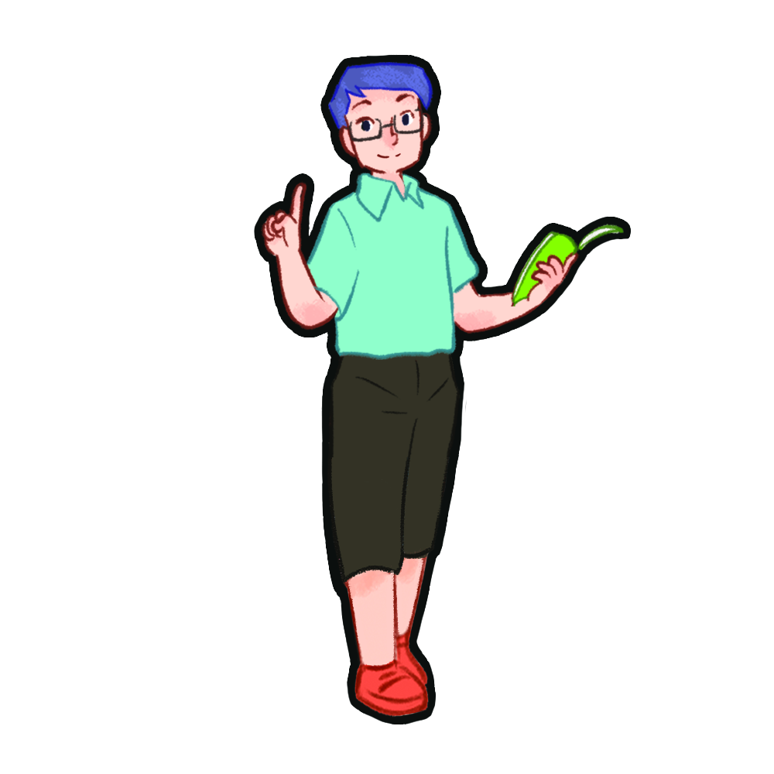
Look, listen and repeat.

Slide 8
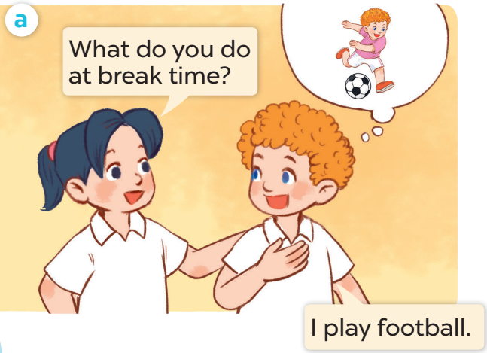
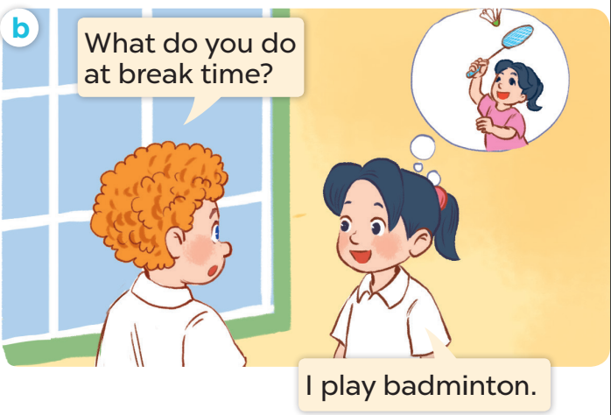

Slide 9
Listen, point and say.

Slide 10
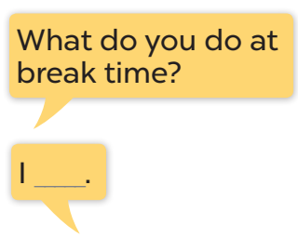
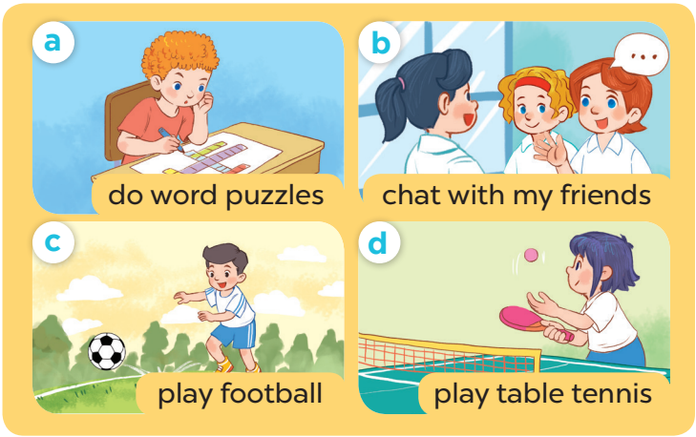

Slide 11
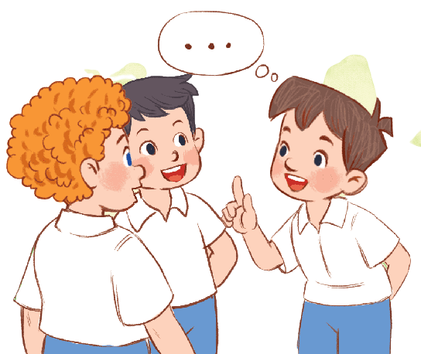
Let’s talk.

Slide 12
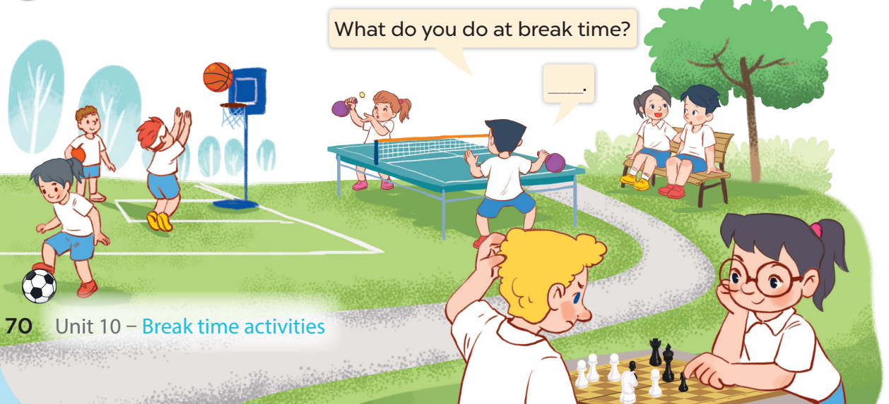

Slide 13
Fun corner and
Wrap-up

Slide 14
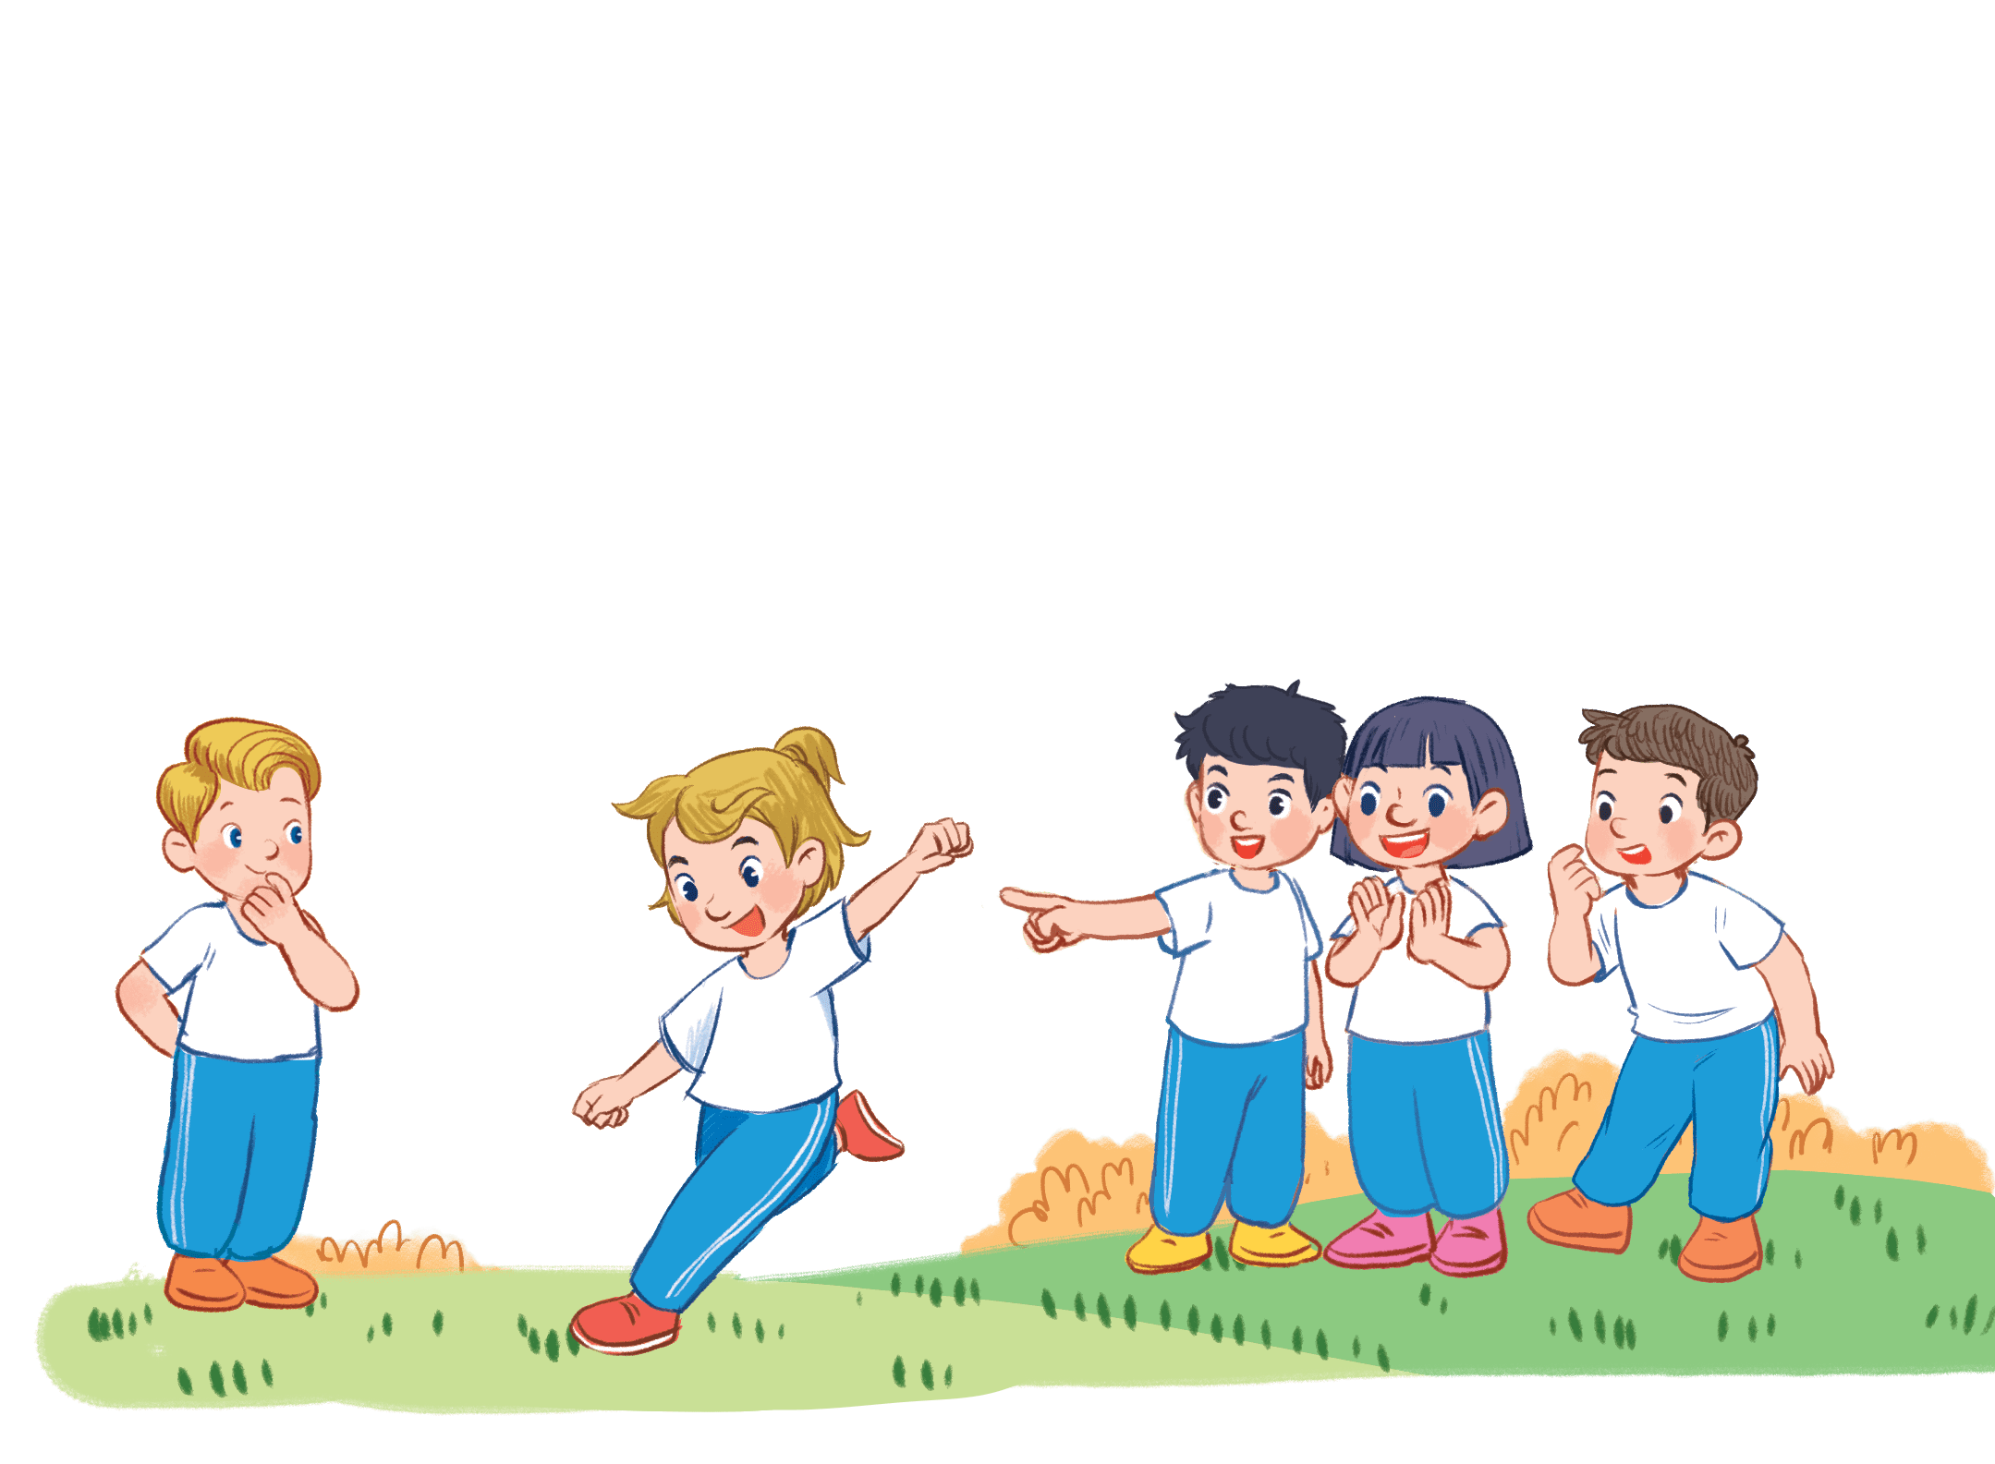
Option 1:
Act and Guess
Notes:
Game: Act and Guess
- Teacher shows pictures students have learnt in unit 10.
- T calls 1 pupil to come to the board and turn back to the board so that they can’t see the pictures.
- The others will act to describe the pictures the teacher points to.

Slide 15

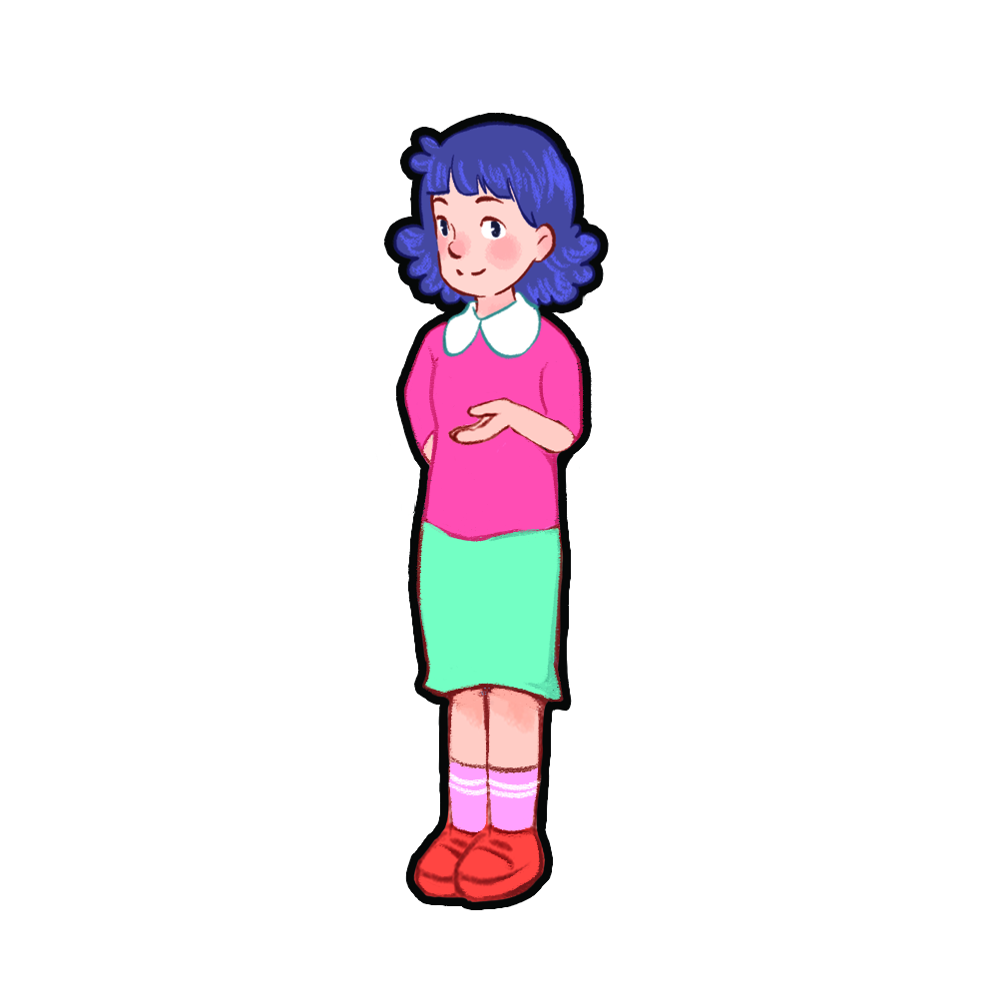
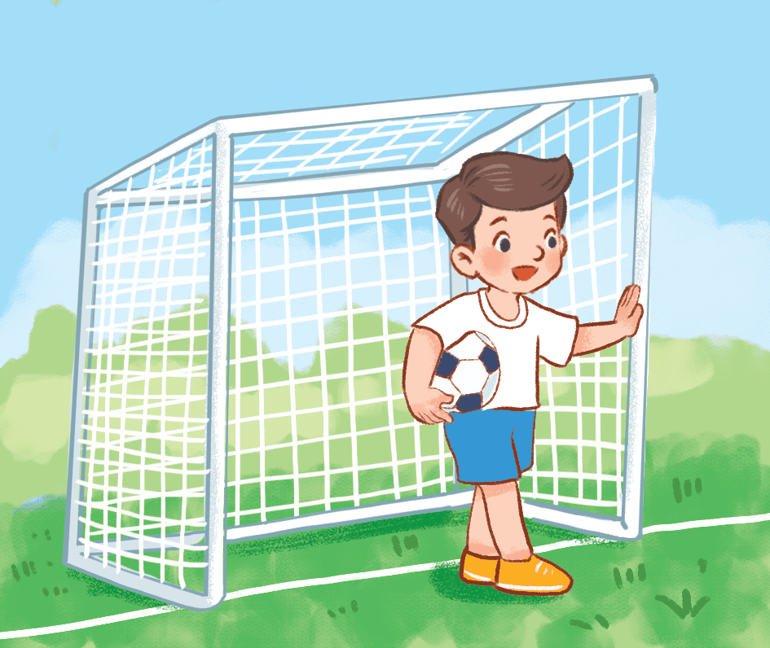
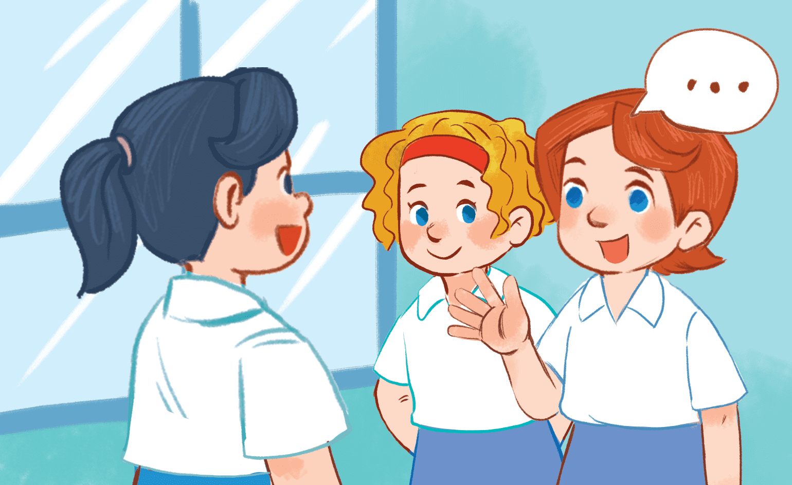
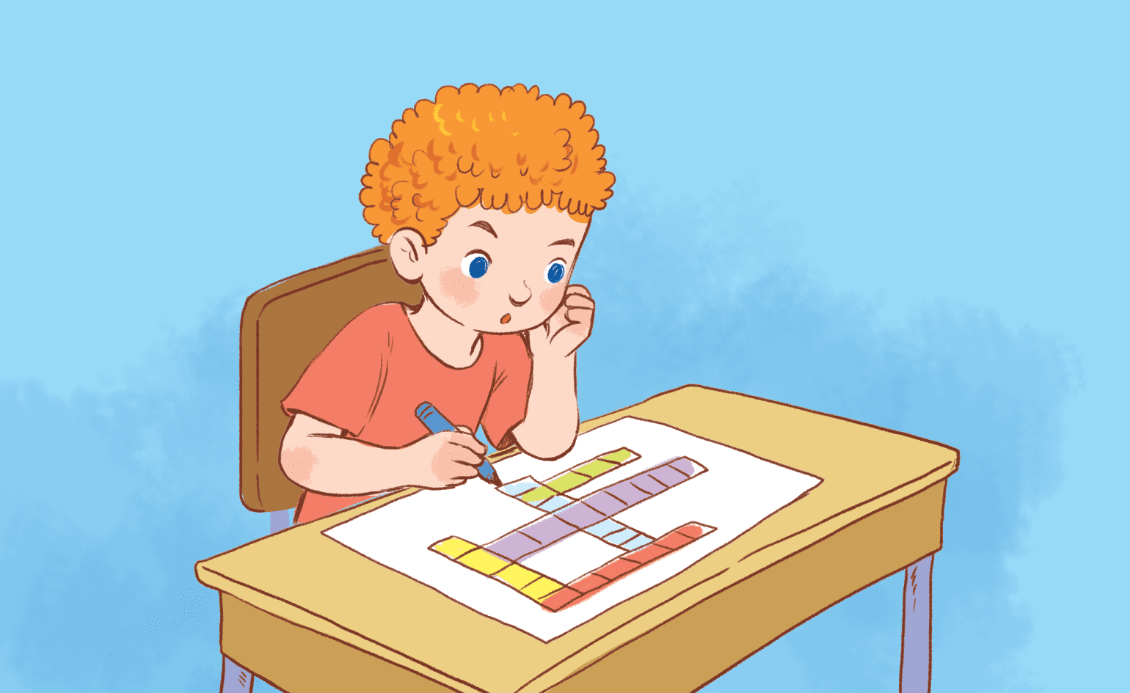
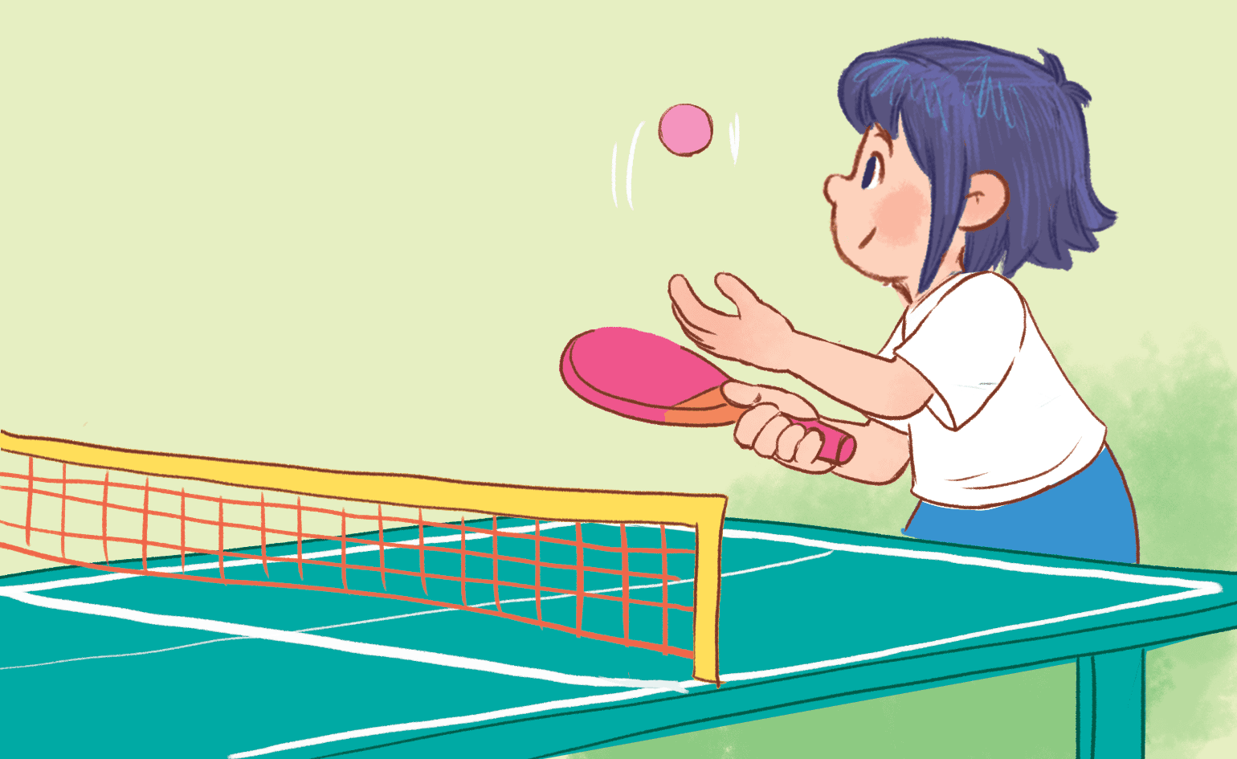
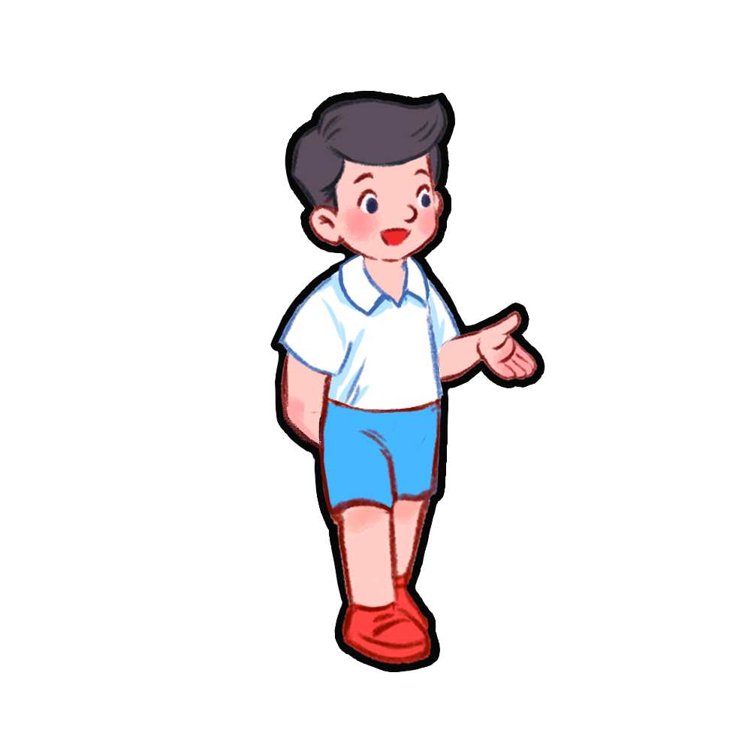
do word puzzles
Notes:
Game: Act and Guess
- Teacher shows pictures students have learnt in unit 10.
- T calls 1 pupil to come to the board and turn back to the board so that they can’t see the pictures.
- The others will act to describe the pictures the teacher points to.

Slide 16
chat with my friends
Notes:
Game: Act and Guess
- Teacher shows pictures students have learnt in unit 10.
- T calls 1 pupil to come to the board and turn back to the board so that they can’t see the pictures.
- The others will act to describe the pictures the teacher points to.

Slide 17
Option 2:
Talking chain
Notes:
- Talking chain: pupils stand in lines and face to face to practise asking and answering about break time activities.
- After 1-2 minutes, teacher rings the bell and the pupils will move to change the partners (move 1 step).

Slide 18
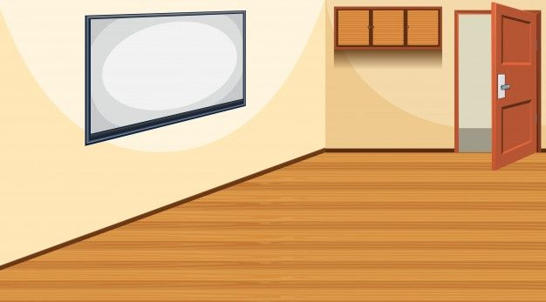
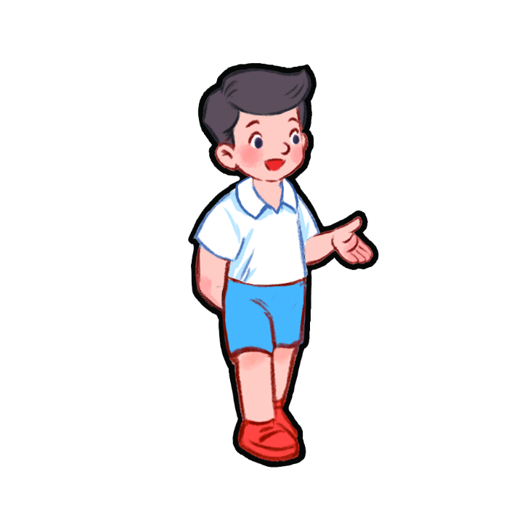
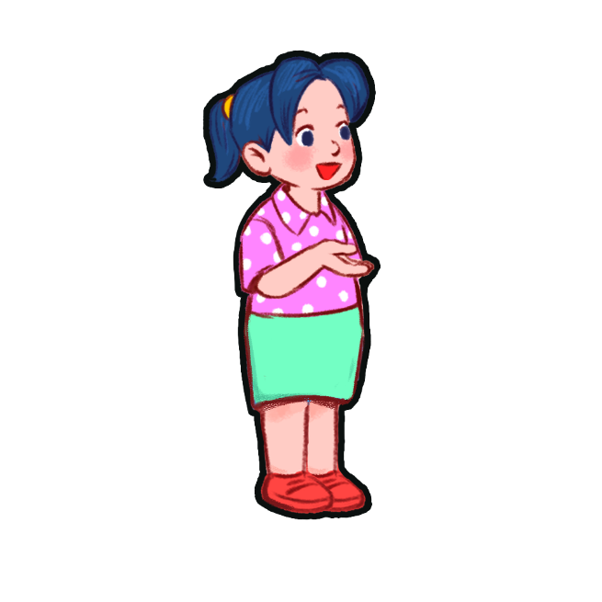
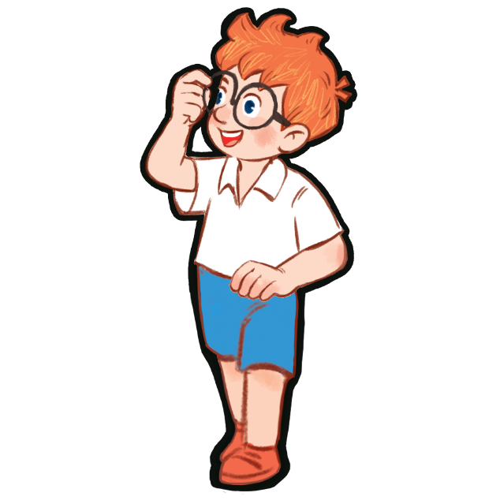


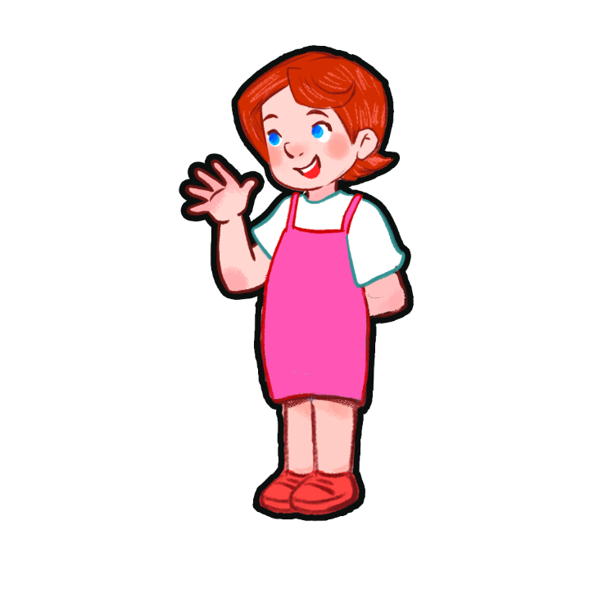
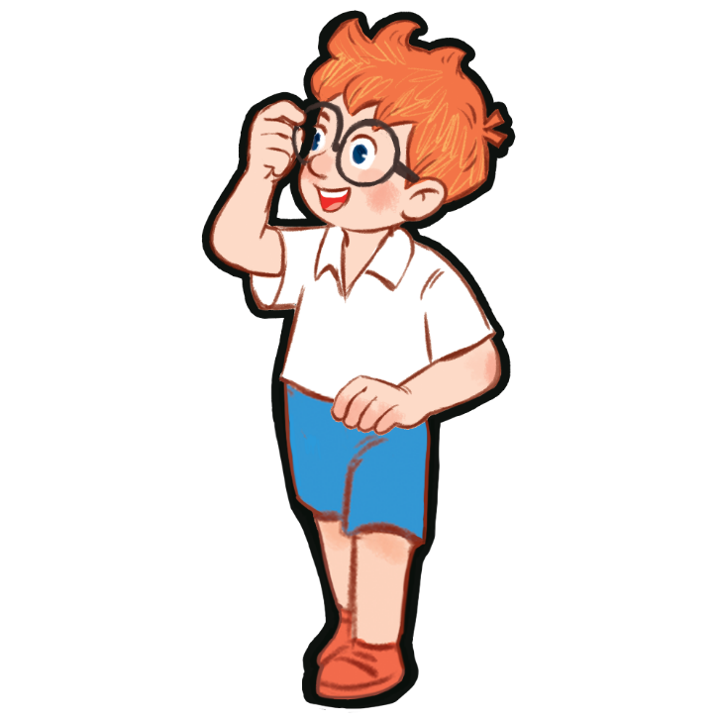
play football
chat with my friends
play word puzzles
play table tennis
Talking chain
Notes:
- Talking chain: pupils stand in lines and face to face to practise asking and answering about break time activities.
- After 1-2 minutes, teacher rings the bell and the pupils will move to change the partners (move 1 step).

Slide 19
play football
chat with my friends
play word puzzles
What do you do at break time ?
play table tennis
I play chess
at break time.
Notes:
- Talking chain: pupils stand in lines and face to face to practise asking and answering about break time activities.
- After 1-2 minutes, teacher rings the bell and the pupils will move to change the partners (move 1 step).

Slide 20



play football
chat with my friends
do word puzzles
play table tennis
Notes:
- Talking chain: pupils stand in lines and face to face to practice asking and answering about break time activities.
- After 1-2 minutes, teacher rings the bell and the pupil will move to change the partners (move 1 step).

Slide 21
Option 3: Practice
Notes:
Teacher shows pictures of activities and question the board and asks pupils to ask and answer, using the sentence patterns.

Slide 22

play
football
chat
with
my friends
do
word
puzzles
play
table tennis
What do you do at break time?
I ………. at break time.
Notes:
Teacher shows pictures of activities and question the board and asks pupils to ask and answer, using the sentence patterns.

