Slide 1
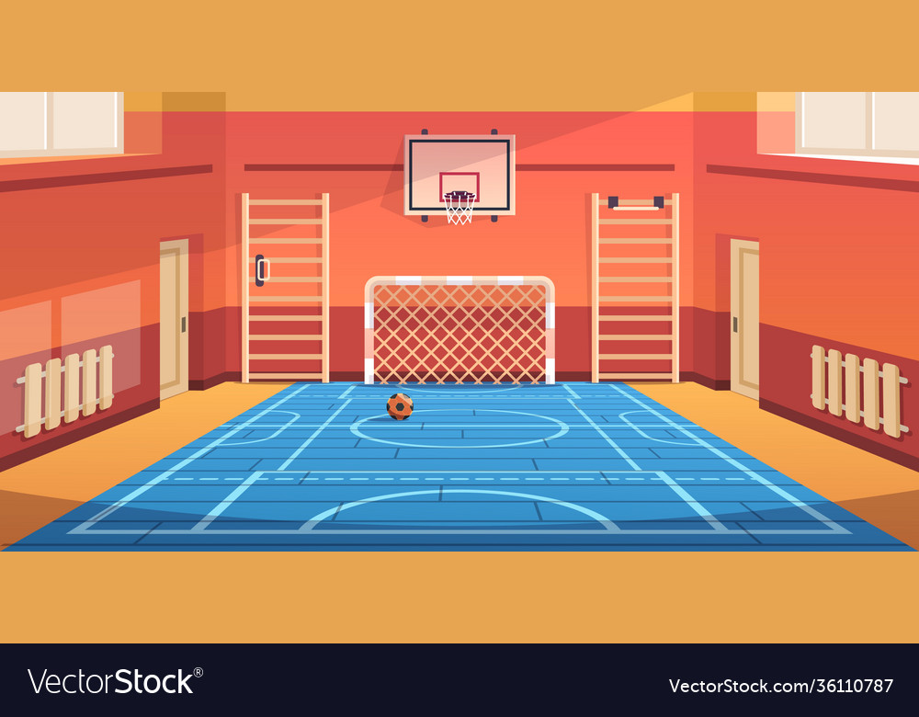




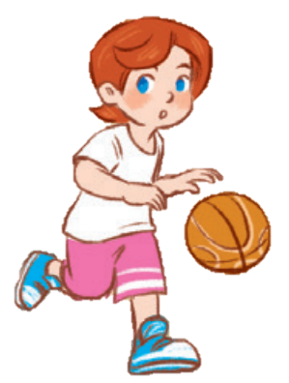
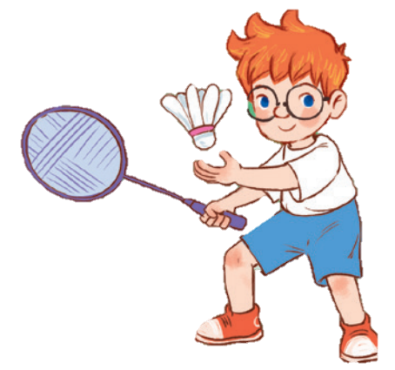
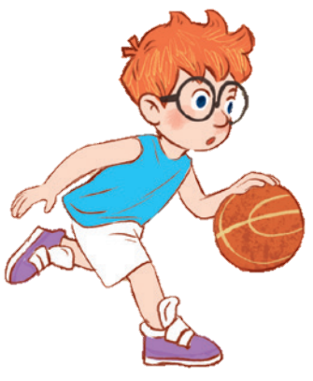
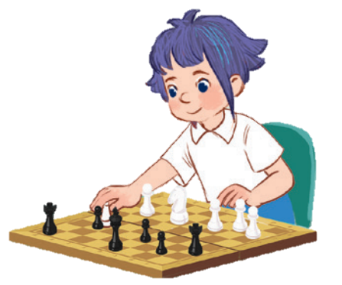
10
Period 4

Slide 2
Contents
1
5
Fun corner and wrap-up
Warm-up and review
4
2
3
Let’s play.
Listen and number.
Read and match.

Slide 3
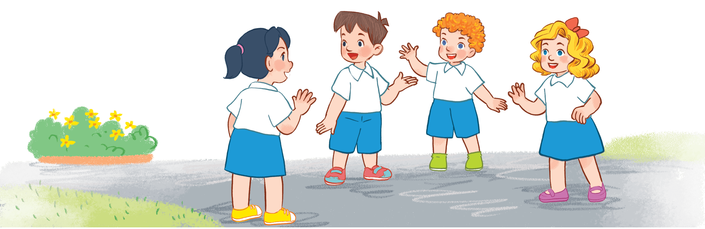
Warm-up AND REVIEW
Notes:
Game: Who’s faster?
- Teacher calls 2 pupils to come to the board.
- Pupils on the board have a quick look at the break time activities on the board.
- When the teacher says the sentences, who get the pictures of those sentences first will get the points.

Slide 4

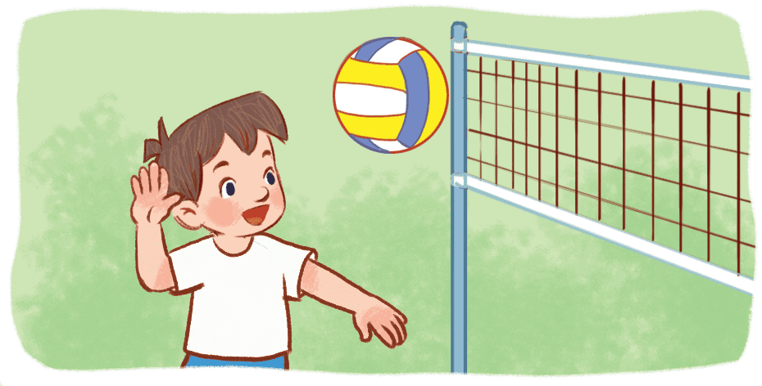
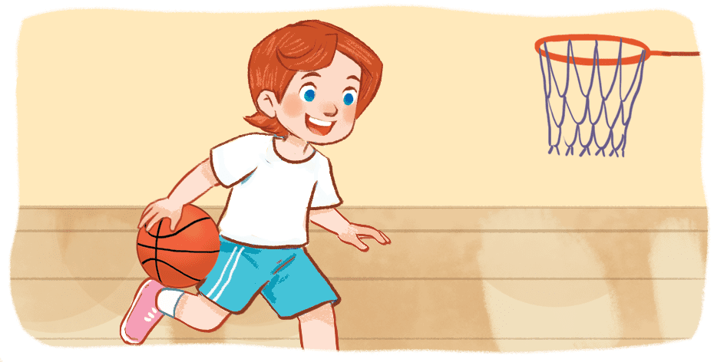
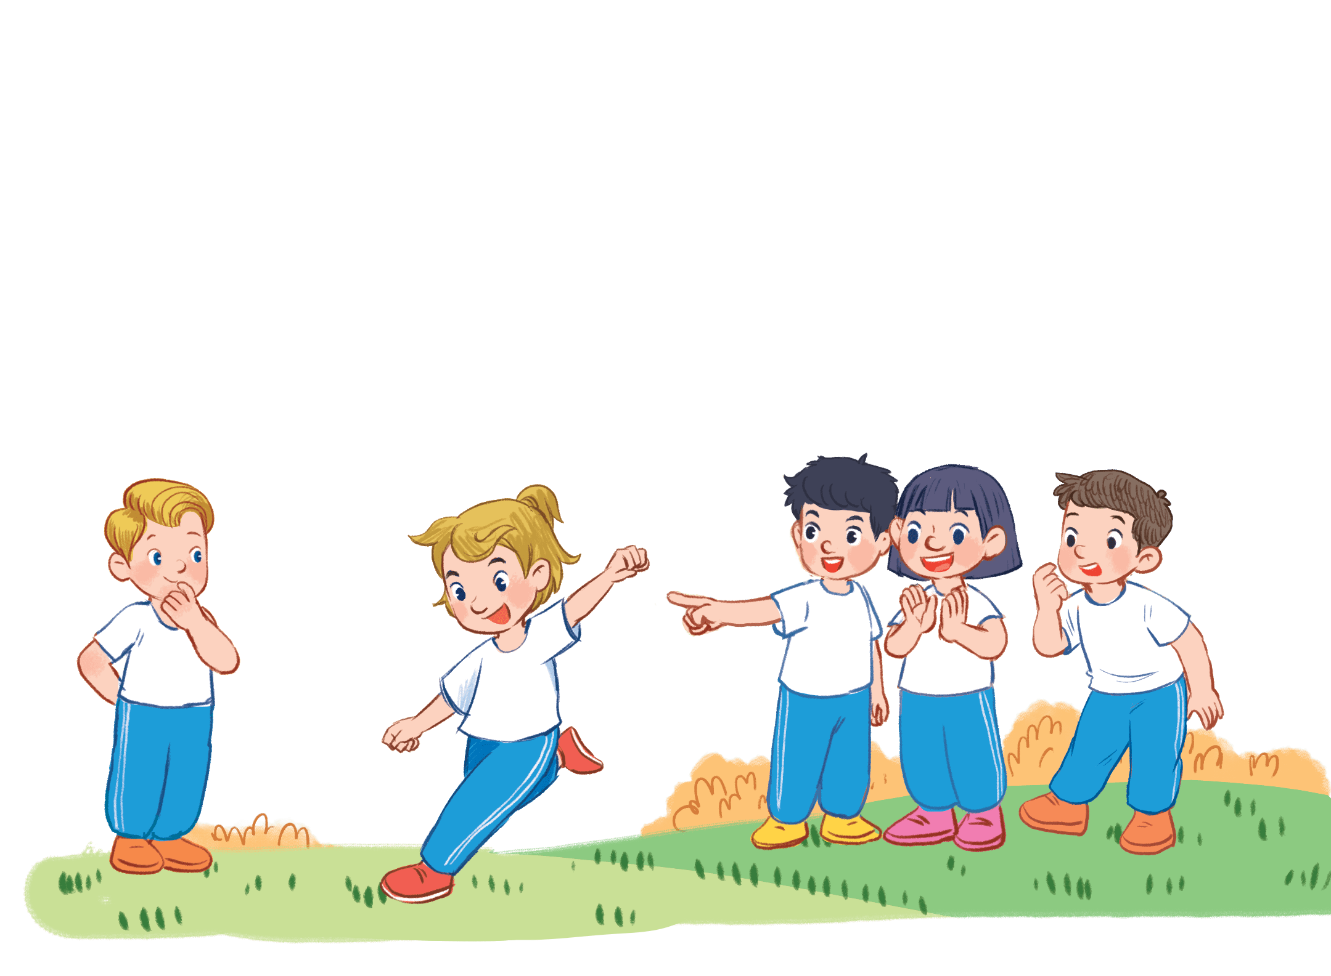

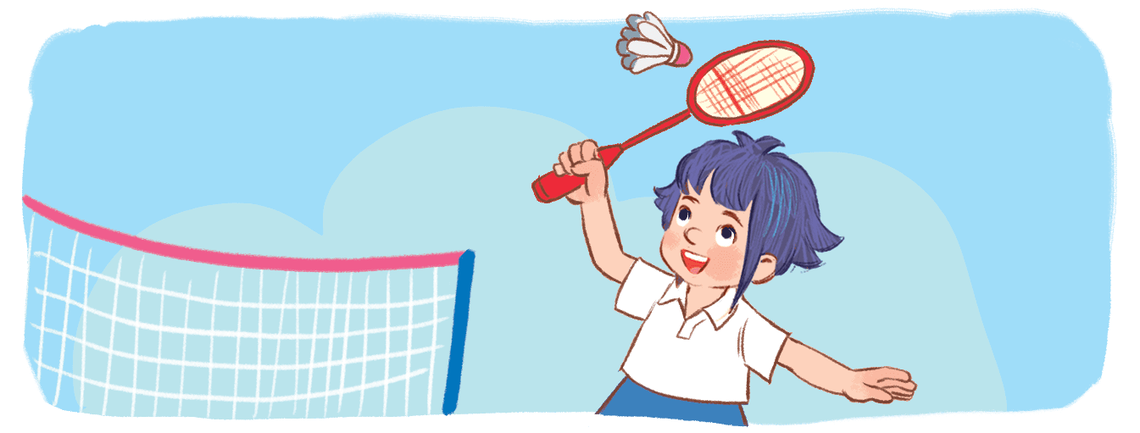
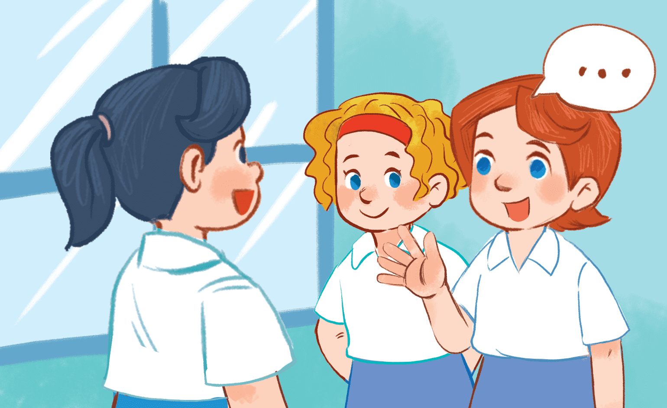
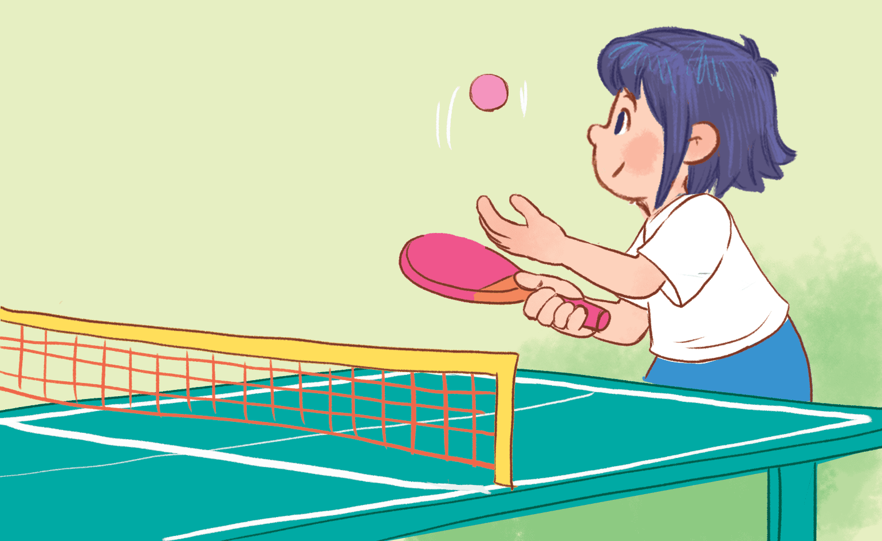
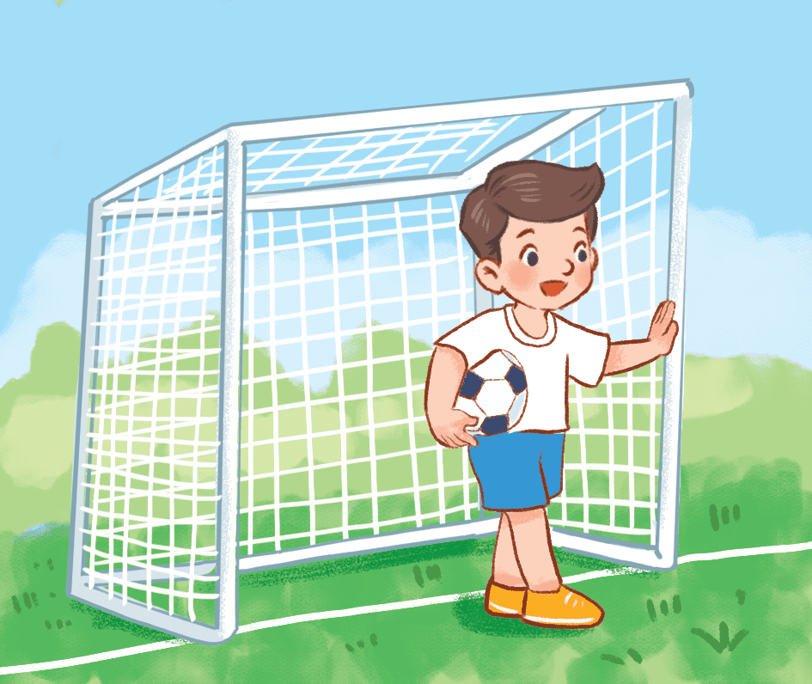
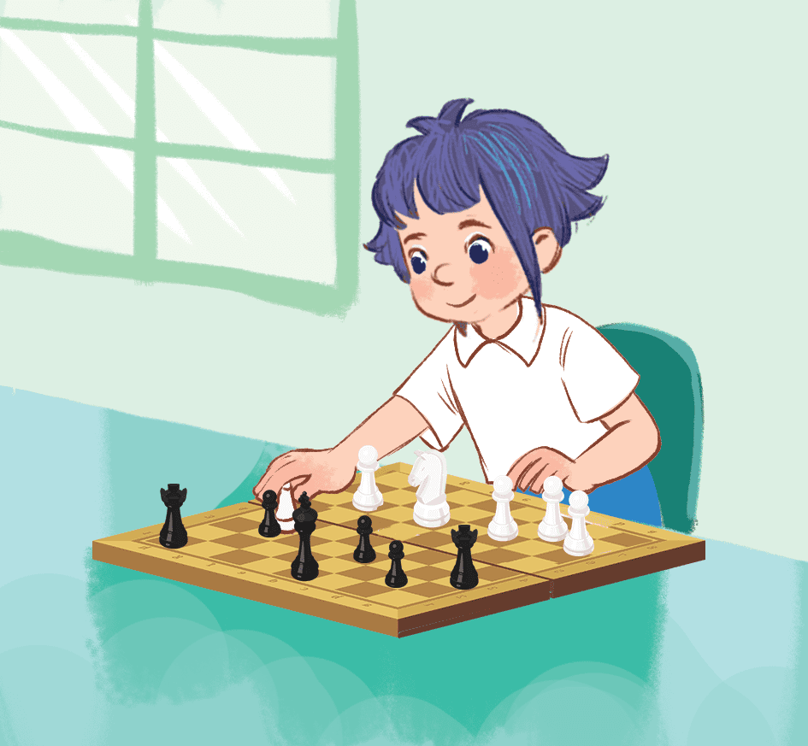
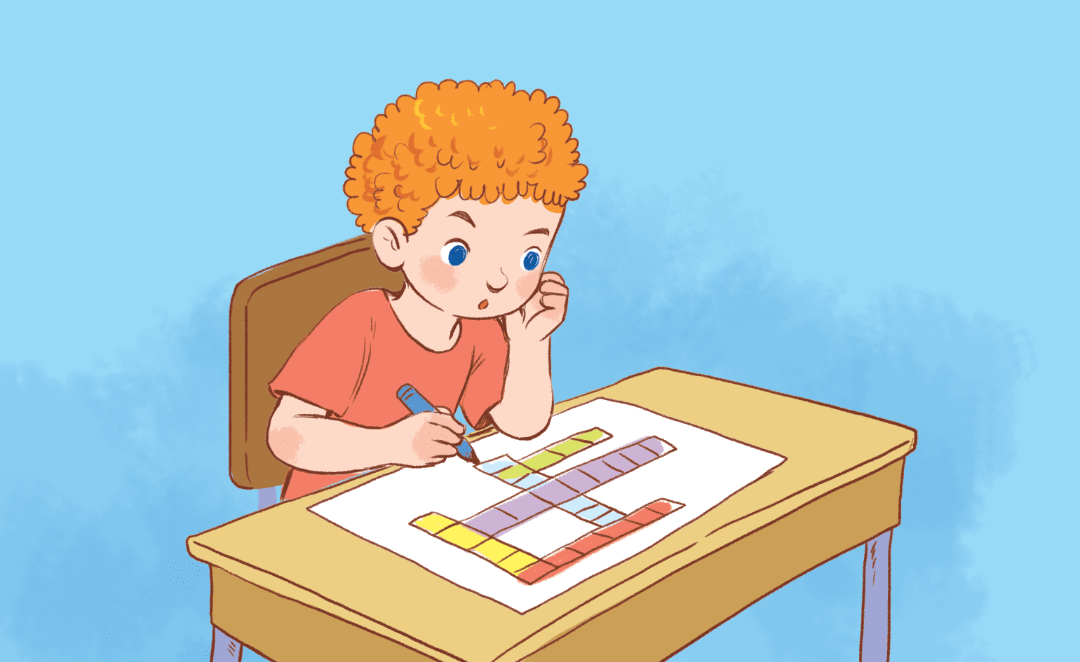
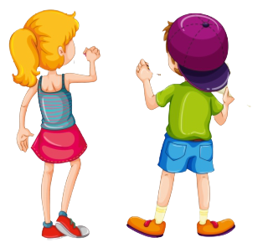
Game time
I play football.
Notes:
Game: Who’s faster?
- Teacher calls 2 pupils to come to the board.
- Pupils on the board have a quick look at the break time activities on the board.
- When the teacher says the sentences, who get the pictures of those sentences first will get the points.

Slide 5
Game time
Good job!
Notes:
Game: Who’s faster?
- Teacher calls 2 pupils to come to the board.
- Pupils on the board have a quick look at the break time activities on the board.
- When the teacher says the sentences, who get the pictures of those sentences first will get the points.

Slide 6
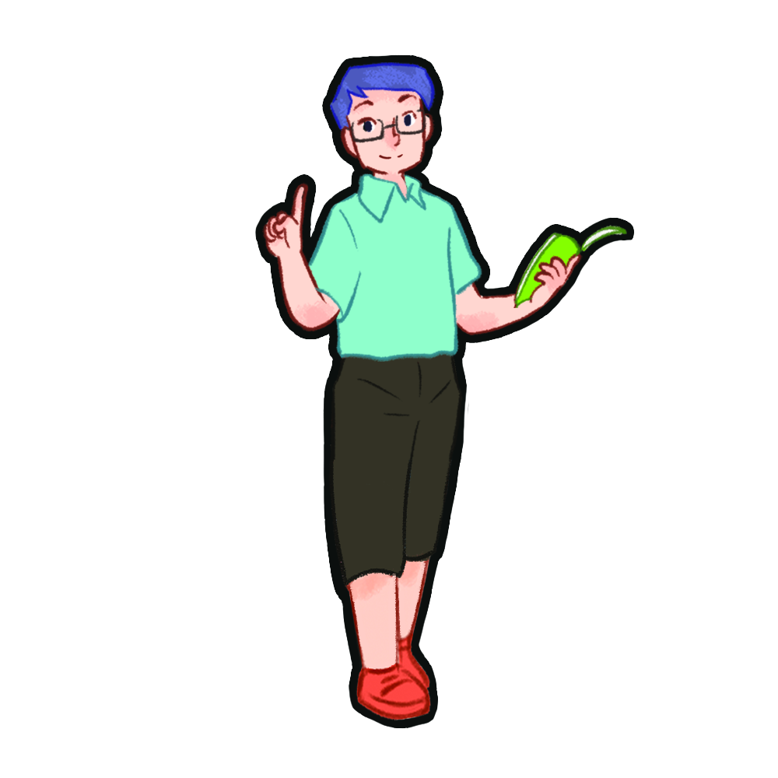
LISTEN AND NUMBER.

Slide 7

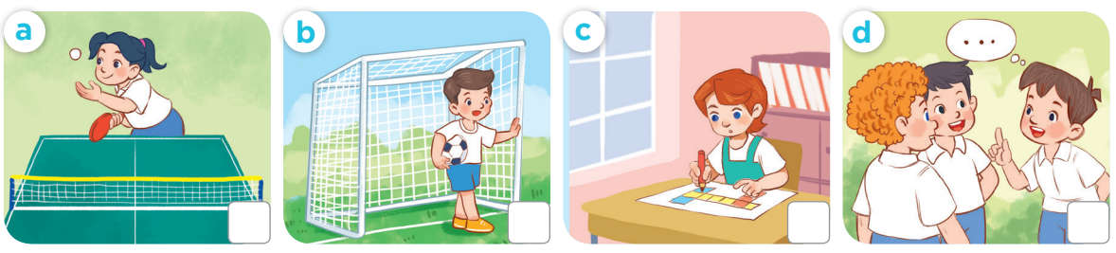
2
1
4
3

Slide 8
READ AND MATCH.

Slide 9
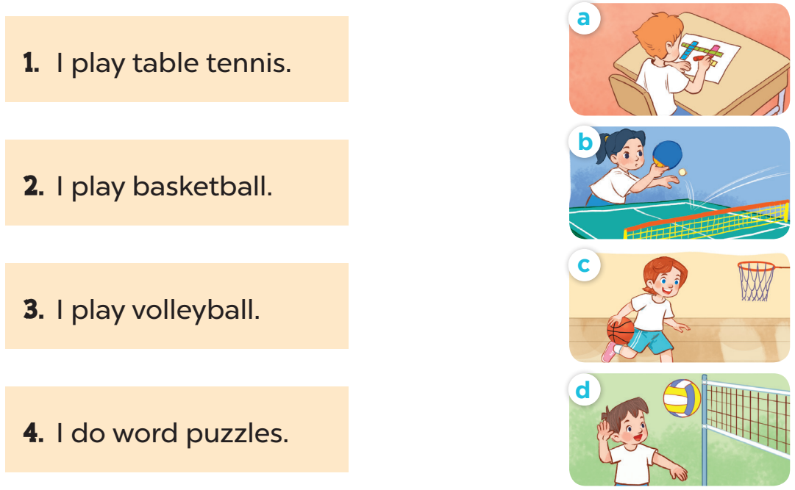

Slide 10
Game time
Notes:
Lucky numbers
- Teacher divides the class into 2 teams (Boys and Girls).
- 1 pupil in each team comes to the board, has a look at the pictures of break time activities and their corresponding phrases.
- When the teacher points to the picture, the first one to write the correct phrases matching with the pictures will choose the lucky numbers to open the boxes and get the hidden points.

Slide 11
Game time
chat with my friends
play volleyball
play football
play chess
play table tennis
do word puzzles
play badminton
play basketball

Slide 12
Game time
chat with my friends
play volleyball
play football
play chess
play table tennis
do word puzzles
play badminton
play basketball
play chess
play chess

Slide 13





1
2
3
4
5
6
7
8
9
10
11
12
13
14
15
16
17
18
19
20
Notes:
Look, Write and Choose lucky numbers.
- Teacher divides the class into 2 Teams (Boys and Girls)
- 1 pupil in each team comes to the board, have a look at the pictures(8) of break time activities and their words.
- When the teacher points to the picture, the first one to write the correct phrases matching with the pictures will choose the lucky numbers to open the boxes and get the hidden points.

Slide 14
Let’s PLAY.

Slide 15
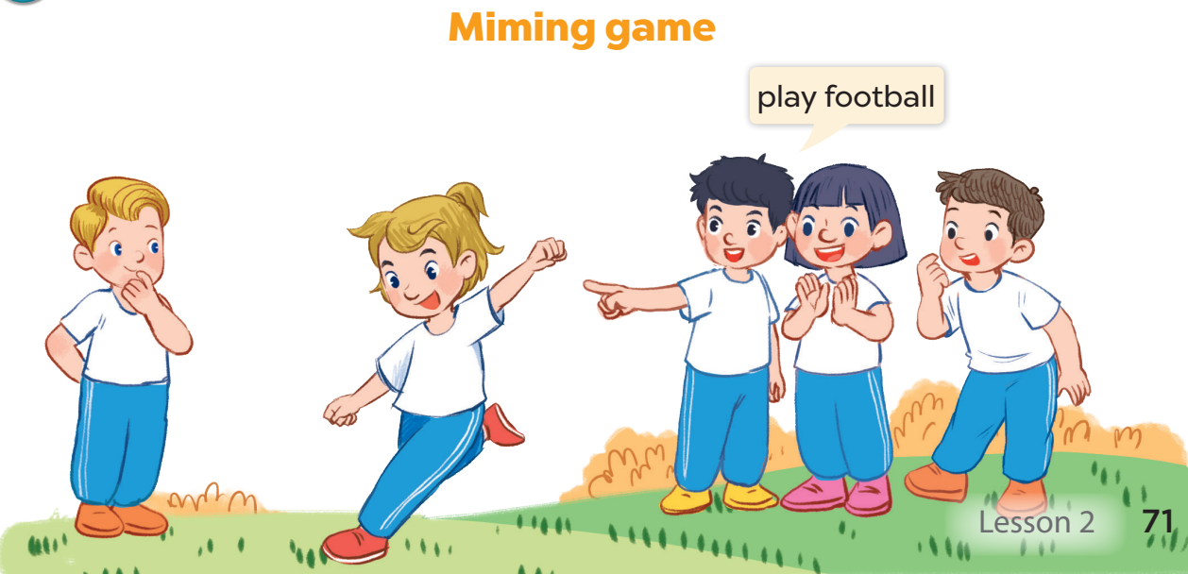

Slide 16
Fun corner and
Wrap-up
Notes:
Game: Who’s faster?
Teacher calls 4 pupils to come to the board.
Pupils on the board have a quick look at the break time activities on the board.
On the four chairs, there are phrases written on pieces of paper which match with the pictures.
When the teacher points to the pictures, 4 pupils try to run fast and look for the matching pieces of paper and sit on the chairs having those pieces.
There are 3 correct answers, so one pupil has to go back to his or her seat.
Repeat the game until the last picture.

Slide 17
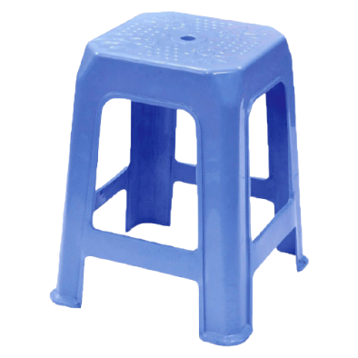
Game time
chat with my friends
play volleyball
play football
play chess
play table tennis
do word puzzles
play badminton
play basketball

Slide 18
Game time
chat with my friends
play volleyball
play football
play chess
play table tennis
do word puzzles
play badminton
play basketball
play football
play football
play chess
play football

Slide 19

play
football
chat
with
my friends
do
word
puzzless
play
table tennis
play volleyball
play badminton
play basketball
play
chess
Notes:
T shows pictures of break time activities on the board and asks pupils to make sentences using the model structure.

