Slide 1



13
My house
LESSON 2 – Part 1,2,3

Slide 2
TABLE OF CONTENTS
Warm-up and review
Look, listen and repeat.
1
2
3
4
Let’s talk.
Listen, point and say.
5
Fun corner and wrap-up

Slide 3
1
Warm-up and review

Slide 4
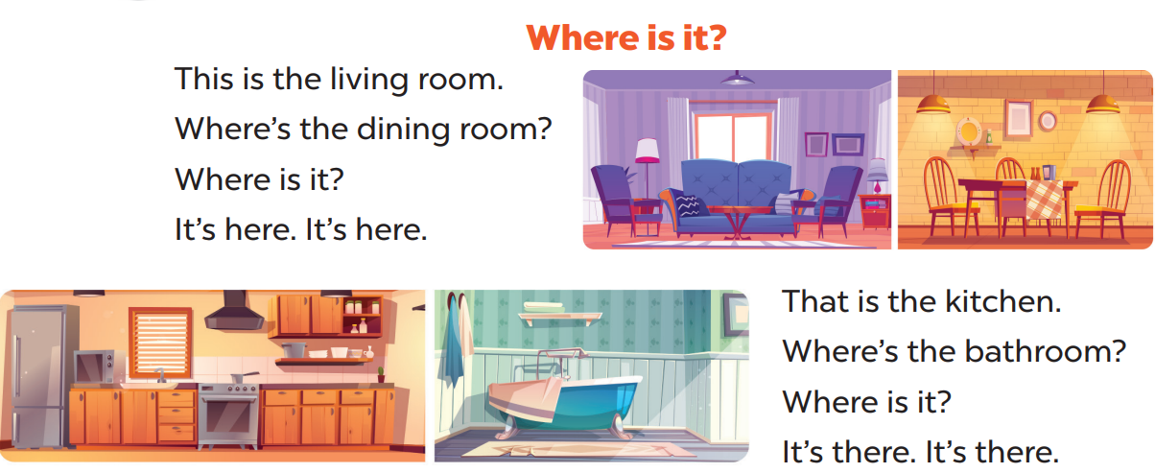

Sing a song
Option 1

Slide 5
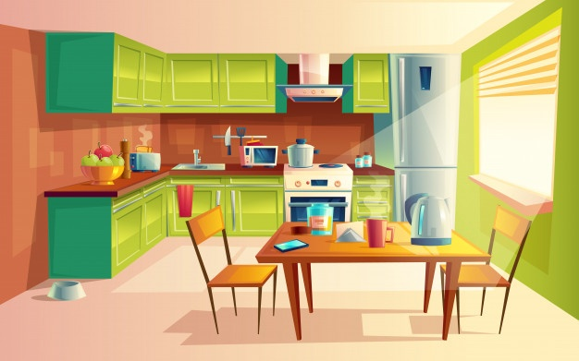
kitchen

Slide 6
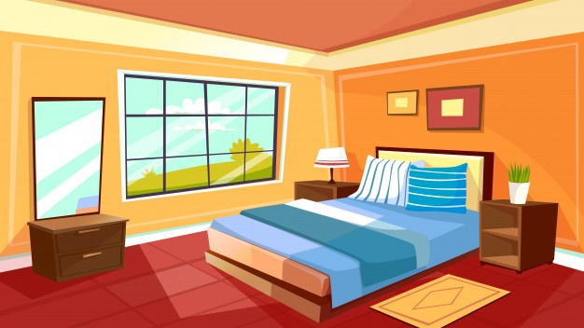
bedroom

Slide 7
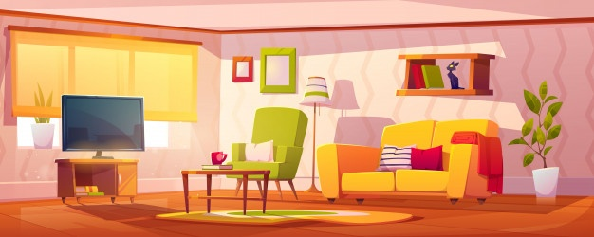
living room

Slide 8
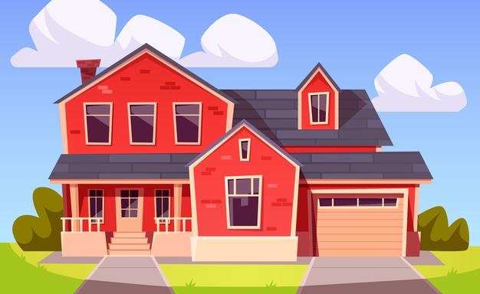
house

Slide 9
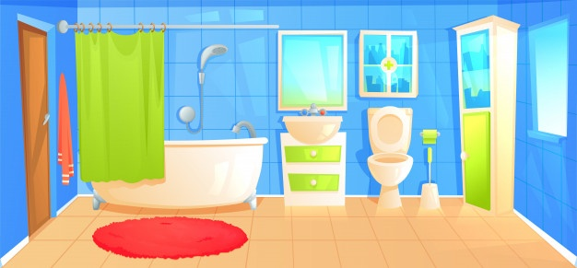
bathroom

Slide 10
2
Look, listen and repeat.

Slide 11
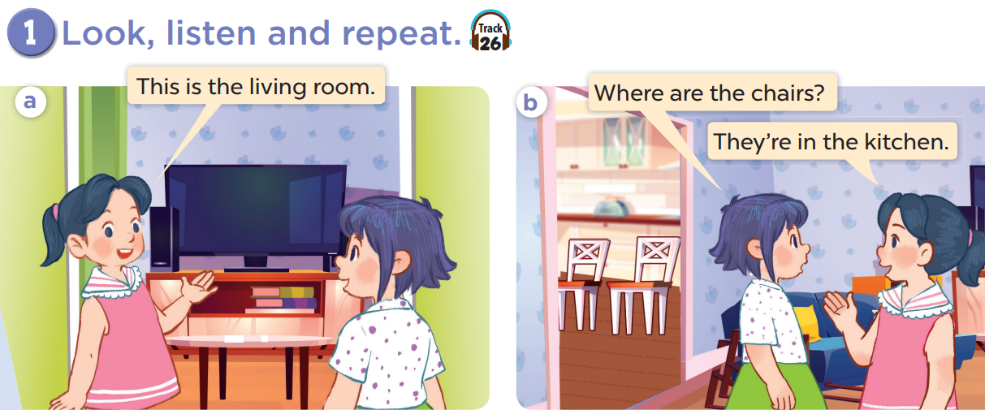

Slide 12
Work in pairs and act.

Slide 13
3
Listen, point and say.

Slide 14
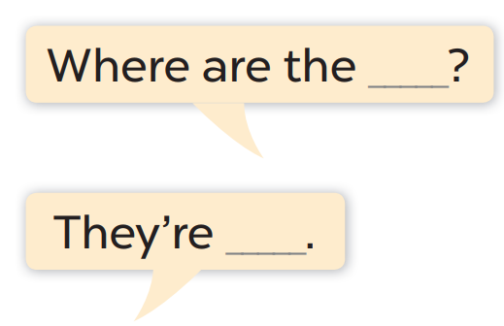
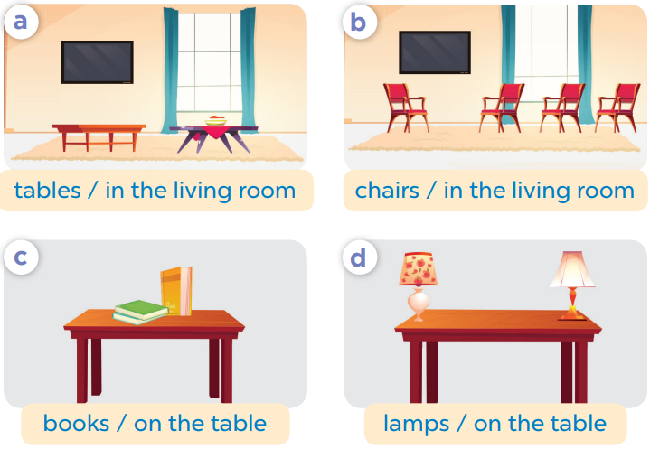
Work in pair, ask and answer.

Slide 15
4
Let’s talk.

Slide 16
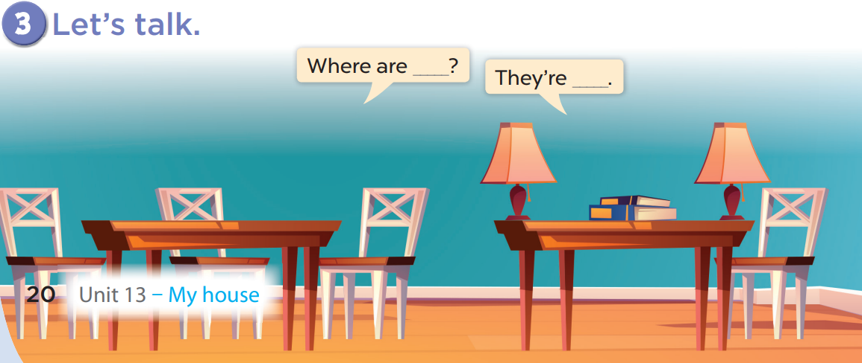
Work in pairs, ask and answer.

Slide 17
5
Fun corner and wrap-up

Slide 18



Lucky number
1
2
3
4
5
6
7
8
Notes:
Divide the class into 2 teams.
Each team takes turns choosing a number then answering the question.

Slide 19
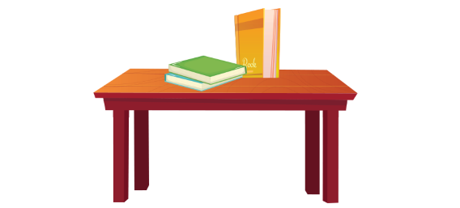





Where are the books?
They’re in the table.
They’re on the table.
Notes:
Click the home to go back.

Slide 20
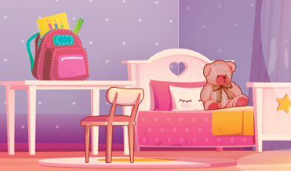

Where………………the teddy bear?
is
are
am
Notes:
Click the home to go back.

Slide 21
……….. is the bag?
What
How
Where
Notes:
Click the home to go back.

Slide 22
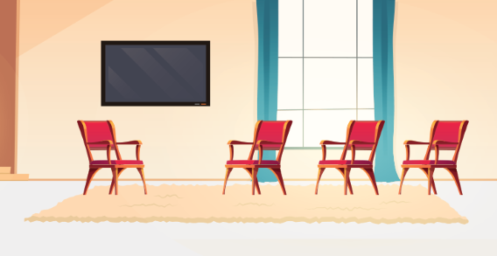
Where are the chairs?
They’re in the living room.
They’re on the living room.
Notes:
Click the home to go back.

Slide 23
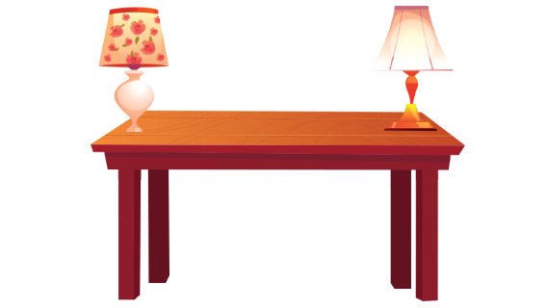
Where………………the lamps?
is
are
am
Notes:
Click the home to go back.

Slide 24
Where are the …………..?
lamp
lamps
a lamp
Notes:
Click the home to go back.

Slide 25
Where are the ……..?
chairs
tables
lamps
Notes:
Click the home to go back.

Slide 26

Where are the ……….?
books
table
book
Notes:
Click the home to go back.

