Slide 1




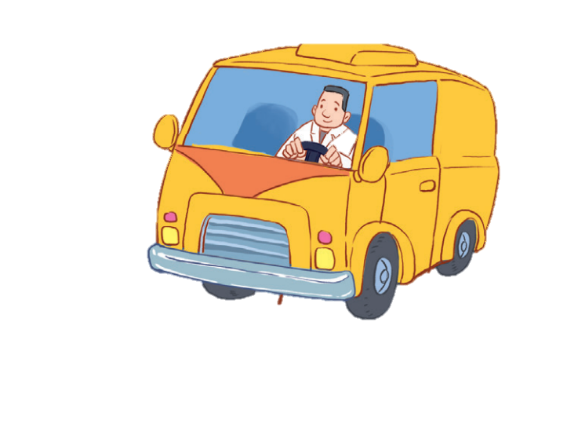


12
LESSON 2 – Part 1,2,3

Slide 2
Contents
Warm-up and review
Listen, point and say.
1
3
Look, listen and repeat.
2
4
Let’s talk.
5
Fun corner and wrap-up

Slide 3
1
Warm-up and review
Game: Simon says
Notes:
Teacher says “Simon says…” for the pupils to do the actions. When the teacher doesn’t start the sentence with “Simon says”, pupils do nothing.
Who can make it until the end is the winner.

Slide 4
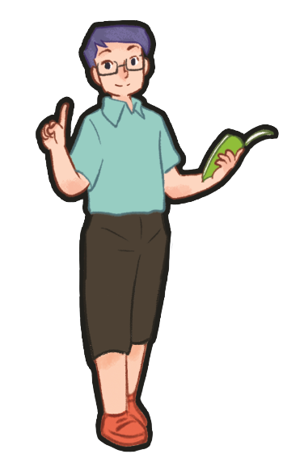
Simon says: Be a doctor.

Slide 5
Be a driver.

Slide 6
2
Look, listen and repeat.

Slide 7

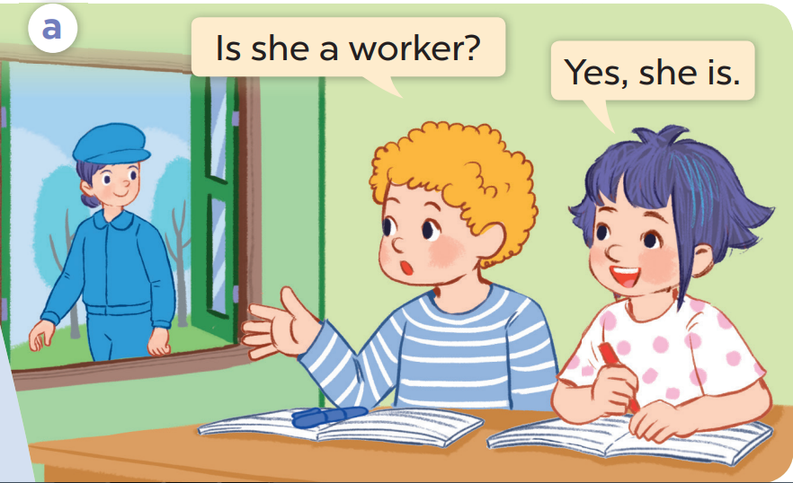
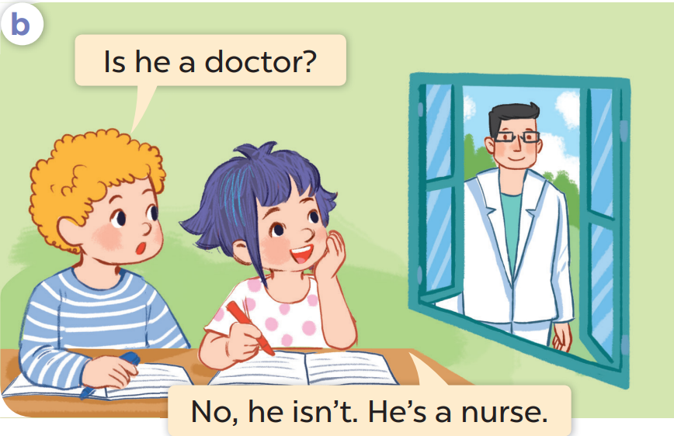

Slide 8
3
Listen, point and say.

Slide 9
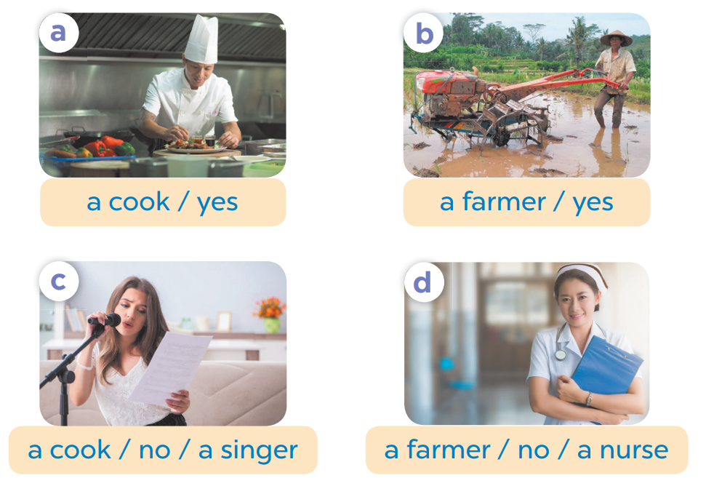
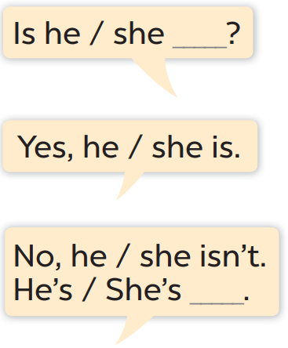

Slide 10

Yes, she is.
No, she isn’t.

Slide 11

Yes, she is.
No, she isn’t.

Slide 12

Yes, he is.
No, he isn’t.

Slide 13

Yes, she is.
No, she isn’t.

Slide 14

Yes, she is.
No, she isn’t.

Slide 15

Yes, he is.
No, he isn’t.

Slide 16

Yes, she is.
No, she isn’t.

Slide 17
4
Let’s talk.

Slide 18
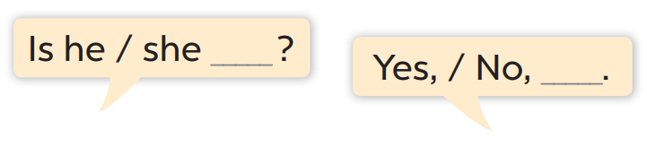



Slide 19



Slide 20

+10
Is he a driver?
No, he isn’t.

Slide 21

Is she a doctor?
+5
Yes, she is.

Slide 22

+10
Is he a farmer?
No, he isn’t.

Slide 23
+10
Is she a singer?
No, she isn’t.

Slide 24

Is she a cook?
+5
No, she isn’t.

Slide 25

Is he a singer?
+5
No, he isn’t.

