Slide 1




14
My bedroom
Lesson 2 – Part 1,2,3

Slide 2




①
Warm-up and review
②
Look, listen and repeat.
③
Listen, point and say.
④
Let’s talk.
⑤
Fun corner and wrap-up

Slide 3



Lesson 2
Period 3
①
Warm-up and review

Slide 4
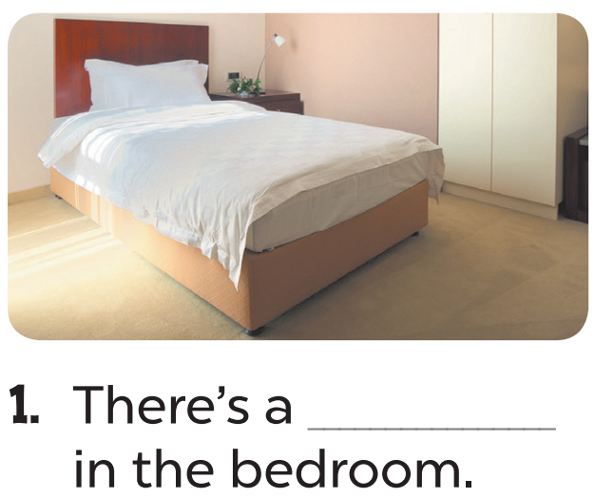
Hết giờ
timing
timing
0
:
0
0
00
59
58
57
56
55
54
53
52
51
50
49
48
47
46
45
44
43
42
41
40
39
38
37
36
35
34
33
32
31
30
29
28
27
26
25
24
23
22
21
20
19
18
17
16
15
14
13
12
11
10
09
08
07
06
05
04
03
02
01
00
+2
A. desk
B. bed

Slide 5
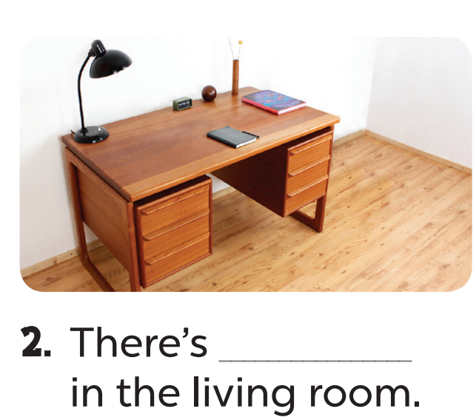
Hết giờ
timing
timing
0
:
0
0
00
59
58
57
56
55
54
53
52
51
50
49
48
47
46
45
44
43
42
41
40
39
38
37
36
35
34
33
32
31
30
29
28
27
26
25
24
23
22
21
20
19
18
17
16
15
14
13
12
11
10
09
08
07
06
05
04
03
02
01
00
+3
A. a desk
B. a bed

Slide 6
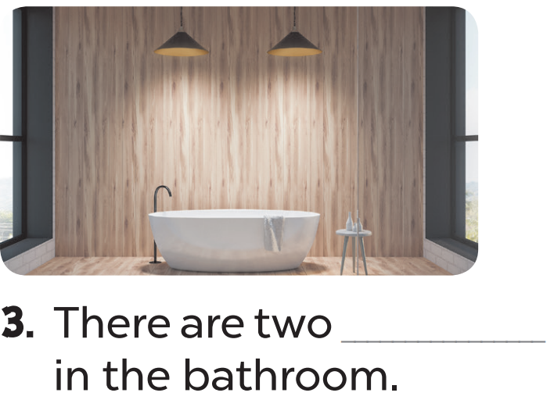
timing
Hết giờ
timing
0
:
0
0
00
59
58
57
56
55
54
53
52
51
50
49
48
47
46
45
44
43
42
41
40
39
38
37
36
35
34
33
32
31
30
29
28
27
26
25
24
23
22
21
20
19
18
17
16
15
14
13
12
11
10
09
08
07
06
05
04
03
02
01
00
+3
A. beds
B. lamps

Slide 7
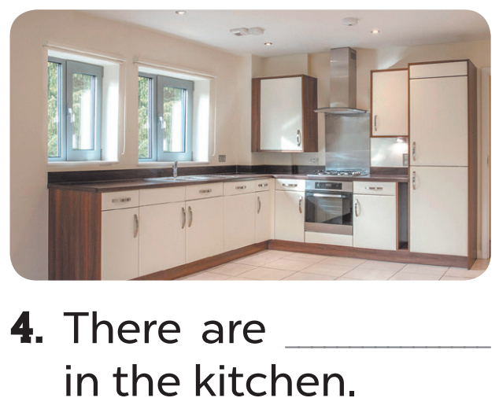
timing
Hết giờ
timing
0
:
0
0
00
59
58
57
56
55
54
53
52
51
50
49
48
47
46
45
44
43
42
41
40
39
38
37
36
35
34
33
32
31
30
29
28
27
26
25
24
23
22
21
20
19
18
17
16
15
14
13
12
11
10
09
08
07
06
05
04
03
02
01
00
+1
A. beds
B. two windows

Slide 8

Hết giờ
timing
timing
0
:
0
0
00
59
58
57
56
55
54
53
52
51
50
49
48
47
46
45
44
43
42
41
40
39
38
37
36
35
34
33
32
31
30
29
28
27
26
25
24
23
22
21
20
19
18
17
16
15
14
13
12
11
10
09
08
07
06
05
04
03
02
01
00
+1
A. two lamps
B. two doors

Slide 9
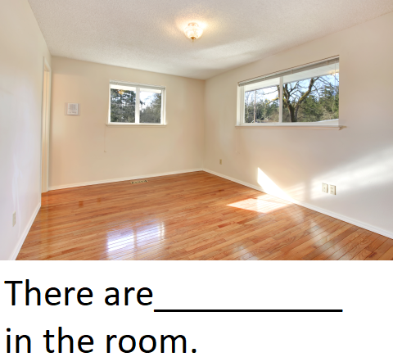
Hết giờ
timing
timing
0
:
0
0
00
59
58
57
56
55
54
53
52
51
50
49
48
47
46
45
44
43
42
41
40
39
38
37
36
35
34
33
32
31
30
29
28
27
26
25
24
23
22
21
20
19
18
17
16
15
14
13
12
11
10
09
08
07
06
05
04
03
02
01
00
+3
A. two doors
B. two windows

Slide 10
Lesson 2
Period 3
②
Look, listen and repeat.

Slide 11

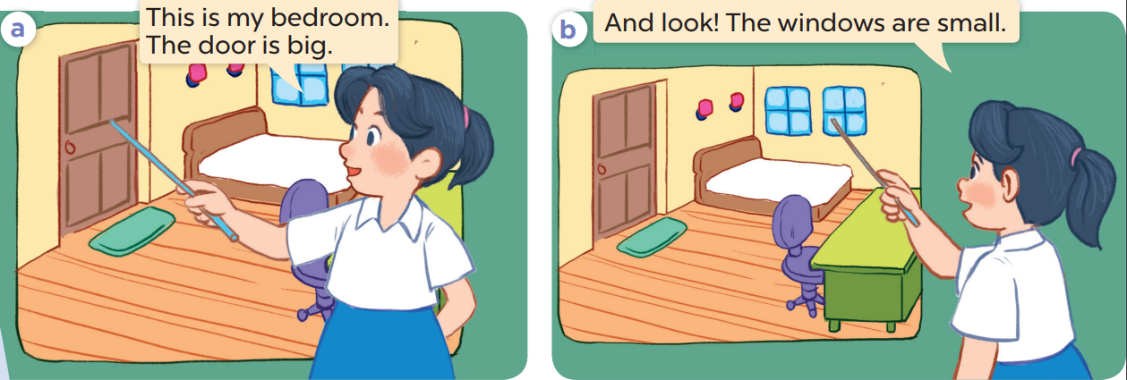

Slide 12
Lesson 2
Period 3
③
Listen, point and say.

Slide 13

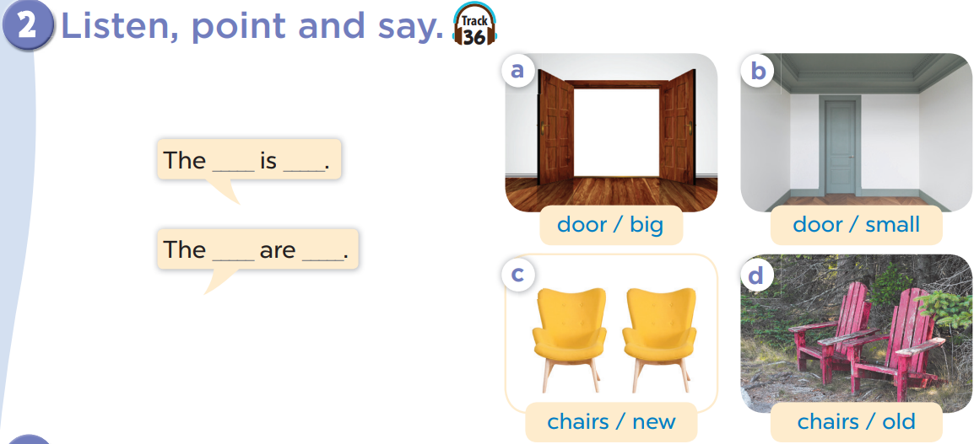

Slide 14




LUCKY WHEEL
3
2
1
2
3
4
10
SPIN
5
8
4
5
6
6
7
7
8
9
Next activity
Notes:
Game: LUCKY WHEEL
- Students choose a number.
- T then asks pupils to make sentences with the words, phrases and pictures given.
- Spin the wheel to get points.

Slide 15


door small.
The………… is………

Slide 16

door big .
The………… is………

Slide 17


chairs new .
The…………… are………

Slide 18

chairs old .
The…………… are………

Slide 19

The door is big.
…………

Slide 20
The door is small.
…………

Slide 21

The chairs are old.
…………

Slide 22
The chairs are new.
…………

Slide 23
Lesson 2
Period 3
④
Let’s talk.

Slide 24
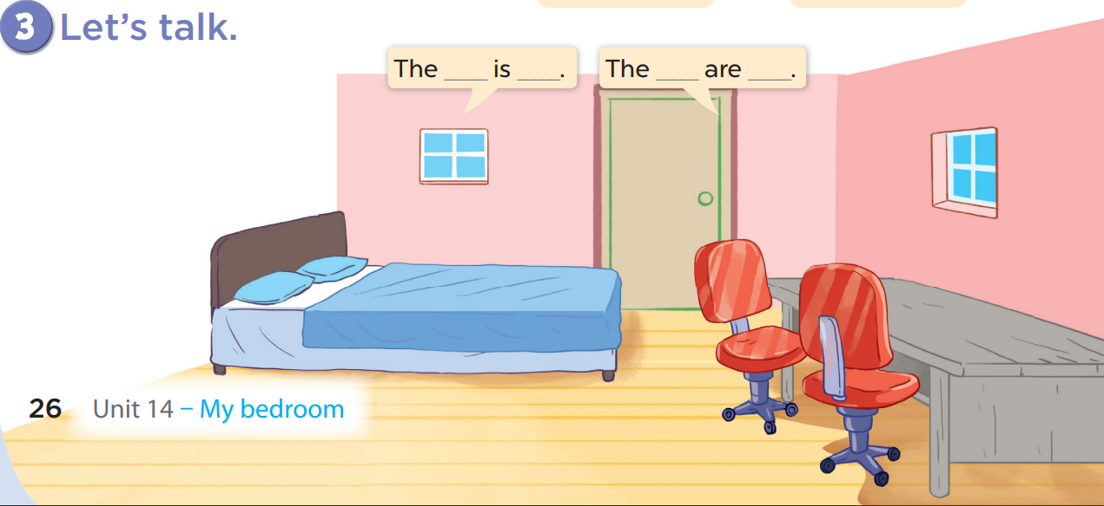

Slide 25
The bed is big.

Slide 26
The desk is old.

Slide 27
The chairs are old.

Slide 28
The windows are small.

