Slide 1



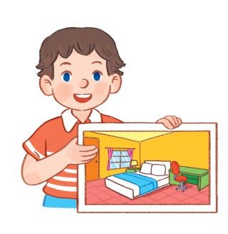

14
My bedroom
LESSON 3 – Part 1,2,3

Slide 2








1. Warm-up and review

Slide 3
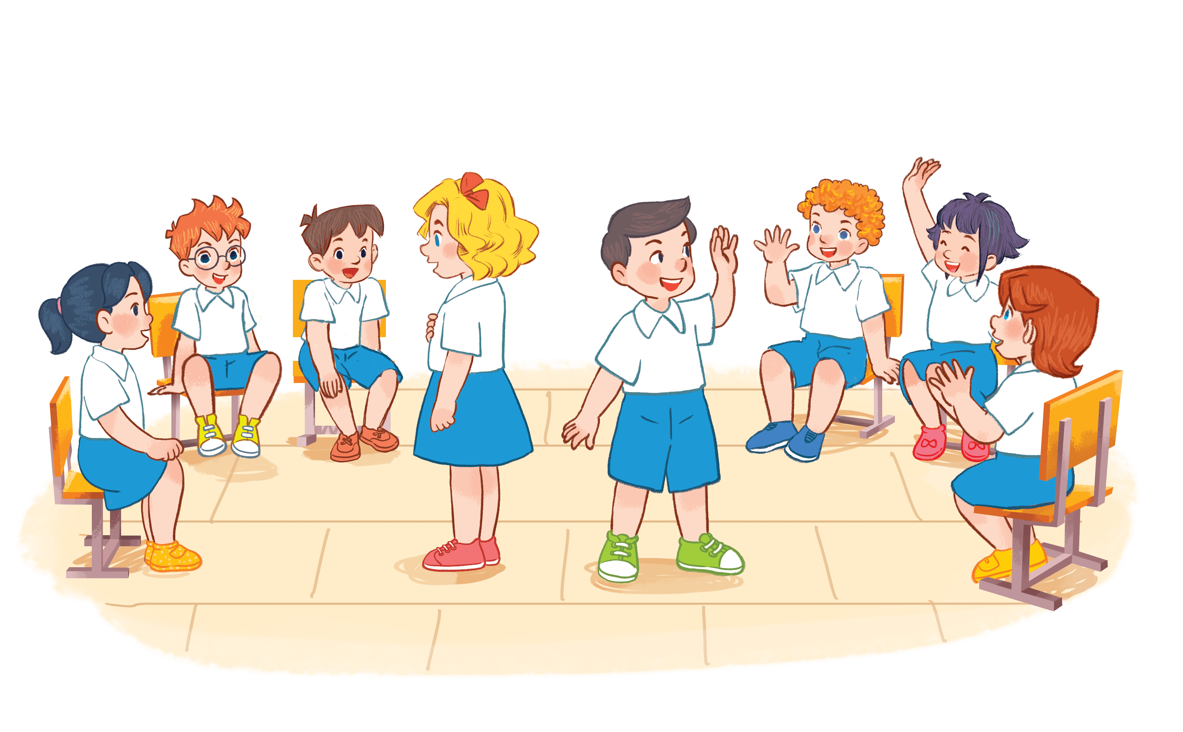
Lucky numbers
Lucky numbers
Notes:
Game: Lucky number.
- Divide the class into 2-4 groups.
Pupils choose numbers from 1 to 6. Look at the pictures then read the sentences to choose the correct answers.
If they answer correctly, their groups will get points.

Slide 4

3
4
2
6
5
1
Next

Slide 5


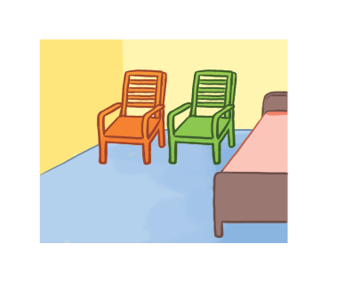
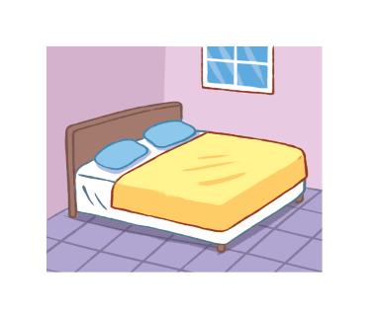
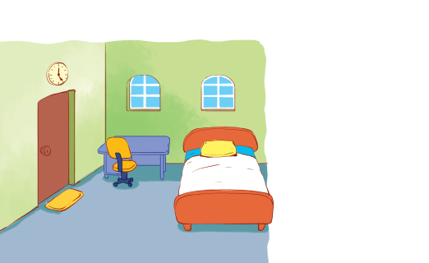
There are two chairs in my bedroom. They’re new.
+ 5
A
B
C
Notes:
There are two chairs in my bedroom. They’re new.
Key: A

Slide 6

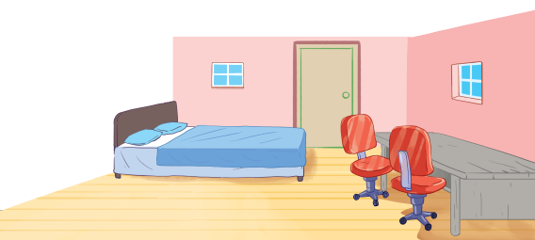
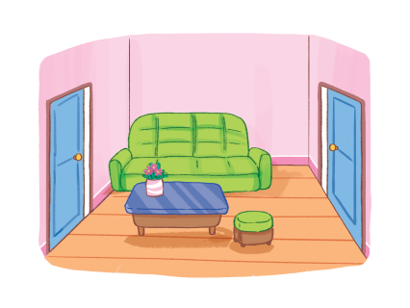
There is a window in the living room. It’s big.
+ 4
A
B
C
Notes:
There is a window in the living room. It’s big.
Key: B

Slide 7
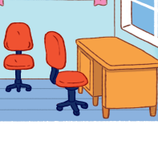
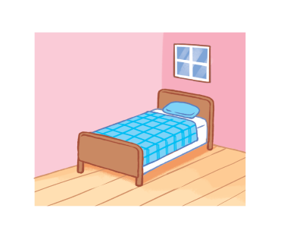
There is a bed in my bedroom. It’s old.
+ 2
A
B
C
Notes:
There is a bed in my bedroom. It’s old.
Key: B

Slide 8

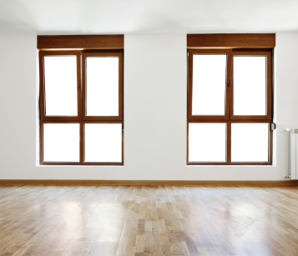
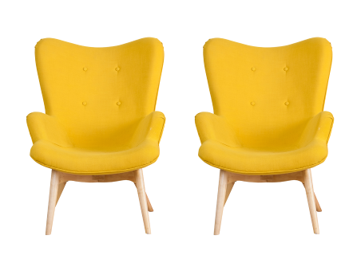
There are two chairs. They’re big.
+ 3
A
B
C
Notes:
There are two chairs. They’re big.
Key: C

Slide 9
There are two doors in the living room. They’re small.
+ 5
A
B
C
Notes:
There are two doors in the living room. They’re small.
Key: A

Slide 10
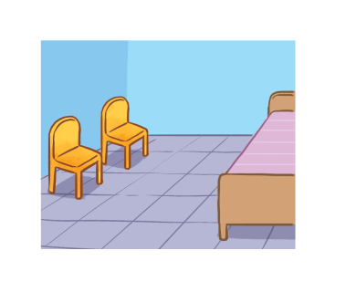
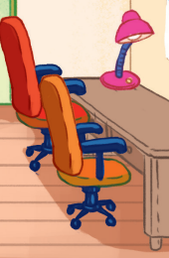
There is a lamp. It’s old.
+ 4
A
B
C
Notes:
There is a lamp. It’s old.
Key: C

Slide 11
2. Listen and repeat.

Slide 12
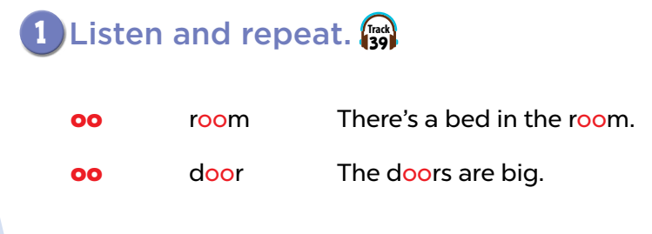
Notes:
No click

Slide 13


Notes:
No click

Slide 14
Notes:
3 clicks

Slide 16



oo
t
b
r
a
d
Notes:
Game: Spelling bee
- Teacher asks pupils to listen carefully, then choose the correct letters to make a word.
- Ask pupils to spell the word again.
- Check pupils’ pronunciation if needed.

Slide 17
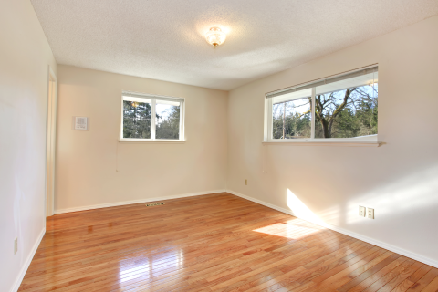
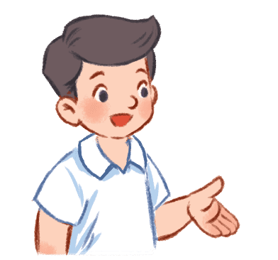

Slide 18
r
o
o
m
o
w
b
r
o
m

Slide 19


Slide 20
b
o
o
k
b
p
o
k
o
s

Slide 21
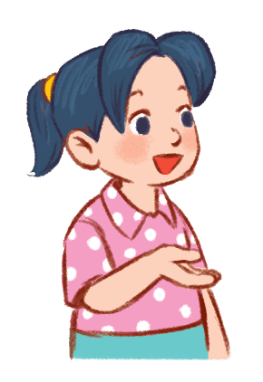

Slide 22
d
o
o
r
d
o
r
i
o
g

Slide 23
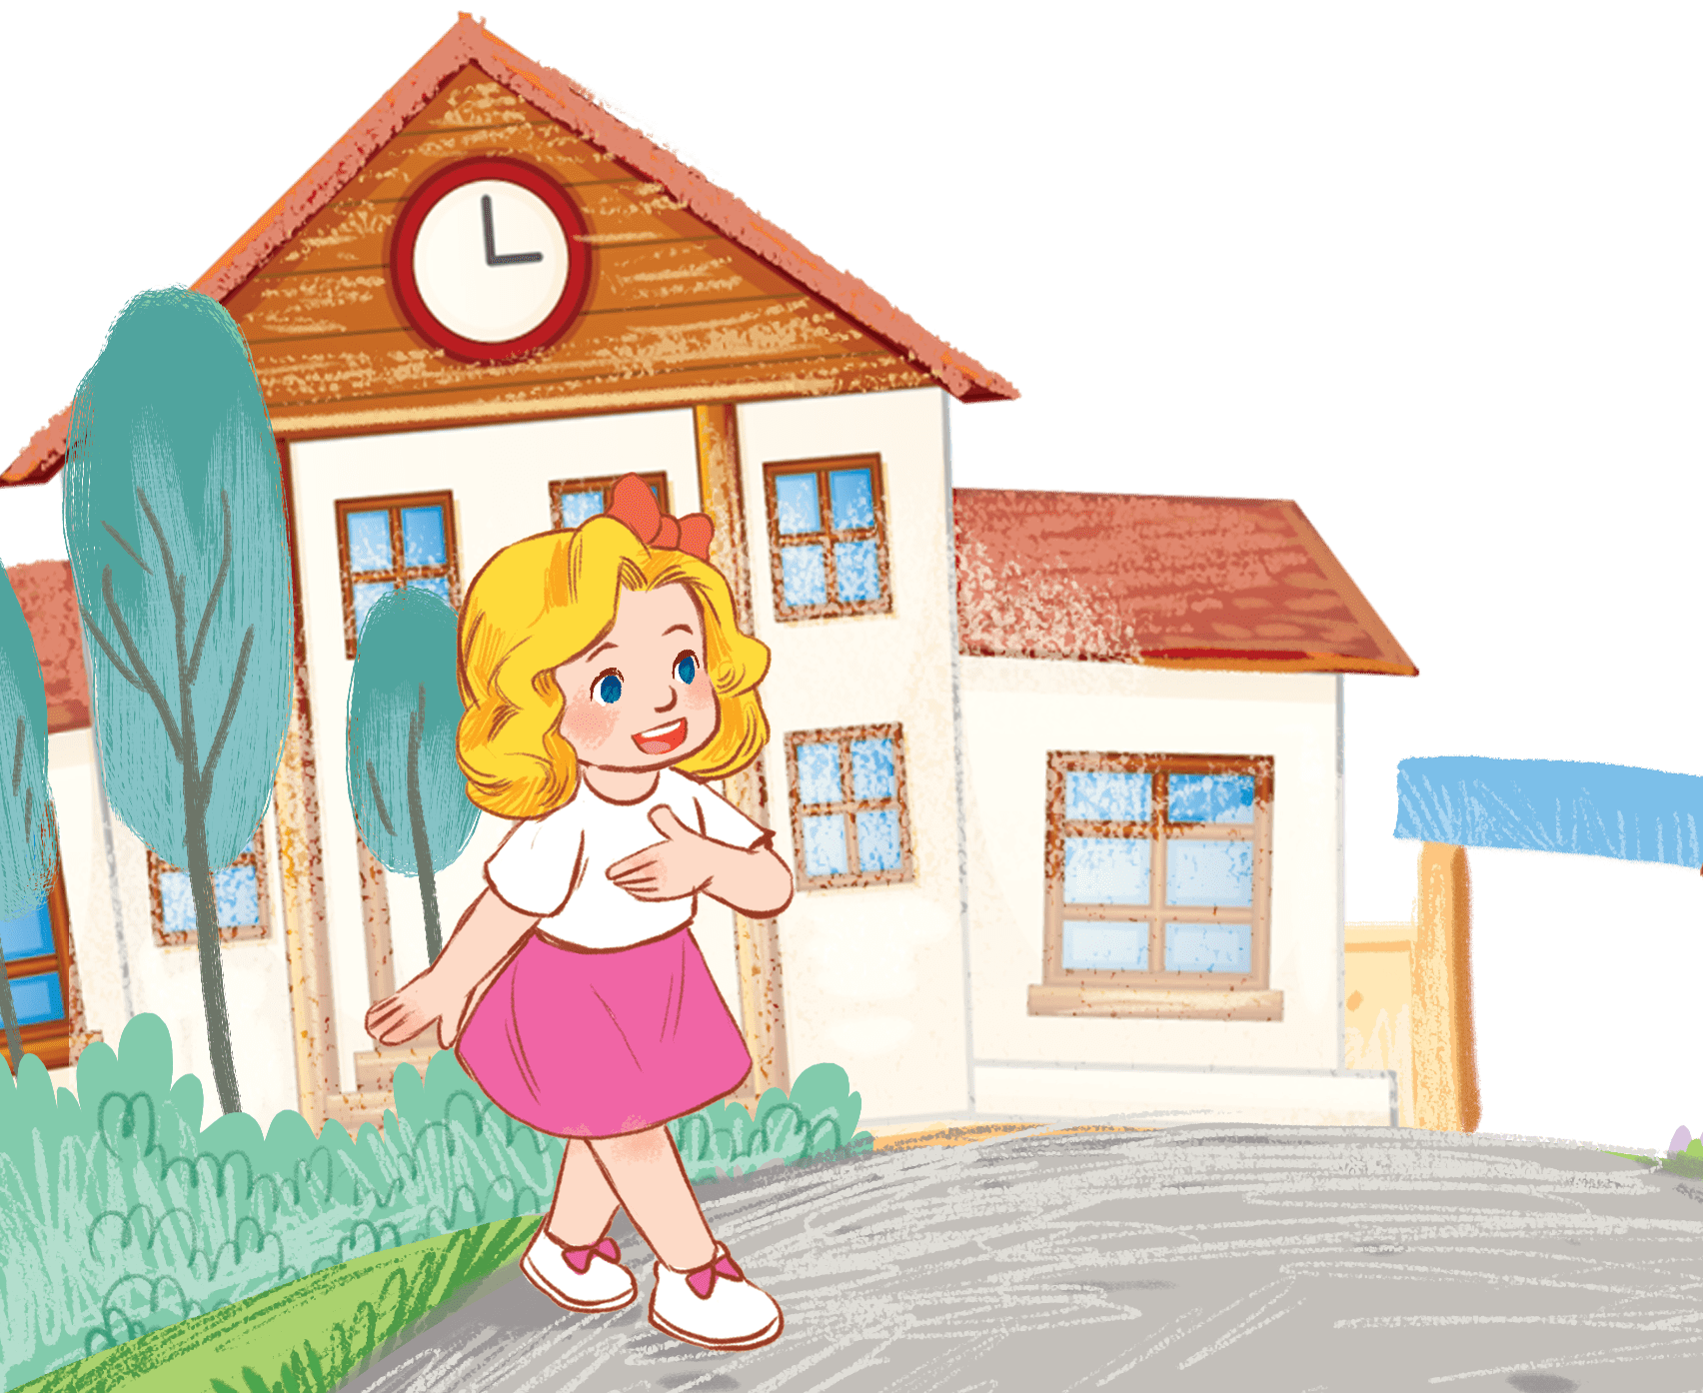

Slide 24
s
o
h
o
l
c
c
h
o
l
i
o
s

Slide 25


Slide 26
m
o
o
n
o
k
d
m
o
n

Slide 27
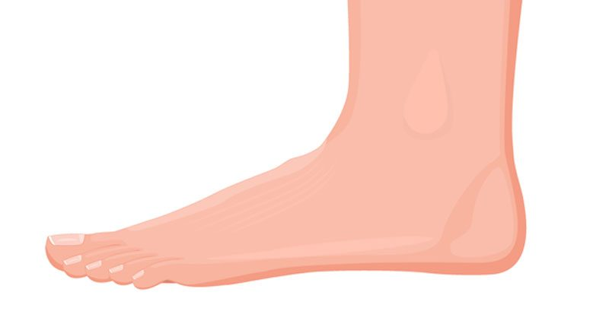

Slide 28
f
o
o
t
f
o
t
n
o
s

Slide 29
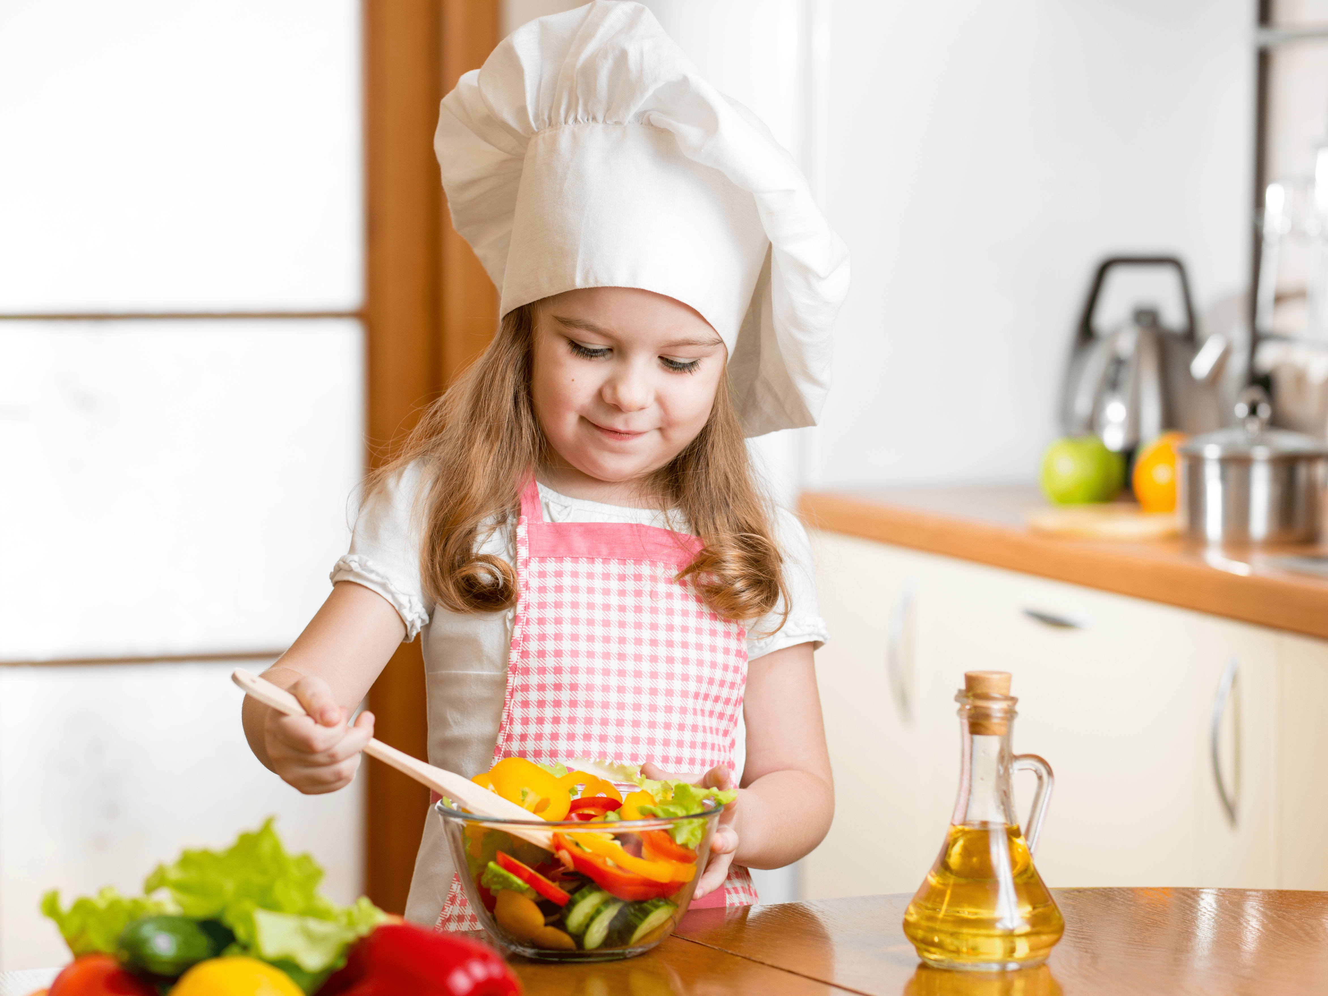

Slide 30
c
o
o
k
o
k
c
v
o
n

Slide 31
3. Listen and circle.

Slide 32
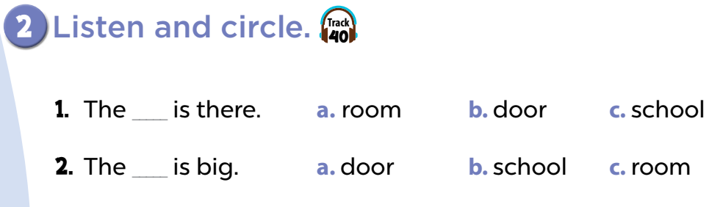
Notes:
Key: 1. b 2. c

Slide 33
Notes:
Key: 1. b 2. c

Slide 34

I’m a speed reader!
Notes:
First, the teacher asks pupils to read each sentence at a slow speed.
Next, ask them to read a little bit faster.
Then, ask them to get ready and read it faster.
And finally, ask them to read as fast as possible!

Slide 35
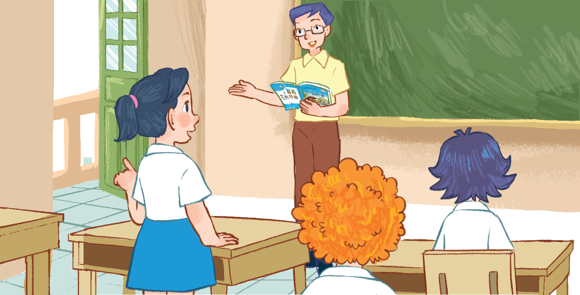
Practice
There are many rooms in my school.

Slide 36
Practice
The bedroom is small.
The living room is small, too.

Slide 37
Practice
There are four doors in my house.

Slide 38
4. Let’s chant.

Slide 39
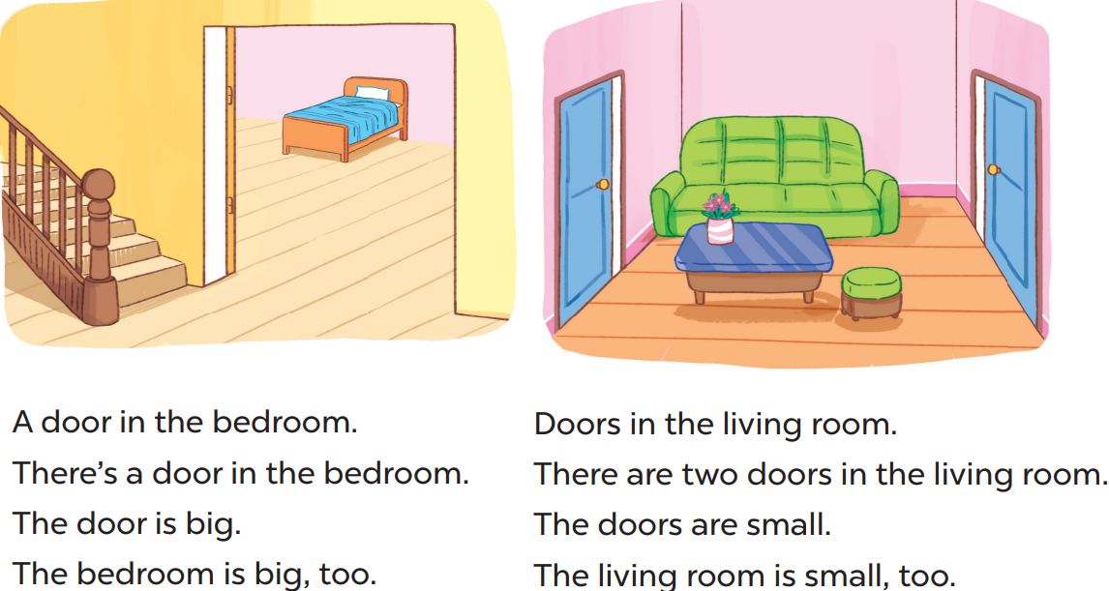

Slide 40
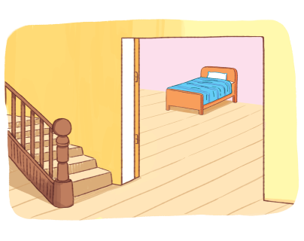
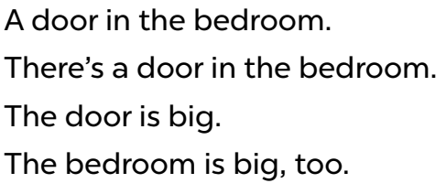

Slide 41
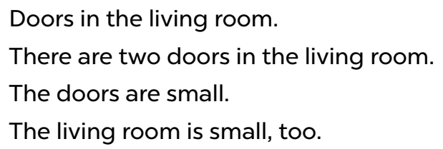

Slide 42
5. Fun corner and wrap-up

Slide 43
Finish the sentences
Notes:
Divide the class into 4 groups. Teacher writes a sentence on a board like "There are...," followed by a blank space.
The first pupil in group 1 adds one word to the sentence, such as “ There are two…”. Then each pupil in group 1 repeats all the sentences before including words of their own, such as “There are 2 windows…”.
Suggested sentence: There are 2 windows in my bedroom. They are new.

Slide 44

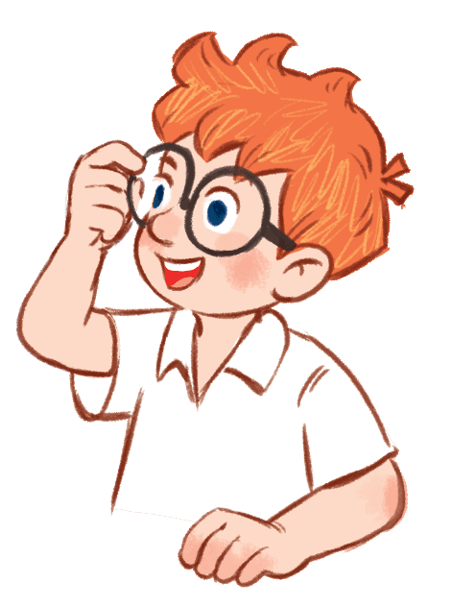
There are...
There are two...
There are two windows ...

Slide 45


There are two windows in…
There are two windows in my …
There are two windows in my bedroom…

Slide 46

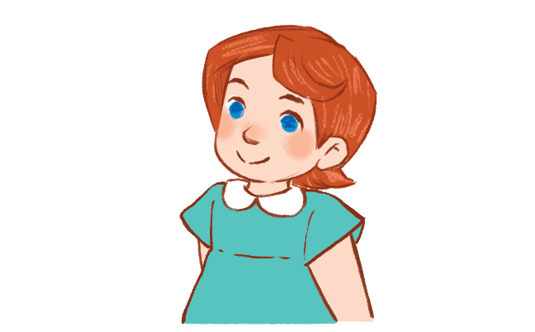
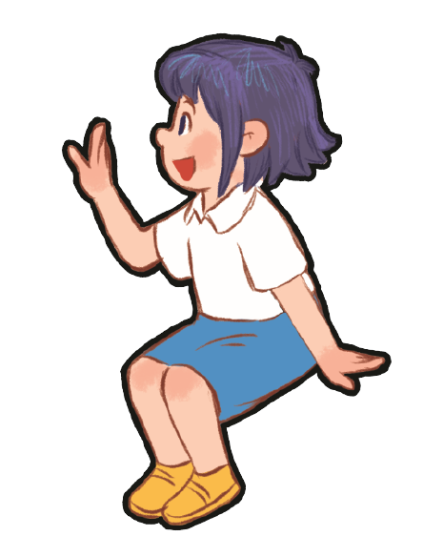


There are two windows in my bedroom. They…
There are two windows in my bedroom.
They are…
There are two windows in my bedroom.
They are new.

