Slide 1


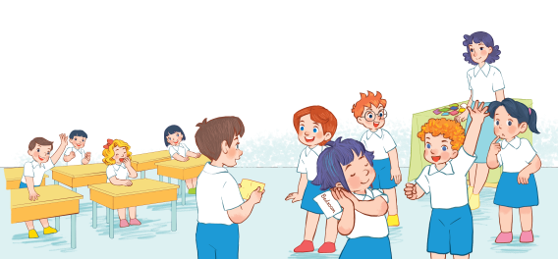
Review 3
ACTIVITY 4-5-6

Slide 2
REVIEW 3
Warm-up
and review
Read and complete.
Fun corner and wrap-up
Read and match.
Ask and answer.

Slide 3
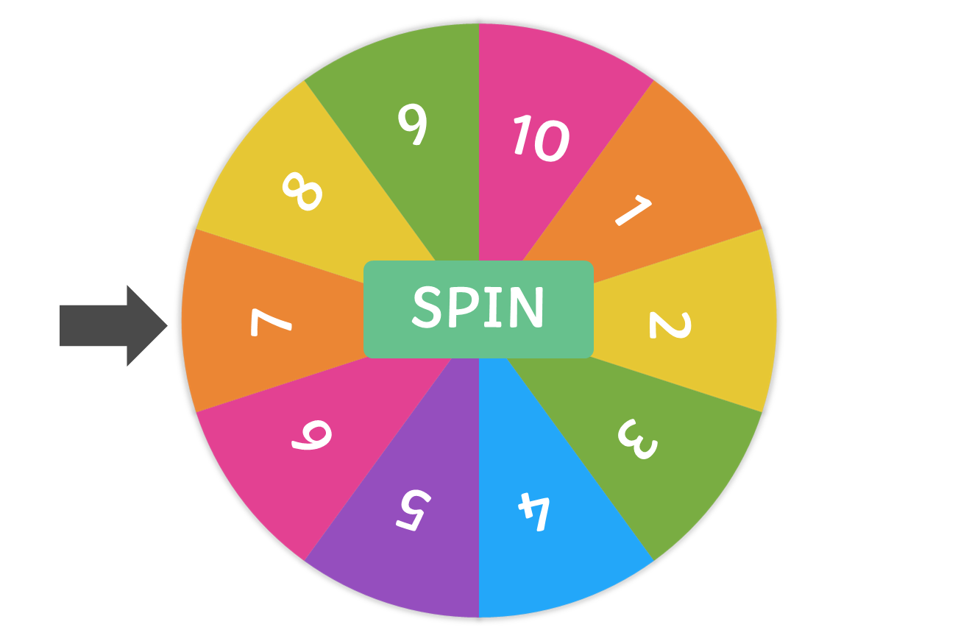


Talk for one minute about….
Warm-up
and review
Notes:
Spin and click the number to go to the question.
Click Start to set the time.
Click the reverse sign to go back to the wheel.

Slide 4
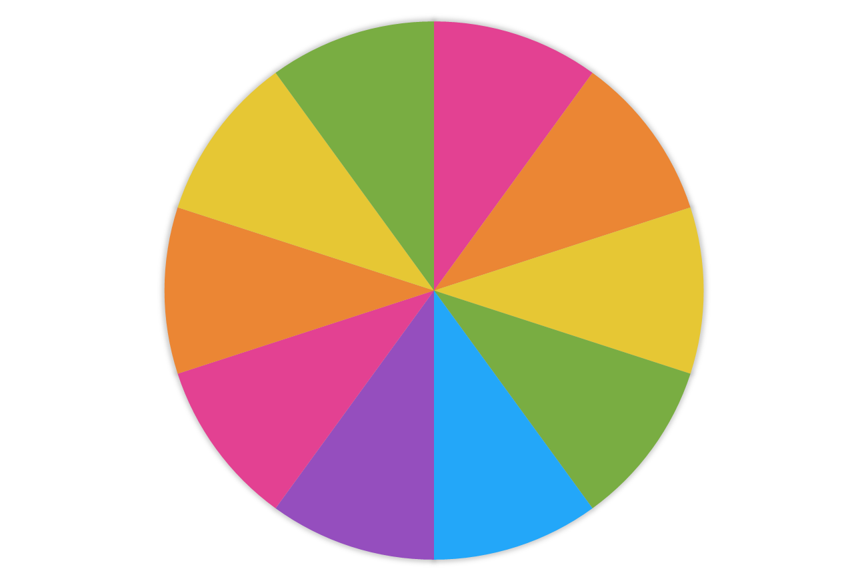
7
8
6
9
5
SPIN
10
4
1
3
2
Notes:
N10

Slide 5
5
6
4
7
3
SPIN
8
2
9
1
10
Notes:
N8

Slide 6
8
9
7
10
6
SPIN
1
5
2
4
3
Notes:
N1

Slide 7
10
1
9
2
8
SPIN
3
7
4
6
5
Notes:
N3

Slide 8
2
3
1
4
10
SPIN
5
9
6
8
7
Notes:
N5

Slide 9
6
7
5
8
4
SPIN
9
3
10
2
1
Notes:
N1

Slide 10
3
4
2
5
1
SPIN
6
10
7
9
8
Notes:
N6

Slide 11
1
2
10
3
9
SPIN
4
8
5
7
6
Notes:
N4

Slide 12
4
5
3
6
2
SPIN
7
1
8
10
9
Notes:
N7

Slide 13
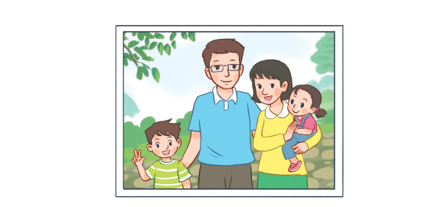


Talk for one minute about family
How old is your sister/ brother?
TIME’S UP

Slide 14
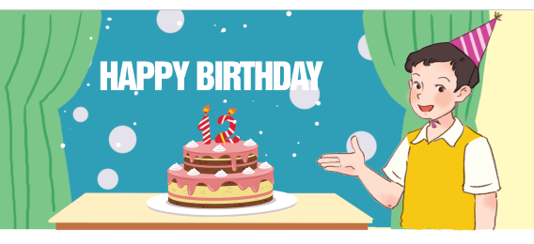
Talk for one minute about family
How old is he?
TIME’S UP

Slide 15

Talk for one minute about
jobs
TIME’S UP
What’s his job?

Slide 16

Talk for one minute about house
TIME’S UP
Is your house big or small?

Slide 17

Talk for one minute about
jobs
TIME’S UP
What’s her job?

Slide 18
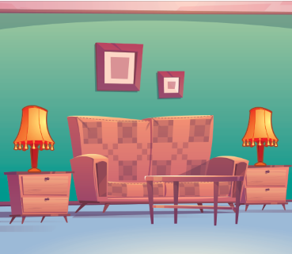
Talk for one minute about your living room
TIME’S UP
There is ………
There are …….

Slide 19
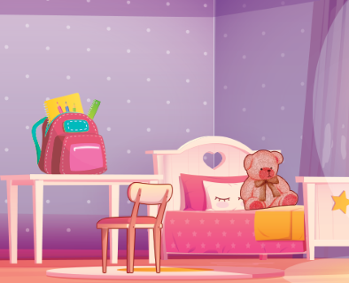
Talk for one minute about house
TIME’S UP
Where is the table?

Slide 20
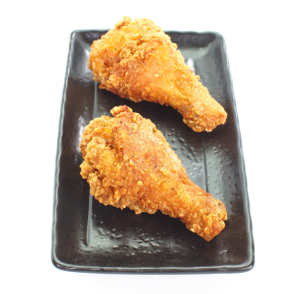
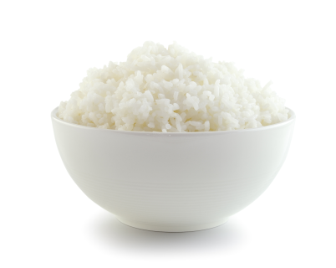
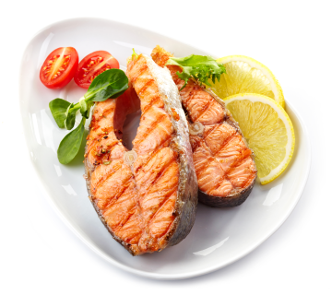
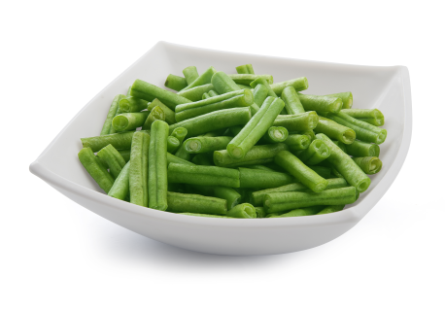
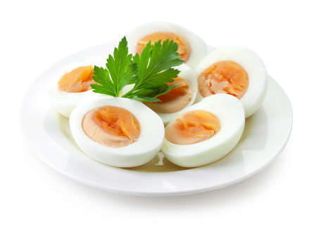
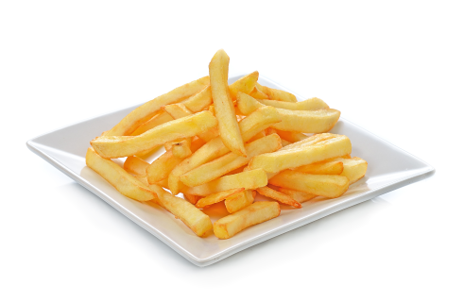
Talk for one minute about food and drinks
TIME’S UP
What would you like to eat?

Slide 21
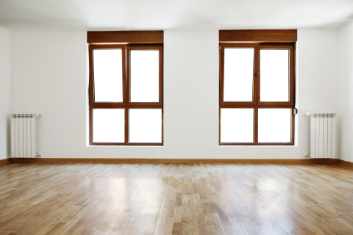
Talk for one minute about house
TIME’S UP
How many windows are there?

Slide 22



Talk for one minute about food and drinks
TIME’S UP
What would you like to drink?

Slide 23

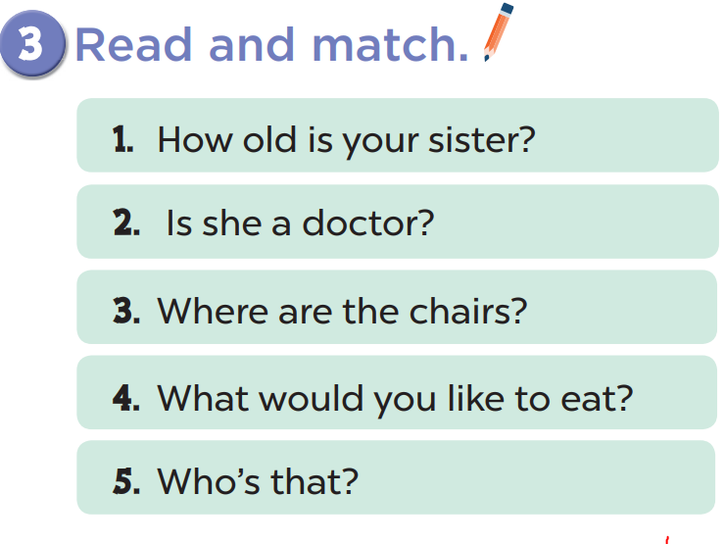
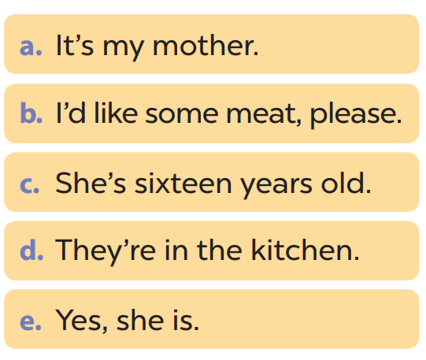

Slide 24
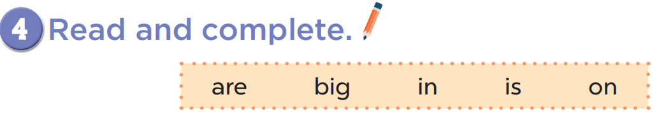
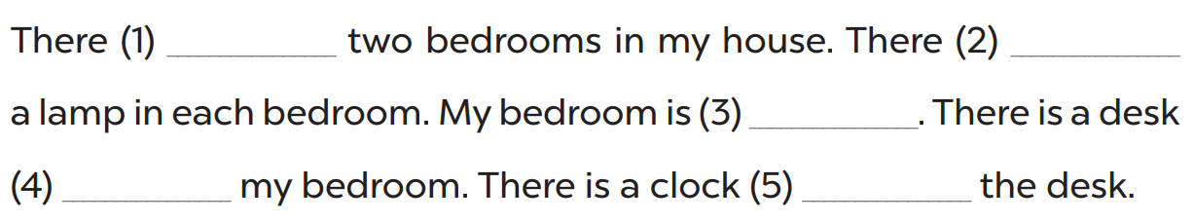
are
is
big
in
on

Slide 25
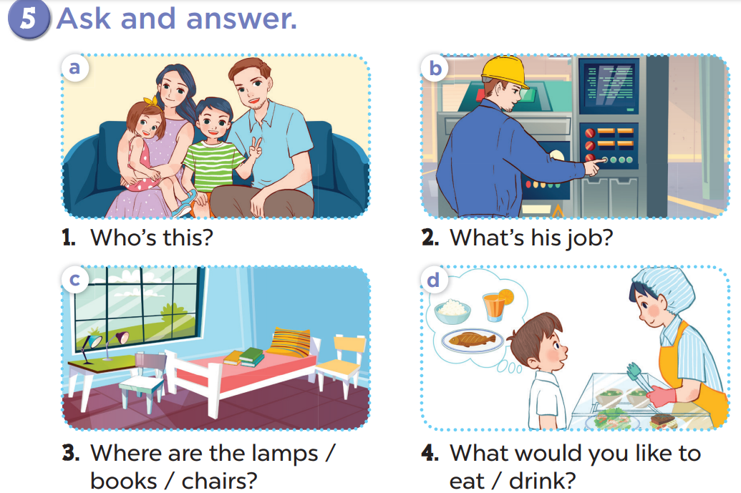

Slide 26



Fabulous sounds!
Fun corner
and wrap-up
A
B
D
E
A
F
G
I
J
B
Notes:
Divide the class into 2 teams.
Each team chooses one letter to go to the question.
Have pupils look, read and choose the right letters that match the sounds.
Back to the menu for pupils to pick another question.
Pupils continue their turns until there is no letter left.

Slide 27

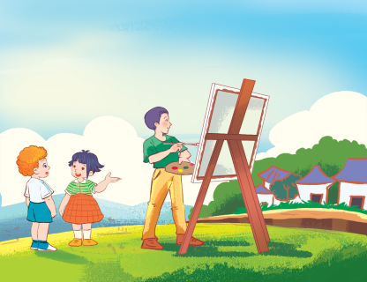

ou
20
or
ow
er
ea
ure
er
It’s my broth

Slide 28
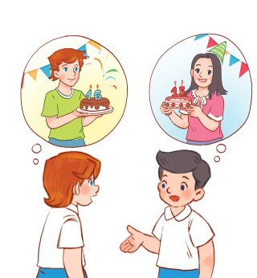
ow
ou
40
oo
ea
or
o
o
How
ld is she?

Slide 29
ou
20
ure
ow
er
ea
or
ure?
Are you s

Slide 30
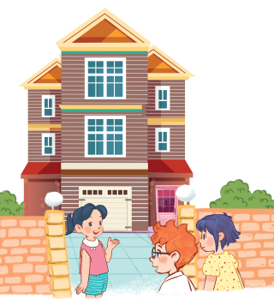
ou
o
50
oo
ea
or
ow
ou
My h
se is big

Slide 31

ow
or
30
oo
ea
er
Sr
oo
There are two d
rs in my room.

Slide 32

ou
30
er
ow
ea
or
ure
or
My mother is a doct

Slide 33
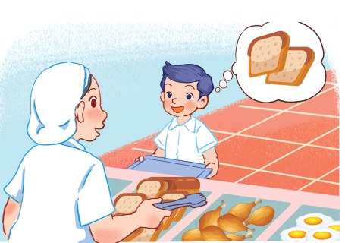
oo
or
50
ure
er
ow
ea
ea
I’d like some br
d.

Slide 34
er
oo
40
or
ow
ea
ou
ow
It’s a br
n house.

Slide 35
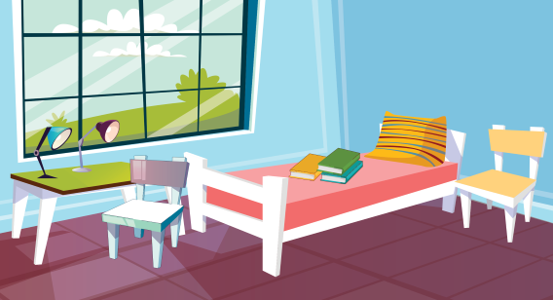
oo
ou
30
or
ow
er
ure
oo
My bedr
m is small.

Slide 36
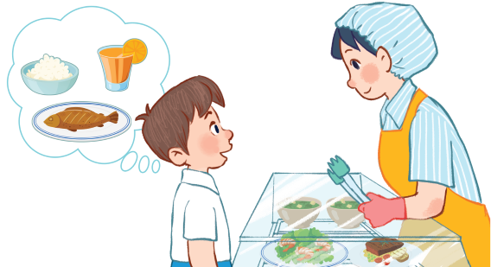
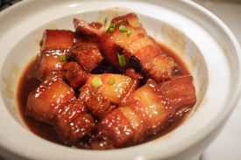
ow
er
30
ou
ea
oo
or
ea
I’d like some m
t.

