Slide 1


My pets
Lesson 1 - Period 2
16

Slide 2
1
2
3
Warm-up and review
4
5
Fun corner and wrap-up
Listen and tick.
Look, complete and read.
Let’s sing.

Slide 3
1
Warm-up and review

Slide 4
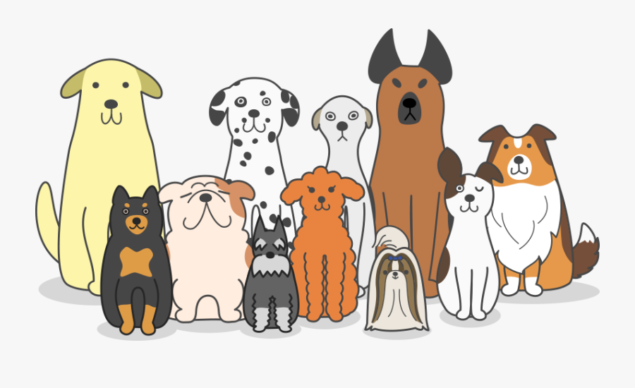
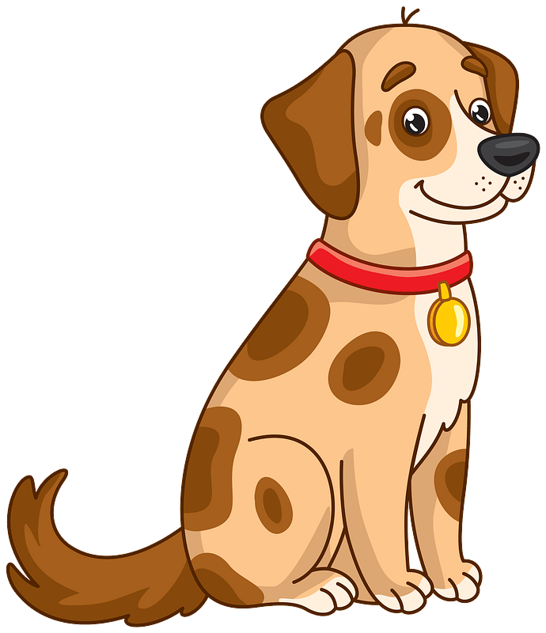
a dog
dogs

Slide 5
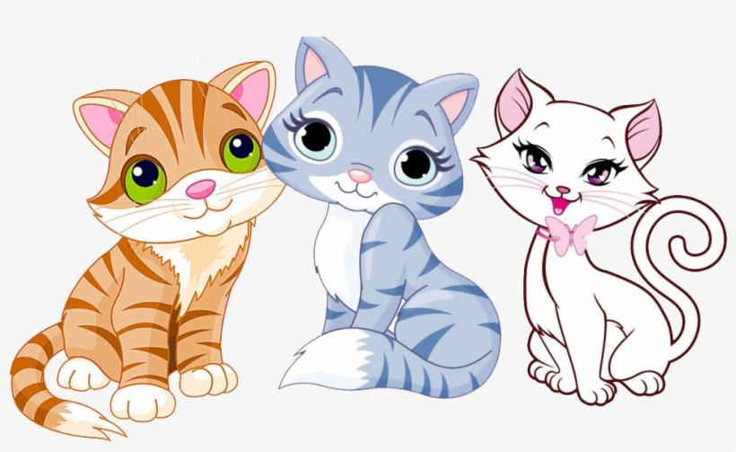

a cat
cats

Slide 6
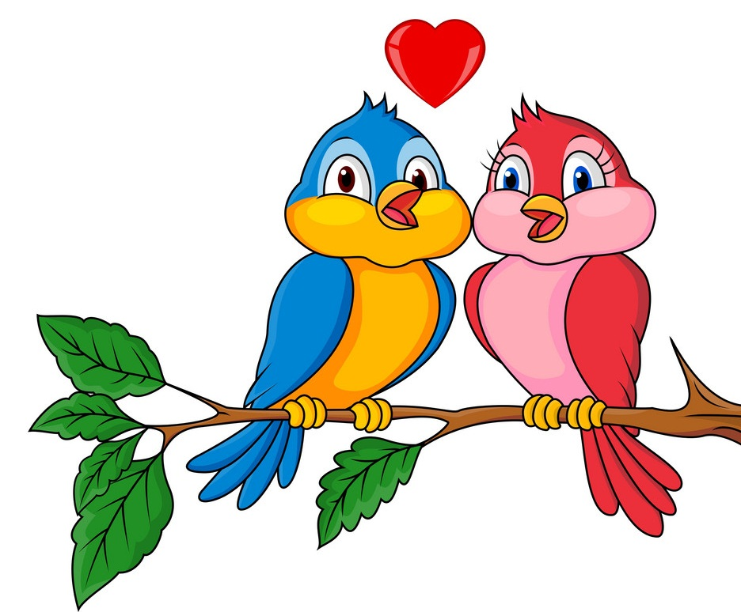
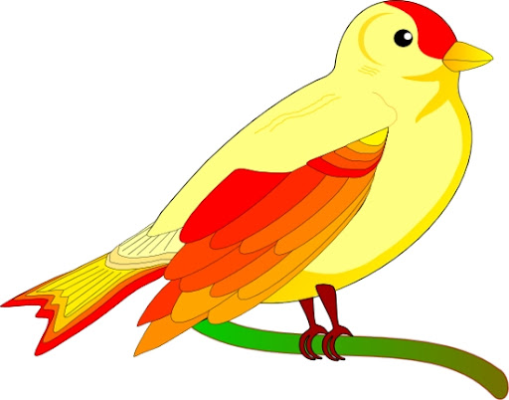
a bird
birds

Slide 7
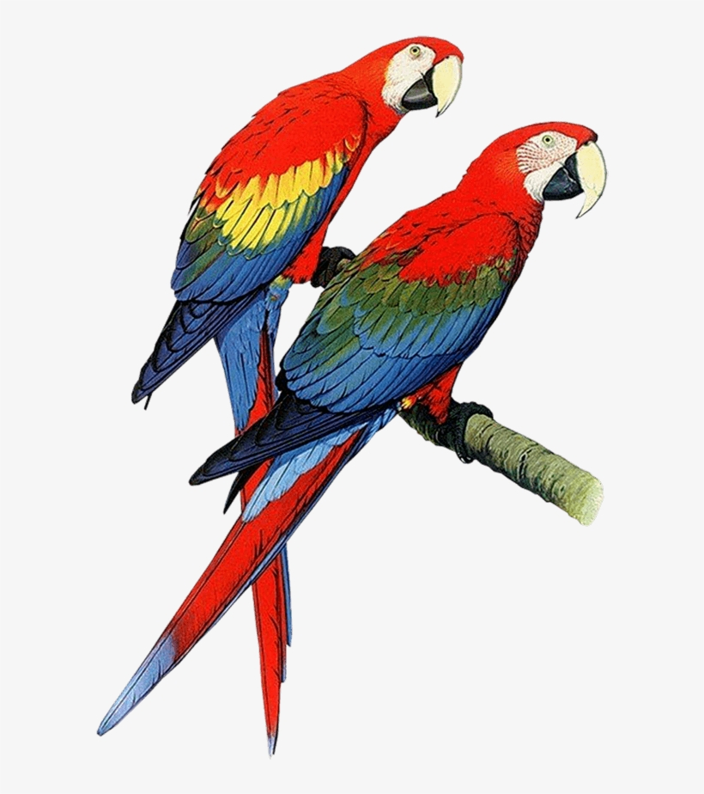
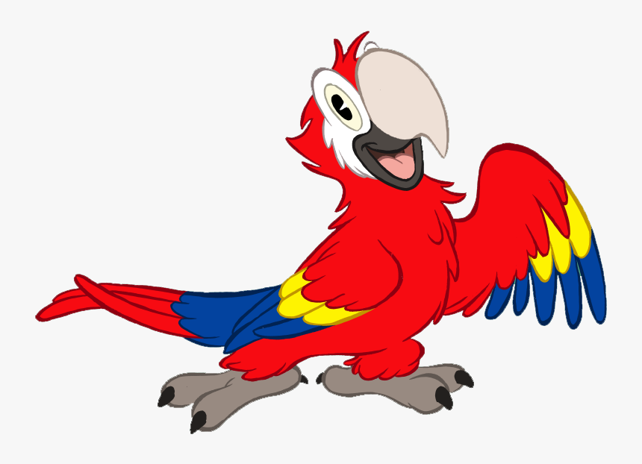
a parrot
parrots

Slide 8
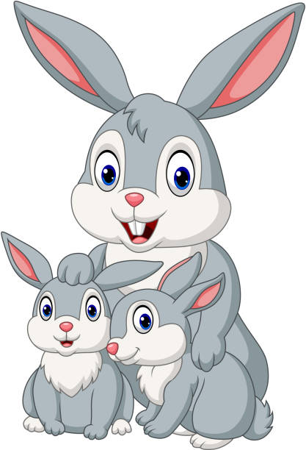
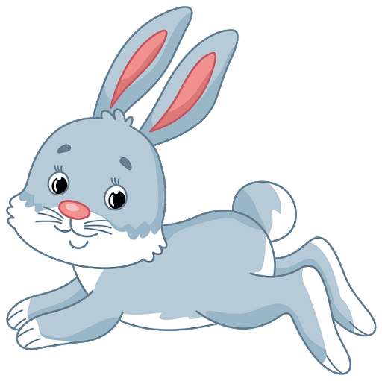
a rabbit
rabbits

Slide 9
Look and guess

Slide 10
1
2
3
4
5
6
7
8
9
a cat

Slide 11
1
2
3
4
5
6
7
8
9
a dog

Slide 12
1
2
3
4
5
6
7
8
9
parrots

Slide 13
1
2
3
4
5
6
7
8
9
cats

Slide 14
1
2
3
4
5
6
7
8
9
a bird

Slide 15
1
2
3
4
5
6
7
8
9
rabbits

Slide 16
2
Listen and tick.

Slide 17

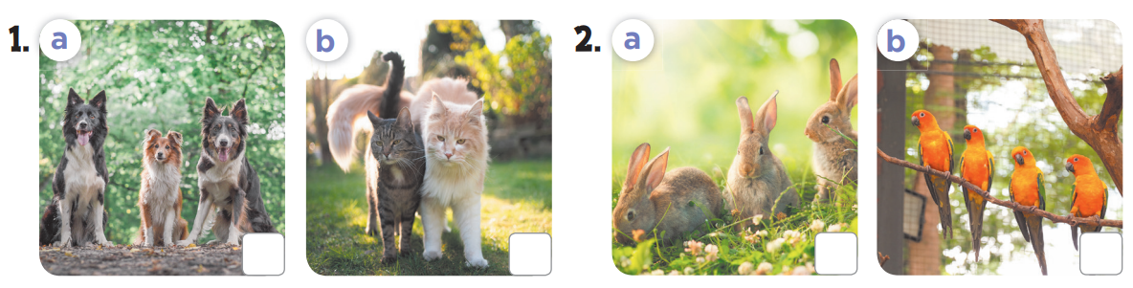


Slide 18
3
Look, complete and read.

Slide 19
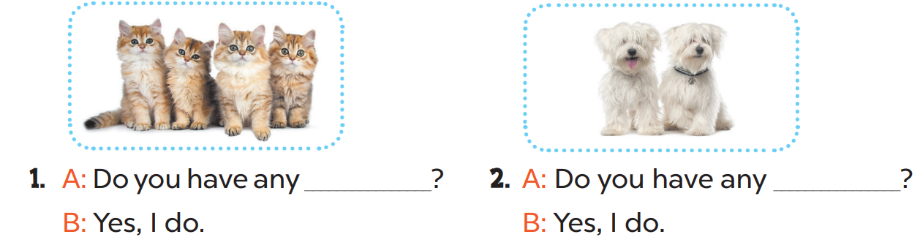
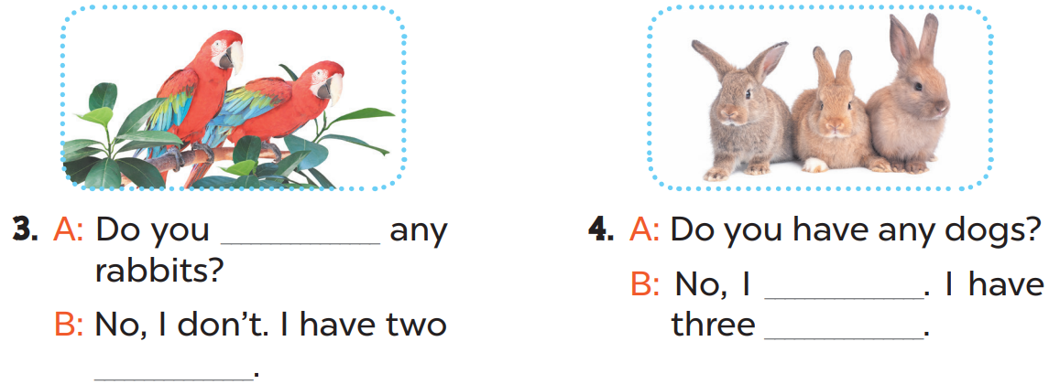
cats
dogs
have
don’t
rabbits
parrots

Slide 20
4
Let’s sing.

Slide 21
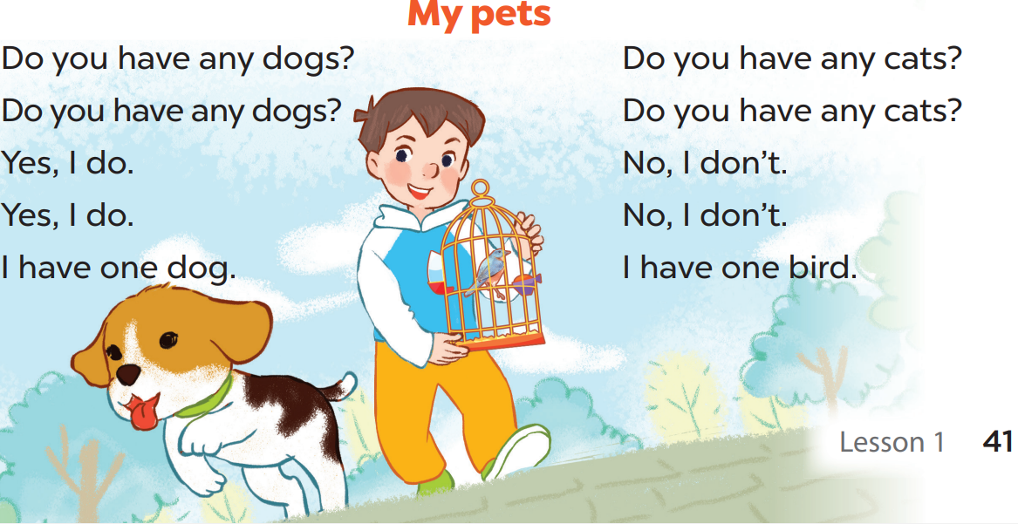

Slide 22
5
Fun corner and wrap-up

Slide 23










TEAM 1
TEAM 2
TEAM 3

Slide 24



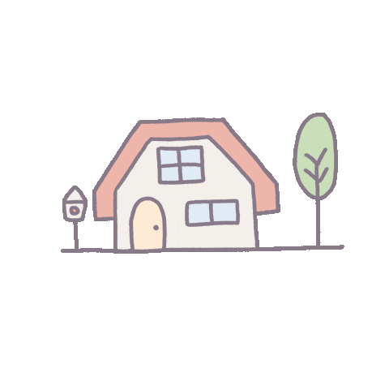
= 1 points
= - 2 points
= 5 points

Slide 25
Do you have any dogs?
Yes, I do. I have one dog.

Slide 26
Do you have any fish?
Yes, I have. I have 2 rabbits.

Slide 27
Do you have any cats?
Yes, I have one cat.

Slide 28
Do you have any rabbits?
No, I don’t. I have three cats.

Slide 29
Do you have any dogs?
No, I don’t. I have one rabbit.

Slide 30
Do you have any parrots?
Yes, I do.

Slide 31
Do you have any birds?
Yes, I do. I have 2 parrots.

Slide 32
Do you have any dogs?
Yes, I do.

Slide 33
Do you have any cats?
No, I don’t. I have one bird.

