Slide 1


Fun time
PERIOD 3

Slide 2
Warm-up
and review
Quiz time
Fun corner
and wrap-up
Do the puzzle.
Circle the healthy foods.

Slide 3


Team A
Warm-up
and review
Team B
GAME RULES
1. Divide pupils into 2 teams.
2. Pupils find words in categories beginning with the set letter.
3. When they finish, they can shout 'Stop the bus!'
4. The winner can choose and open a gift box.
Notes:
Press NEXT button to go to next slide
Press GO button to set the time
Press REVERSE button to go back to the menu
Press QUESTION button to see the hint

Slide 4





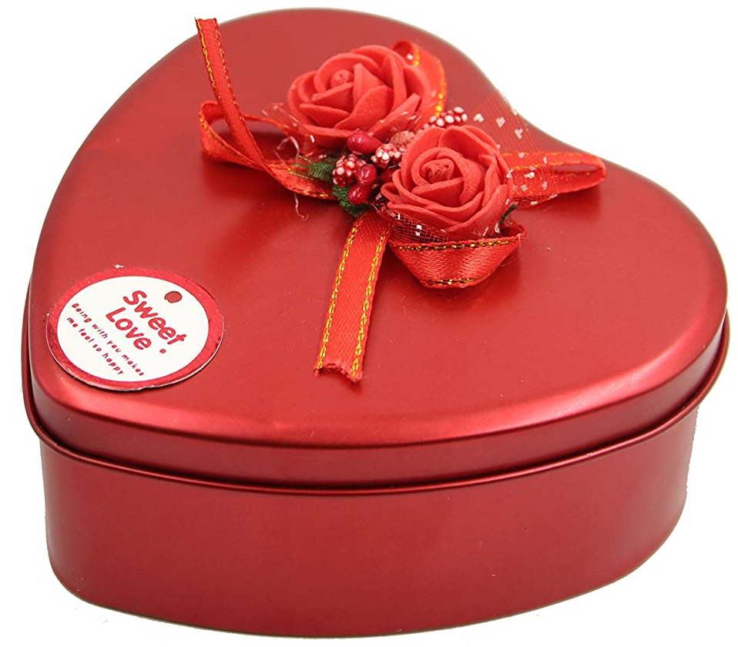


Name 3 words starting with letter F about:
Family members
Food
Jobs
Go!
HELP
father
fish
farmer
X
20
30
40
Let’s take a gift!

Slide 5



Name 3 words starting with letter B about:
Family member
Food
Rooms
Go!
HELP
X
brother
bread/beans
bedroom/
bathroom
30
40
50
Let’s take a gift!

Slide 6


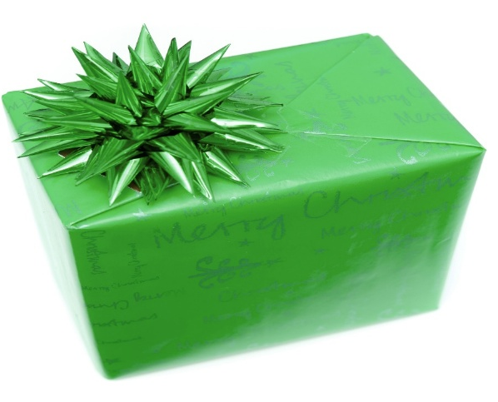
Name 3 words starting with letter S about:
Family member
Number
Jobs
Go!
HELP
sister
sixteen….
singer
X
80
60
50
Let’s take a gift!

Slide 7



Name 3 words starting with letter T about:
Things in the house
Jobs
Numbers
Go!
table
teacher
twelve…
HELP
X
70
80
90
Let’s take a gift!

Slide 8



Name 3 words start with letter M about:
Family member
Food
Rooms in school
Go!
mother
Milk/ meat
Music room
HELP
X
60
50
40
Let’s take a gift!

Slide 9



Name 3 words starting with letter W about:
Things in the house
Food/ drink
Jobs
Go!
HELP
window
water
worker
X
30
40
50
Let’s take a gift!

Slide 10
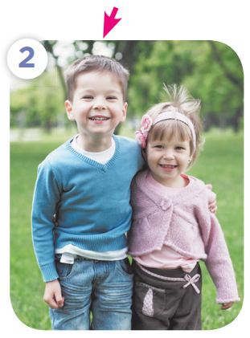


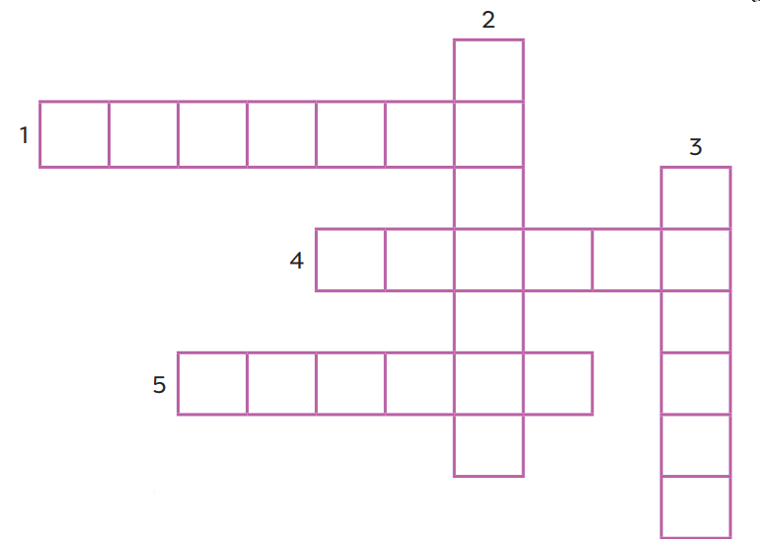







Do the puzzle!

Slide 11

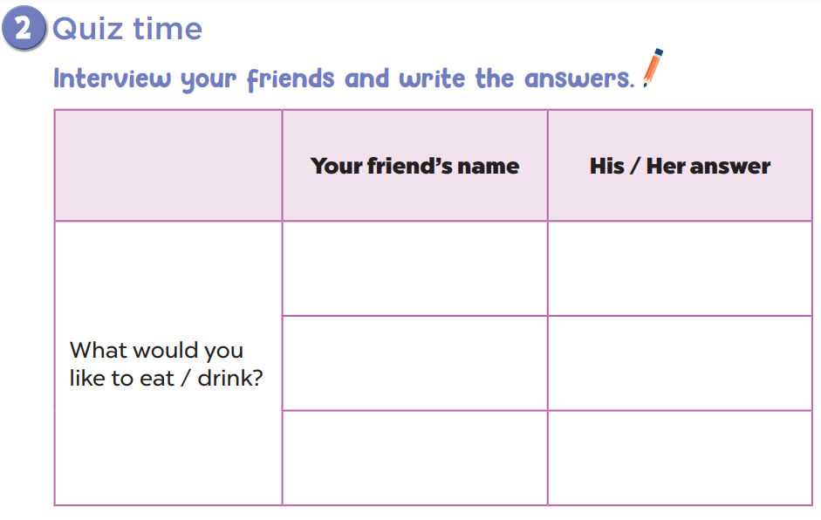

Slide 12
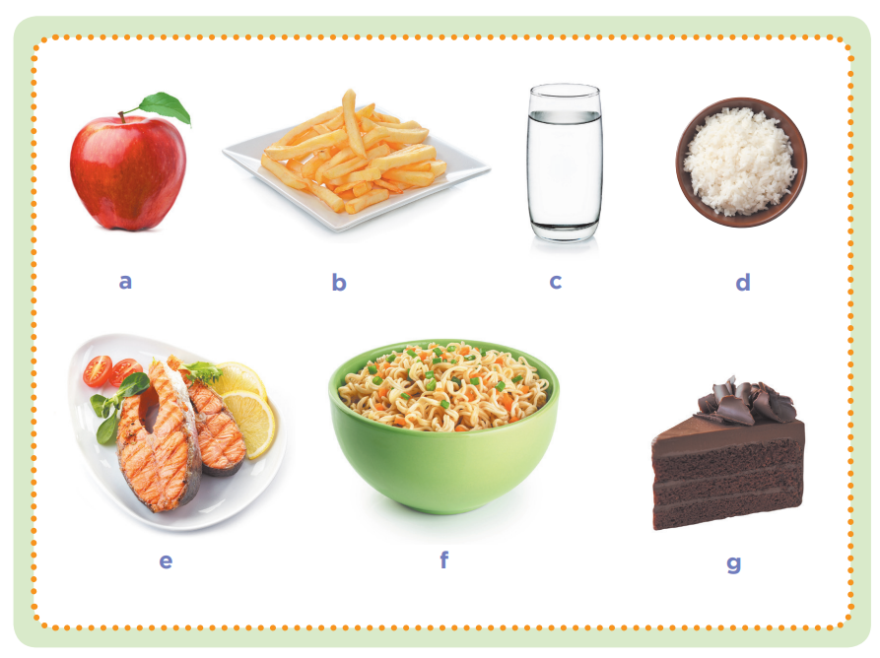
Circle the healthy foods and drinks!

Slide 13

BUILD A SPACESHIP
Fun corner
and wrap-up
A
B
C
Team A
Team B
E
D
F
Notes:
Divide the class into 2 teams.
Have pupils guess the word letter by letter. Teacher may give some cues.
Whenever pupils guess a letter that is in the secret word, click the letter to fill it into the blank where it occurs.
The one who has the correct answers can build a spaceship and fly to space.

Slide 14


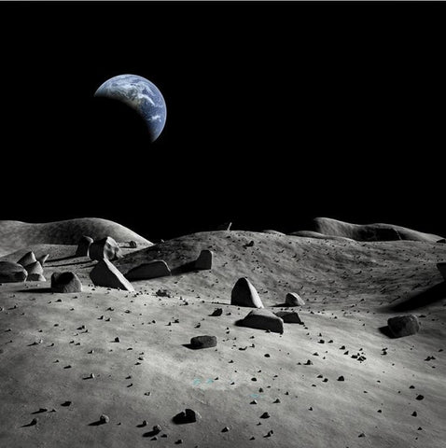











A
B
C
D
E
F
G
H
40
I
J
K
L
M
N
O
P
Q
R
S
T
U
V
W
X
Y
Z
BUILD
F
A
M
I
L
Y

Slide 15
A
B
C
D
E
F
G
H
30
I
J
K
L
M
N
O
P
Q
R
S
T
U
V
W
X
Y
Z
BUILD
D
O
C
T
O
R

Slide 16
A
B
C
D
E
F
G
H
30
I
J
K
L
M
N
O
P
Q
R
S
T
U
V
W
X
Y
Z
BUILD
H
O
U
S
E

Slide 17
A
B
C
D
E
F
G
H
40
I
J
K
L
M
N
O
P
Q
R
S
T
U
V
W
X
Y
Z
BUILD
W
I
N
D
O
W

Slide 18
A
B
C
D
E
F
G
H
50
I
J
K
L
M
N
O
P
Q
R
S
T
U
V
W
X
C
H
I
C
K
E
N
Y
Z
BUILD

Slide 19
A
B
C
D
E
F
G
H
30
I
J
K
L
M
N
O
P
Q
R
S
T
U
V
W
X
Y
Z
BUILD
J
U
I
C
E

