Slide 1



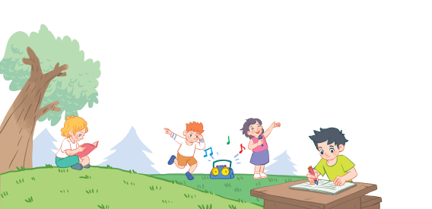
18
Part 1,2,3

Slide 2
Contents
1
Warm-up and review
2
3
4
Listen and repeat.
Listen and circle.
Let’s chant.
5
Fun corner and wrap-up

Slide 3
1. Warm-up and review

Slide 4
Activity:
Listen and say!

Slide 5
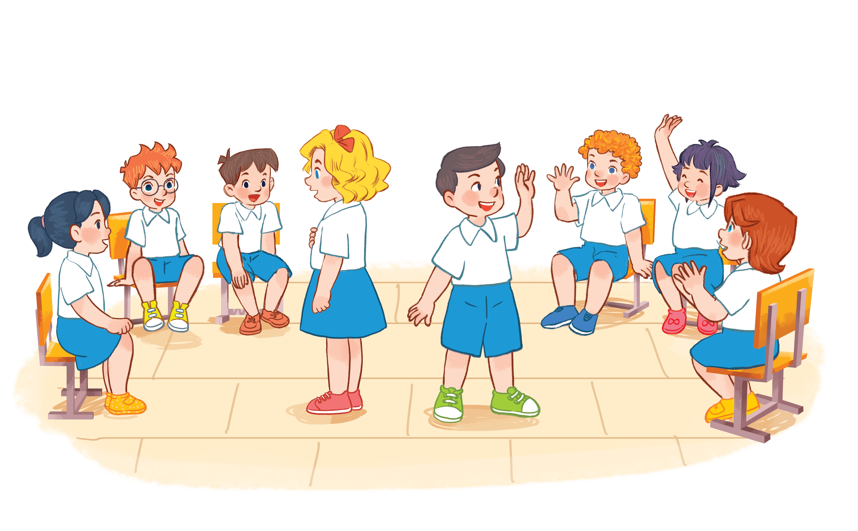

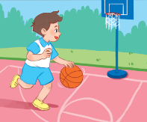
playing basketball.
I am playing basketball.
Notes:
Activity: Listen and say!
Pupils sit in a circle. Some pupils come in the middle and keep the pictures.
The others take turn saying a word, the one keeping the pictures raise their hands then say the whole sentence.
Who can make it will have points.

Slide 6
I am drawing a picture.
drawing a picture
Notes:
Activity:
-Pupils sit in circle. Some pupils come in the middle and keep pictures.
-The others around take turn say sentences, the one keeping the pictures raise their hands.

Slide 7
2. Listen and repeat.

Slide 8
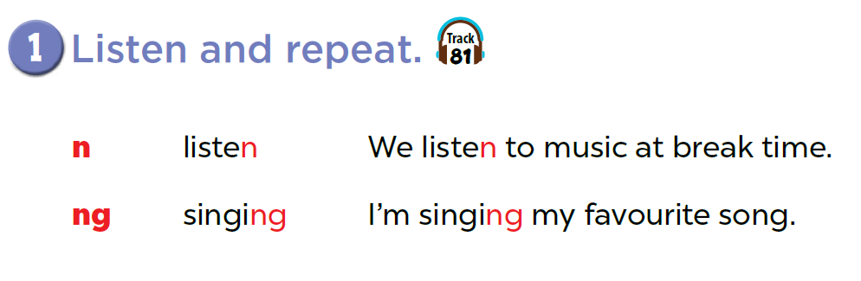


Slide 9

Game: Listen and choose!
n
listening
singing
ng
Notes:
T divides class into 2 teams: BOYS and GIRLS.
1 boy and 1 girl of each team come to the board, listen to the recording and choose the right words. (Pupils slap the words on the board)

Slide 10
Game: Listen and choose!
n
listening
singing
ng

Slide 11
Game: Listen and choose!
n
listening
singing
ng

Slide 12
Game: Listen and choose!
n
listening
singing
ng

Slide 13
3. Listen and circle.

Slide 14
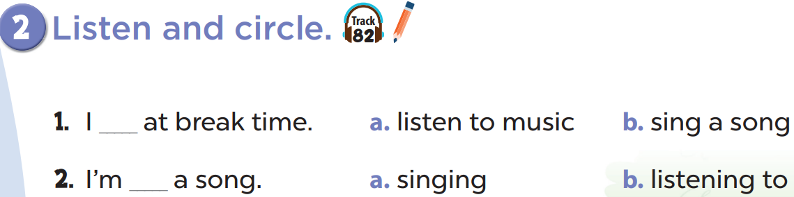

Slide 16
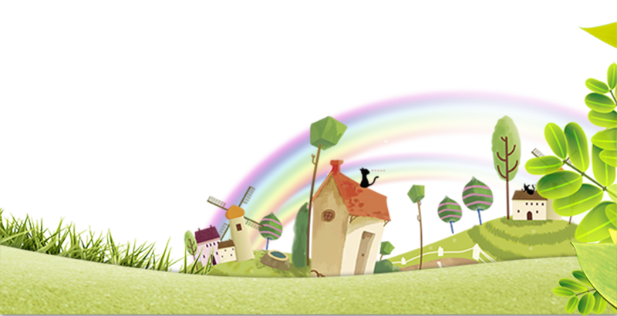
Game: Look and say

Slide 17
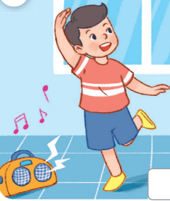
Look and say
I’m _________.
dancing

Slide 18
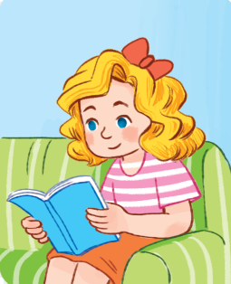
Look and say
I’m ________ a book.
reading

Slide 19
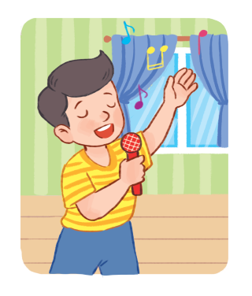
Look and say
I’m ________ a song.
singing

Slide 20
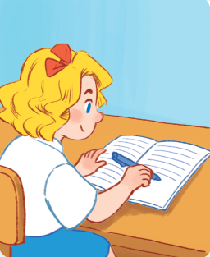
Look and say
I’m ________ my lesson.
writing

Slide 21
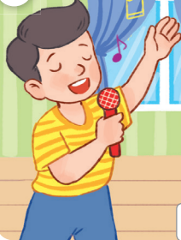
Look and say
I’m ________ a song.
singing

Slide 22
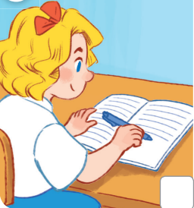
Look and say
I’m ________ a story.
writing

Slide 23
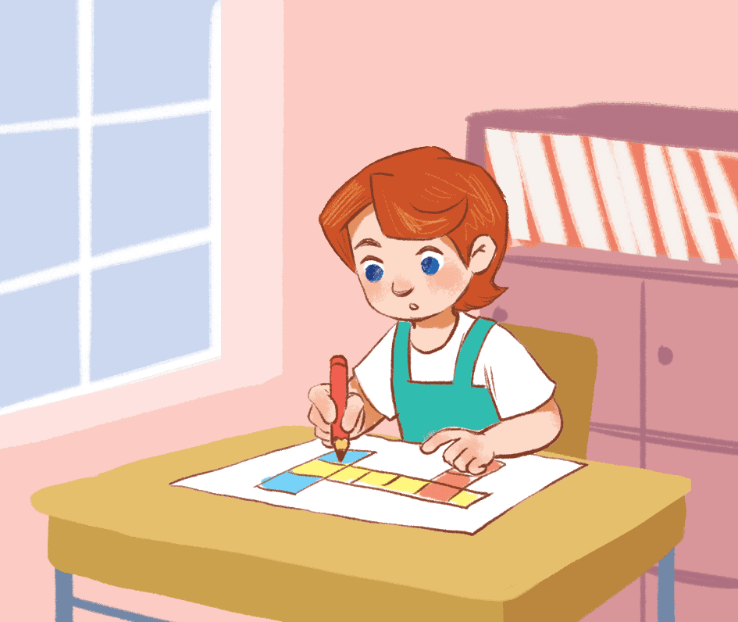
Look and say
I’m ________ a picture.
drawing

Slide 24
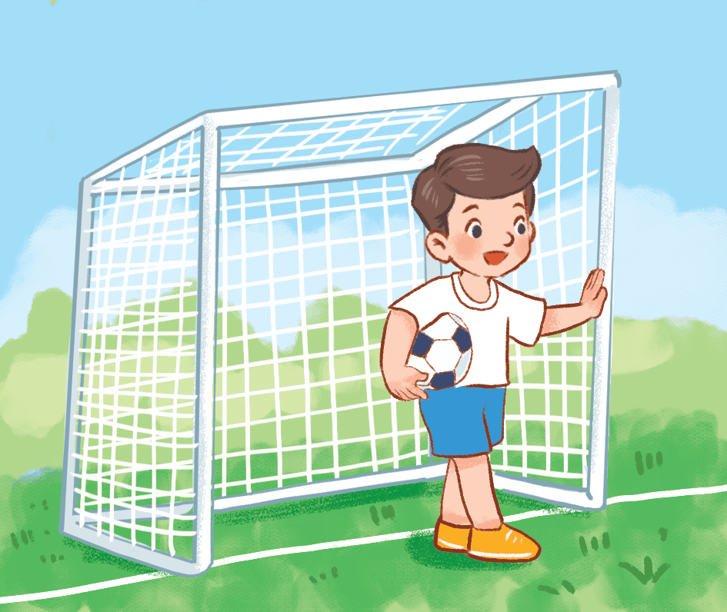
Look and say
I’m ________ football.
playing

Slide 25
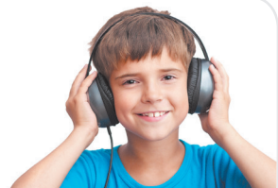
Look and say
I’m ________ to music.
listening

Slide 26
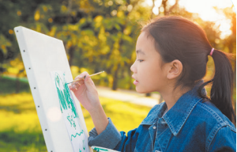
Look and say
I’m ________ a picture.
drawing

Slide 27
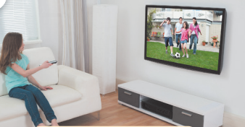
Look and say
I’m ________ TV.
watching

Slide 28
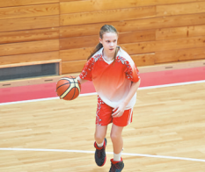
Look and say
I’m ________ basketball.
playing

Slide 29
4. Let’s chant.

Slide 30
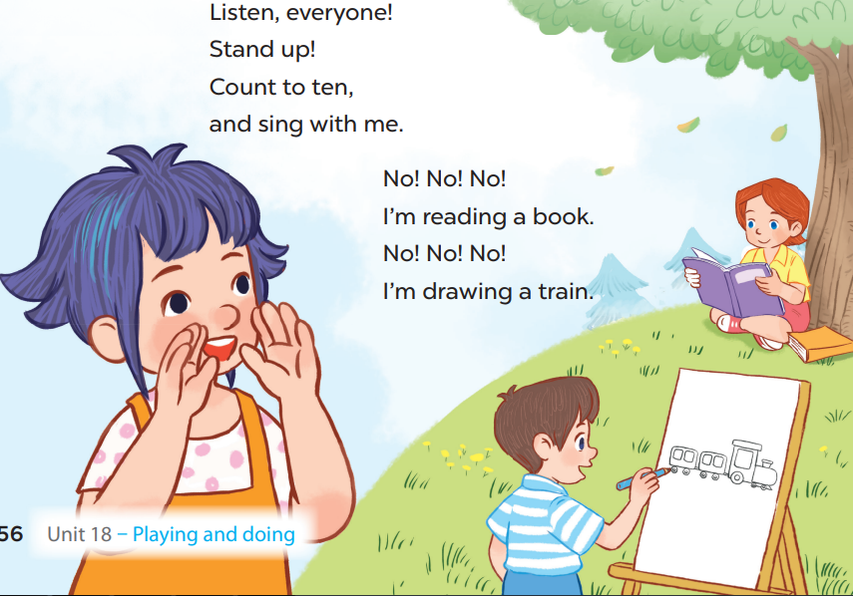

Slide 32
5. Fun corner and wrap-up

Slide 33
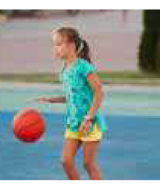
Notes:
Pupils sit in circle. Some of them hold flashcards of activities (listening to music, playing basketball, singing, drawing...), then pass it one by one with music.
When they listen to the music, they have to pass the flashcards to the person next to them. When the music stops, those who keeps the cards have to stand in the middle of the circle and say the words, the others listen and check the answer.

Slide 34
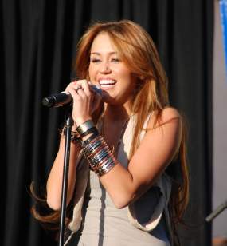
Notes:
-Pupils hold flashcards of activities (listening to music, playing basketball, singing, drawing...), then pass it one by one with music. -Pupils sit in circle. When they listen to the music, they have to pass the flashcards to the person next to them. When the music stops, those who keeps the card have to stand in the middle of the circle and say the words, the others listen and check the answer.

