Slide 1



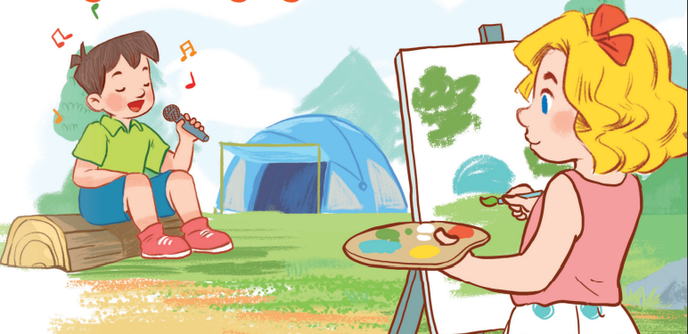
19
Outdoor activities
LESSON 2 – Part 4,5,6

Slide 2
Warm-up
& Review
Listen
and number.
Look,
complete
and read.
Let’s play.
Fun corner
& wrap-up

Slide 3











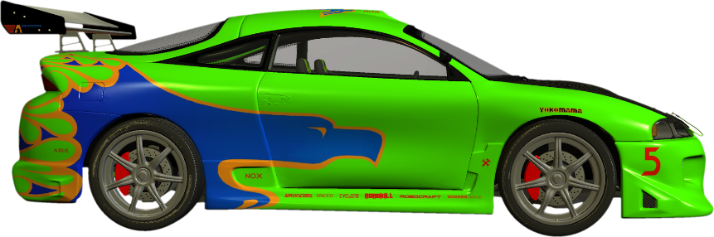

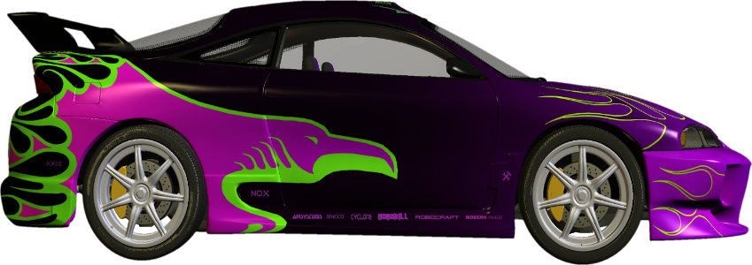
CAR RACING
Click to make the green car move
Click to make the purple car move

Slide 4



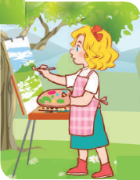
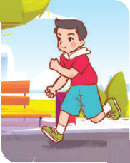
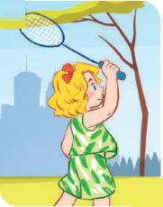
Listen and choose.
Notes:
Click on teachers once to listen to the conversation and choose the right picture.

Slide 5

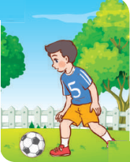
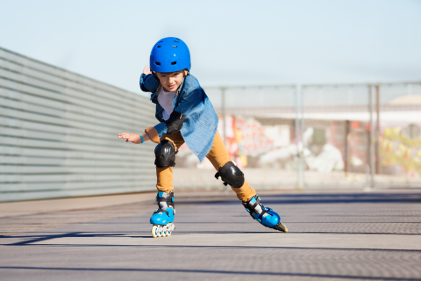
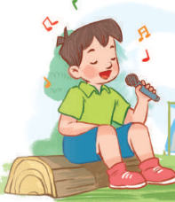
Listen and choose.

Slide 6
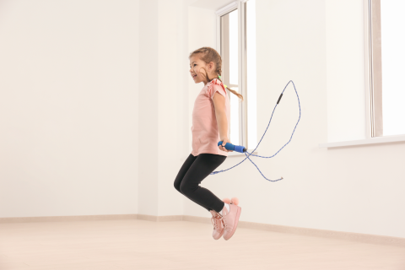
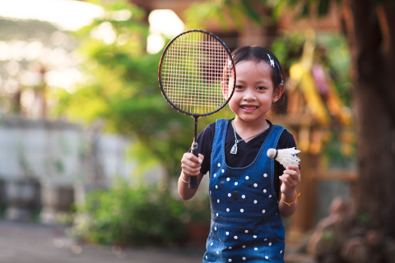
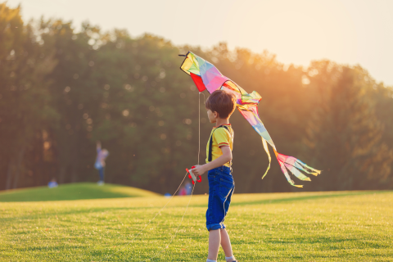
Listen and choose.

Slide 7
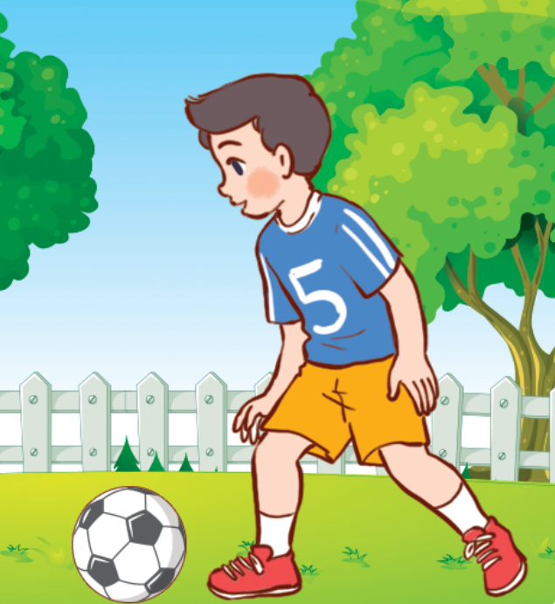
Listen and choose.

Slide 8
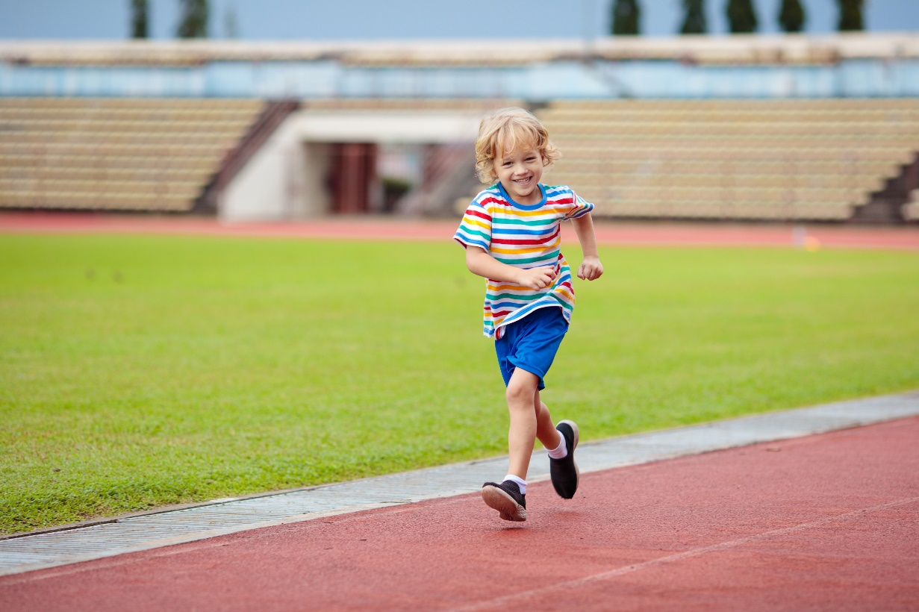
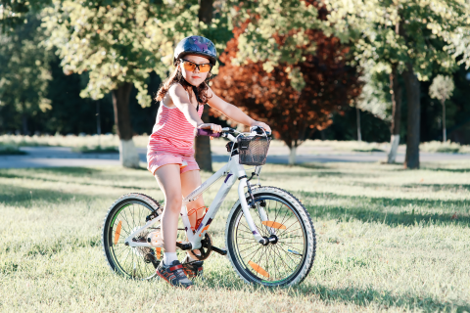
Listen and choose.

Slide 9

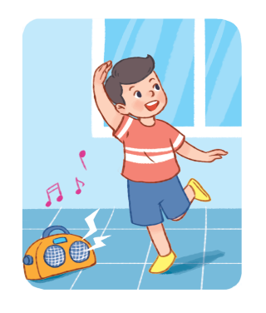
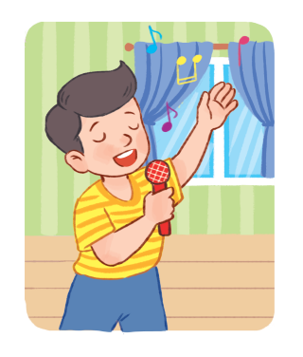
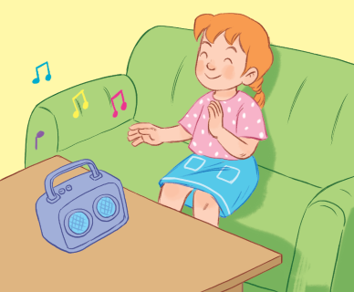
Listen and choose.

Slide 10
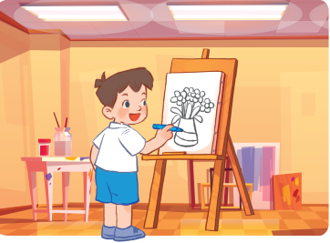

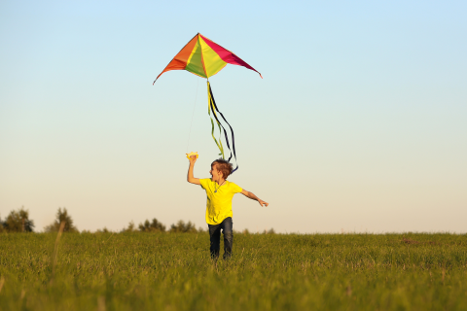
Listen and choose.

Slide 11
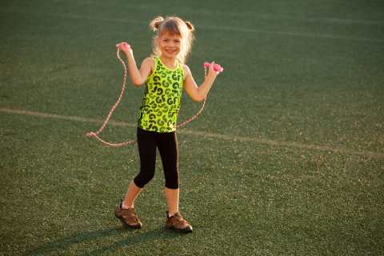

Listen and choose.

Slide 12
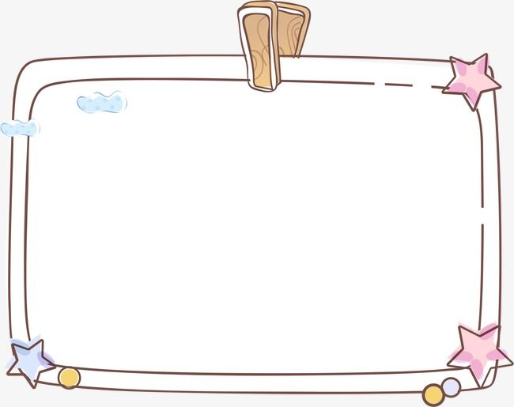
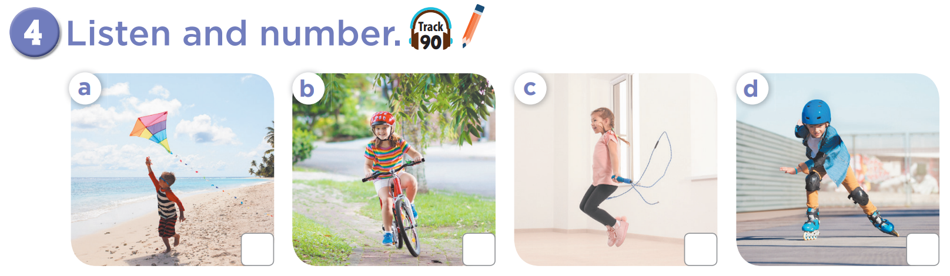
2
3
4
1

Slide 13
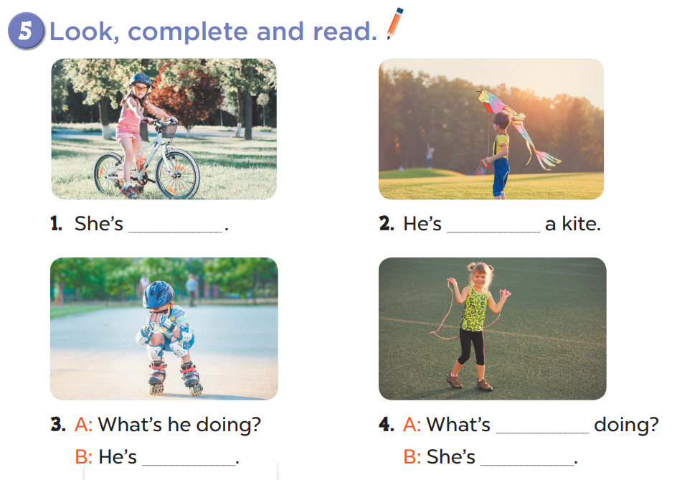
cycling
flying
she
skating
skipping

Slide 14
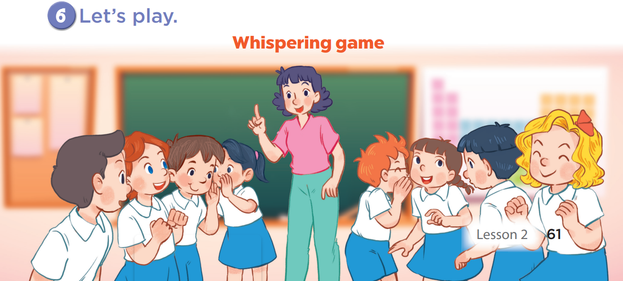

Slide 15

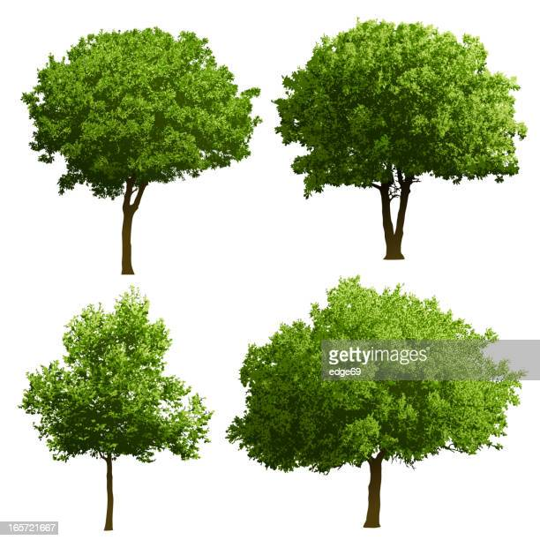
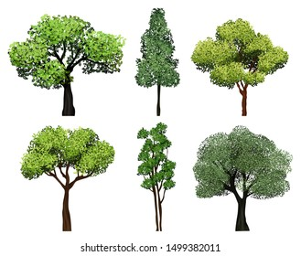

Green Earth
Team A
Team B
1
2
3
4
5
6
7
8
Notes:
Click on the numbers to go to the questions.
Click on the home icon to turn back to the menu.
Click on the trees to grow trees for the Earth.

Slide 16
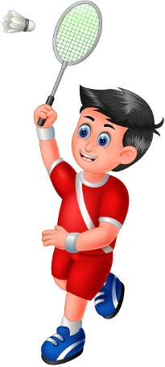
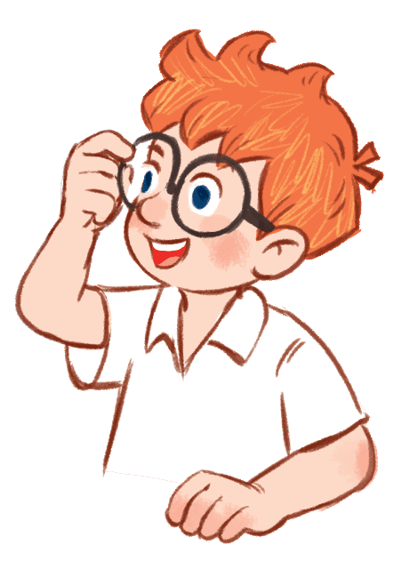
What’s he doing?
He’s playing badminton.
Notes:
Let pupils look and guess what people are doing.

Slide 17
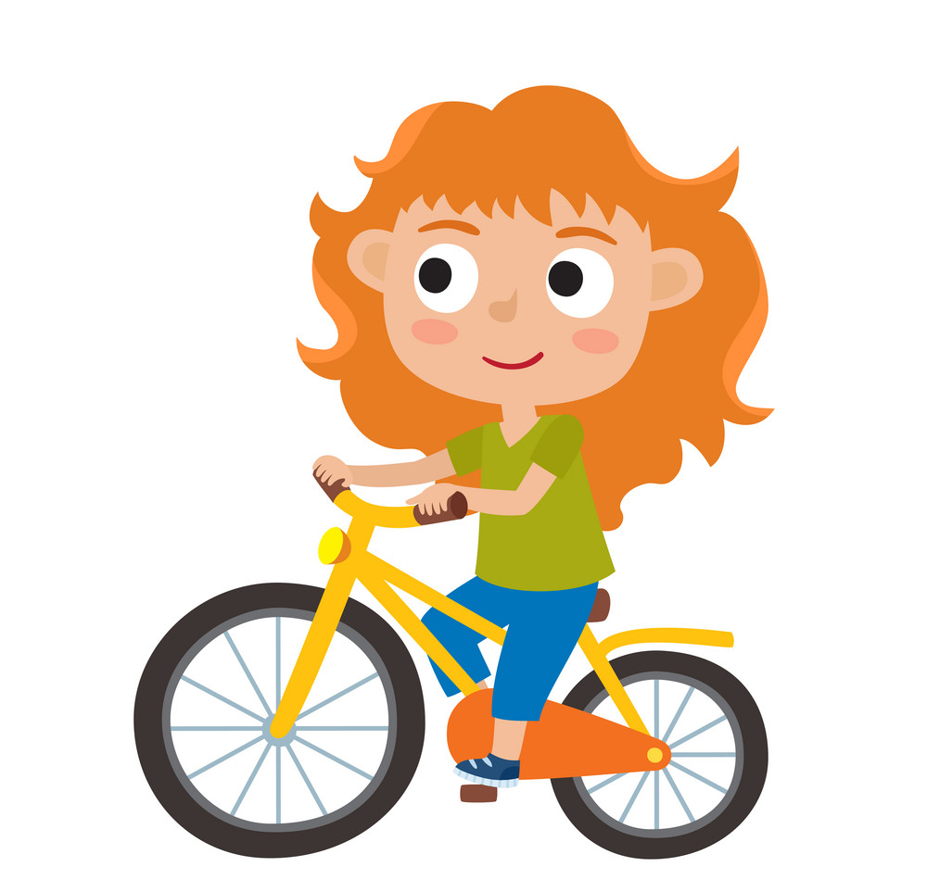
What’s she doing?
She’s cycling.

Slide 18
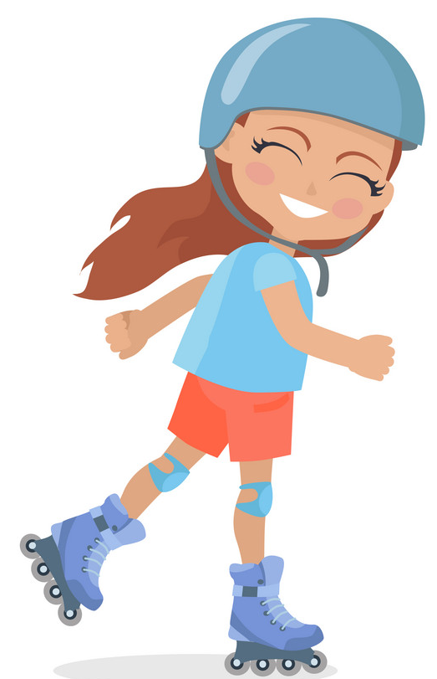
What’s she doing?
She’s skating.

Slide 19
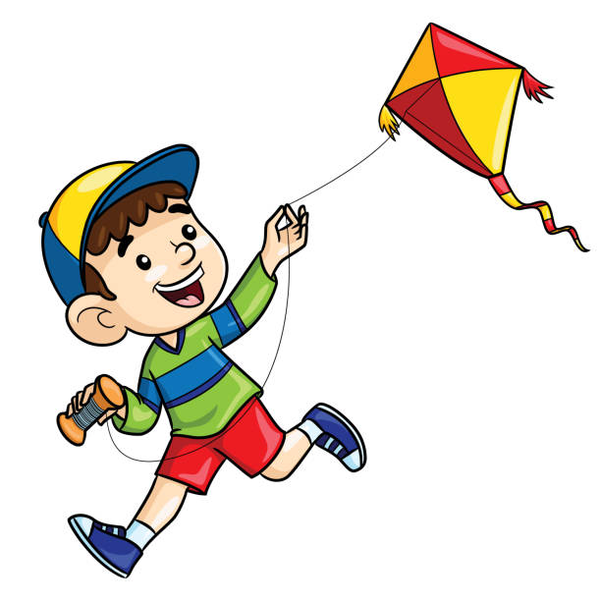
What’s he doing?
He’s flying a kite.

Slide 20

What’s she doing?
She’s walking.

Slide 21

What’s she doing?
She’s skipping.

Slide 22
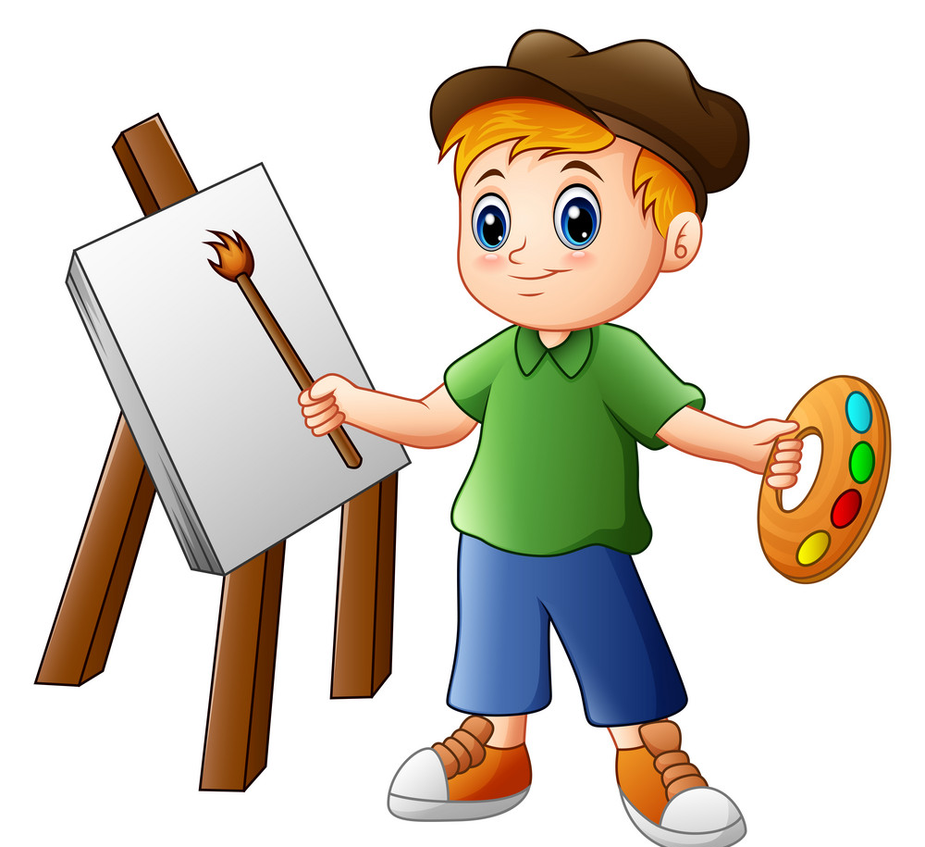
What’s he doing?
He’s painting.

Slide 23
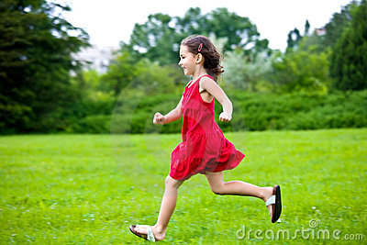
What’s she doing?
She’s running.

