Slide 1





Our toys
17
LESSON 3
Part 1,2,3

Slide 2
Contents
1
Warm-up and review
2
Listen and repeat.
3
Listen and circle.
4
Let’s chant.
5
Fun corner and wrap-up

Slide 3
Warm-up and review
1
1
Game: Chasing the thief

Slide 4




Notes:
Step 1: Divide the class into 4 teams.
Step 2: Invite 1 pupil to go to the board and look at the picture, then say aloud which one is missing.
Step 3: Encourage pupil to join in the game.
Step 4: Give points for pupils.

Slide 5









He wants to steal…
Click on the right option
Trains
Buses
Cars
TIME’S UP

Slide 6

He wants to steal…
Click on the right option
plane
car
doll
TIME’S UP

Slide 7

He wants to steal…
Click on the right option
doll
train
kite
TIME’S UP

Slide 8

He wants to steal…
Click on the right option
planes
trucks
buses
TIME’S UP

Slide 9

He wants to steal…
Click on the right option
cars
trucks
kites
TIME’S UP

Slide 10
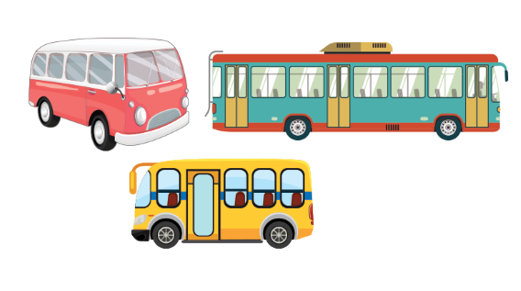
He wants to steal…
Click on the right option
dolls
planes
buses
TIME’S UP

Slide 11

He wants to steal…
Click on the right option
balls
bus
dolls
TIME’S UP

Slide 12

He wants to steal…
Click on the right option
Teddy bears
kites
Cars
TIME’S UP

Slide 13




Slide 14
Listen and repeat.
2
2

Slide 15
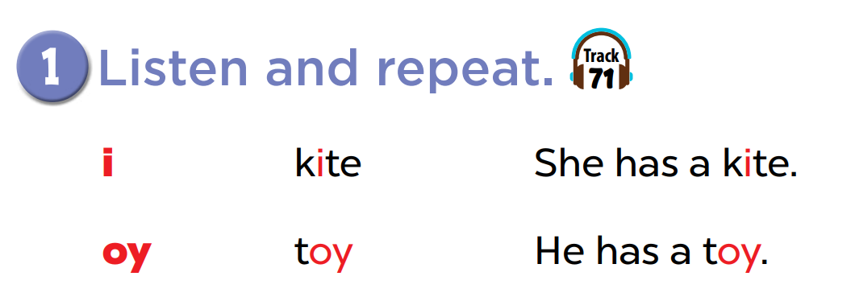

Slide 16
Listen and circle.
3
3

Slide 17
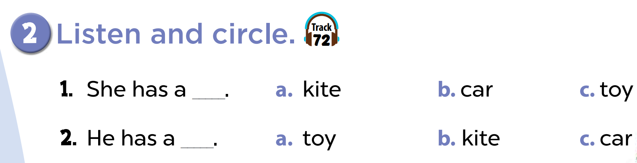

Slide 19


Listen and choose
She has _______.

Slide 20
Listen and choose
He has a ________.

Slide 21

Listen and choose
They have three _____.

Slide 22
Listen and choose
She has a _____.

Slide 23


Listen and choose
They have ____.

Slide 24

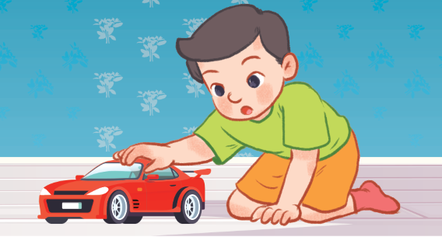
Listen and choose
He has ____.

Slide 25
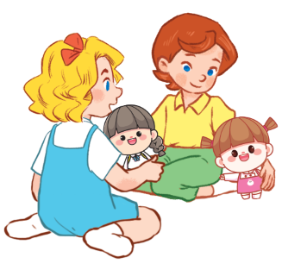
Listen and choose
They have two _____.

Slide 26

Let’s chant.
4
4

Slide 27
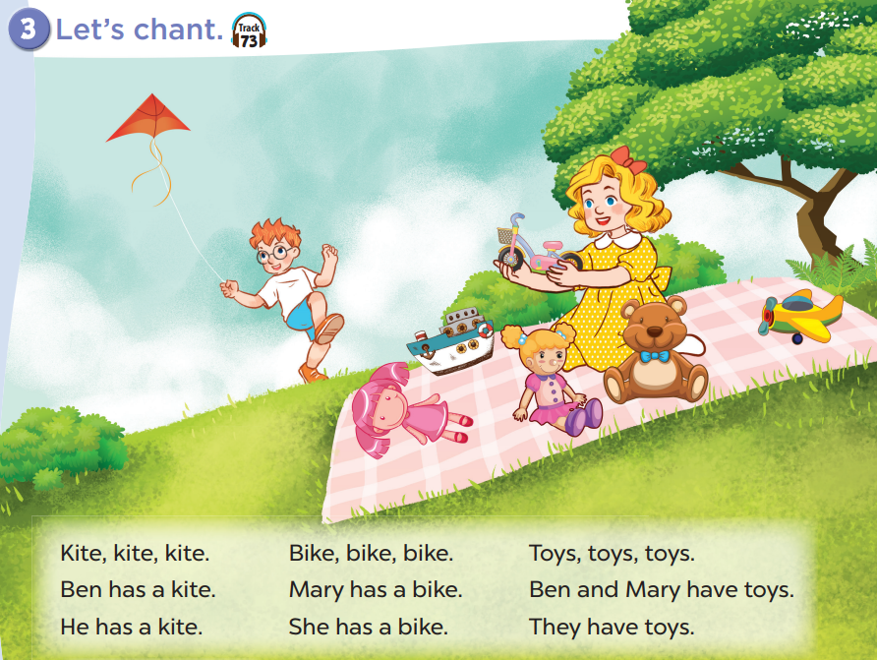

Slide 29
Fun corner and wrap-up
5
5

Slide 30

Guessing game
Notes:
Step 1: Divide the class into 2 teams.
Step 2: Invite each pupil from each team to look at the phonics words or pictures and say them aloud. The faster pupil with correct answer will get points for his/her team.
Step 3: Encourage pupils to practice speaking English.
Step 4: Give points for pupils.

Slide 31
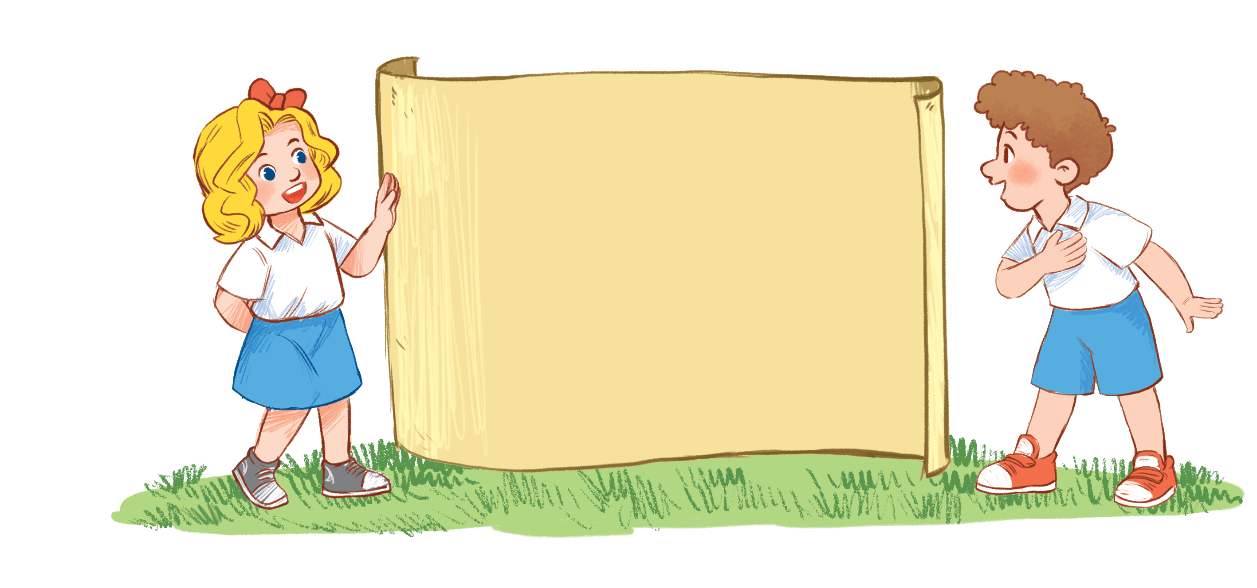
kite

Slide 32
i
i

Slide 33

toy

Slide 34
oy
oy

