Slide 1


Slide 2


Our summer holidays
10
Lesson 1 – Period 2

Slide 3


Table of Contents
Listen and tick.
Look, complete and read.
01
02
03
Warm-up
04
Let’s sing.
05
Fun corner

Slide 4
01
Warm-up
Guessing Game

Slide 5
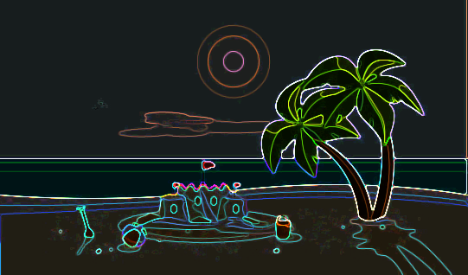
Where is it?

Slide 6
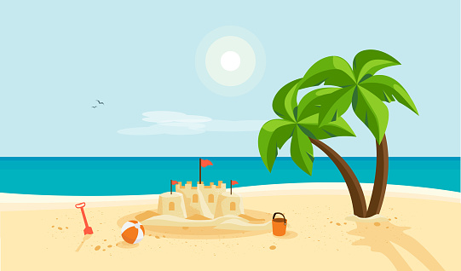
on the beach

Slide 7
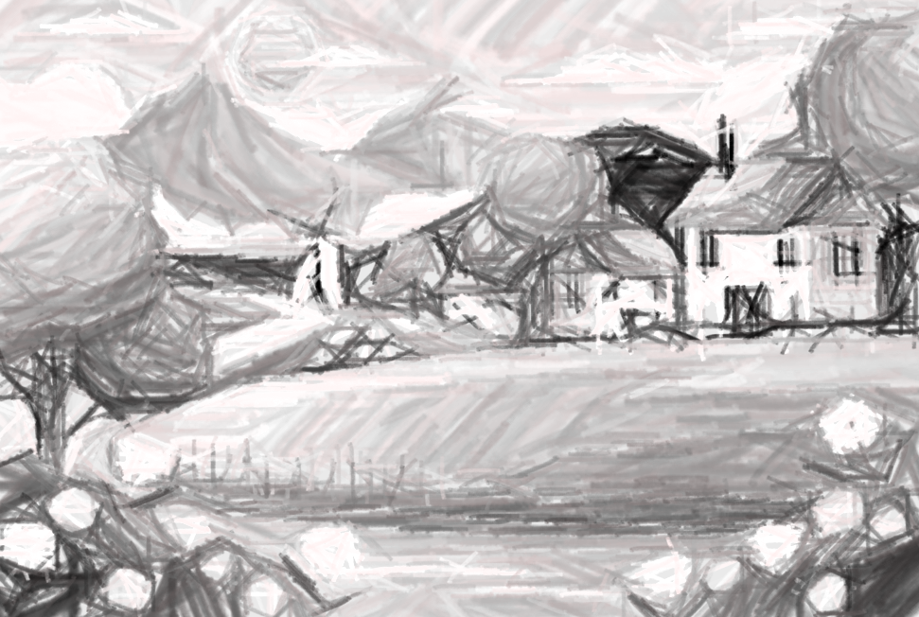
Where is it?

Slide 8
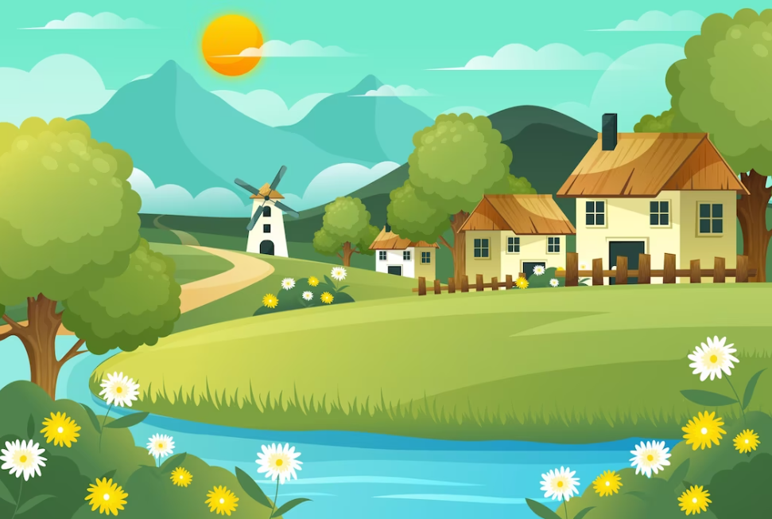
in the countryside

Slide 9
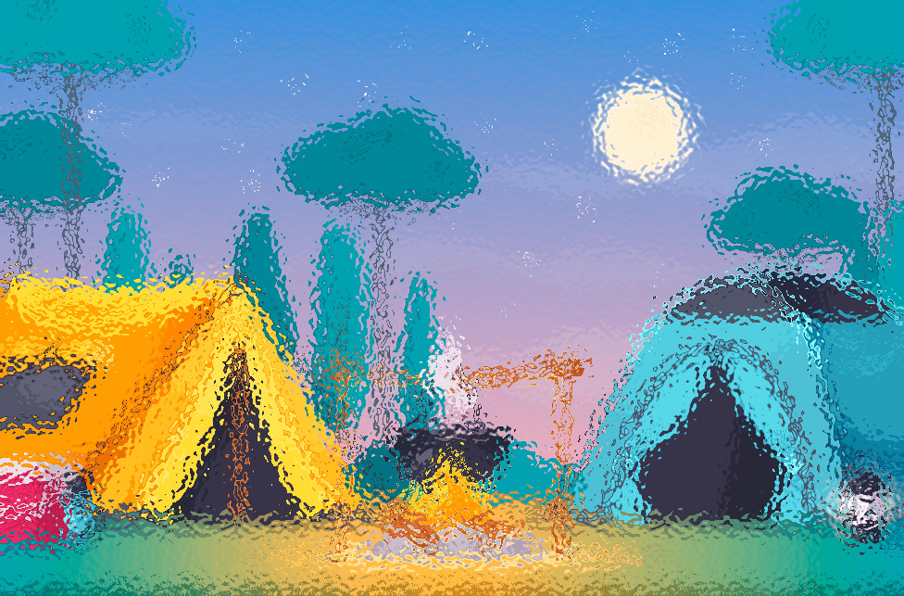
Where is it?

Slide 10
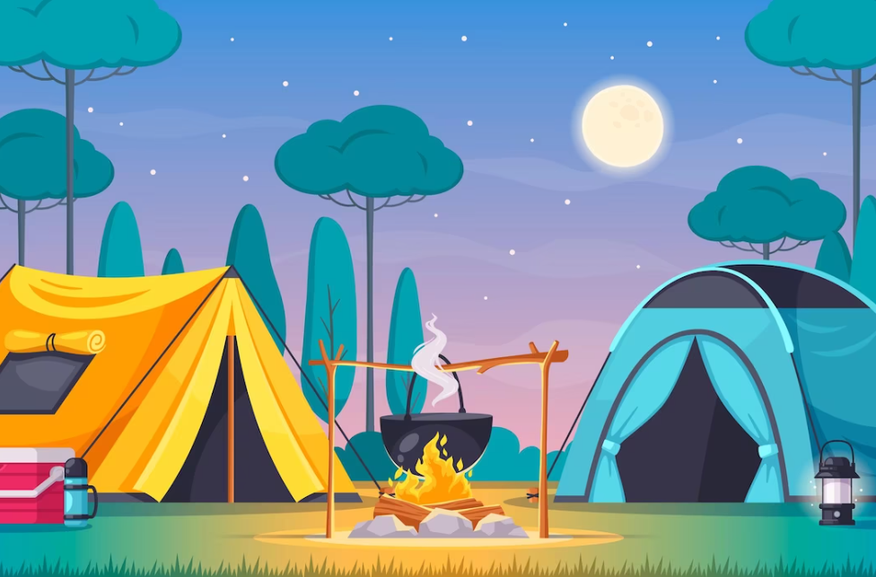
at the campsite

Slide 11

Where is it?

Slide 12
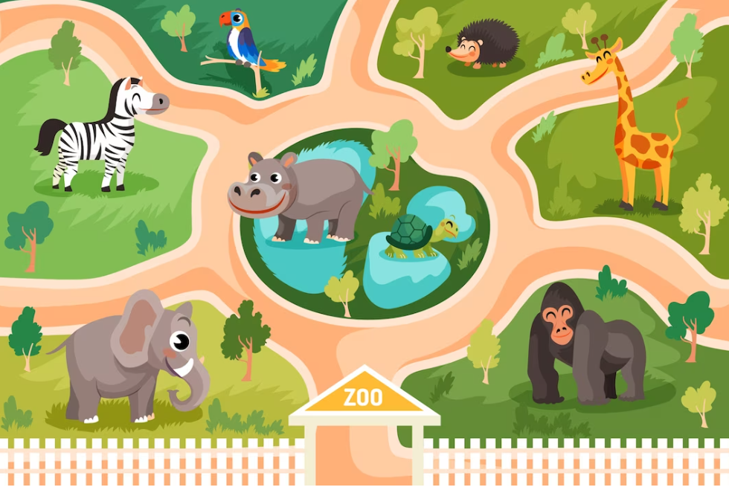
at the zoo

Slide 13
02
Activity 4
Listen and tick.

Slide 14


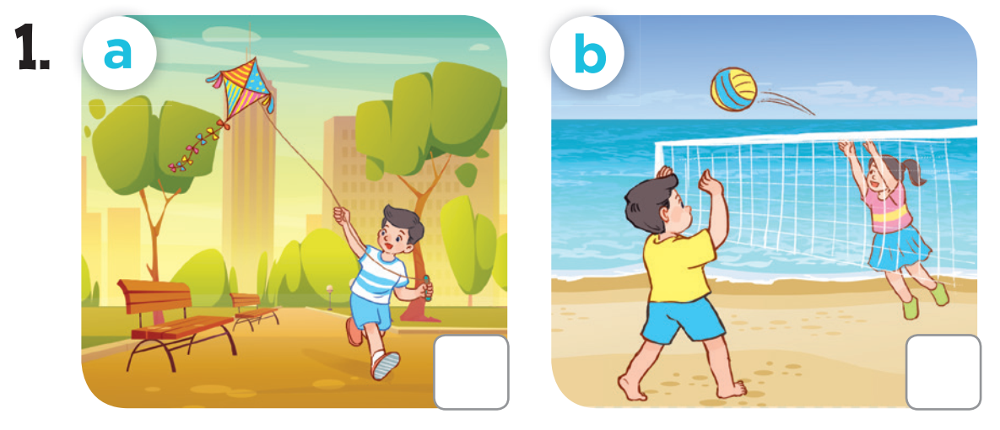


Slide 15
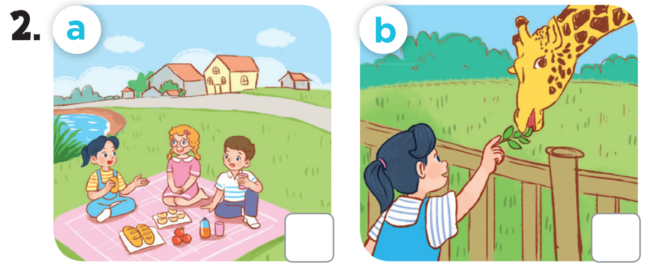

Slide 16
03
Activity 5
Look, complete and read.

Slide 17
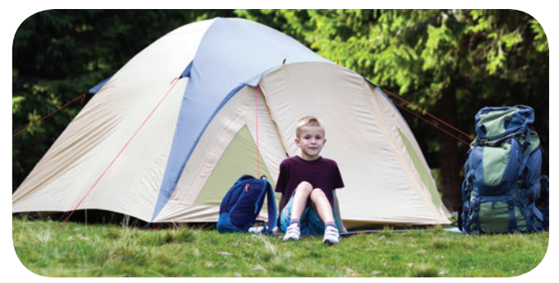
1. I was at __________ yesterday.
the campsite

Slide 18
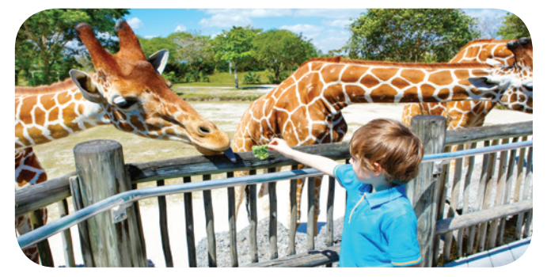
2. I was ________ last weekend.
at the zoo

Slide 19
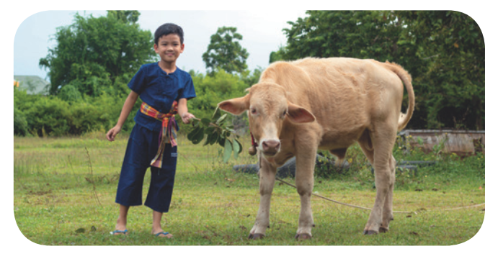
3. A: Were you in the mountains
last weekend?
B: No, I wasn’t. I was in
____________.
the countryside

Slide 20
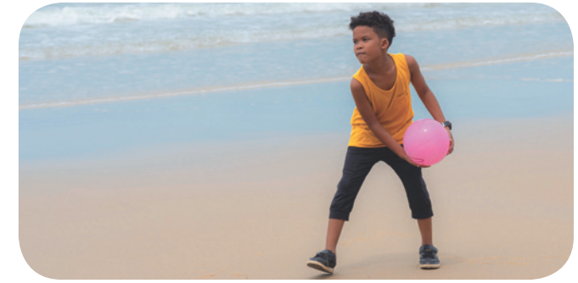
4. A: _____ you on the beach
yesterday?
B: _____, I was.
Were
Yes

Slide 21
04
Activity 6
Let’s sing.

Slide 22

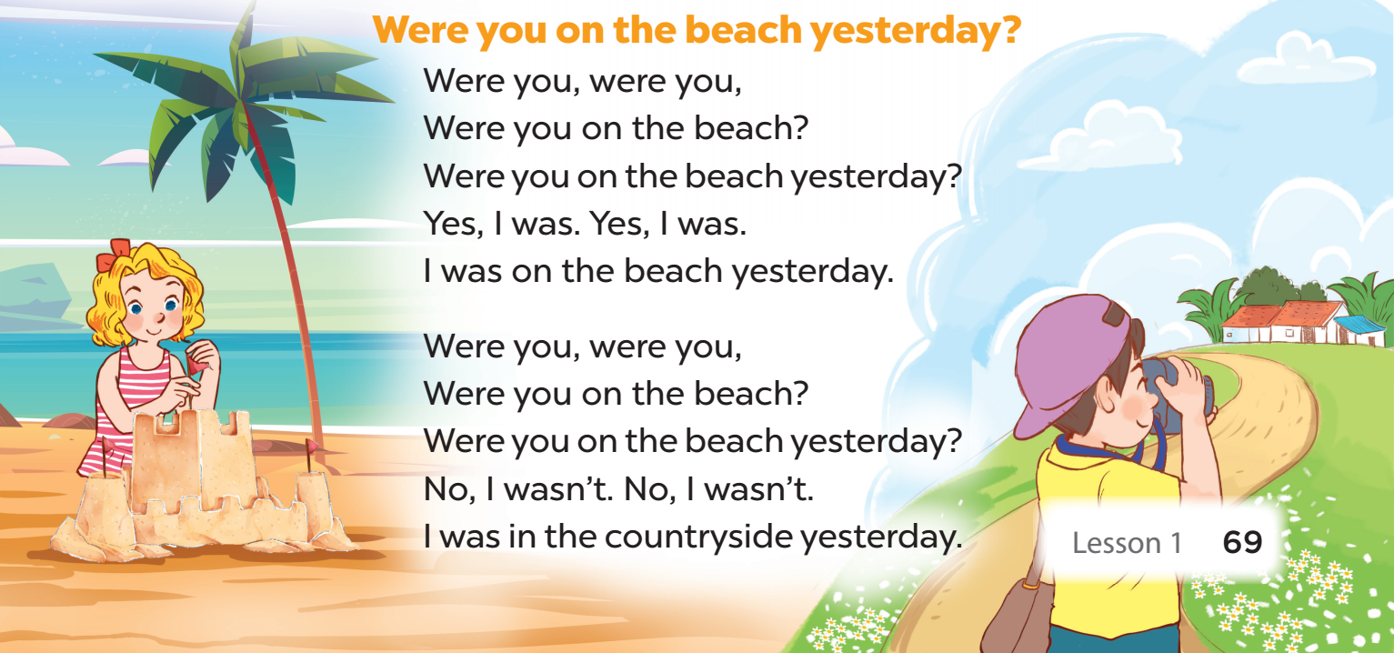

Slide 23
05
FUN CORNER
Fast food game

Slide 24

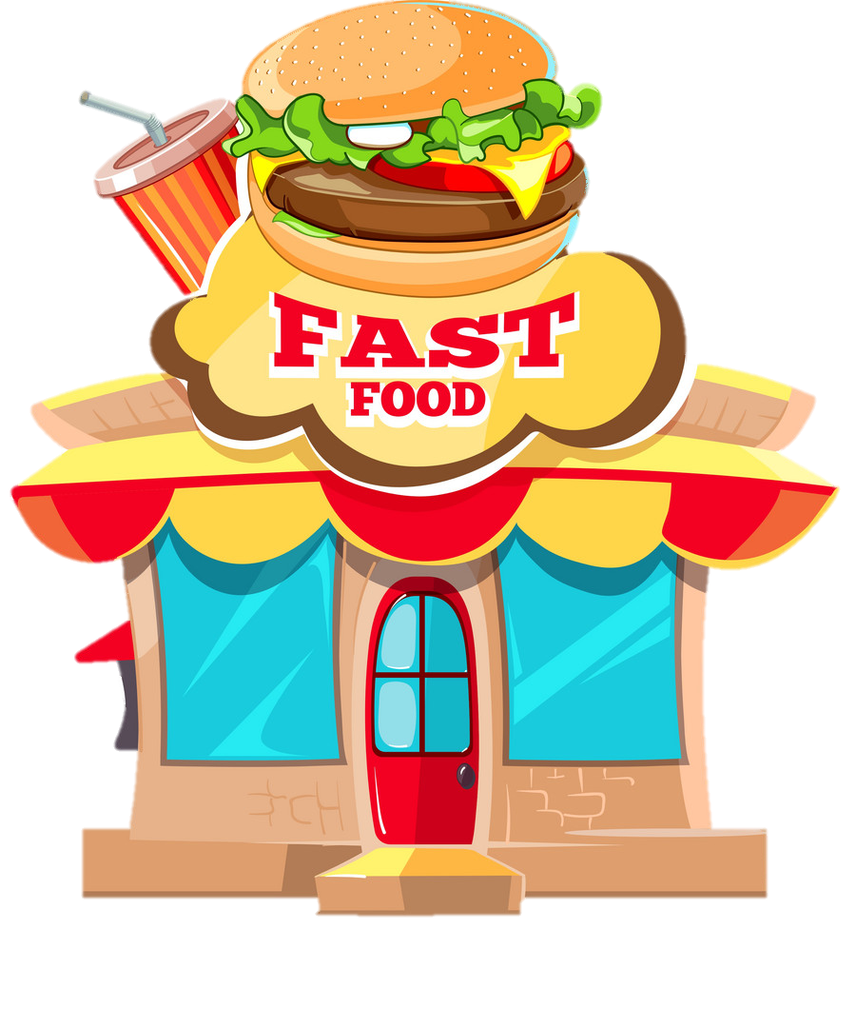
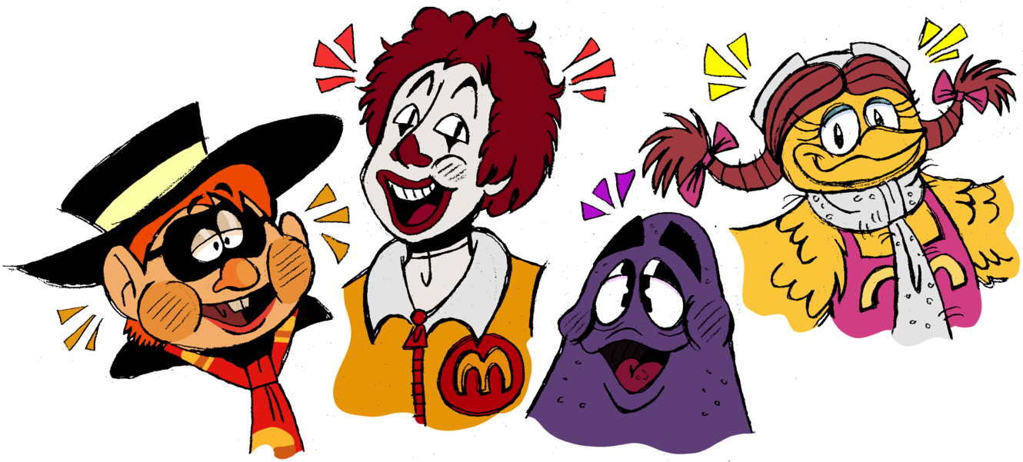

Slide 25










Slide 26
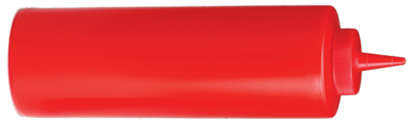




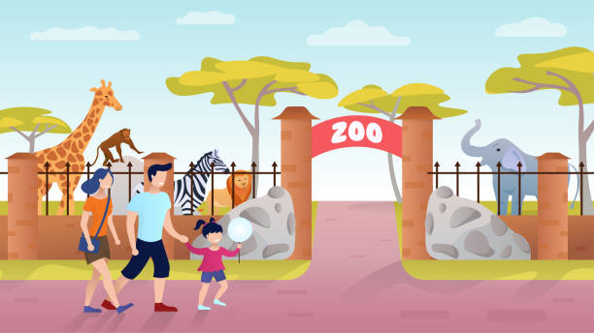


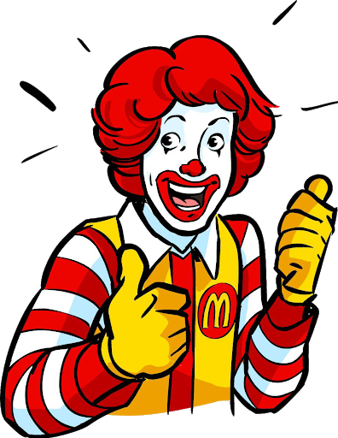
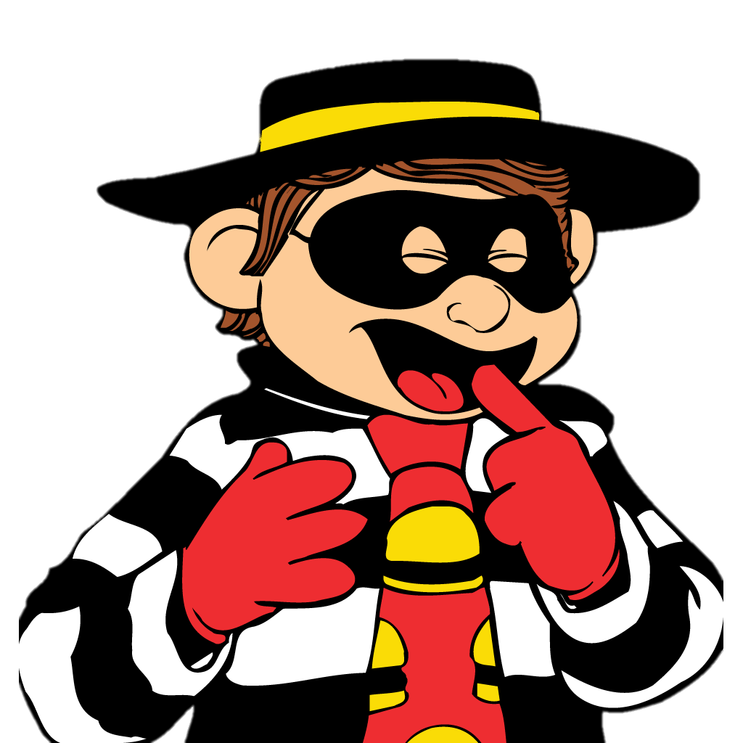
____ you at the zoo yesterday?
Were

Slide 27
Were you ___ the beach last summer?
on

Slide 28
Were you at the ____ last weekend?
campsite

Slide 29
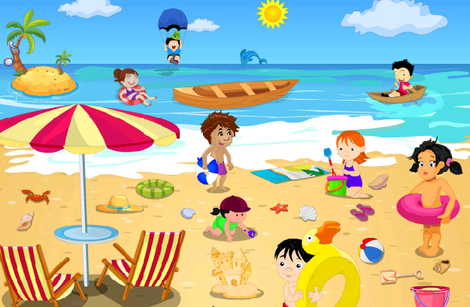
Were you in the countryside last weekend?
No, I wasn’t.

Slide 30
Were you at the zoo
last weekend?
Yes, I was.

Slide 31
Were you ____ the campsite last weekend?
at

Slide 32
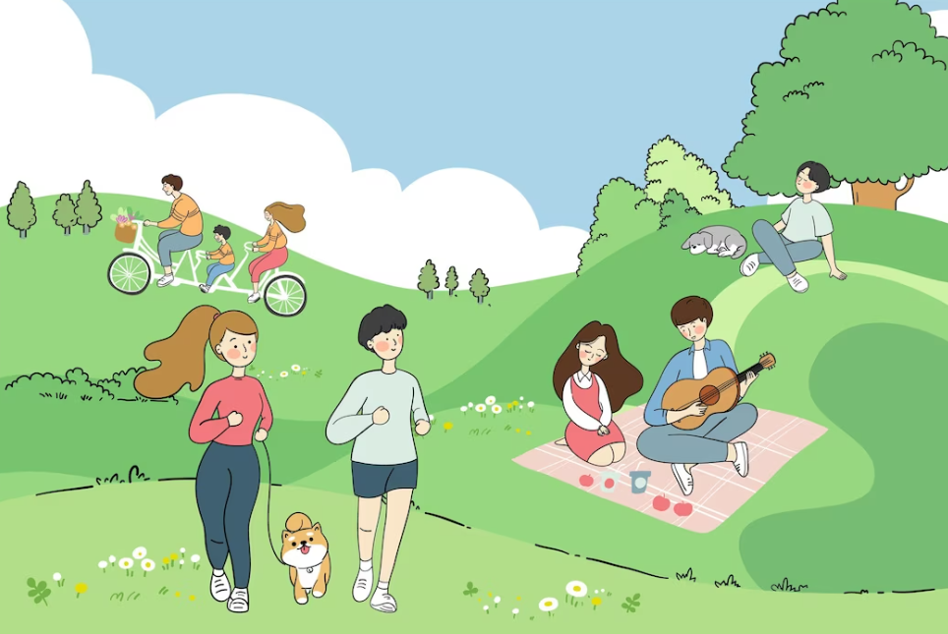
- Were you at the park yesterday?
- ___, I was.
Yes

Slide 33
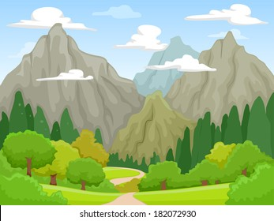
Were you on the beach yesterday? - ___, I wasn’t.
No

Slide 34
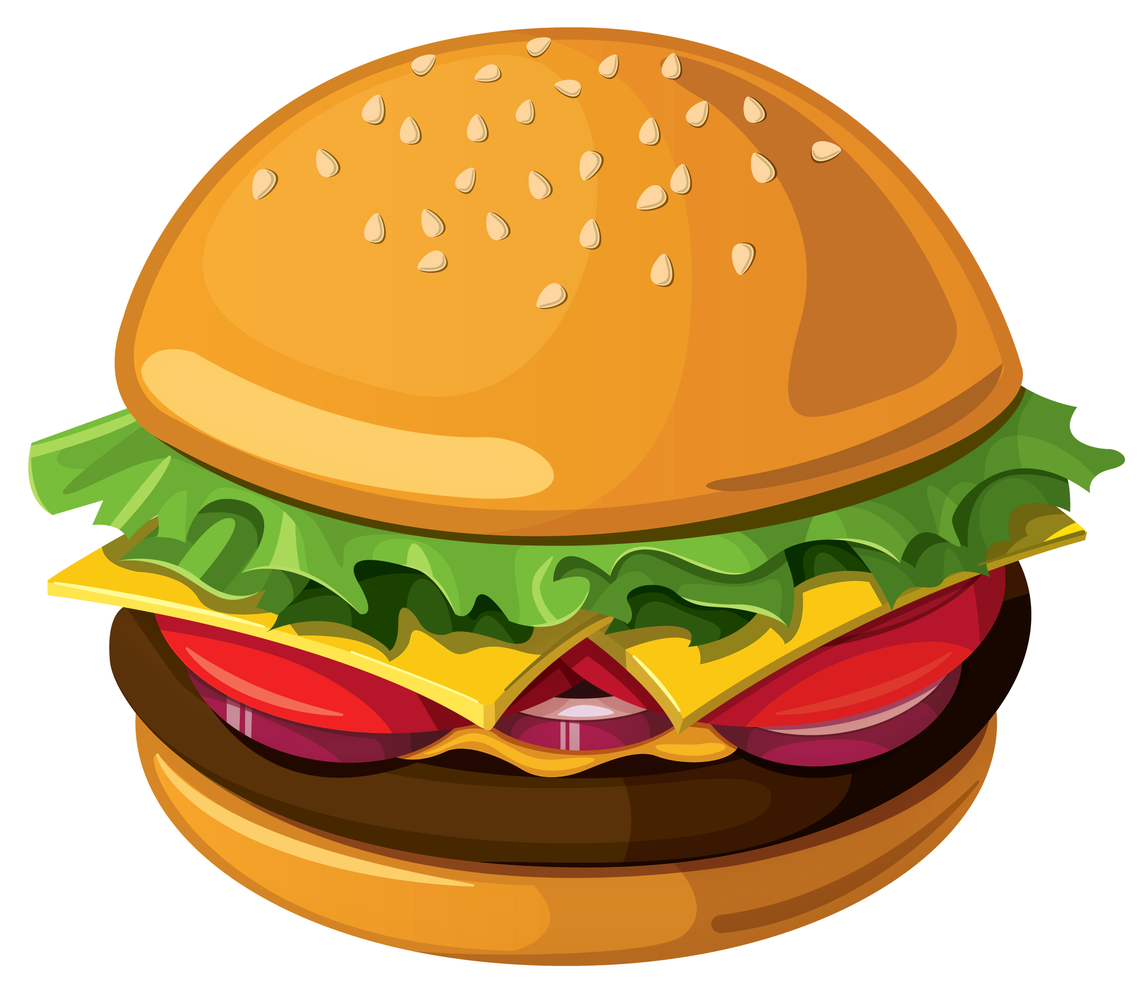
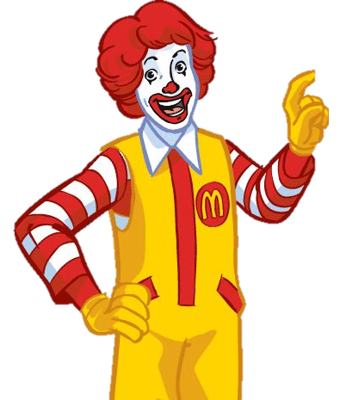
You got a hamburger!

Slide 35
You got a hamburger!

Slide 36
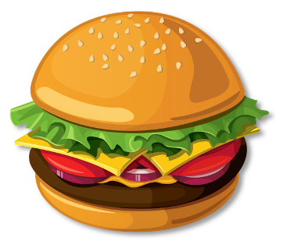
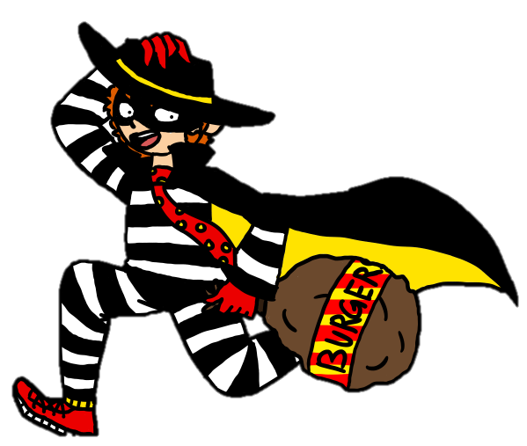
You got 7 hamburgers!
You got a hamburger!

Slide 37
You got 2 hamburgers!

Slide 38
You got 6 hamburgers!

Slide 39
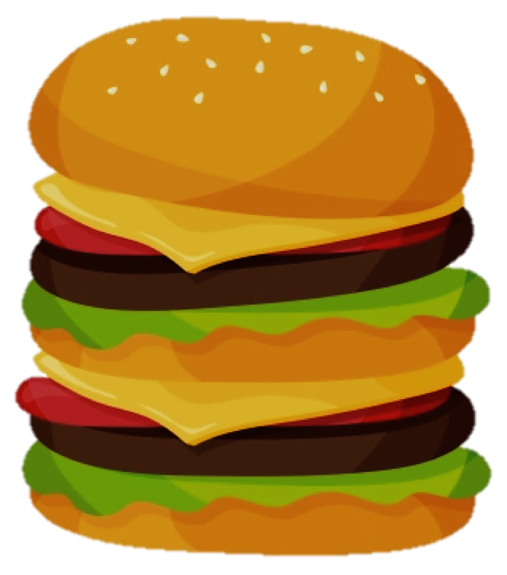
You got a double cheese burger!

Slide 40
You got 4 hamburgers!

Slide 41
You got 3 hamburgers!

Slide 42
You got 3 hamburgers!

Slide 43
You got 2 hamburgers!

Slide 44

Website: hoclieu.vn
Fanpage: facebook.com/www.tienganhglobalsuccess.vn

