Slide 1
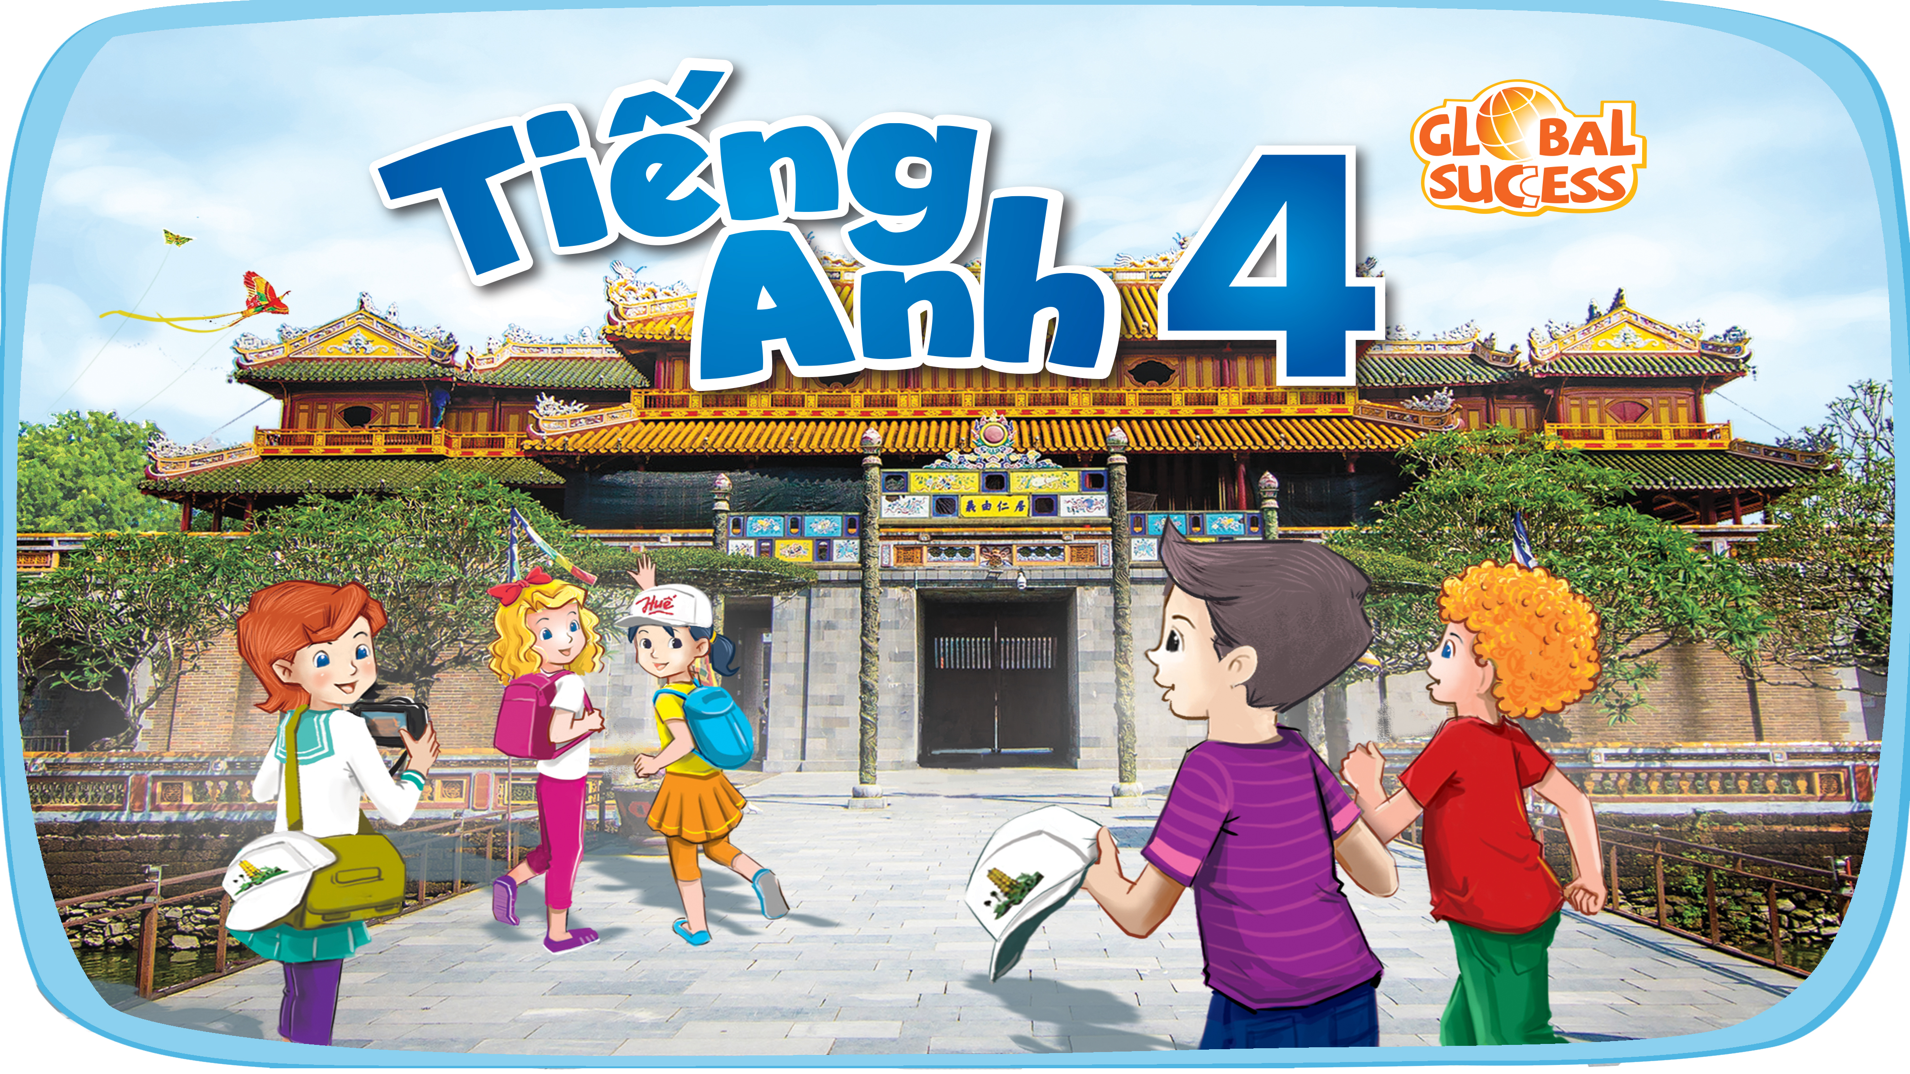

Slide 2


Our summer holidays
10
Lesson 2 – Period 4

Slide 3


Table of Contents
Listen and match.
Look, complete
and read.
01
02
03
Warm-up
04
Let’s play.
05
Fun corner

Slide 4
01
Warm-up

Slide 5
Who is Faster?

Slide 6
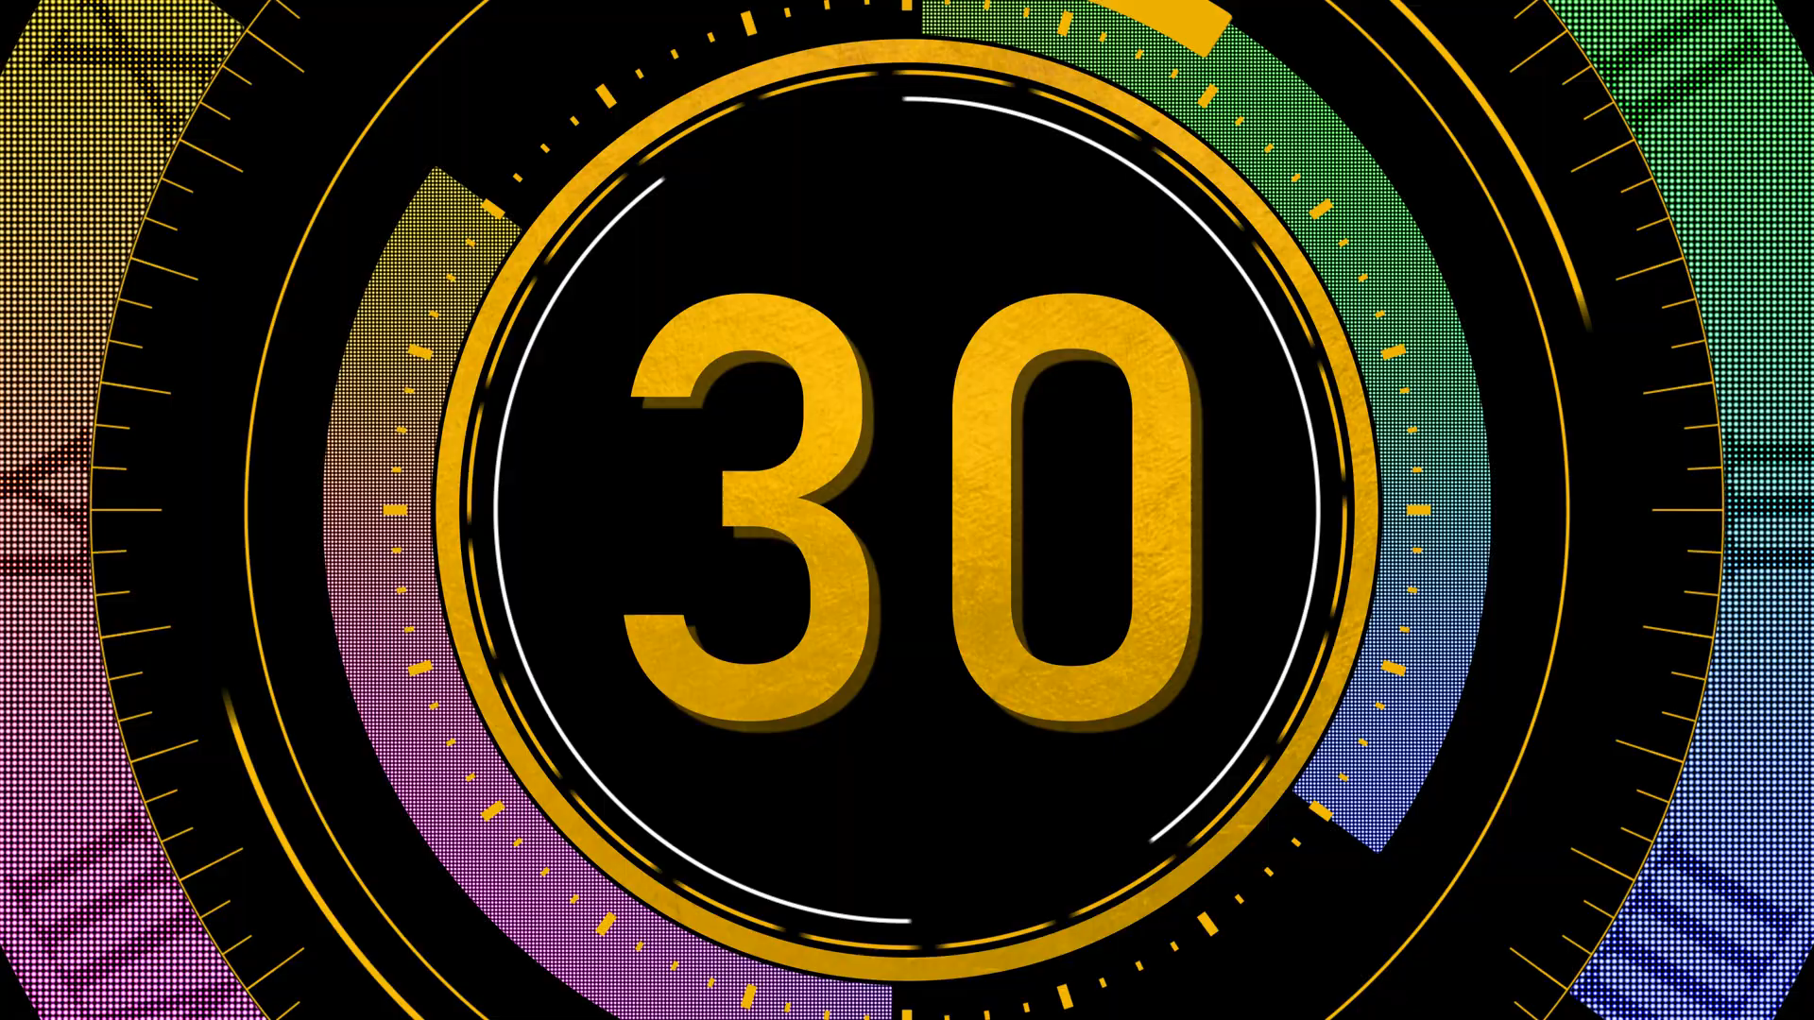

It’s a city in Thailand.
Bangkok
Sydney
Tokyo
A
B
C

Slide 7
The “Shell” Opera House is here.
Sydney
London
Tokyo
A
B
C

Slide 8
It’s in England.
Sydney
London
Bangkok
A
B
C

Slide 9
The Big Ben is here.
Sydney
London
Tokyo
A
B
C

Slide 10
It’s in Australia.
Sydney
London
Tokyo
A
B
C

Slide 11
It’s in Japan.
Sydney
London
Tokyo
A
B
C

Slide 12
You can see many temples here.
Sydney
Bangkok
Tokyo
A
B
C

Slide 13
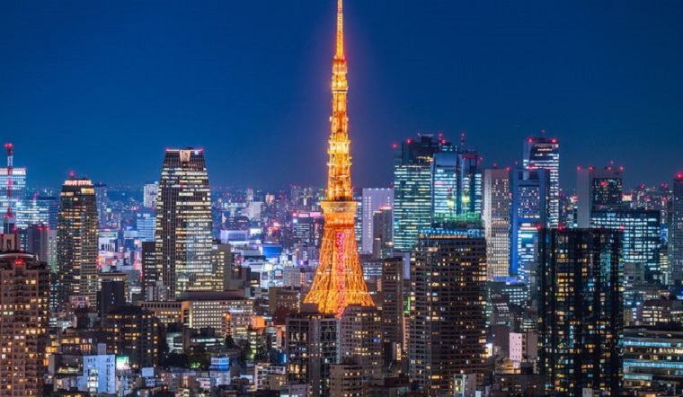
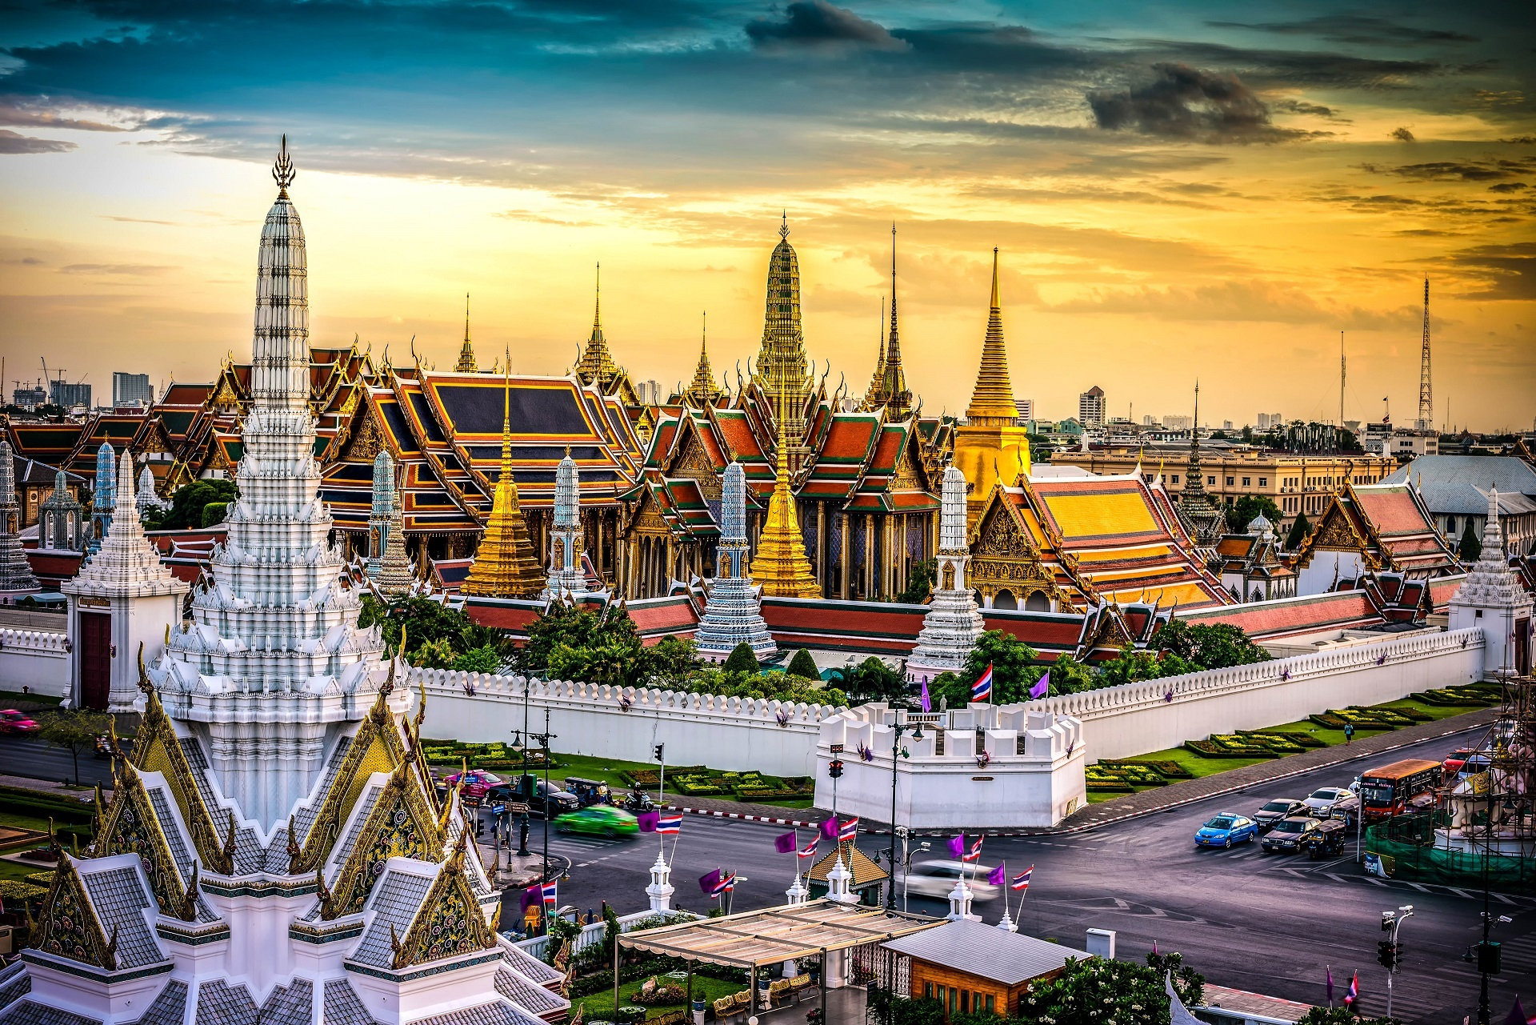
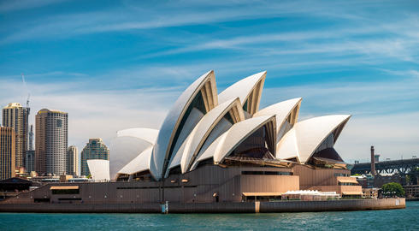
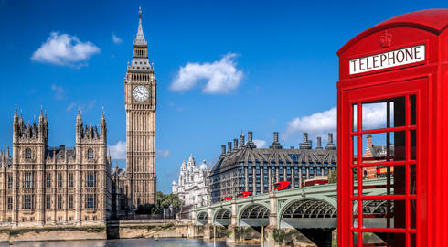
Tokyo
Bangkok
Sydney
London

Slide 14
02
Activity 4
Listen and match.

Slide 15


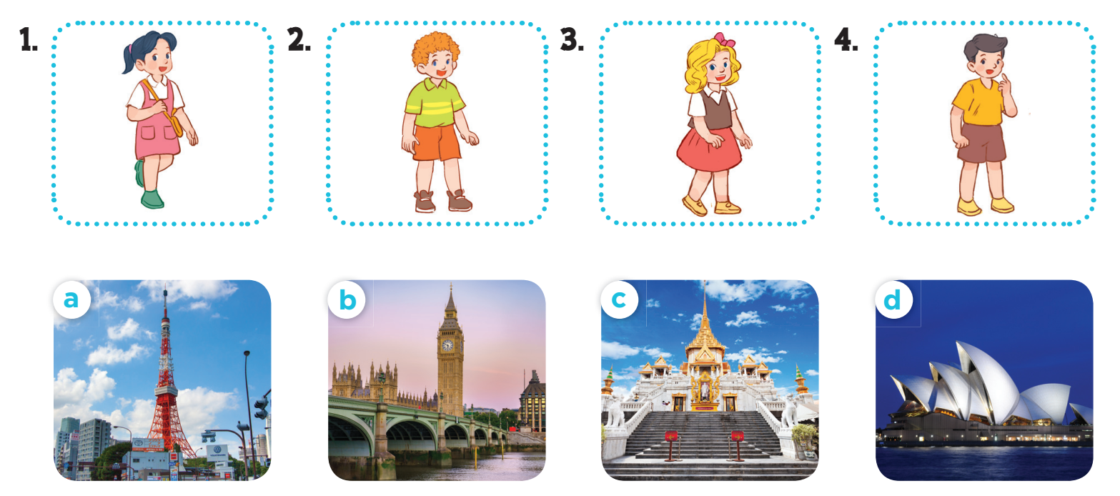

Slide 16
03
Activity 5
Look, complete and read.

Slide 17

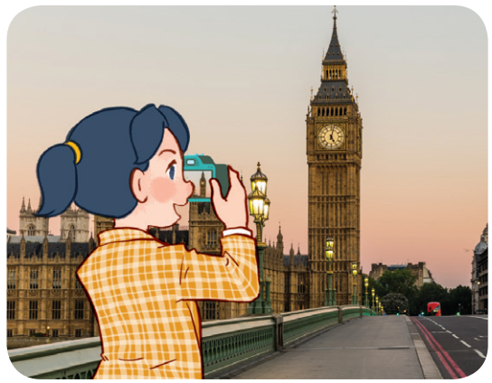
1. A: Where were you last summer, Mai?
B: I was in _______.
A: Is it a big city?
B:____, it is.
London
Yes

Slide 18
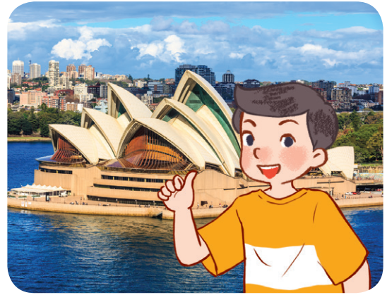
1. A: ______ were you last summer, Nam?
B: I ______ in Sydney.
Were you in Sydney, too?
A: ____, I wasn’t.
Where
was
No

Slide 19
04
Activity 6
Let’s play.

Slide 20
MAKING SENTENCES

Slide 21
Where / you / summer / were / last / ?
→ Where were you last summer ?

Slide 22
was / Sydney / I / in / .
→ I was in Sydney.

Slide 23
Were / Bangkok / you / in / ?
→ Were you in Bangkok?

Slide 24
I / wasn’t / No / , / .
→ No, I wasn’t.

Slide 25
big / a / Is / city / it / ?
→ Is it a big city?

Slide 26
05
FUN CORNER
Plants vs Zombies

Slide 27
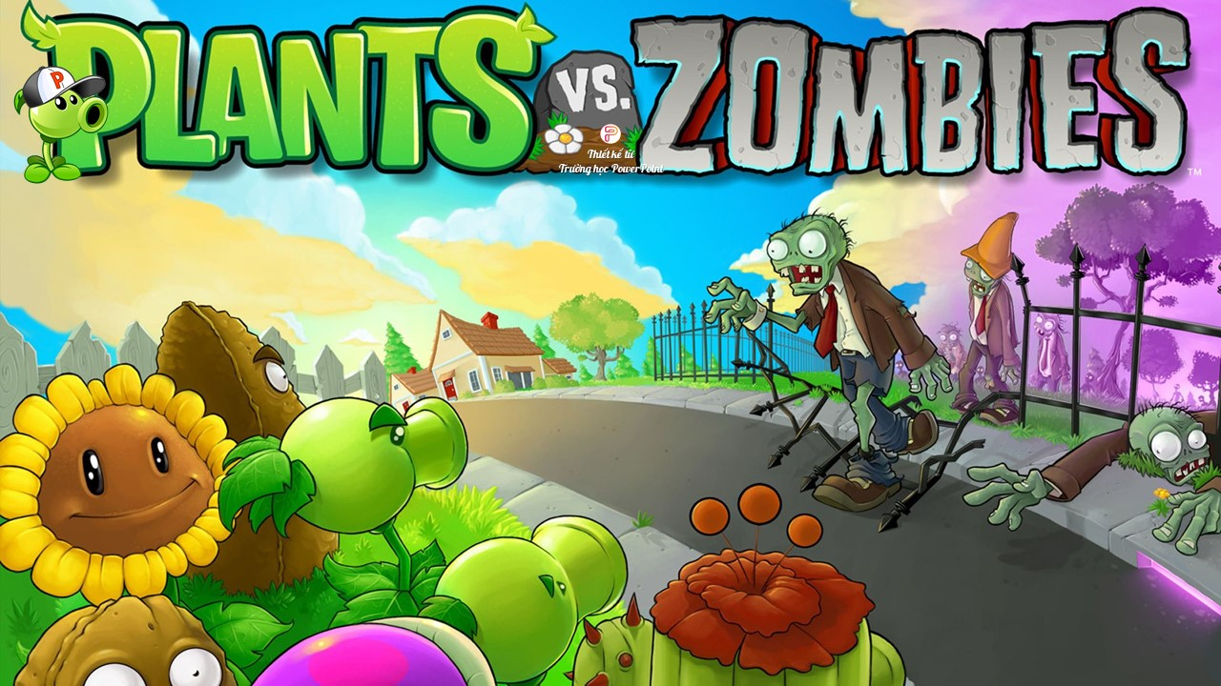


Slide 28
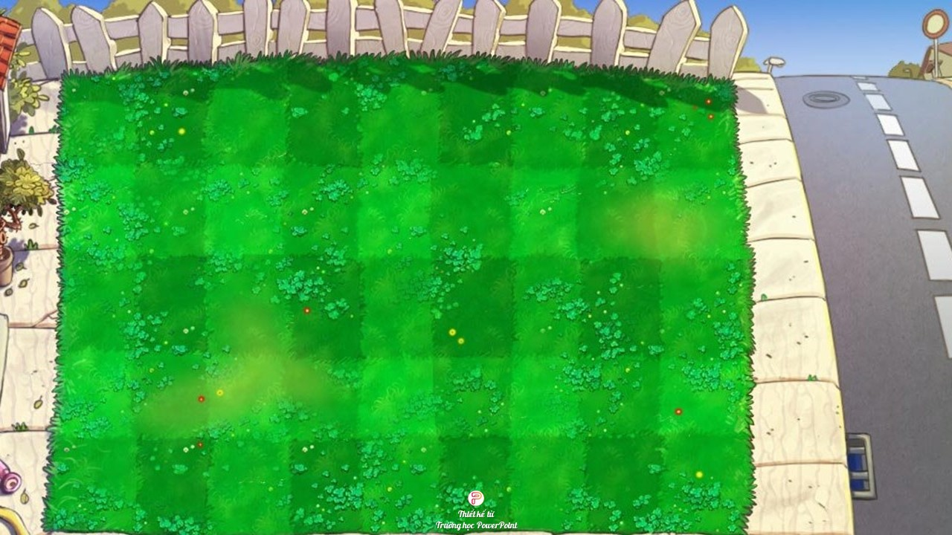

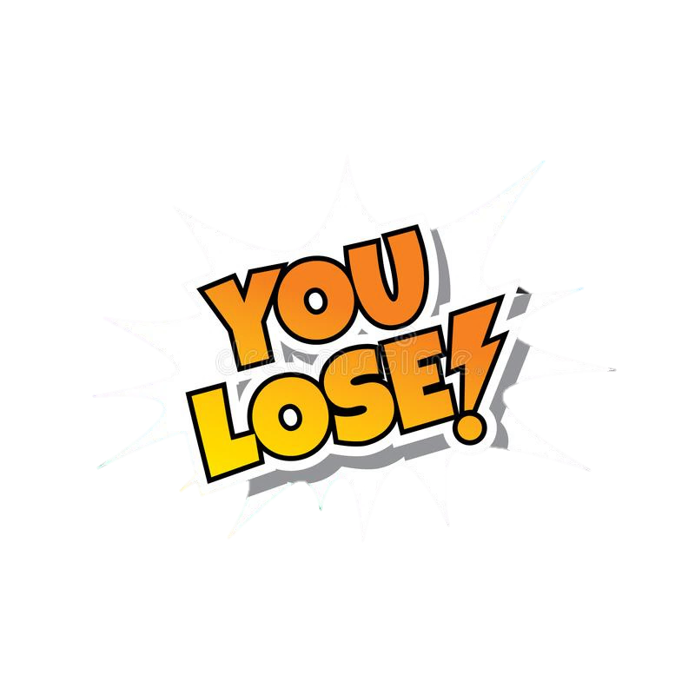

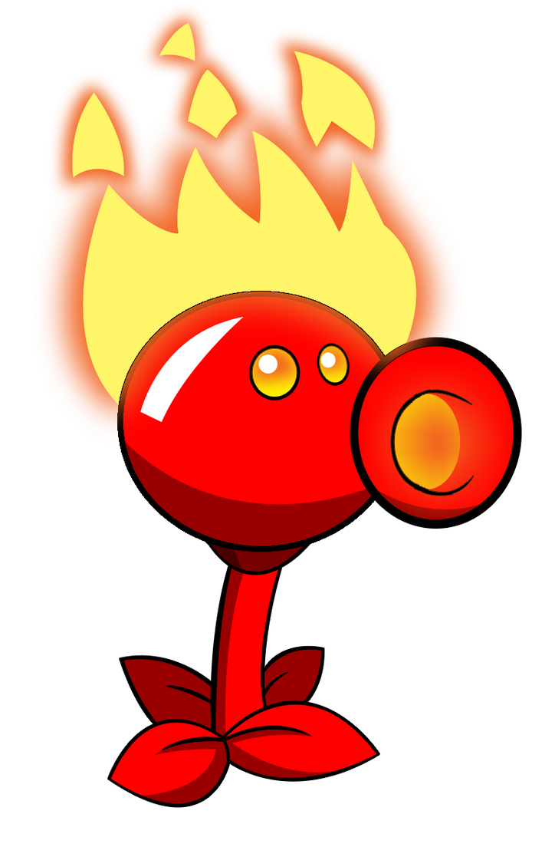
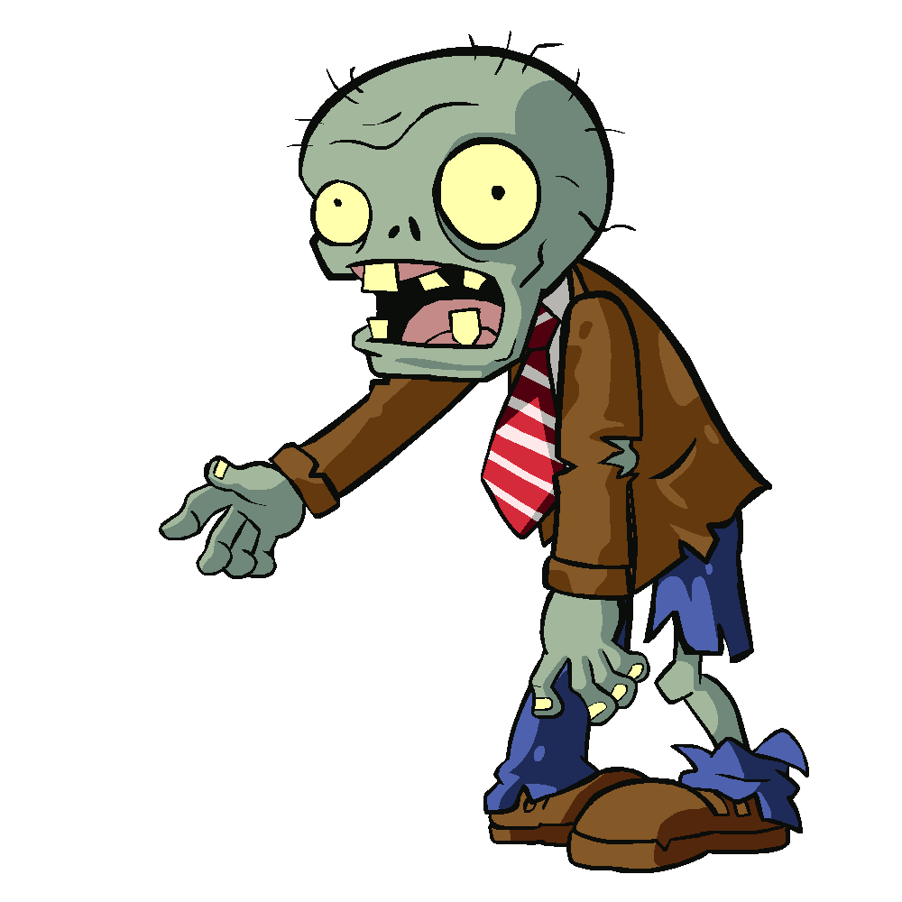










Slide 29
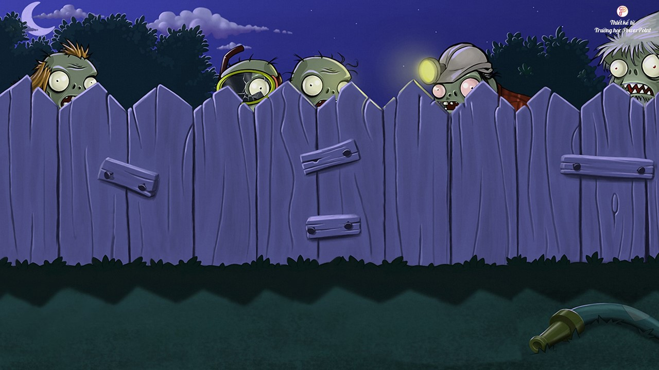


Choose the correct answer:
- ___ were you last summer ?
- I was in London.
A. What
B. When
C. Where
D. How

Slide 30
Choose the correct answer:
A. Bangkok
B. Tokyo
C. London
D. Sydney

Slide 31
Choose the correct answer:
Where ___ you last summer?
A. do
B. are
C. was
D. were

Slide 32
Choose the correct answer:
A. Bangkok
B. Tokyo
C. London
C. Sydney

Slide 33
Choose the correct answer:
Where ___ Bill last summer?
A. were
B. are
C. was
D. is

Slide 34
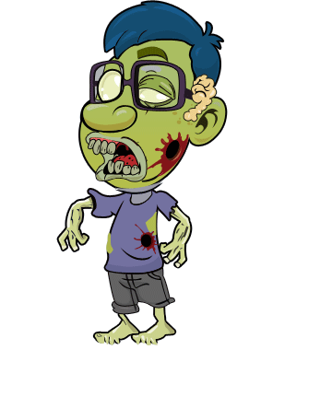

Slide 35
Choose the correct answer:
A. Sydney
B. Bangkok
C. Tokyo
D. London

Slide 36
Choose the correct answer:
Is London a big city?
A. Yes, I was.
B. No, she wasn’t
C. Yes, it is.
C. No, it does.

Slide 37
Choose the correct answer:
Were you ___ the zoo yesterday?
A. in
B. at
C. on
D. of

Slide 38
Choose the correct answer:
A. Sydney
B. Tokyo
C. London
D. Bangkok

Slide 39
Choose the correct answer:
Where was your family ___ weekend?
A. next
B. ago
C. last
D. this

Slide 40
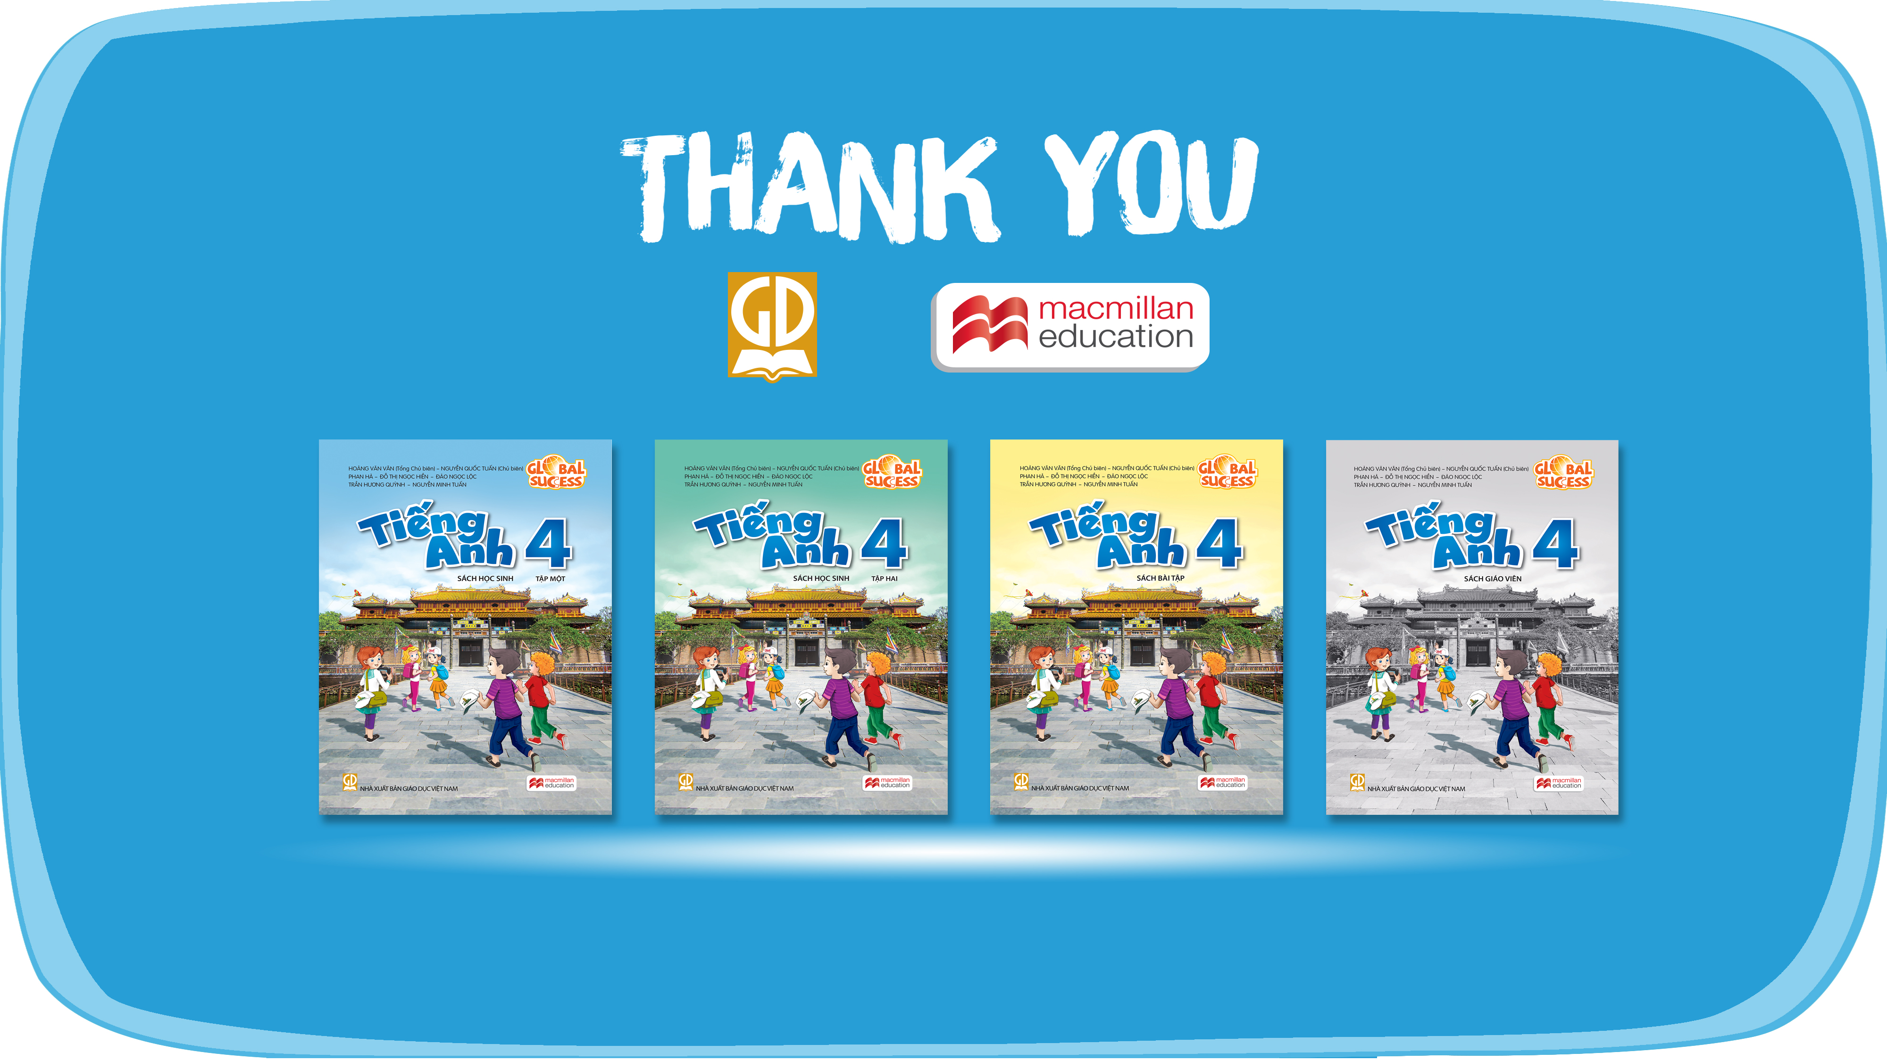
Website: hoclieu.vn
Fanpage: facebook.com/www.tienganhglobalsuccess.vn

