Slide 1





Slide 2


Slide 3



Things we can do
5
LESSON 1 PART 1,2,3

Slide 4
03
Activity 1 Look, listen and repeat.

Slide 5
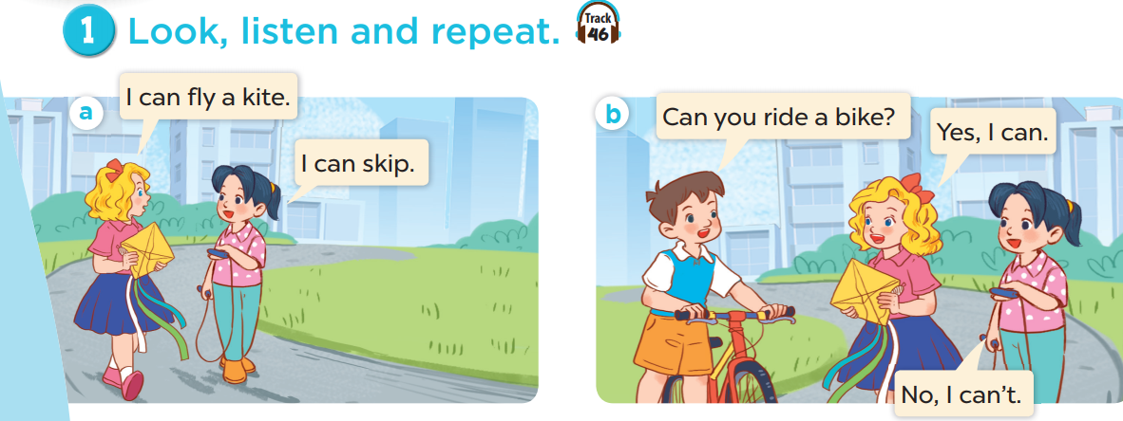


Slide 6
04
Activity 2 Listen, point and say.

Slide 7
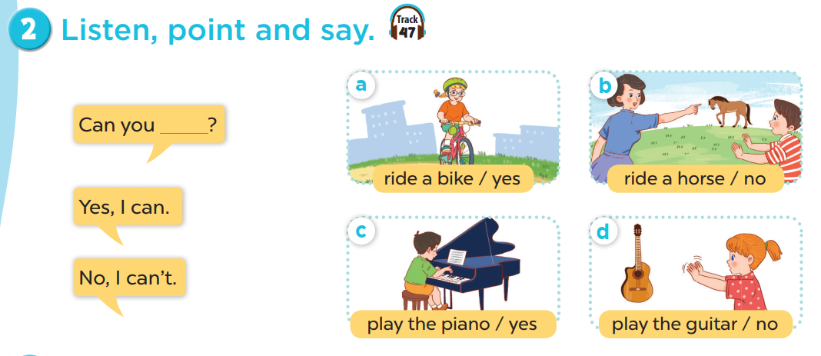

Slide 8
05
Activity 3 Let’s talk.

Slide 9
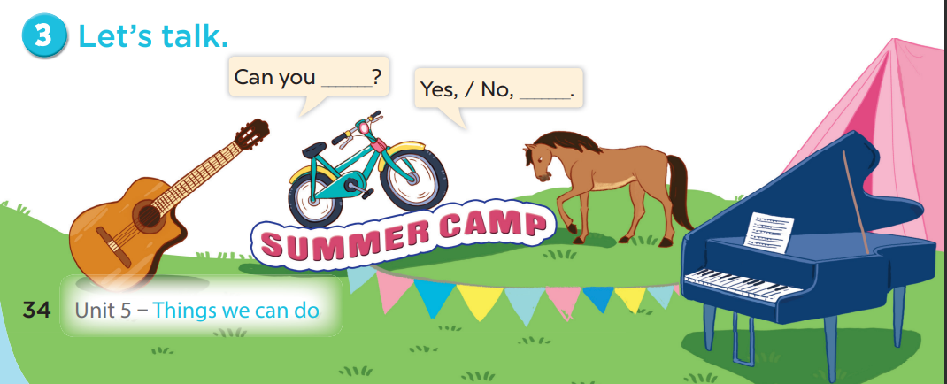

Slide 10

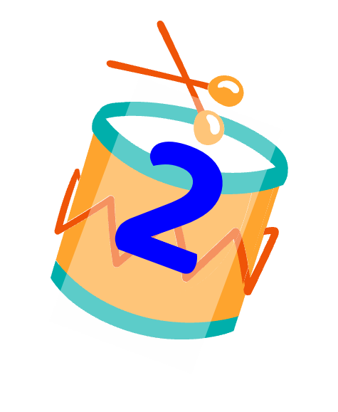



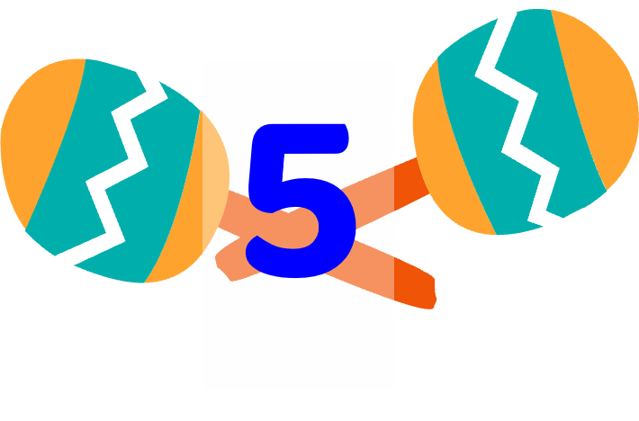



Notes:
Choose a number.
Read the quiz and say the answer.
Get points when balloon flies away.

Slide 11
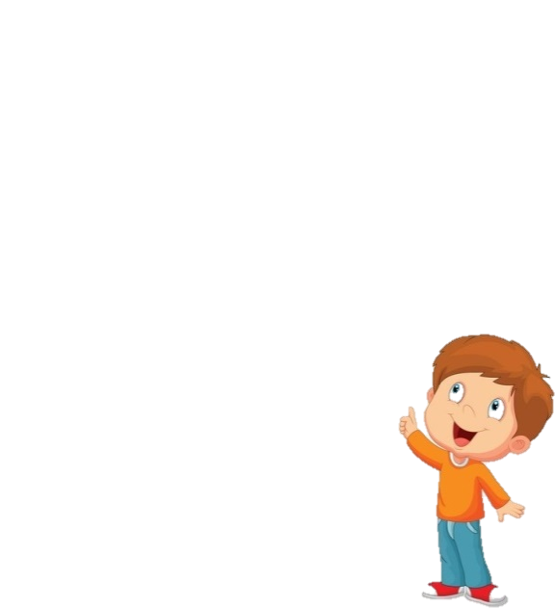
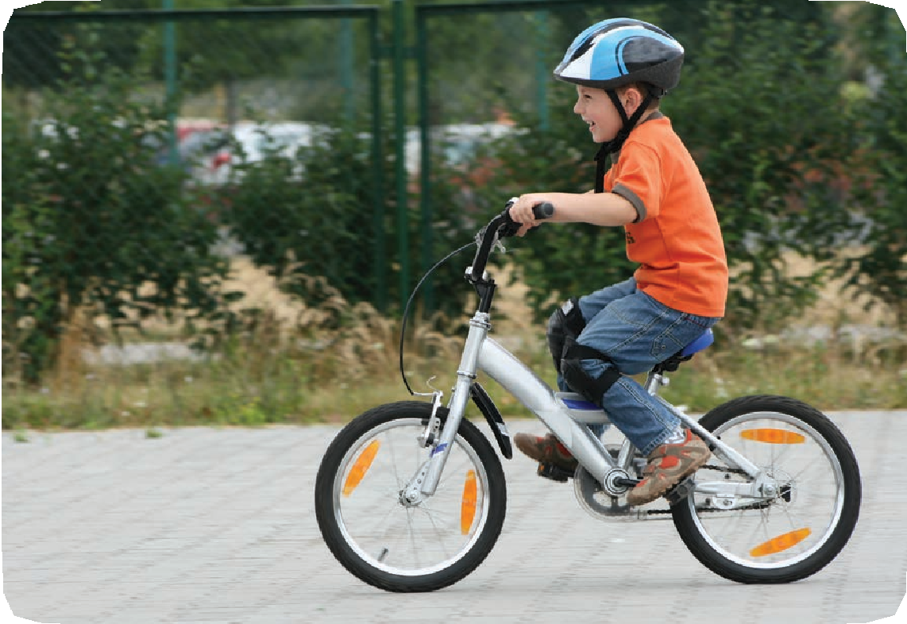
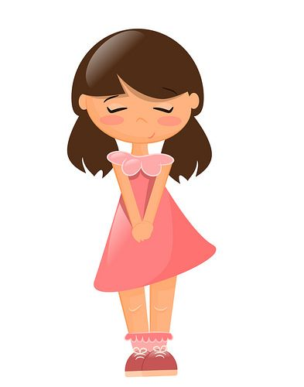
Can you ride a bike?
Yes, I can.

Slide 12

+ 1 POINTS

Slide 13
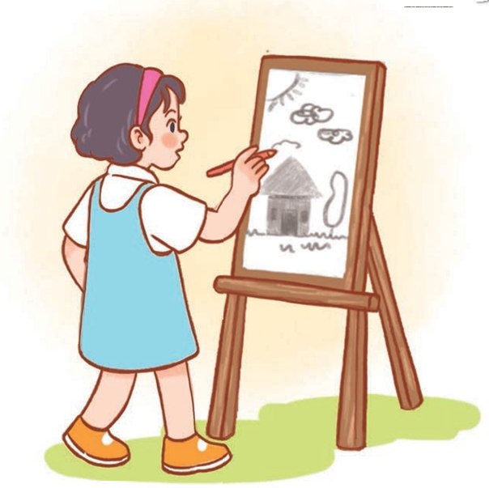
Can you draw?
Yes, I can.

Slide 14
+ 3 POINTS

Slide 15
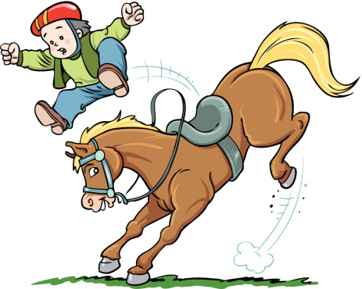
Can you ride a horse?
No, I can’t.

Slide 16
+ 1 POINT

Slide 17
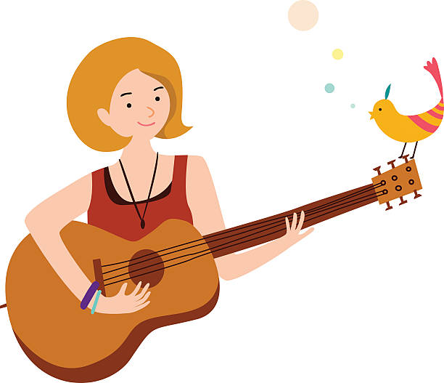
Can you play the guitar?
Yes, I can.

Slide 18
+ 2 POINT

Slide 19
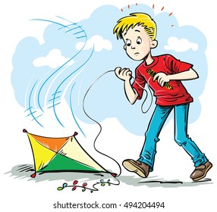
Can you fly a kite?
A. Yes, I can.
B. No, I can.
C. No, I can’t.

Slide 20
+2 POINTS

Slide 21
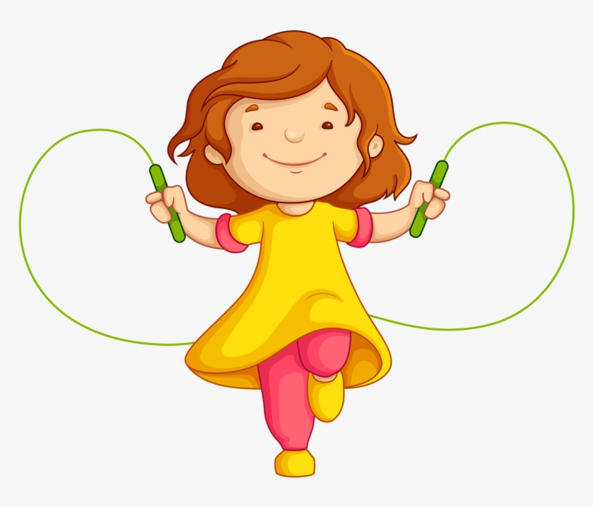
Can you skip?
A. Yes, I can’t.
B. Yes, I can.
C. No, I can.

Slide 22
+ 1 POINTS

Slide 23
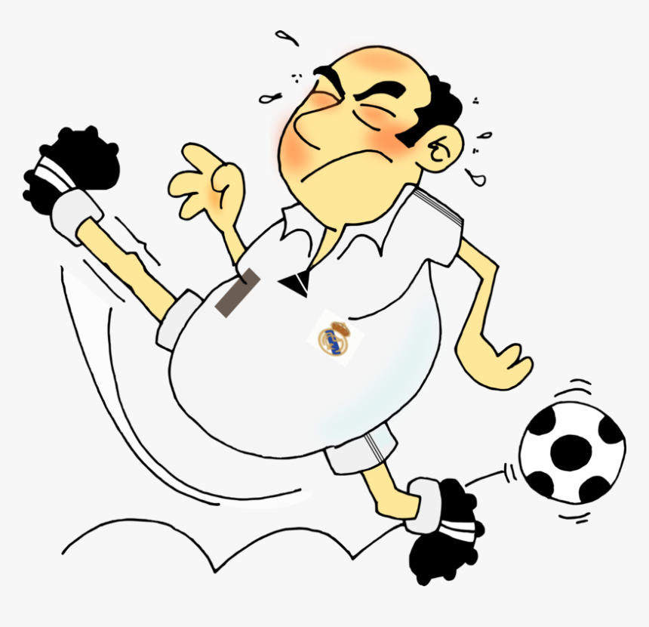
Can you
play football?
A. No, I can’t.
B. No, I can.
C. Yes, I can.

Slide 24
+2 POINTS

Slide 25
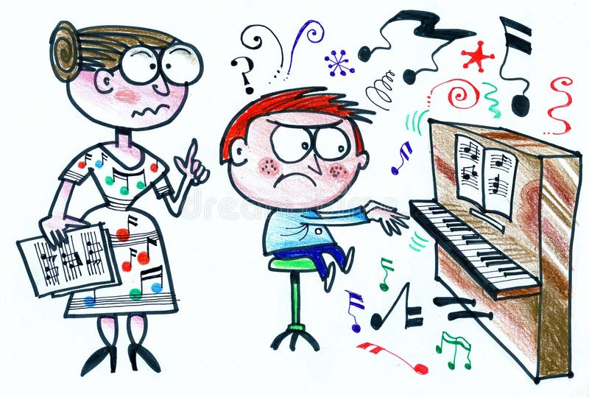
Can you play the piano?
No
…………, I can’t.

Slide 26
+1 POINT

Slide 27

Can you cook?
Yes
…………, I can.

Slide 28
+ 1 POINT

