Slide 1




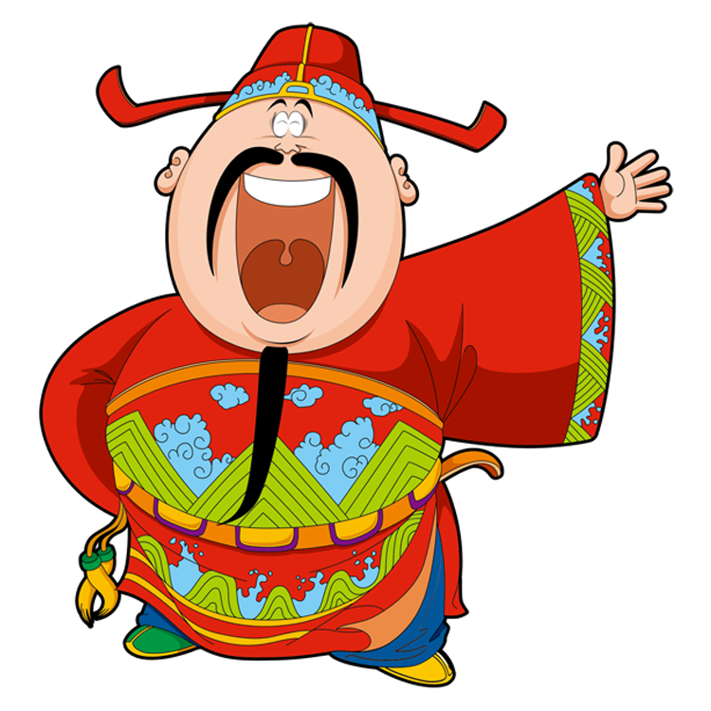
Lucky Money

Slide 2

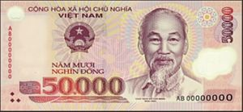

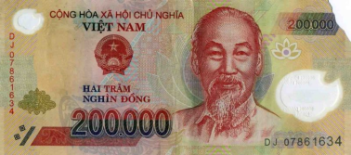

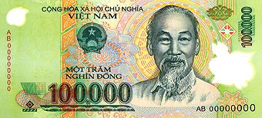

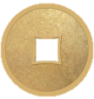
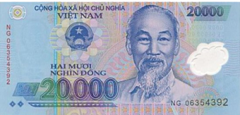





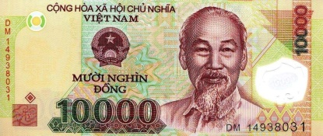



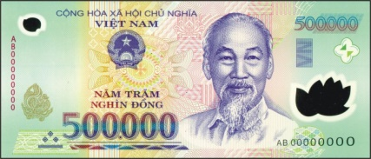
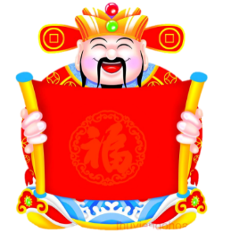
2
6
3
7
1
10
5
8
4
9
Boys
Girls

Slide 3
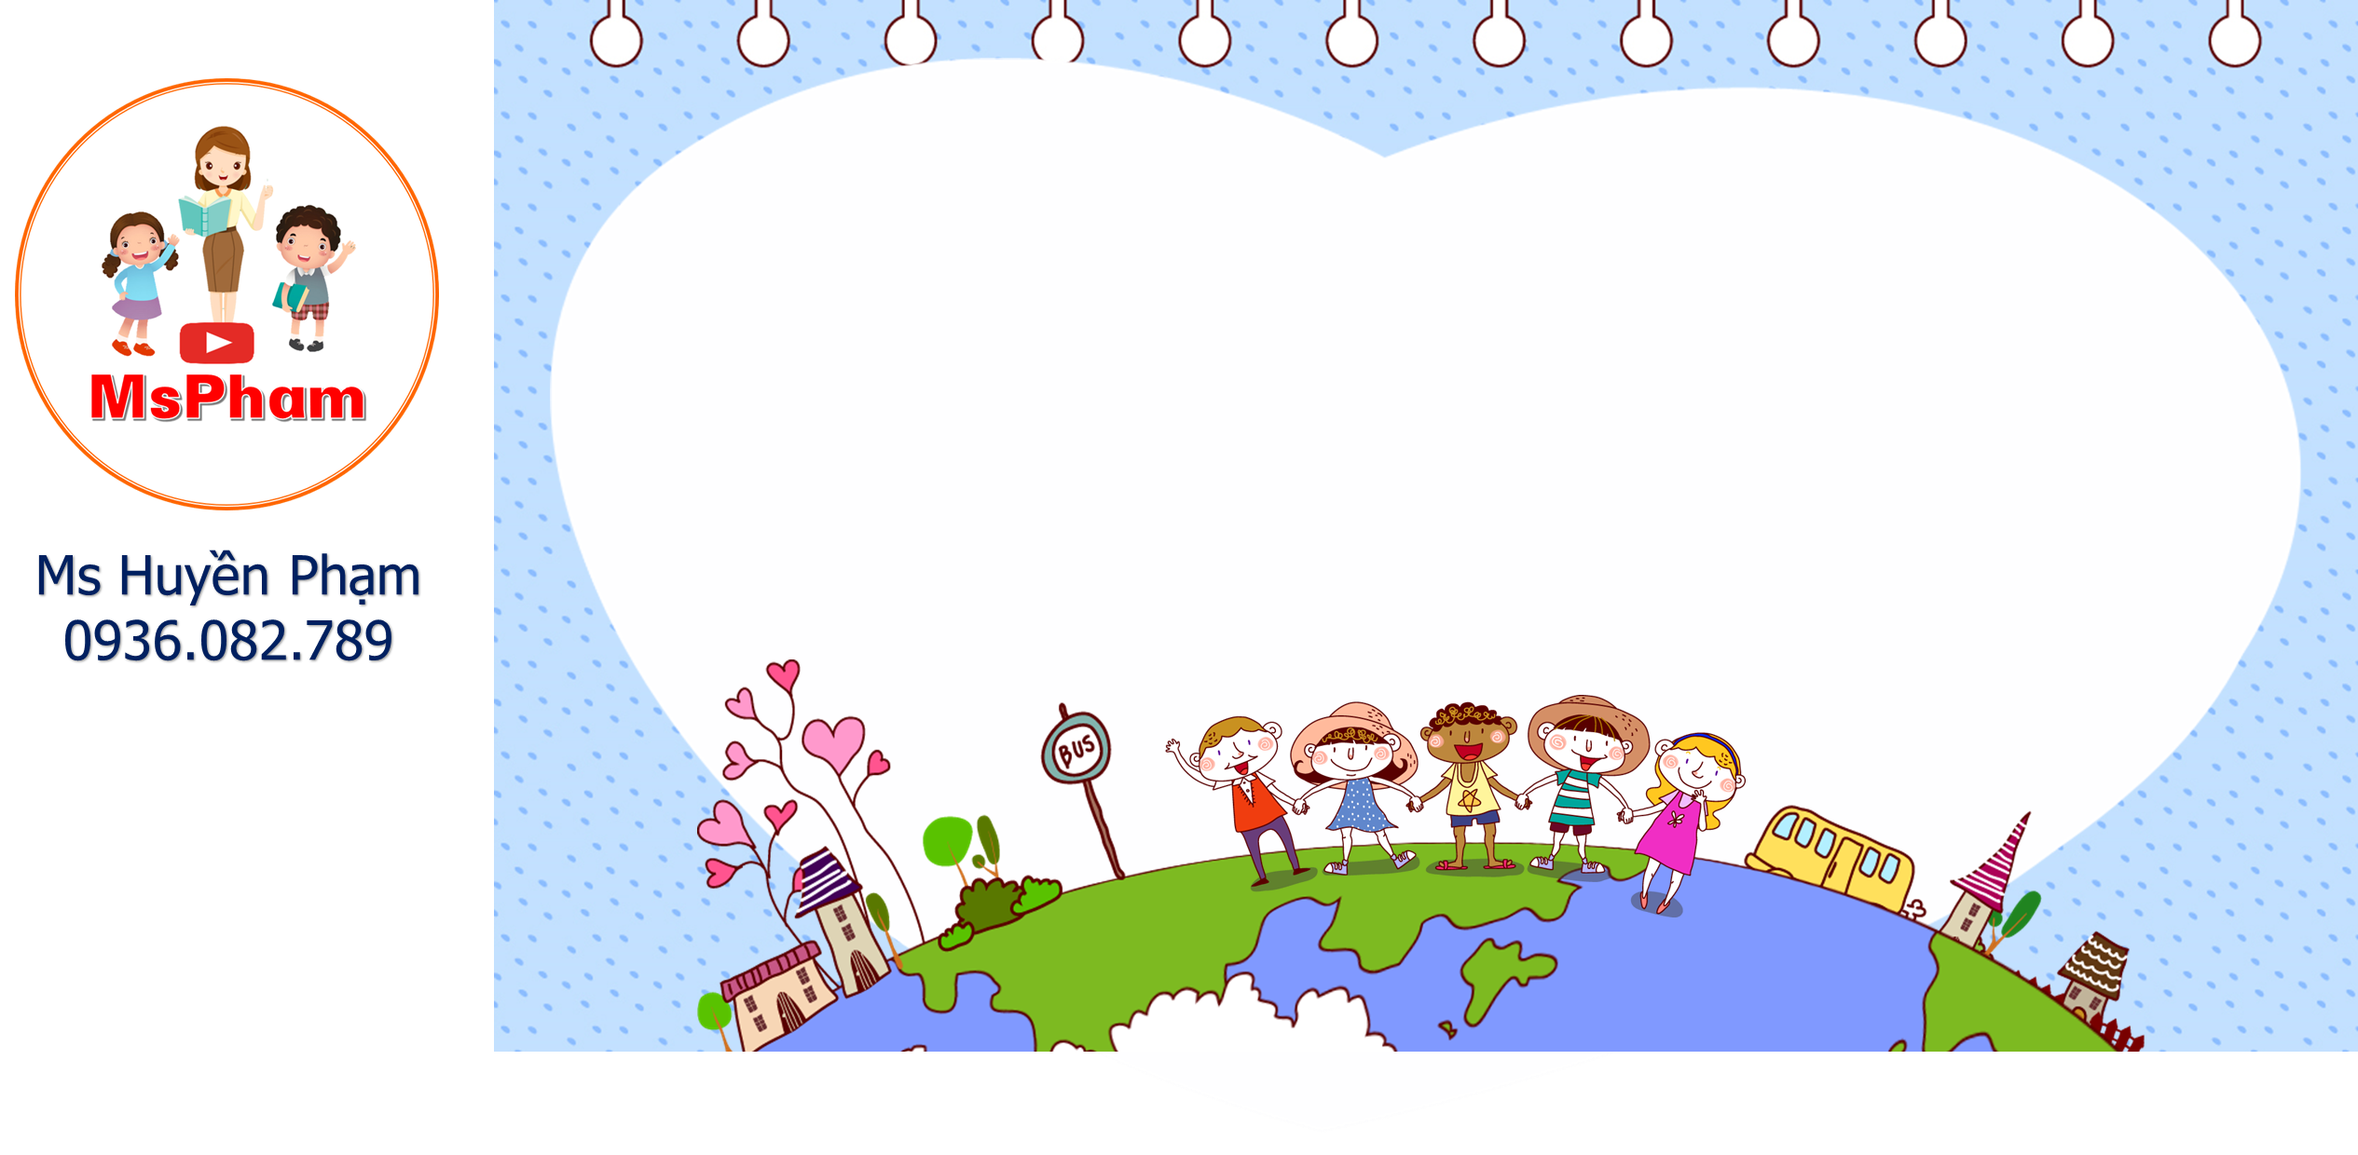








What do you do in your free time?
surf the Internet
Go to the cinema
Go to the zoo

Slide 4
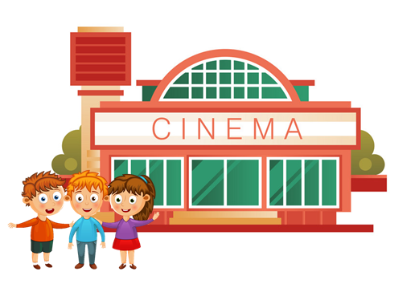
What do you do in your free time?
Go to the cinema
Go to the library
Go to the zoo

Slide 5
______ do you do in your free time?
- I chat with my friends.
What
What’s
Where

Slide 6
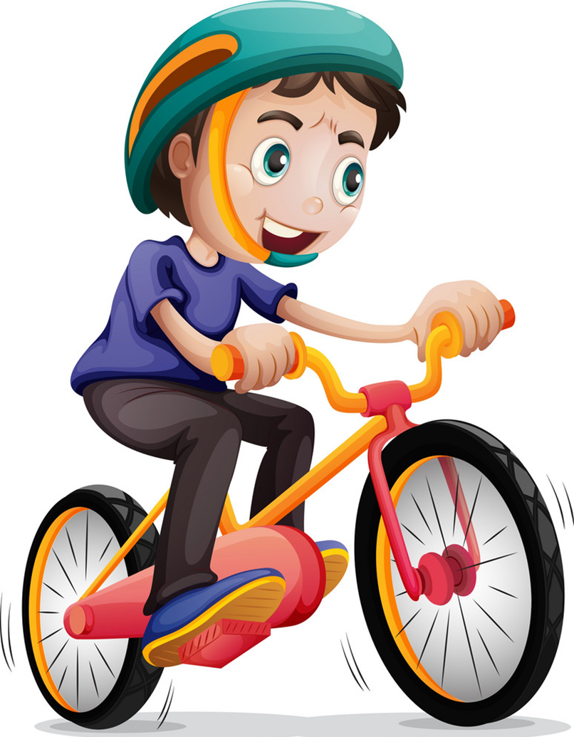
What do you do in your free time?
Surf the Internet
Ride my bike
Do karate

Slide 7
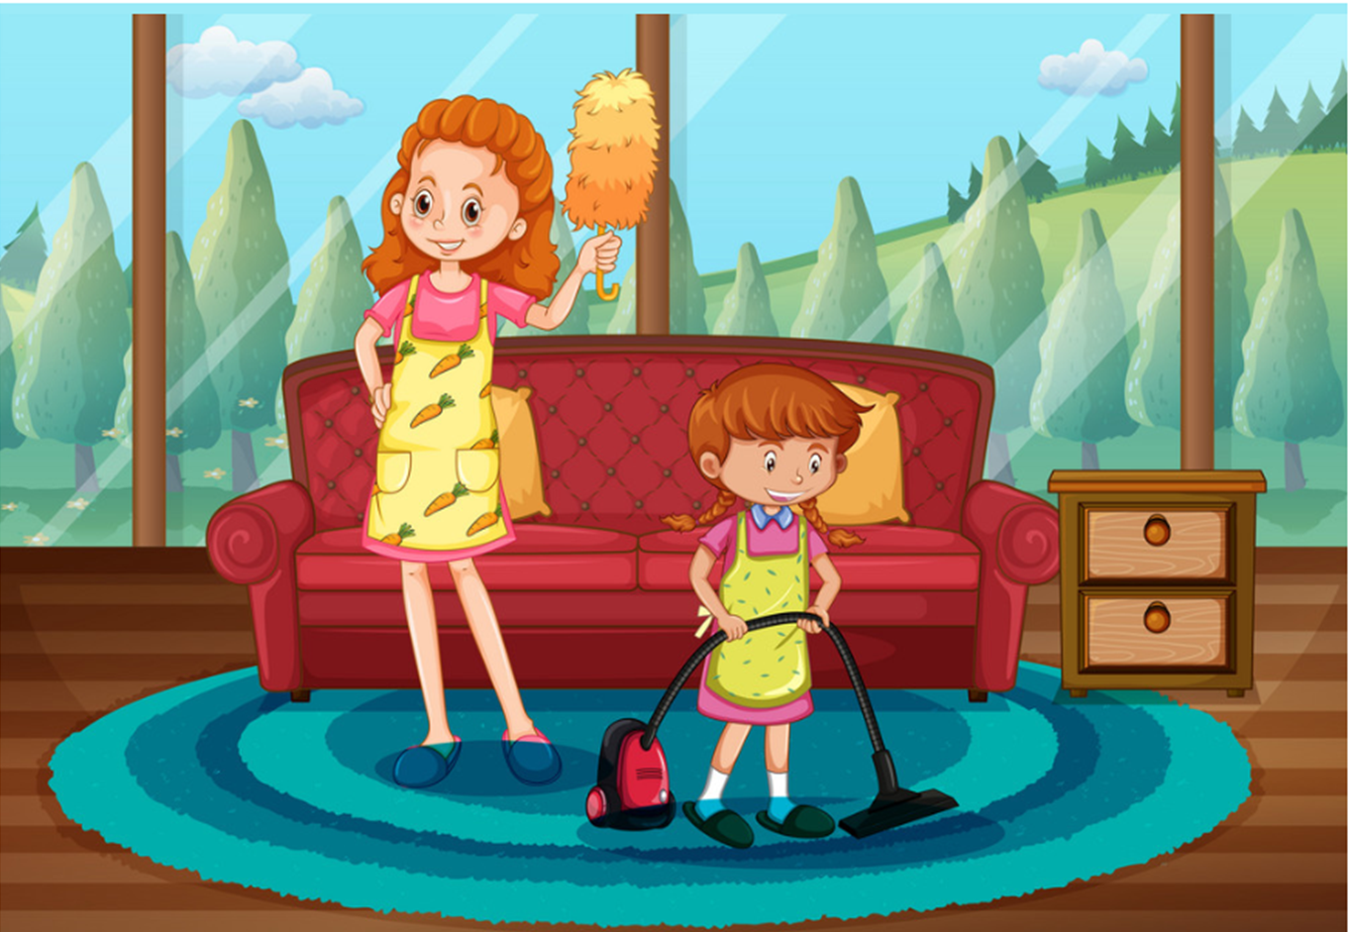
What do you do in your free time?
do karate
draw pictures
clean the house

Slide 8
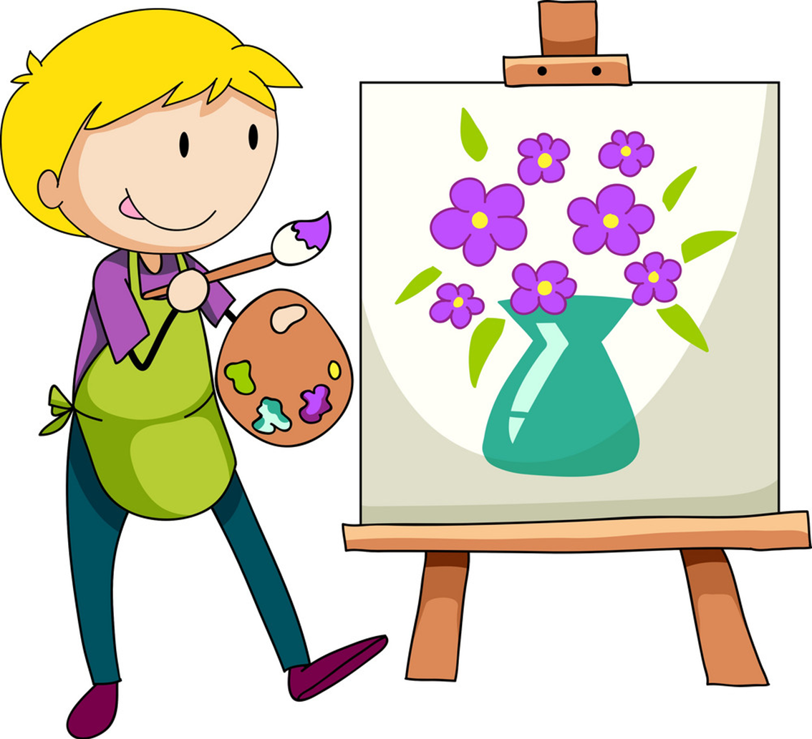
What do you do in your free time?
surf the Internet
draw pictures
do karate

Slide 9
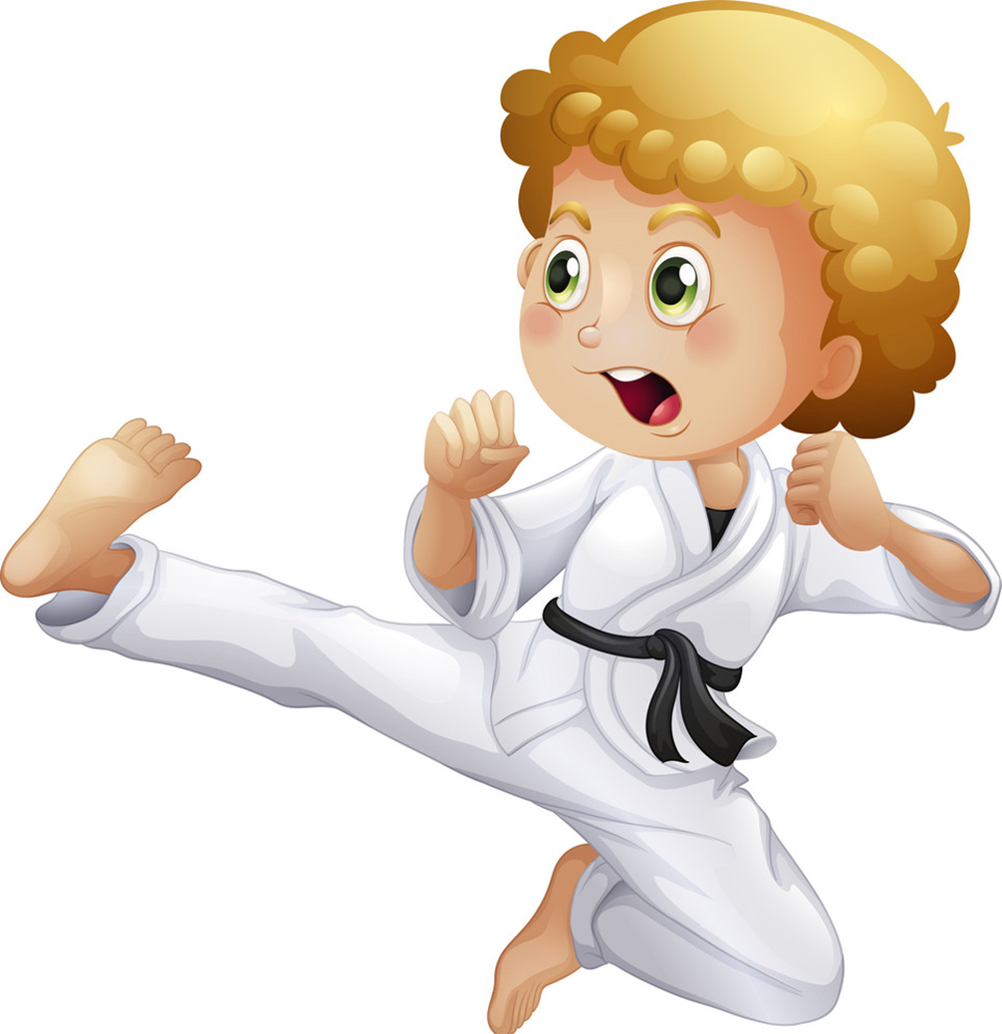
What do you do in your free time?
go to the cinema
do karate
clean the house

Slide 10
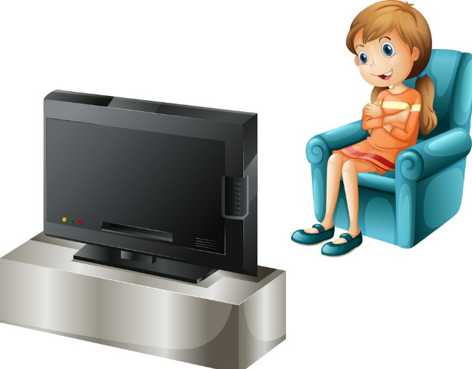
What do you do in ____ free time?
I watch TV.
his
your
her

Slide 11

What do you do in your free time?
I _________________
write email.
do homework
read a book.

Slide 12
What ____ you do in your free time?
I surf the Internet.
are
does
do

