Slide 1

OUR SPECIAL DAYS
Lesson 1 - Period 2

Slide 2
01
Warm-up

Slide 3
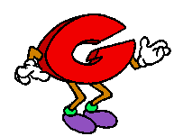
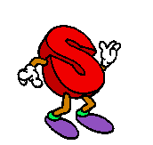
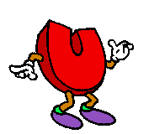

Can you?

Slide 4
Look and guess the occasions
1 picture open: 3 points
2 pictures open: 2 points
All pictures open: 1 point

Slide 5

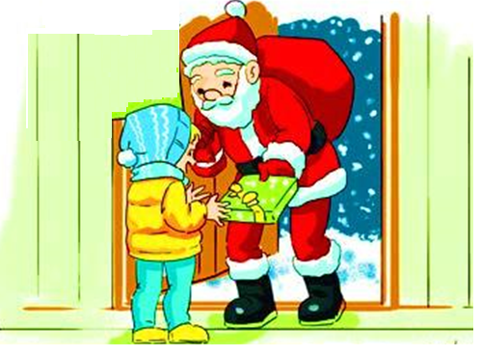


Christmas Day

Slide 6
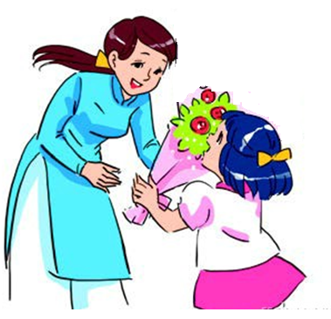


Teachers’ Day

Slide 7
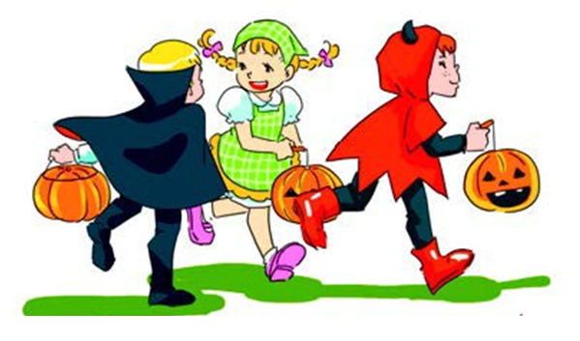


Halloween Day

Slide 8
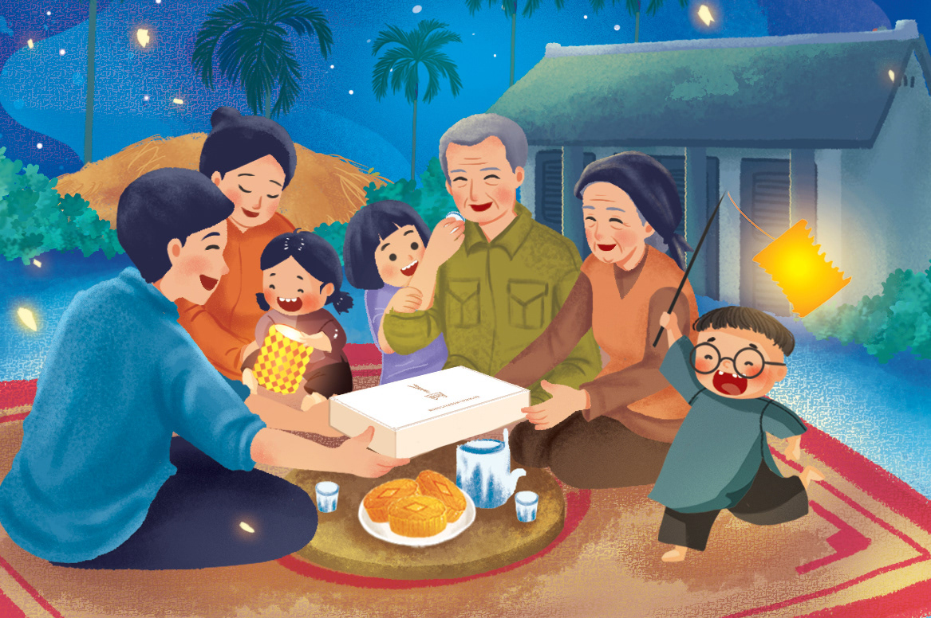


Mid-Autumn Festival

Slide 9
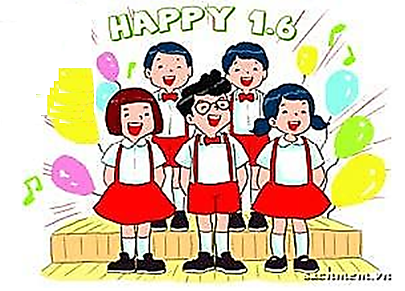

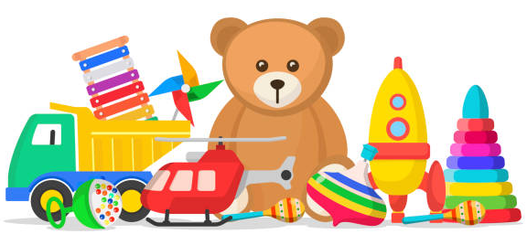
Children’s Day

Slide 10
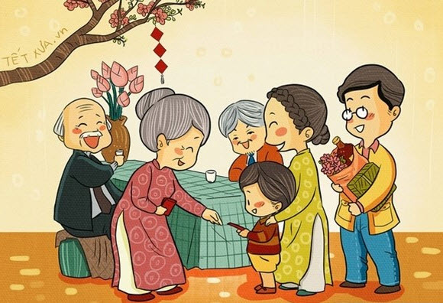


Tet

Slide 11
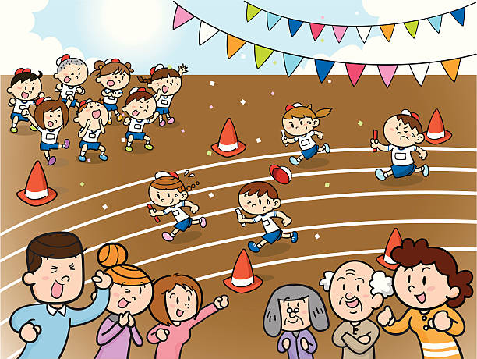
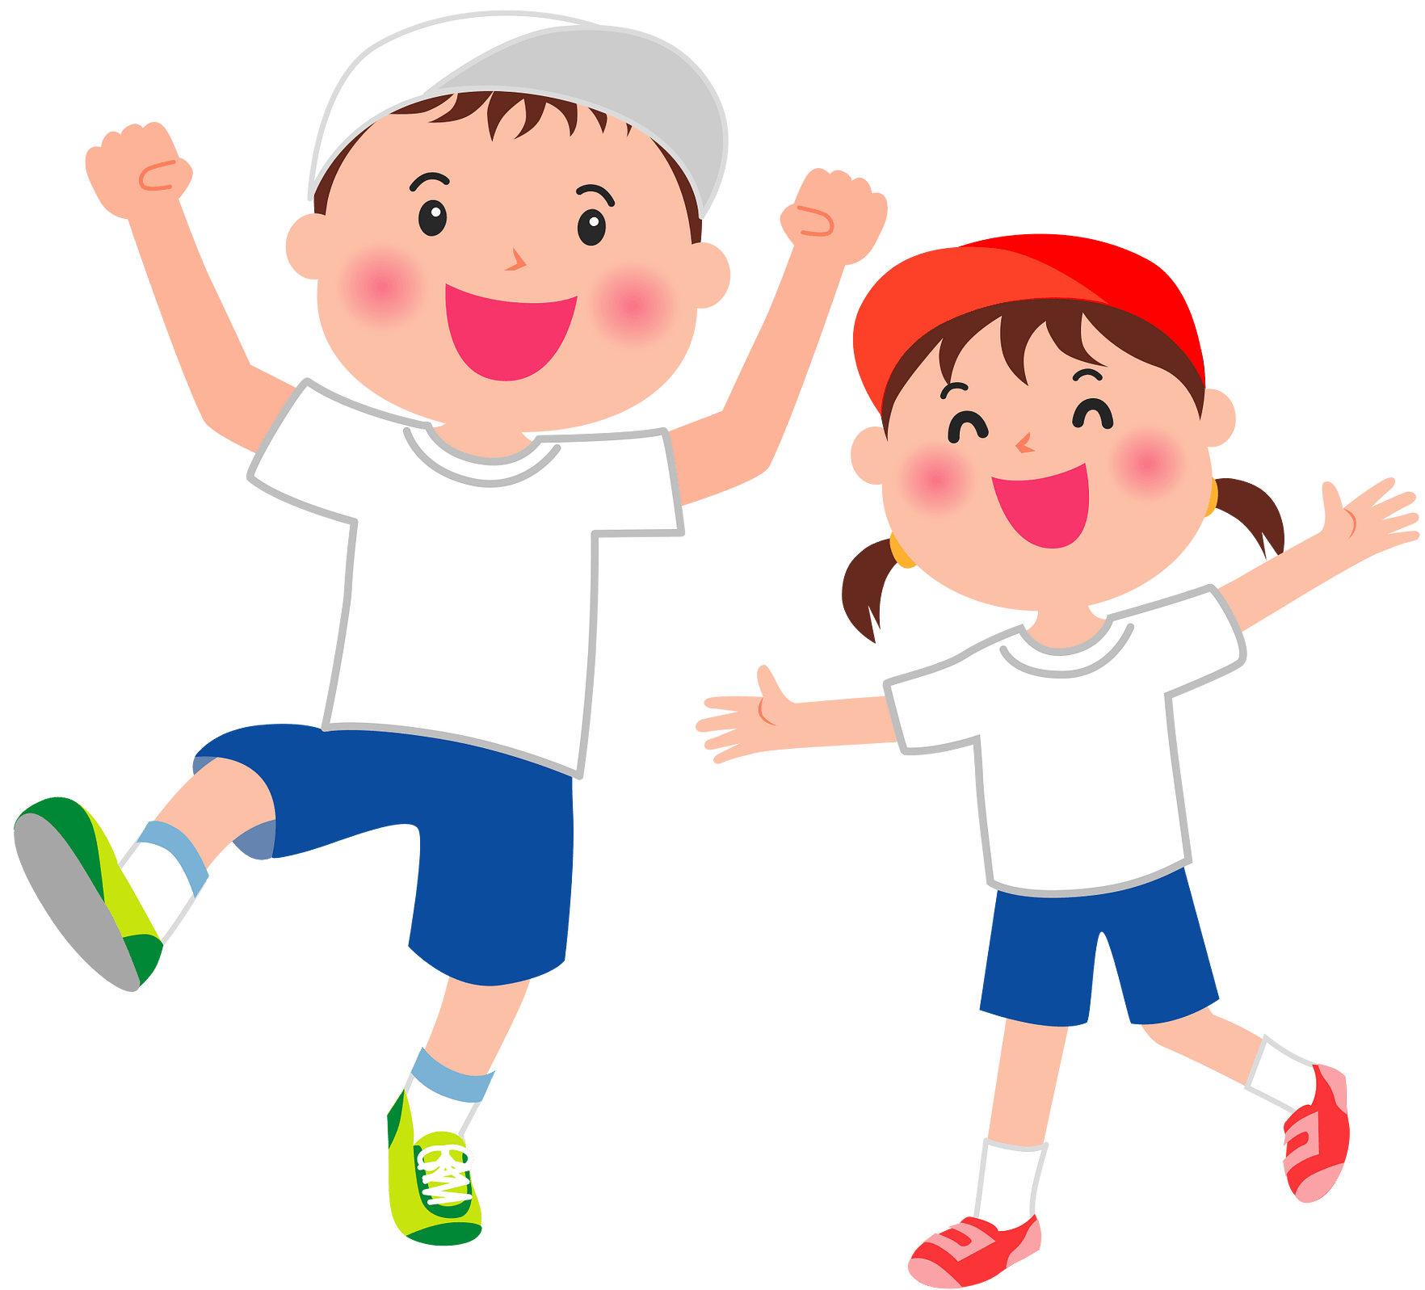

Sports Day

Slide 12

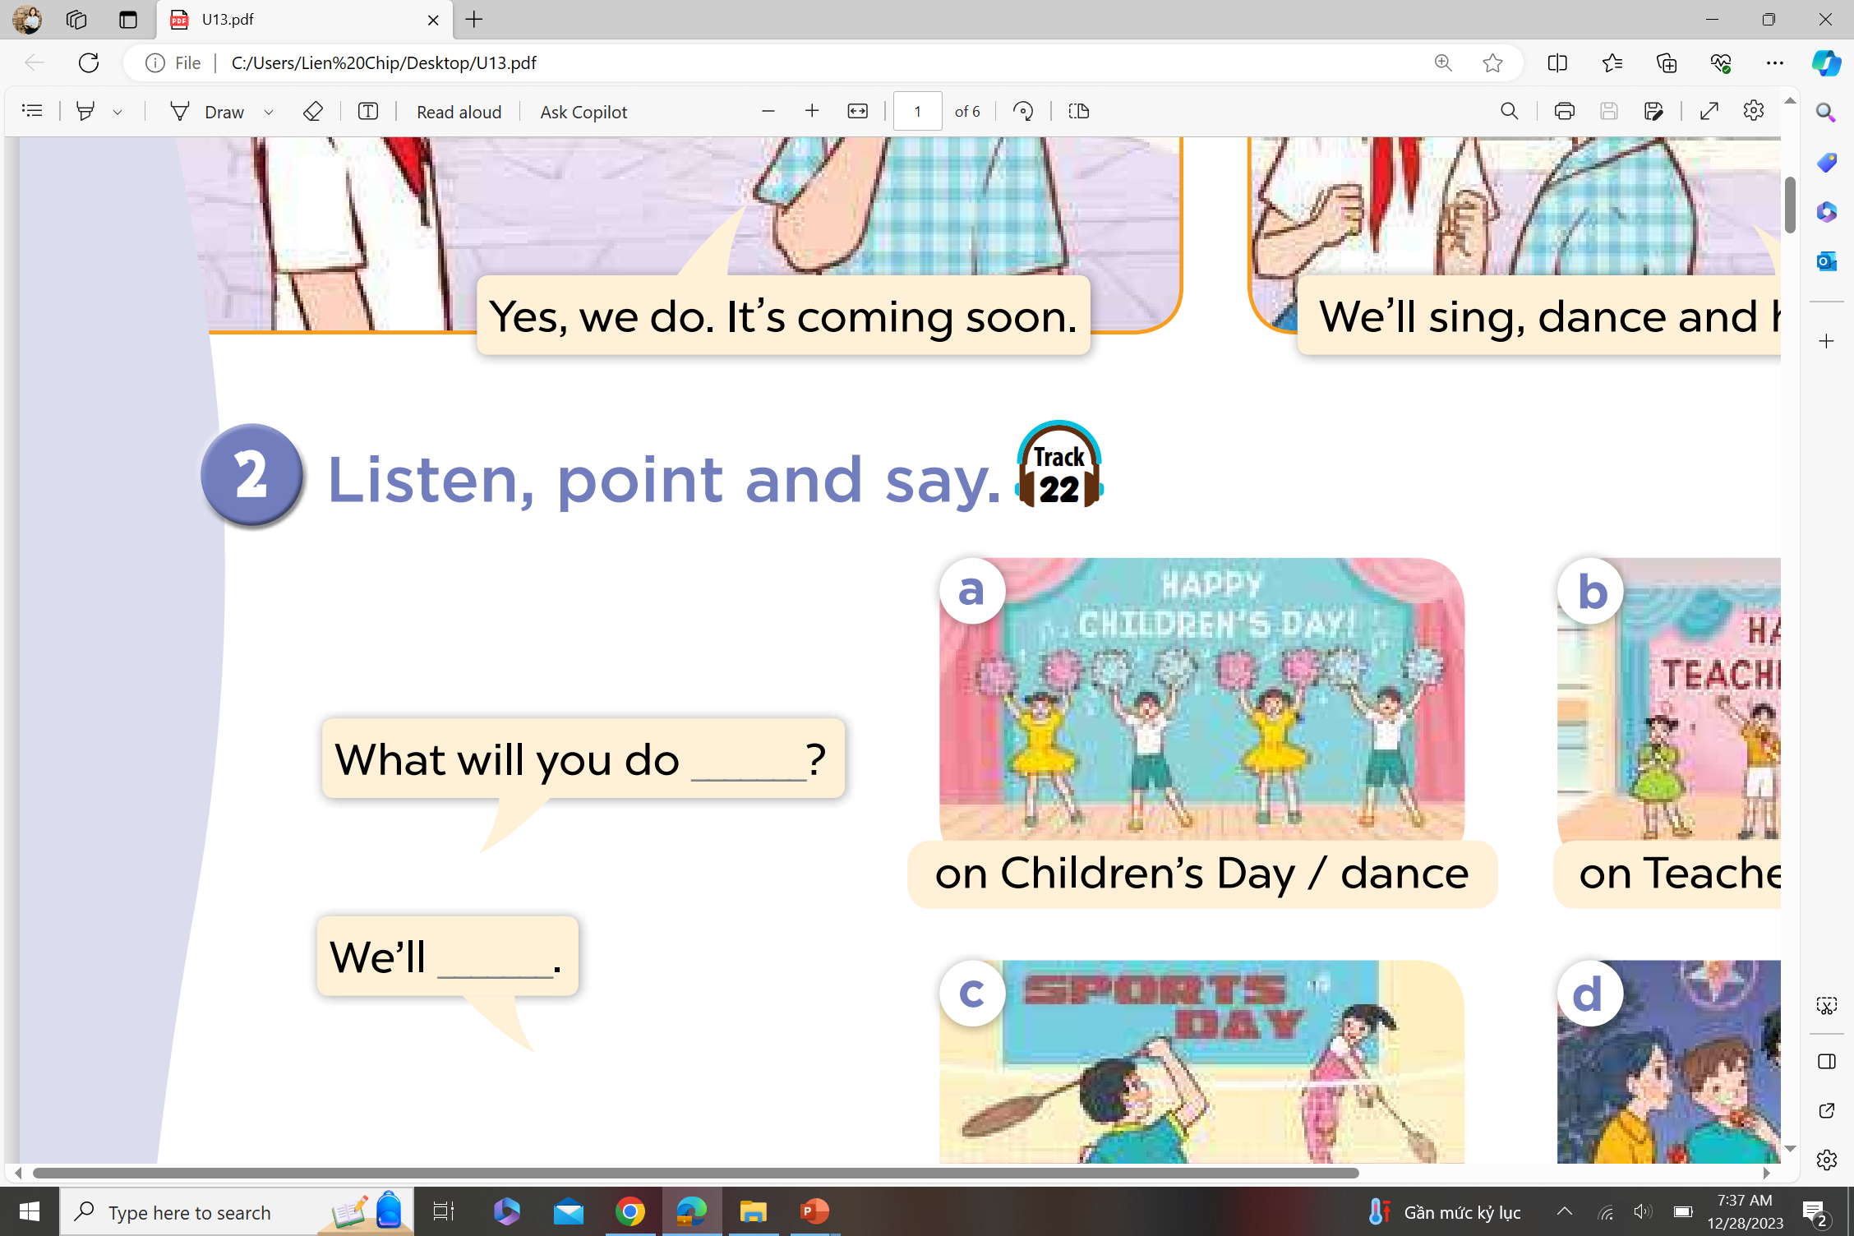
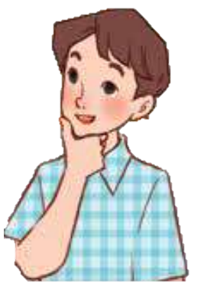
Ask and answer.

Slide 13
02
Activity 1
Listen and tick or cross.

Slide 14
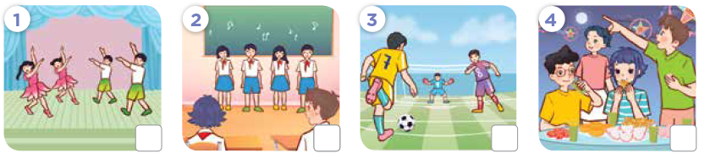
Look! What will they do?

Slide 15


Listen and tick or cross.

Slide 16
Listen and repeat.

Slide 17
03
Activity 2
Read and complete.

Slide 18
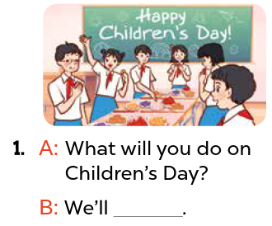
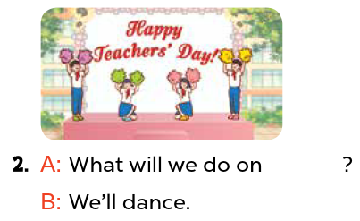
Read and complete.
Teachers’ Day
have a party

Slide 19
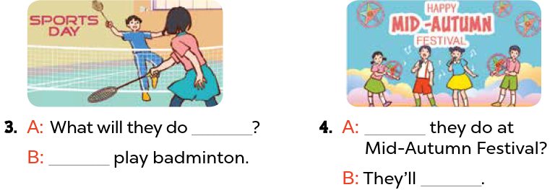
Read and complete.
on Sports Day
What will
We’ll
sing and dance

Slide 20
Activity 3
04
Listen, complete and sing.

Slide 21
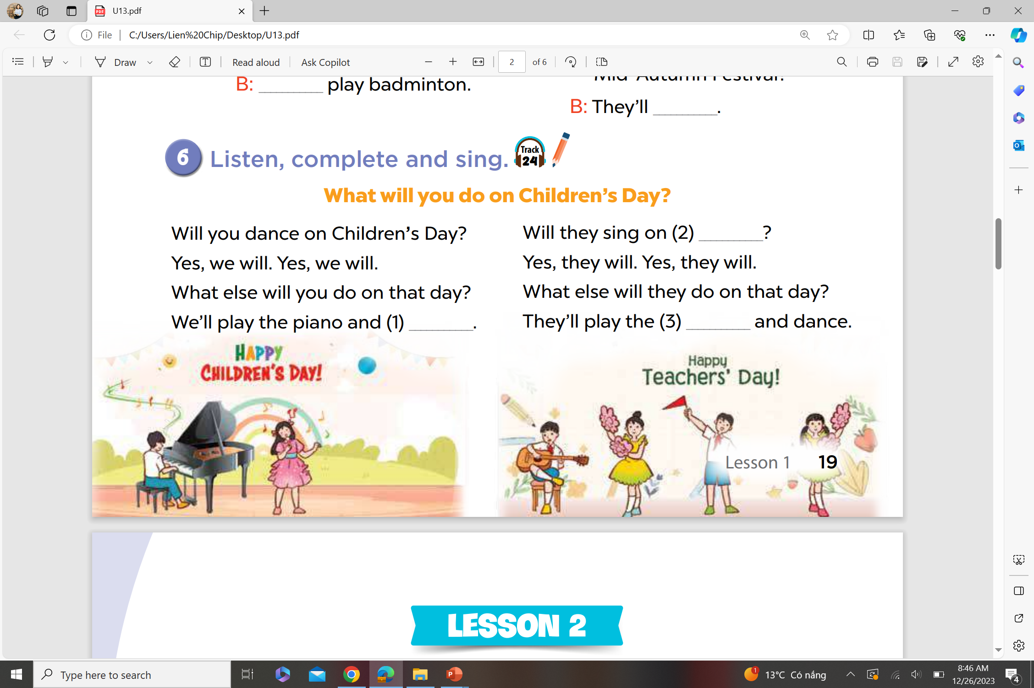
Listen, complete and sing.
Teachers’ Day
sing
guitar

Slide 22
Fun Corner
05
Look, read and choose.

Slide 23


.................. will you do on
Christmas Day?
What
A. When
B. What
C. Who

Slide 24
What .................. you do on
Children’s Day?
will
A. are
B. do
C. will

Slide 25
What will you do at Mid–Autumn Festival? – We’ll .................. a party.
have
A. have
B. has
C. to have

Slide 26
What will you do ..................
Mid–Autumn Festival?
at
A. at
B. on
C. in

Slide 27
What will you do ..................
Halloween Day?
on
A. in
B. on
C. at

Slide 28
What will you do on Sports Day?
- We’ll .................. badminton.
play
A. to play
B. plays
C. play

Slide 29
What will you do on Teachers’ Day?
- We’ll ...................
sing
A. sings
B. singing
C. sing

