Slide 1
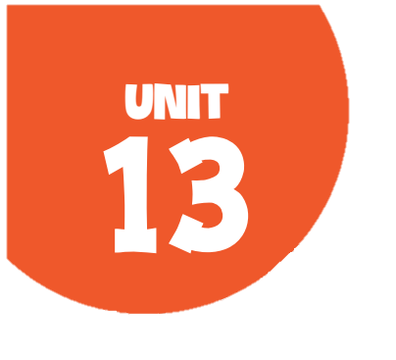
OUR SPECIAL DAYS Lesson 2 - Period 3

Slide 2
01
Warm-up
Guess the occasions

Slide 3
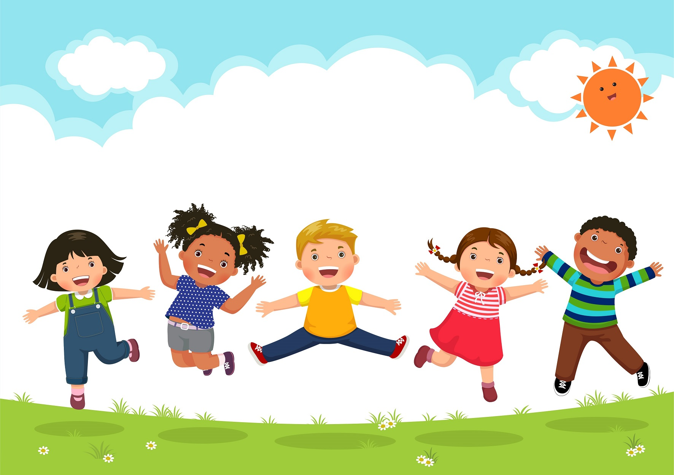
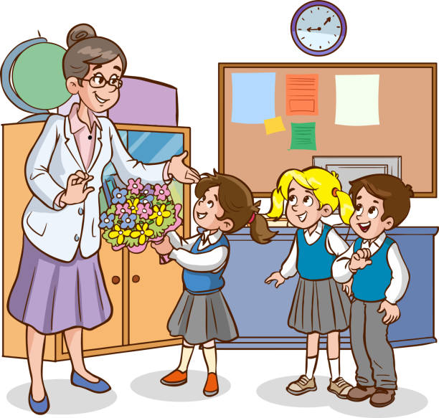
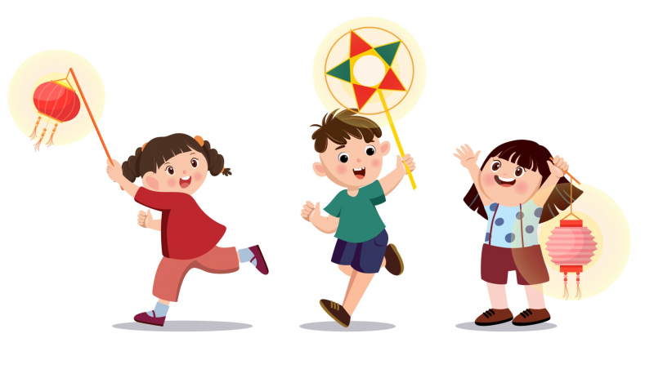
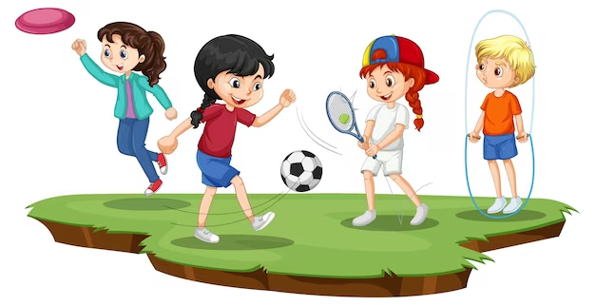
1st June
20th November
Teachers’ Day
Children’s Day
15th August (lunar)
27th March
Mid-Autumn Festival
Sports Day
actor

Slide 4
02
Activity 1
Look, listen and repeat.

Slide 5
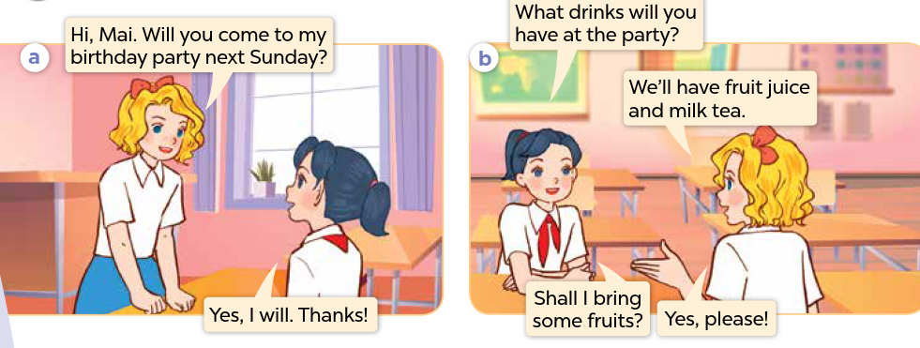
Who can you see?
What are they talking about?

Slide 6

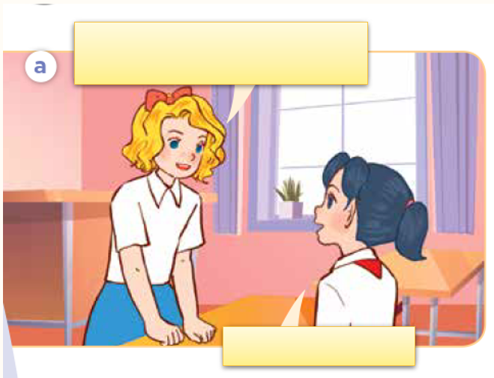
Look, listen and repeat.

Slide 7
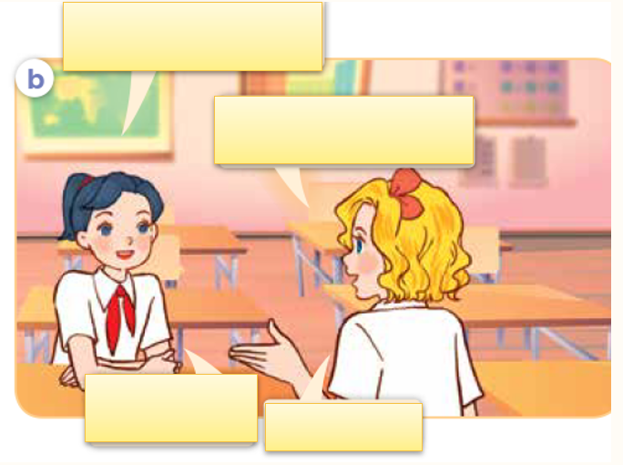
Look, listen and repeat.

Slide 8
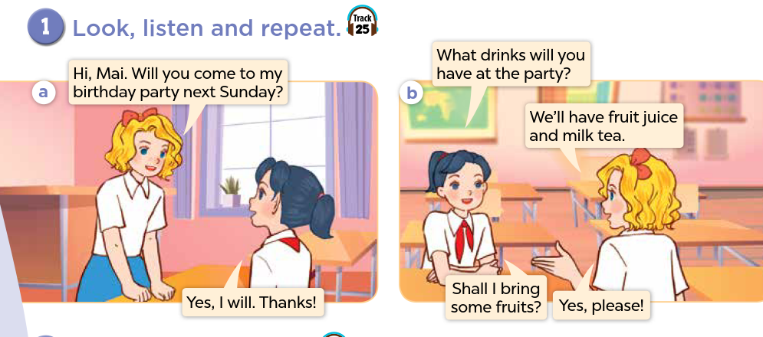

Slide 9
Sentence pattern
What drinks will you have at the party?
We’ll have fruit juice and milk tea.

Slide 10
03
Activity 2
Listen, point and say.

Slide 11
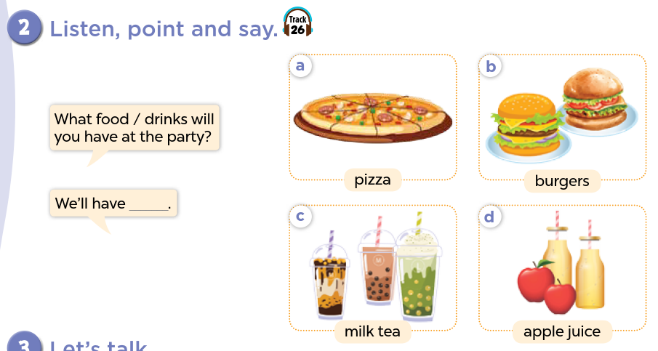

Slide 12
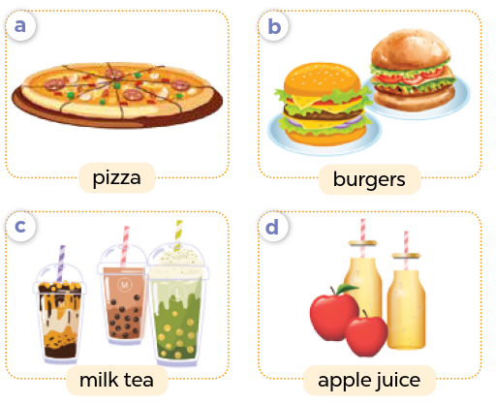
Name the food/drinks.

Slide 13
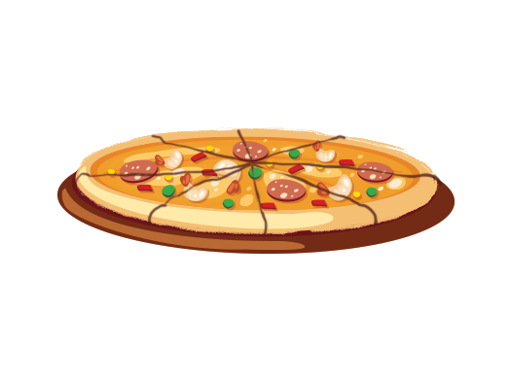
Listen, point and say.
a. pizza

Slide 14
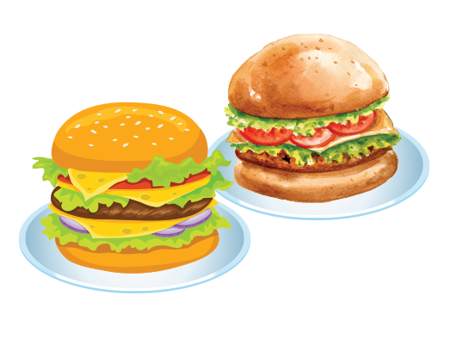
Listen, point and say.
b. burgers

Slide 15
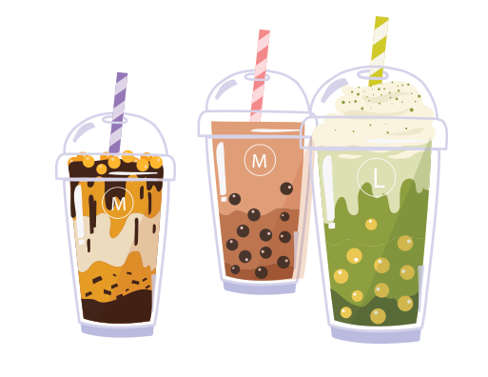
Listen, point and say.
c. milk tea

Slide 16
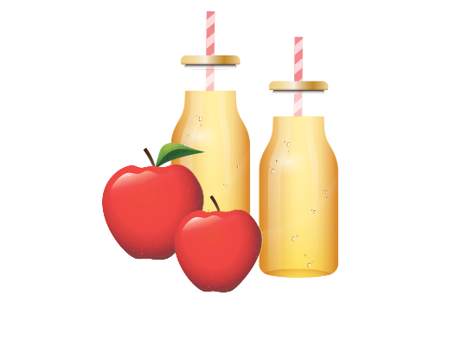
Listen, point and say.
d. apple juice

Slide 17
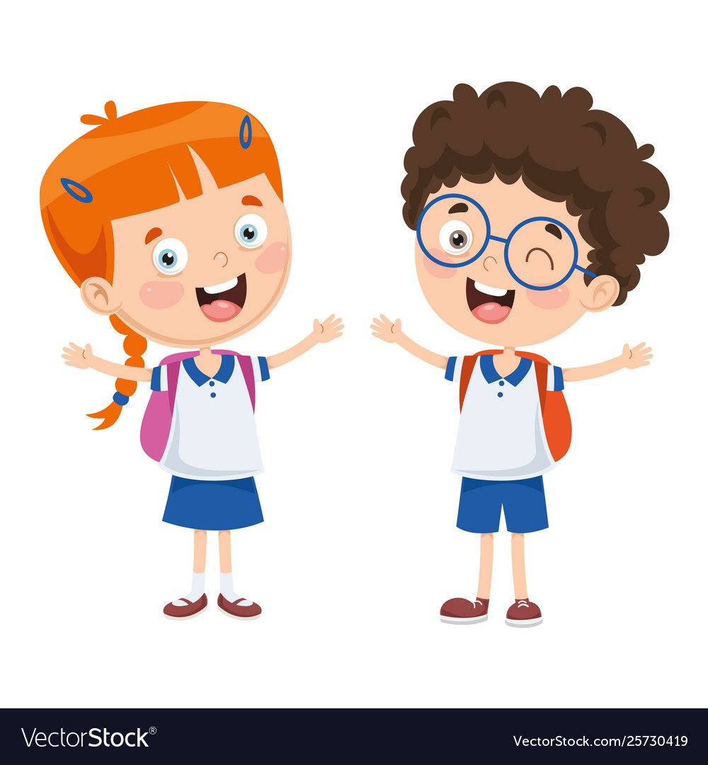
What food / drinks will you have at the party?
We’ll have ____.

Slide 18
What food will you have at the party?
We’ll have pizza.

Slide 19
What food will you have at the party?
We’ll have burgers.

Slide 20
What drinks will you have at the party?
We’ll have milk tea.

Slide 21
What drinks will you have at the party?
We’ll have apple juice.

Slide 22
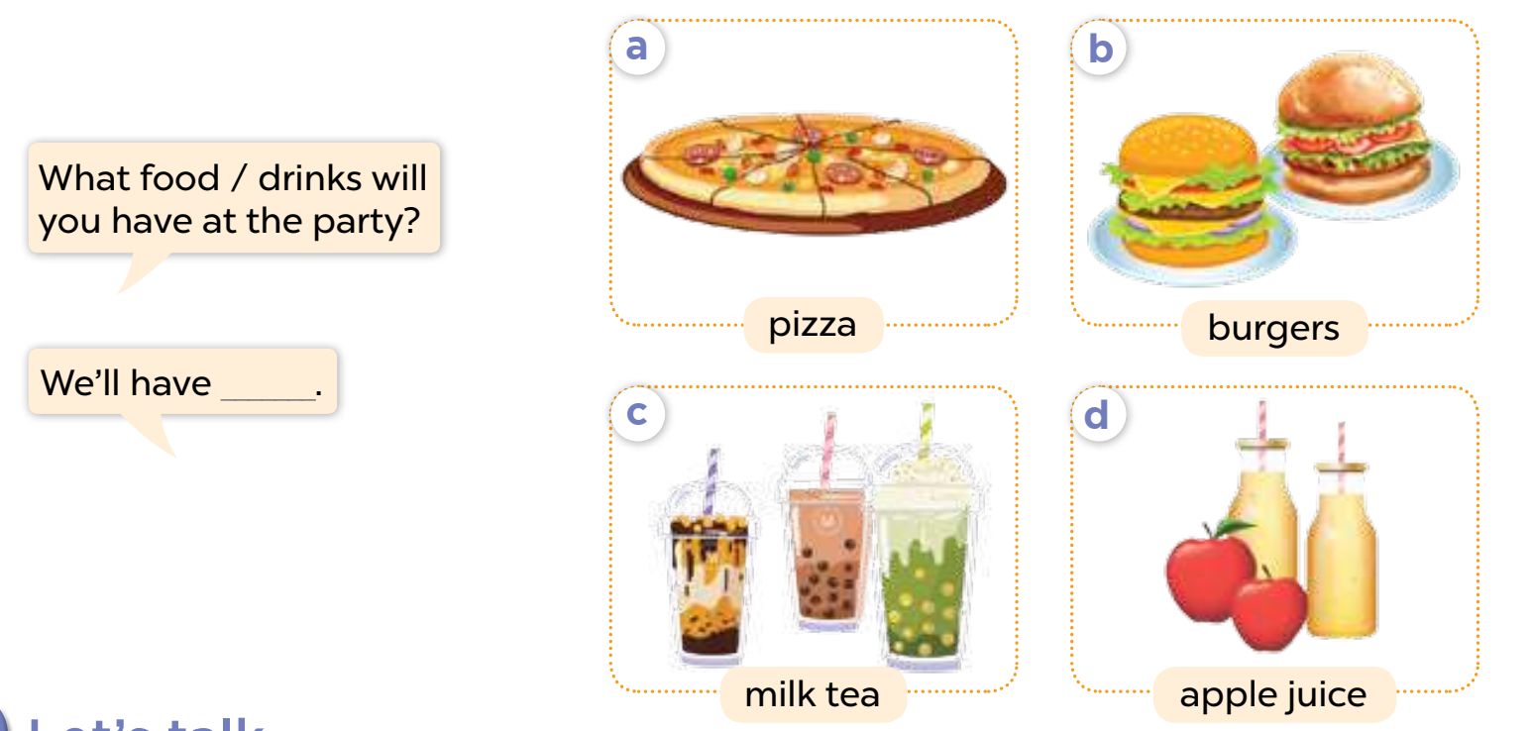
Listen, point, and say.

Slide 23
Activity 3
04
Let’s talk.

Slide 24
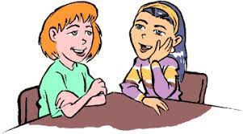
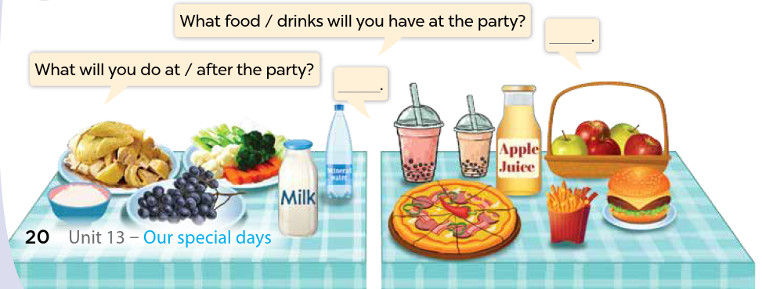
Look and name the food / drinks.
Let’s talk!

Slide 25
What food / drinks will you have at the party?
__________.

Slide 26
Fun Corner
05
Play the game.

Slide 27
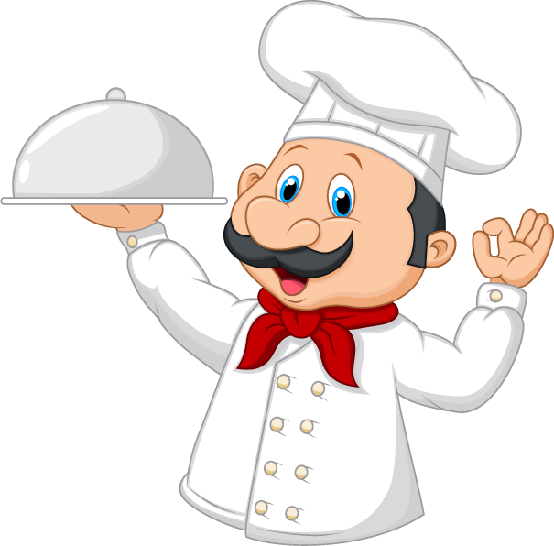
Let’s get ready for the party!!!

Slide 28
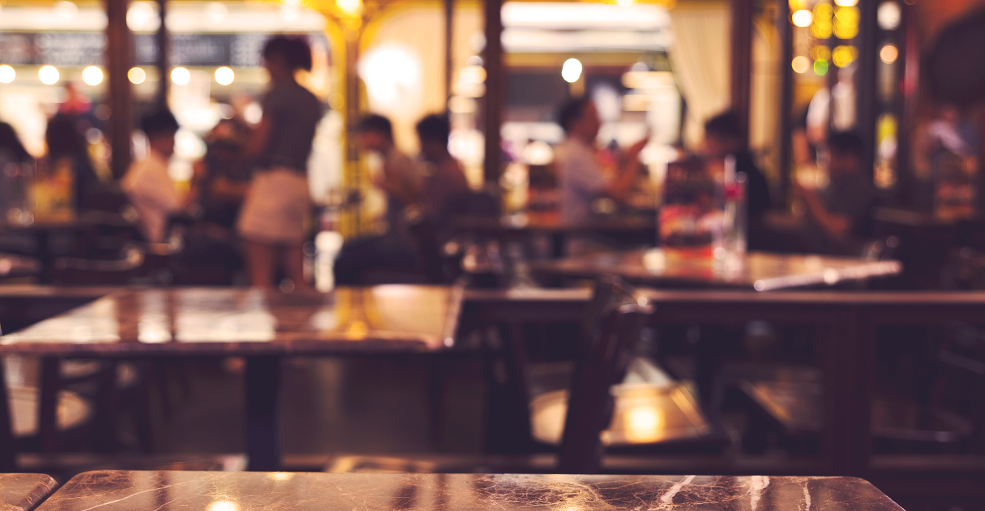

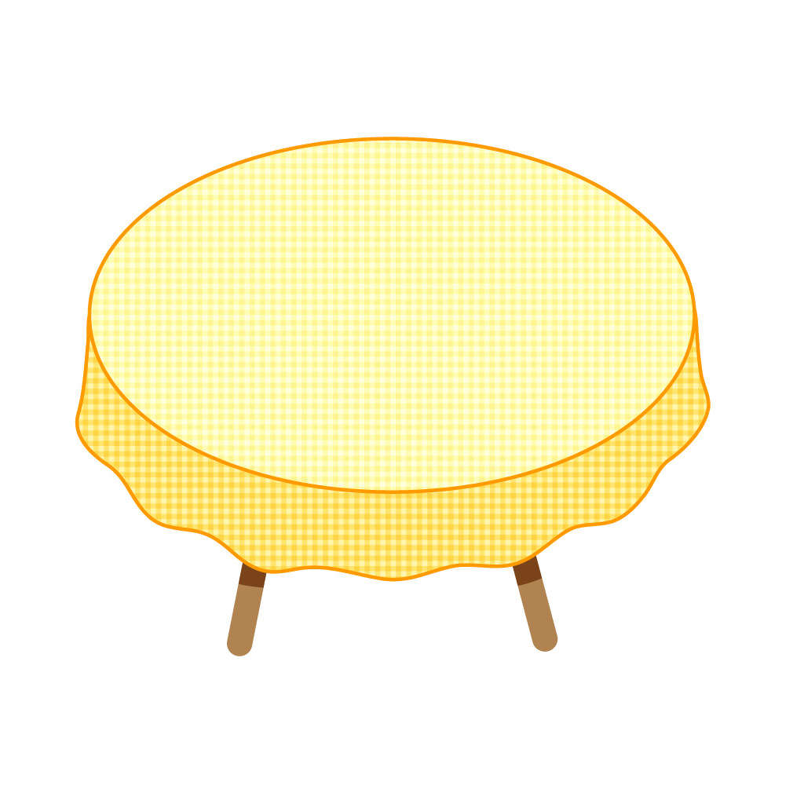
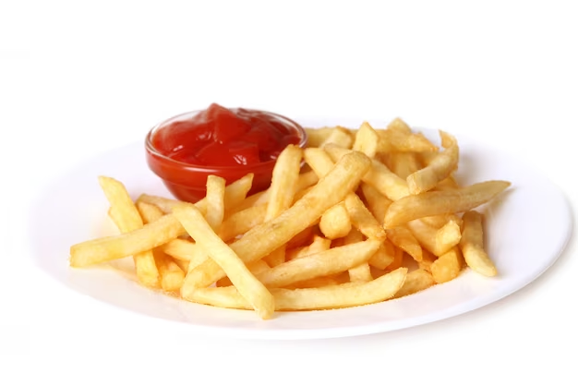

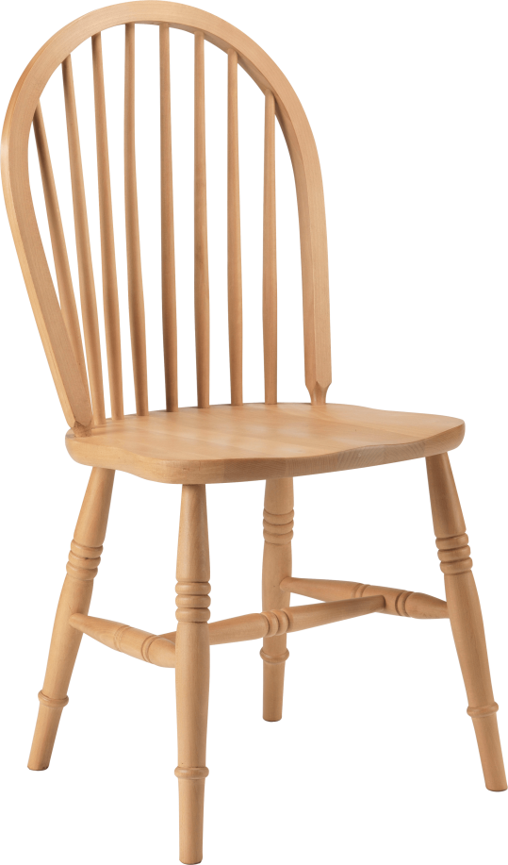
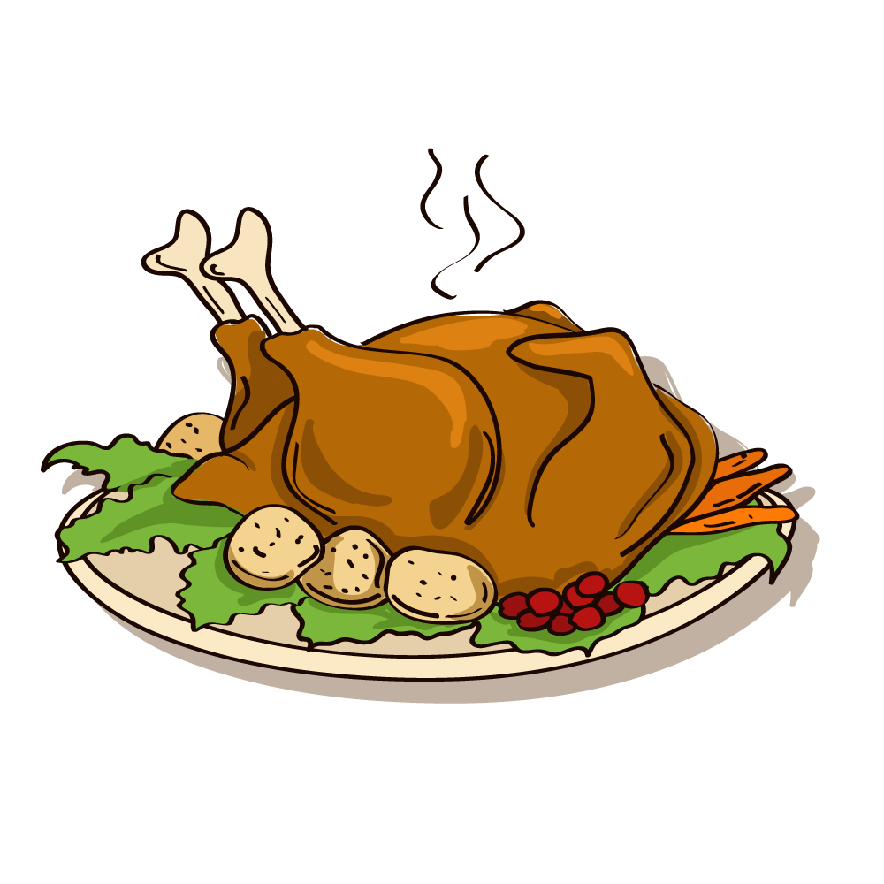
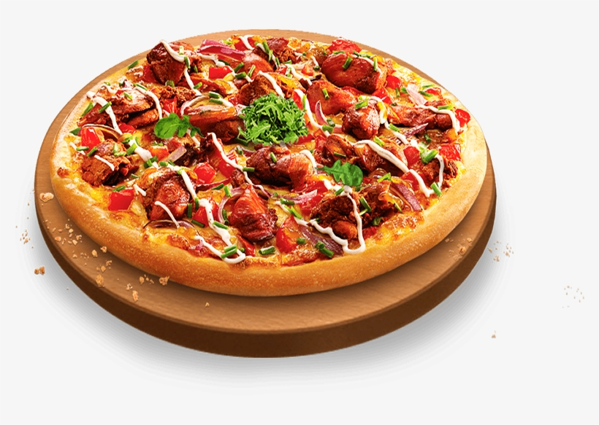
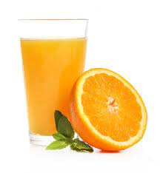

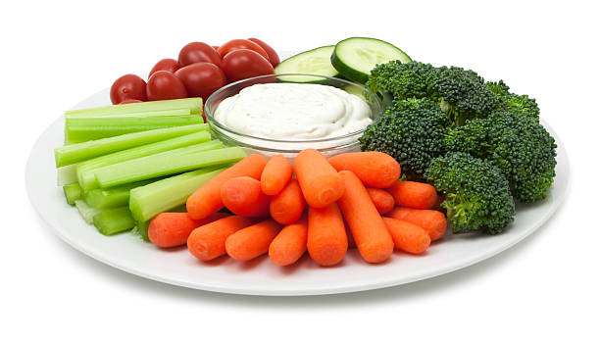

Slide 29






What food will you have at the party?
A
We will have pizza.
Time’s up!
B
We will have burgers.
C
We have pizza.
D
We will has pizza.

Slide 30
What food will you have at the party?
A
We will have vegetables.
Time’s up!
B
We will have apples.
C
We will have cakes.
D
We will have chips.

Slide 31
What food will you have at the party?
A
We will have sweets.
Time’s up!
B
We will have chicken.
C
We will have milk.
D
We will have fish.

Slide 32
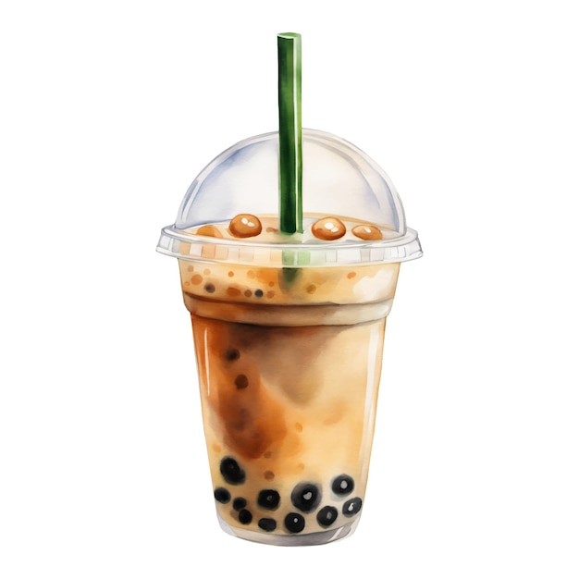
What drink will you have at the party?
A
We will have apple juice.
Time’s up!
B
We will have milk.
C
We will have milk tea.
D
We will have tea.

Slide 33
What food will you have at the party?
A
We will have chips.
Time’s up!
B
We will have fruit.
C
We will have rice.
D
We will have vegetables.

Slide 34
What drink will you have at the party?
A
We will have watermelon juice.
B
We will have grape juice.
Time’s up!
C
We will have apple juice.
D
We will have orange juice.

