Slide 1

OUR SPECIAL DAYS Lesson 2 - Period 4

Slide 2
01
Warm-up
Discuss.

Slide 3
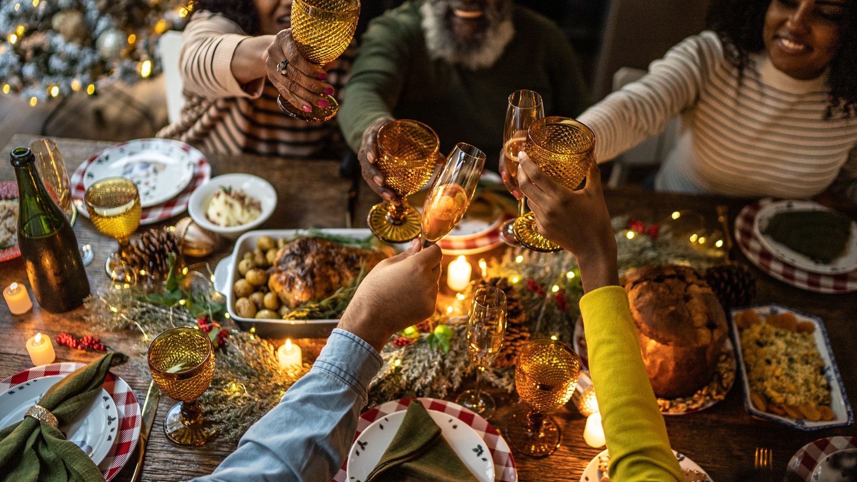
When do we have a party?
Notes:
Encourage students to say as many special occasions when we can organize parties as possible.

Slide 4
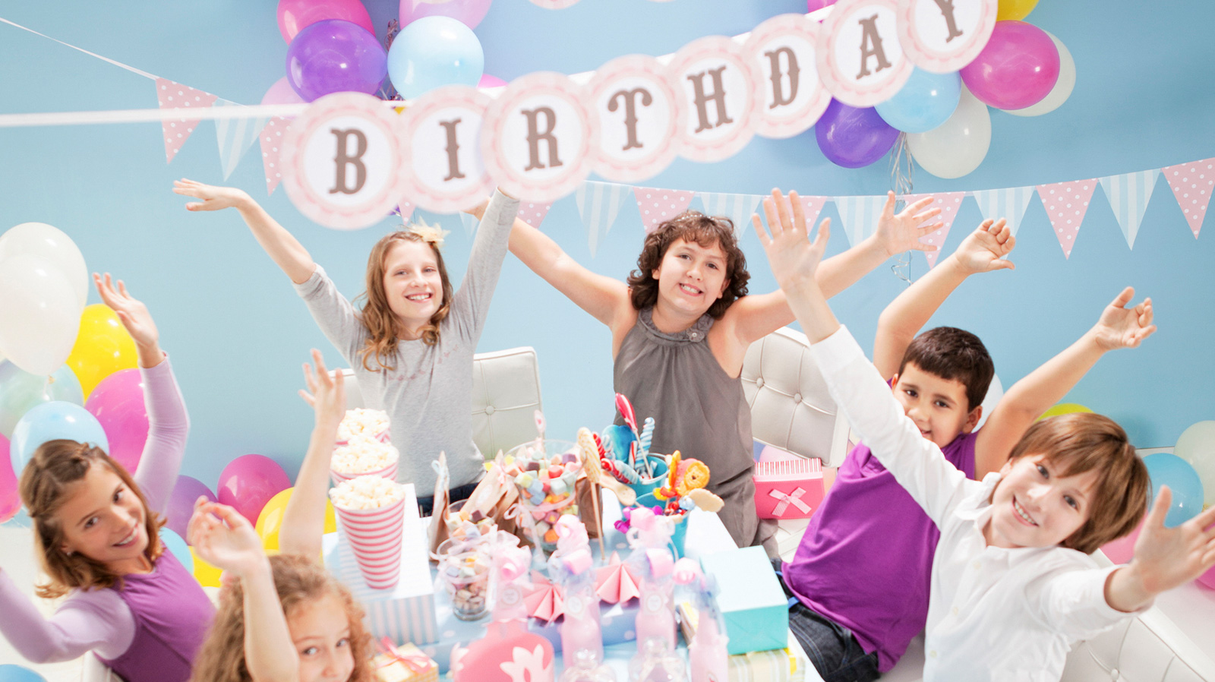
What food/drinks will you have at your birthday party?

Slide 5
02
Activity 4
Listen and tick.

Slide 6
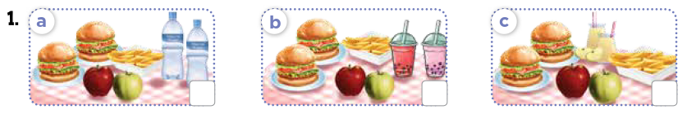
Look! What food and drinks will they have?

Slide 7
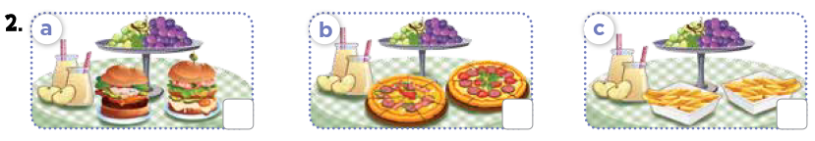
Look! What food and drinks will they have?

Slide 8

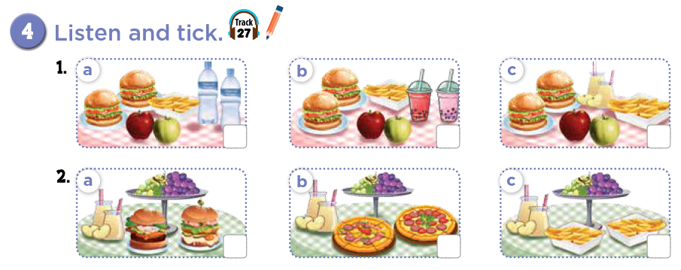

Slide 9
Let's check!



Slide 10
Listen and repeat.



Slide 11
03
Activity 5
Read and complete.

Slide 12
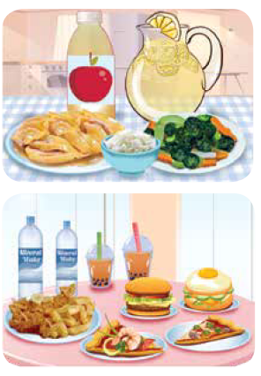
Look at the pictures. What food and drinks do you see?

Slide 13
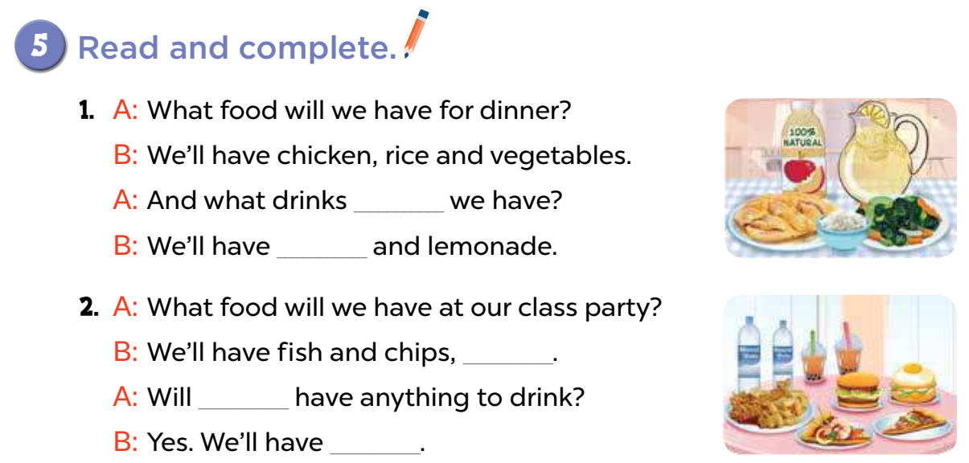
will
apple juice
___________________ and lemonade.
burgers and pizzas
____________________.
we
water and milk tea
_______________________________.

Slide 14
In pairs. Act it out.
will
apple juice
___________________ and lemonade.
burgers and pizzas
____________________.
we
water and milk tea
_______________________________.

Slide 15
Activity 6
04
Let's play.

Slide 16
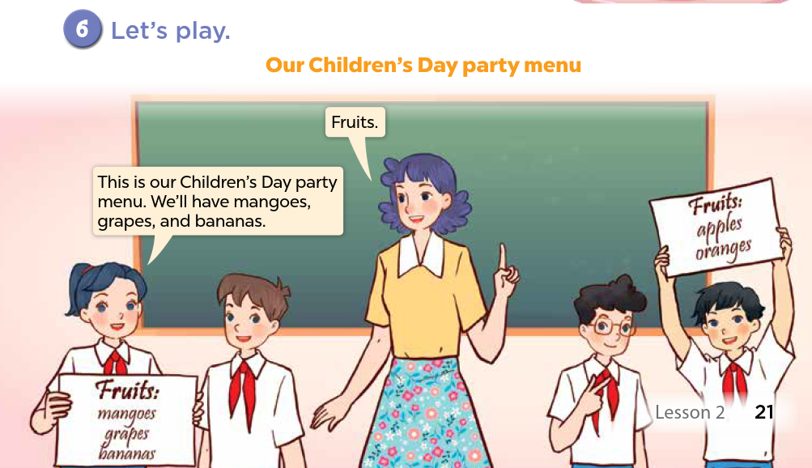

Slide 17
Fun Corner
05
Collect the hamburgers!

Slide 18









What will you have? Pick your favourite.
Notes:
Encourage students to say "I will have ____" when picking the question.

Slide 19


What food ___ we have for dinner?
A. wills
B. drinks
C. will
D. we

Slide 20
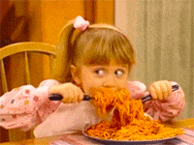
Spaghetti Time! + 3 points

Slide 21
A: What ___ will we have for dinner?
B: Fried rice.
A. food
B. drinks
C. day
D. candy

Slide 22
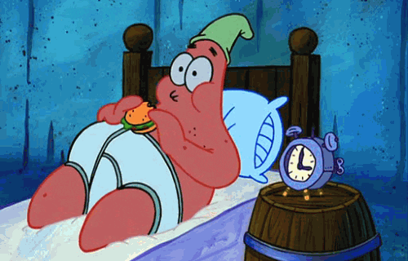
Night Food? -1 point

Slide 23
A: What drinks will we have?
B: _________.
A. Burgers
B. Lemonade
C. Ice cream
D. Pizza

Slide 24
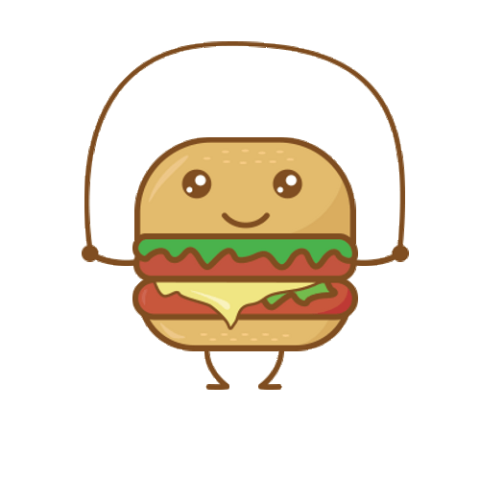
Exercise is good for you! +2 points

Slide 25
A: What food will we have?
B: We'll have _________.
A. mineral water
B. milk tea
C. soda
D. pizza

Slide 26
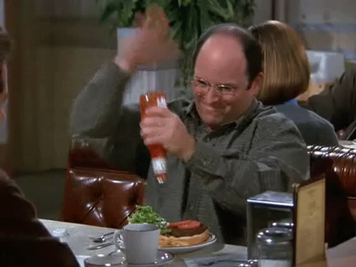
No ketchup! -2 points

Slide 27
A: What ___ will we have at the party?
B: We'll have milk tea and soda.
A. drinks
B. food
C. water
D. fruits

Slide 28
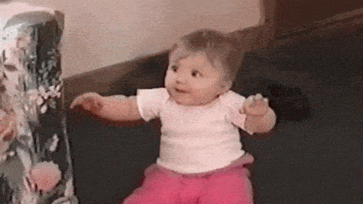
Ice cream is the best! +5 points

Slide 29
What drinks will we have ___ the party?
A. on
B. at
C. will
D. our

Slide 30
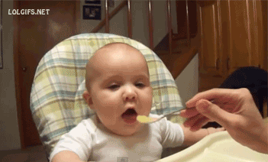
It doesn't taste good! -3 points

Slide 31
_____ anything to drink?
A. Will you have
B. Will you has
C. You will have
D. We'll have

Slide 32
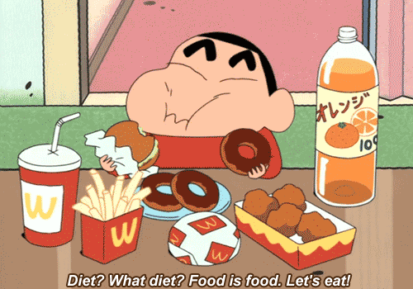
So yummy! +4 points

Slide 33
A: What ____ will we have for Mid-Autumn Festival?
B: We'll have apples and pomelos.
A. drinks
B. songs
C. oranges
D. fruits

Slide 34
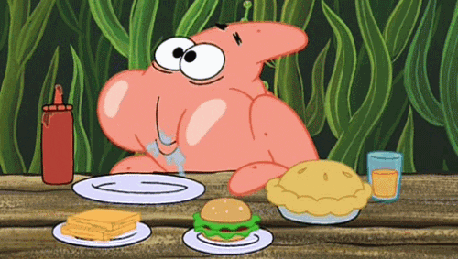
"Food" Morning! +2 points

Slide 35
What will we have ___ breakfast?
A. on
B. for
C. will
D. in

Slide 36
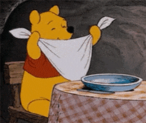
Good etiquette! +3 points

Slide 37
Website: hoclieu.vn
Fanpage: https://www.facebook.com/tienganhglobalsuccess.vn/

