Slide 1




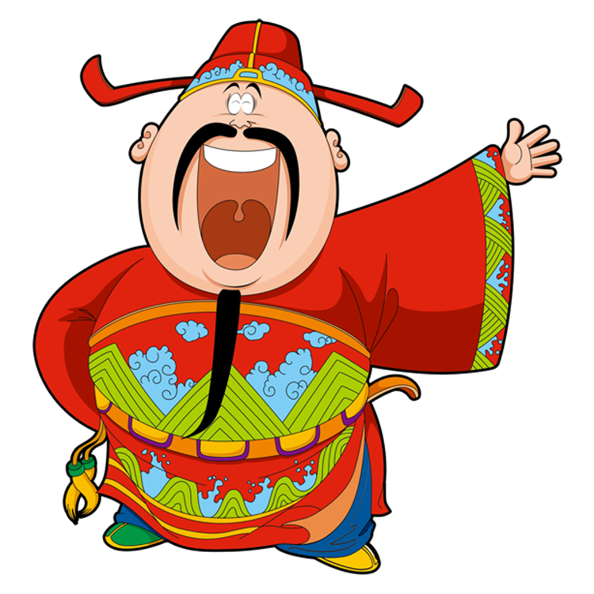
Lucky Money

Slide 2

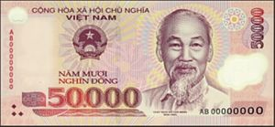

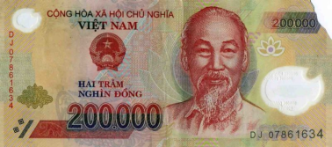

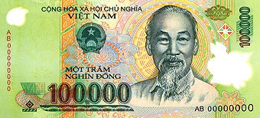


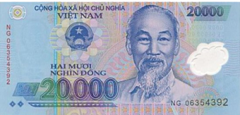





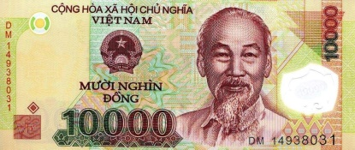



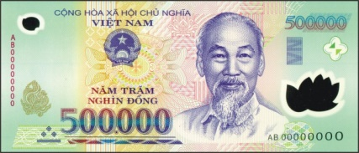
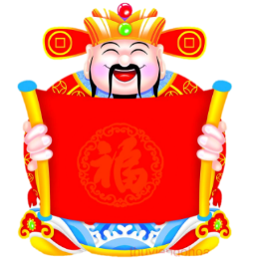
2
6
3
7
1
10
5
8
4
9
Boys
Girls

Slide 3


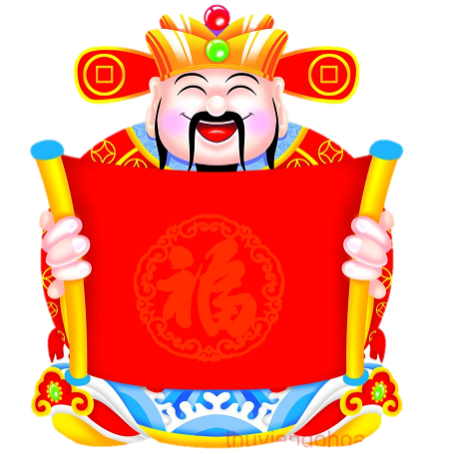
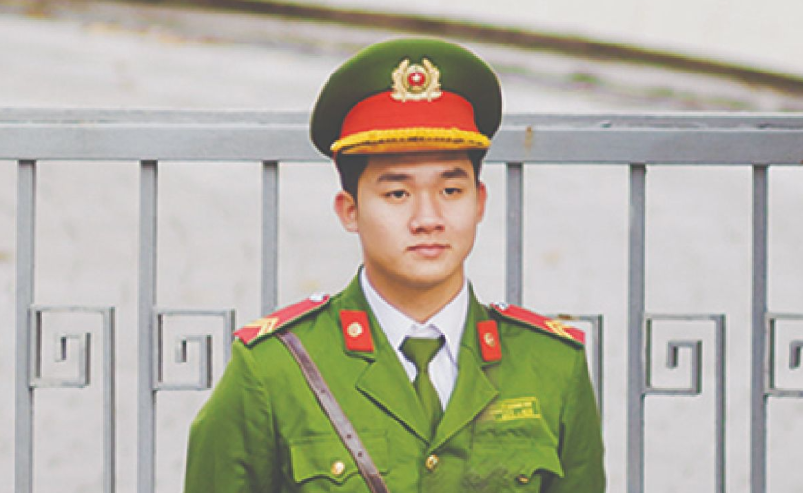
What does he do?
A.
He’s a policeman.
He’s a teacher.
B.

Slide 4

What does she do?
A.
She’s a worker.
She’s an office worker.
B.

Slide 5
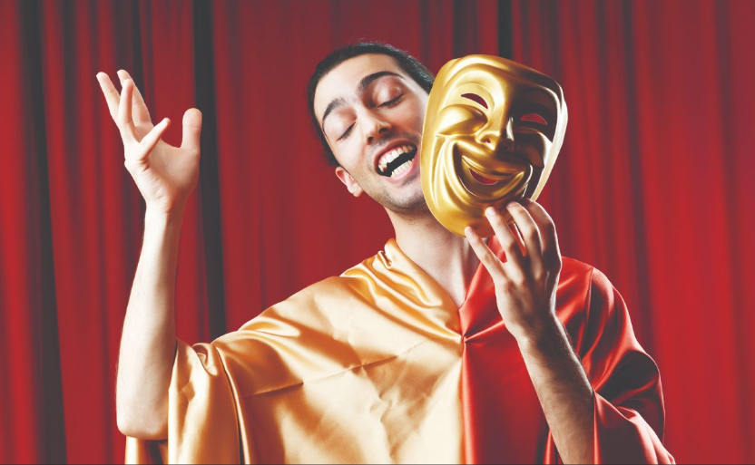
What does he do?
A.
He’s an actor.
He’s a actor.
B.

Slide 6
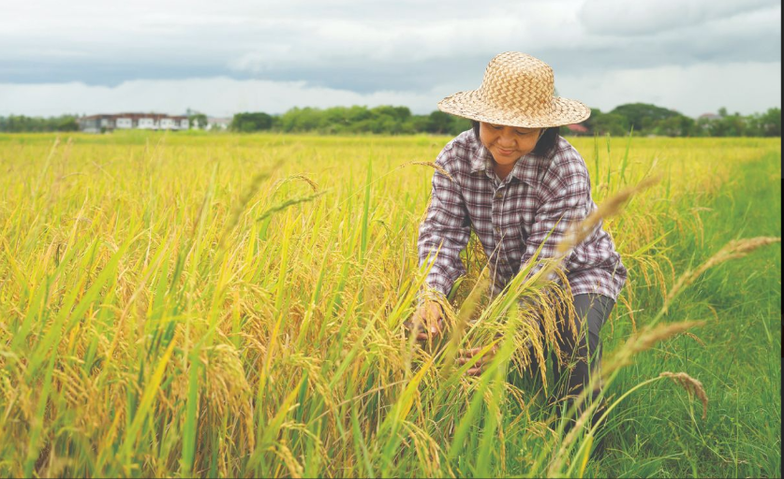
What does she do?
A.
She’s a farmer.
He’s a farmer.
B.

Slide 7
She’s ……office worker.
A.
a
an
B.

Slide 8

Lucky Money
You’re lucky!

Slide 9
Lucky Money
You’re lucky!

Slide 10
Lucky Money
You’re lucky!

Slide 11
He’s ……actor.
an
A.
a
B.

Slide 12
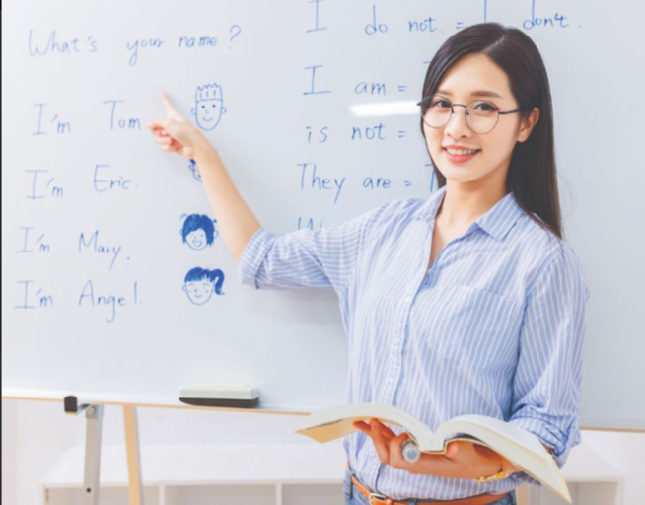
…… a teacher.
He’s
A.
She’s
B.

Slide 13
Happy New Year

Slide 14
Thank you
and
Happy New Year

Slide 15


