Slide 1



Unit 12: Our Tet holiday
Lesson 1 - Period 2

Slide 2
Activity 4
2
Listen and tick.

Slide 3
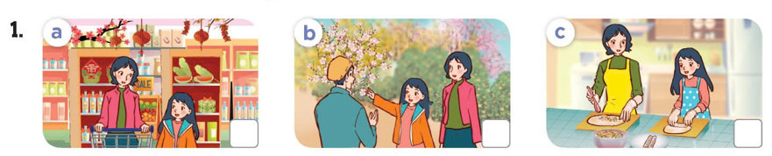
Look at the pictures.
What will they do for Tet?

Slide 4


Listen and tick.

Slide 5
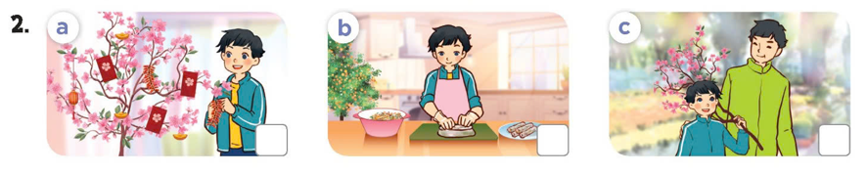
Look at the pictures.
What will they do for Tet?

Slide 6
Listen and tick.


Slide 7
3
Activity 5
Read and complete.

Slide 8
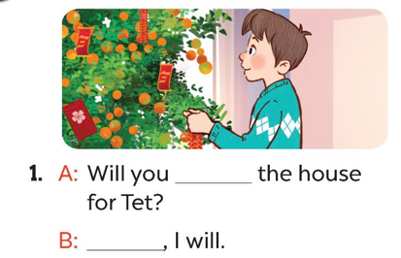
Look at the pictures. What will the boy do?
What are the missing words?
decorate
Yes

Slide 9
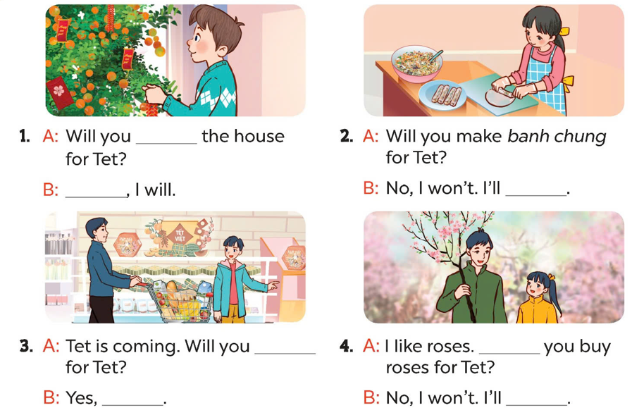
decorate
Yes
make
spring rolls
do the shopping
Will
I will
buy a branch of peach blossoms

Slide 10
Practice in pairs.
decorate
Yes
make
spring rolls
Act it out!
do the shopping
Will
I will
buy a branch of peach blossoms

Slide 11
Activity 6
6
Let's sing!

Slide 12
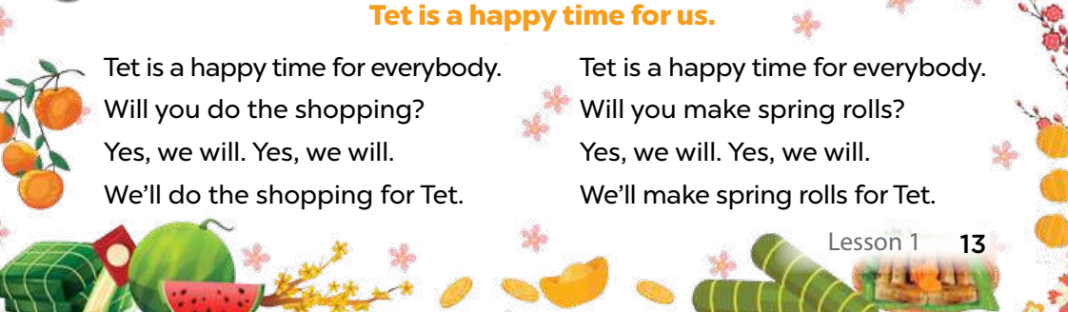
Read the lyrics.

Slide 13
Listen.
Practice line by line.
Sing the song.

Slide 14
Fun time

Slide 15
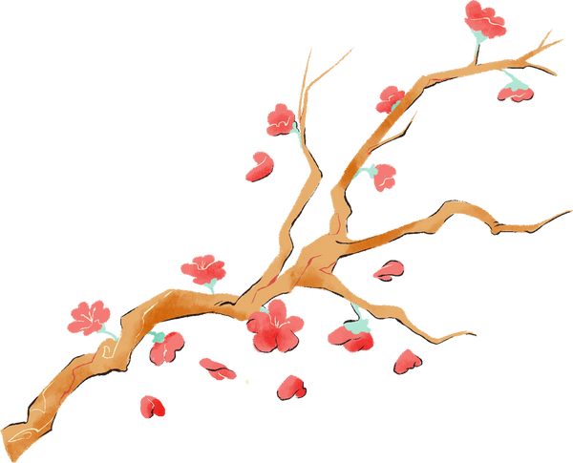




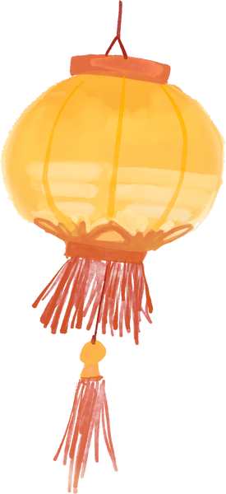

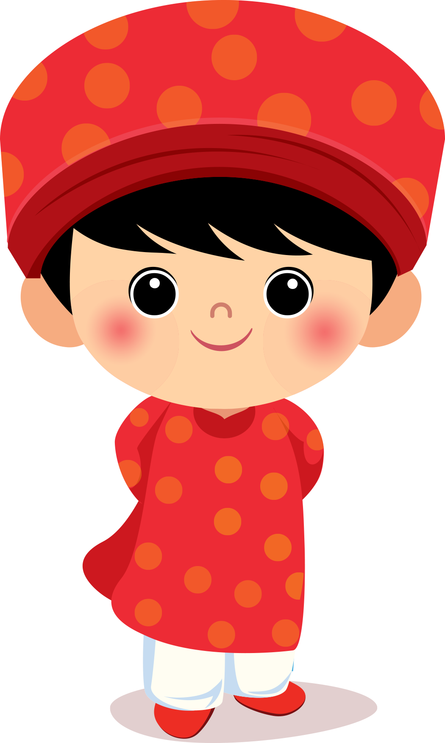
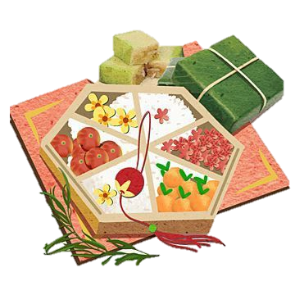



TRÒ CHƠI
ĐỐ VUI NGÀY TẾT
Get the lucky money

Slide 16

Rules
2 teams
10s for each question. You'll get 10 points for each correct answer.
2 lucky questions with 20 points
The winner team'll get a present.
Let's start !!!

Slide 17










Choose the question.
Team A
Team B
00
00

Slide 18
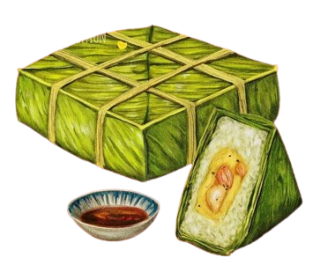
CORRECT!!!
Will you ......... the house for Tet?
A
decorate
B
make
C
do
D
buy

Slide 19
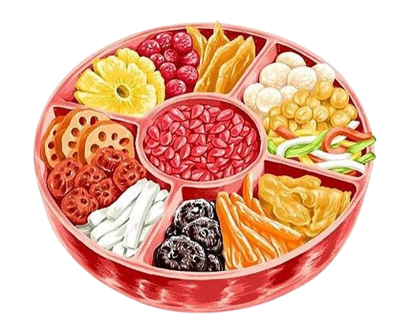
CORRECT!!!
You'll get 20 points!
Alex: .......... you buy a branch of peach blossoms for Tet?
Nam: Yes, I will.
A
What
B
Won't
C
Do
D
Will

Slide 20
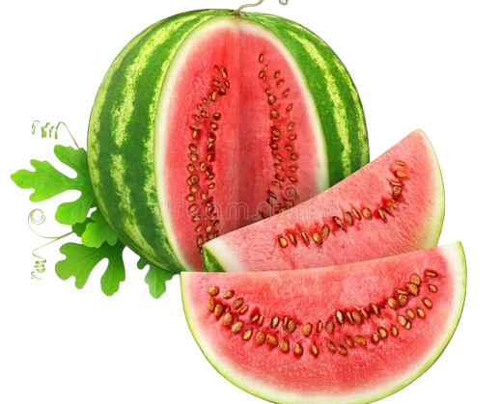
CORRECT!!!
Tet is coming.
Will you ______ the shopping?
A
doing
B
do
C
does
D
will do

Slide 21
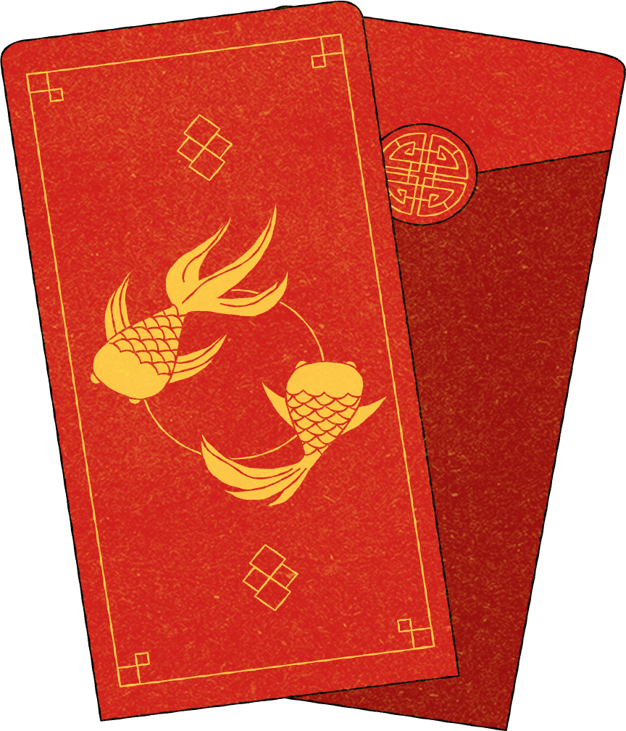
CORRECT!!!
Lan: Will you make spring rolls for Tet?
Minh: No, I _____. I'll make banh chung.
A
will
B
don't make
C
won't
D
not make

Slide 22
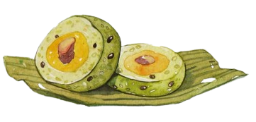
CORRECT!!!
You get 20 points!
Lan: Will you make banh chung for Tet?
Minh: No, I _____. I'll make spring rolls.
A
will
B
won’t
C
don’t
D
do

Slide 23

CORRECT!!!
Ben: Will you do the shopping for Tet?
Mary: _____, I will.
A
Yes
B
No

Slide 24
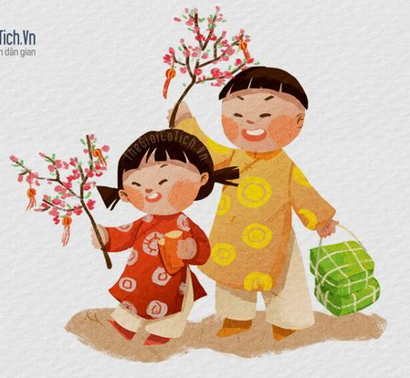
CORRECT!!!
Mai: Will you buy roses for Tet?
Lucy: No, I won't. I'll __________.
A
make spring rolls
B
buy banh chung
C
decorate the house
D
buy a branch of peach blossoms

Slide 25
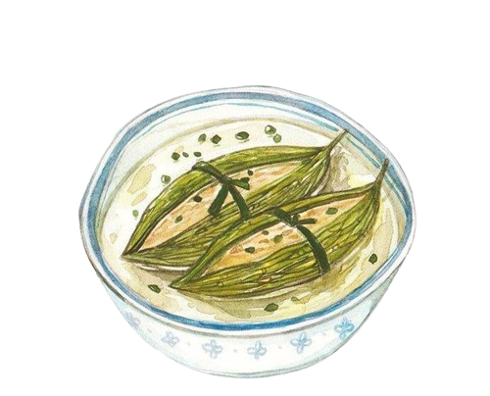
CORRECT!!!
Lan: Will you do the shopping, Dad?
Dad: ______. I'll decorate the house.
A
No, I don't.
B
Yes, I do.
D
No, I won't.
C
Yes, I will.

Slide 26

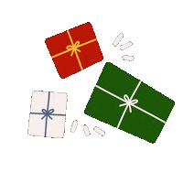
Good job!

Slide 27

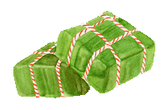
Happy new year

Slide 28
Thanks

