Slide 1

Unit 10
Our school trip
Lesson 2 - Period 3

Slide 2


01
Warm-up and Review

Slide 3

Secret boxes
Game

Slide 4




Secret boxes

Slide 5
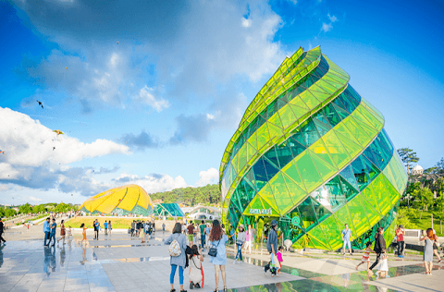
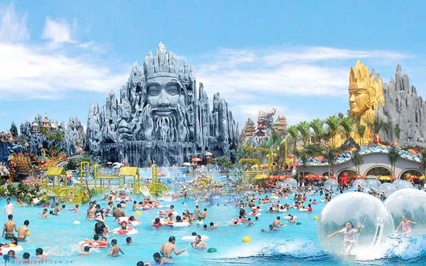
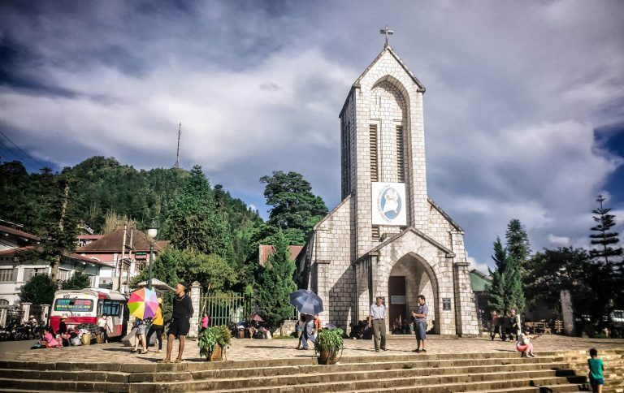
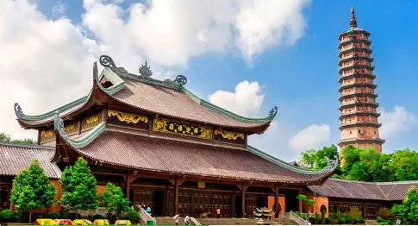
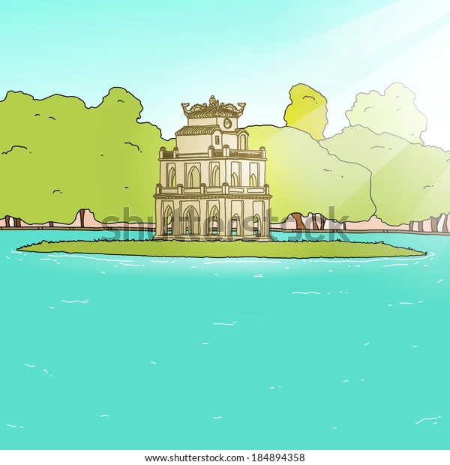
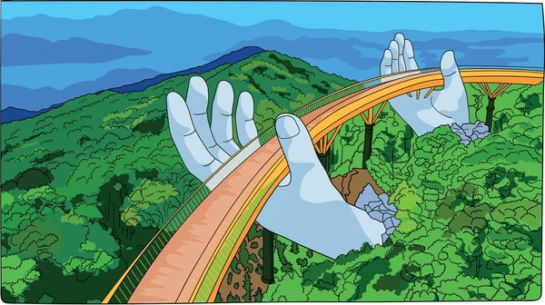




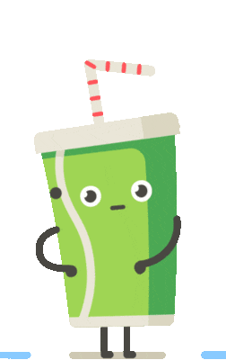



Secret boxes
Notes:
Click vào hộp quà xuất hiện bức tranh. HS hỏi đáp về bức tranh.
Click vào hình ảnh để làm biến mất nó.
Cick và tên team để hiện Stick ghi điểm

Slide 6



Slide 7
02
Activity 1.
Look, listen and repeat

Slide 8









Slide 9

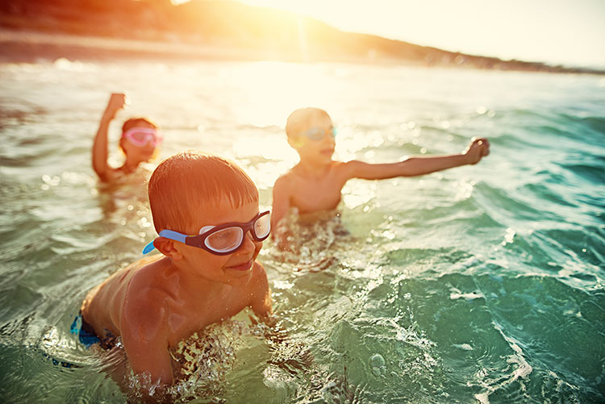

S
W
I
M

Slide 10
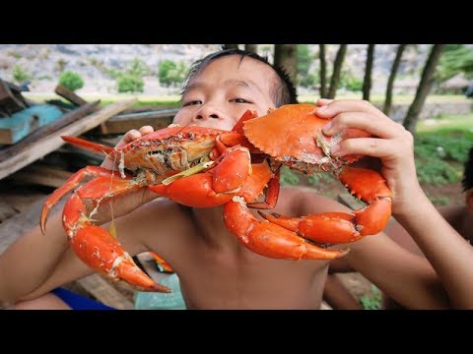
E
A
T
S
E
A
F
O
O
D

Slide 11
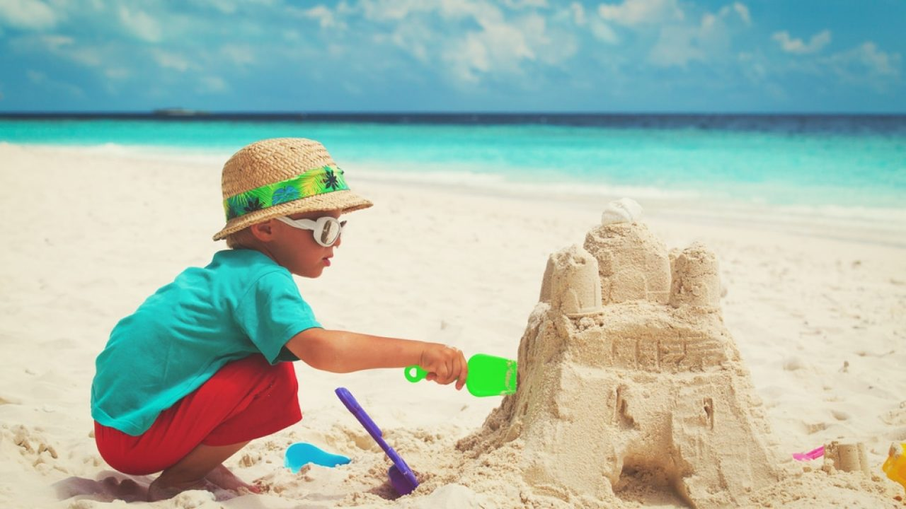
B
U
I
L
D
S
A
N
D
C
A
S
T
L
E

Slide 12
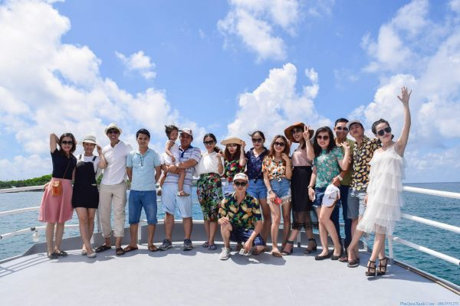
T
A
K
E
P
H
O
T
O
S

Slide 13
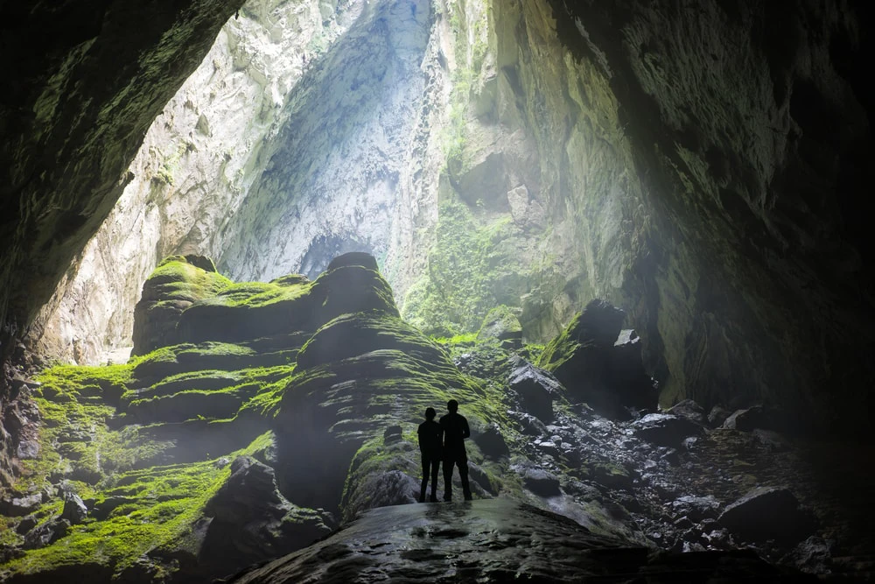
E
X
P
L
O
R
E

Slide 14
activities
(on holiday)

Slide 15
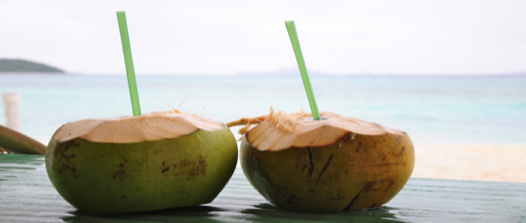
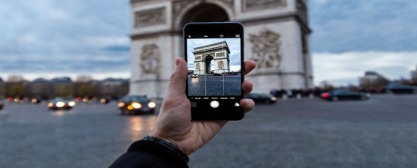


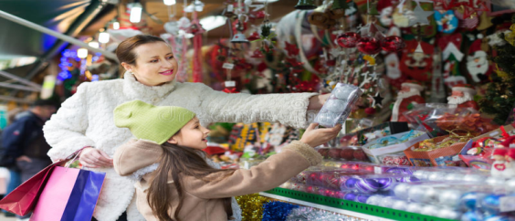
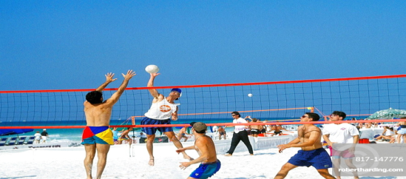
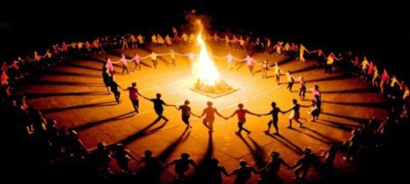

eat seafood
drink
take photos
build sandcastles
swim
buy souvenir
play beach volleyball
dance
explore the caves

Slide 16

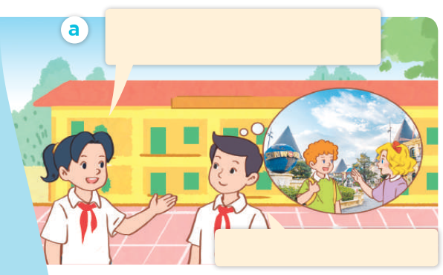
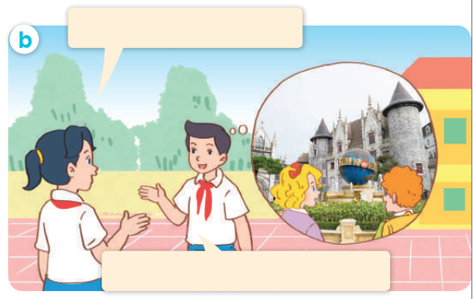
Look, listen and repeat.

Slide 17
Look, listen and repeat.
Where did Mary and Bill go on the school trip last weekend?
They went to Ba Na Hills.

Slide 18
Look, listen and repeat.
What did they do there?
They visited the old buildings.

Slide 19
Look, listen and repeat.
Where did Mary and Bill go on the school trip last weekend?
What did they do there?
They went to Ba Na Hills.
They visited the old buildings.

Slide 20
03
Activity 2.
Listen, point and say

Slide 21
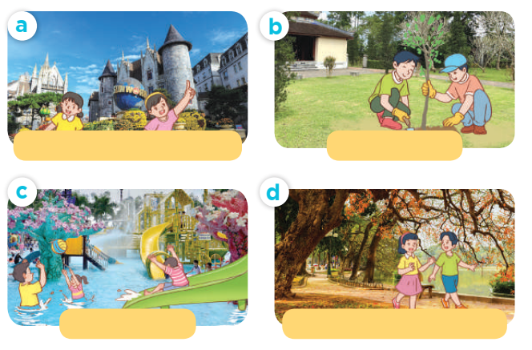
Listen, point and say.

Slide 22
Listen, point and say.
visit the old buildings

Slide 23
Listen, point and say.
plant trees

Slide 24
Listen, point and say.
play games

Slide 25
Listen, point and say.
walk around the lake

Slide 26

What did they do there?
They _______.

Slide 27
Listen, point and say.
What did they do there?
They visited the old buildings.
visit the old buildings

Slide 28
Listen, point and say.
What did they do there?
They planted trees.
plant trees

Slide 29
Listen, point and say.
What did they do there?
They played games.
play games

Slide 30
Listen, point and say.
What did they do there?
They walked around the lake.
walk around the lake

Slide 31
Listen, point and say.
What did they do there?
visit the old buildings
plant trees
They ______.
play games
walk around the lake

Slide 32
04
Activity 3. Let’s talk

Slide 33
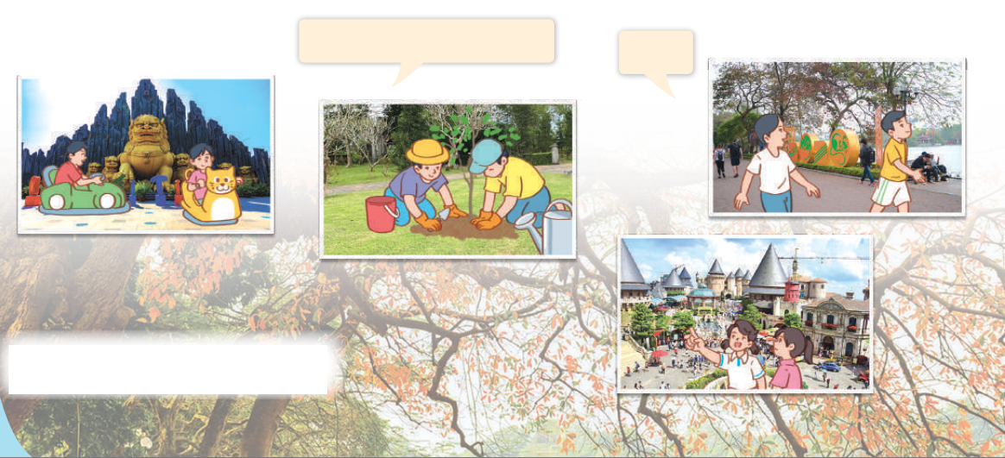
Let’s talk.
What did they do there?
___.

Slide 34
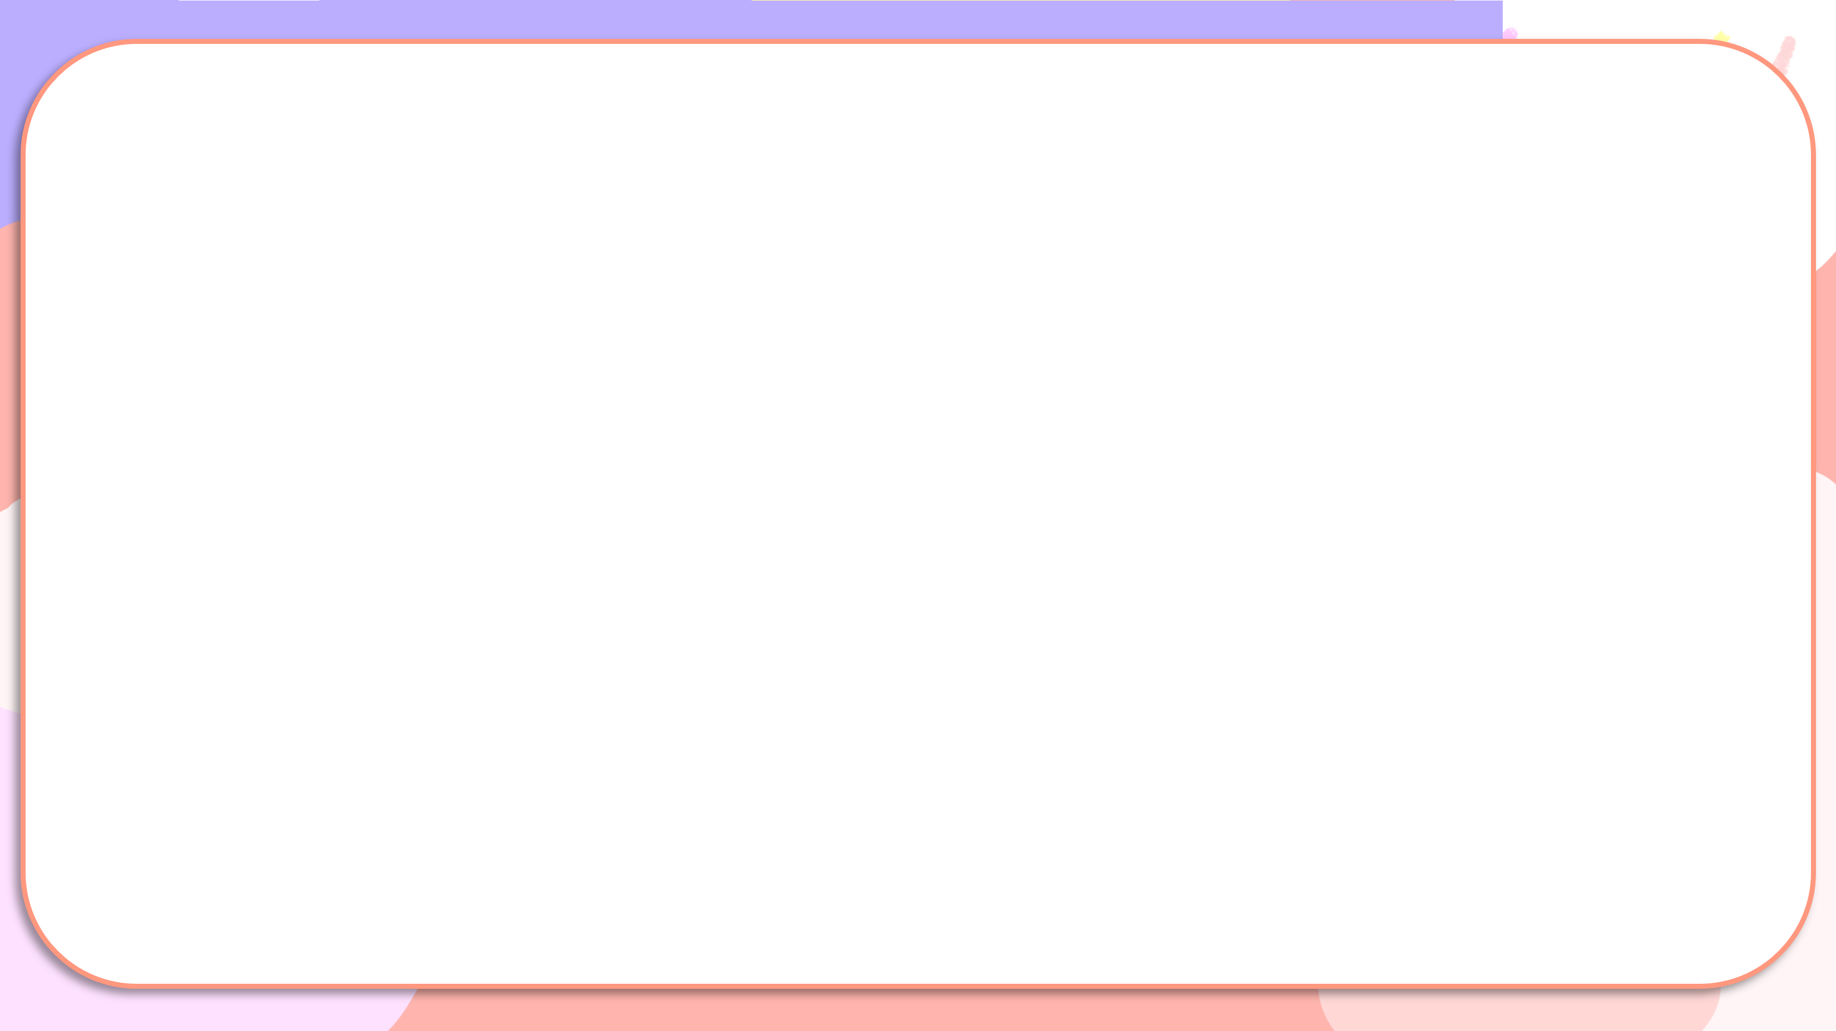


What did they do there?
They ___.

Slide 35
05
Fun corner and Wrap-up

Slide 36

Game
Sentence puzzle

Slide 37

Sentence puzzle
1. visited / They / old / buildings. / the
2. trees. / They / planted
3. walked / lake. / around / They/ the
4. games. / played / They

Slide 38
Sentence puzzle
1. visited / They / old / buildings. / the
They visted old the buildings.

Slide 39
Sentence puzzle
2. trees. / They / planted
They planted trees.

Slide 40
Sentence puzzle
3. walked / lake. / around / They/ the
They walked around the lake.

Slide 41
Sentence puzzle
4. games. / played / They
They played games.

Slide 42


Very Good!

