Slide 2

Unit 16
Seasons and the weather
Lesson 1 - Period 2

Slide 3


Table of contents
01
Warm-up and Review
02
Listen and number.
03
Read and complete.
04
Let’s sing.
05
Fun corner and Wrap-up

Slide 4


01
Warm-up and Review

Slide 5


How’s the weather
in Ha Noi in ____?
It’s ____.

Slide 6

Multiple choice
Game
A
B
C

Slide 7


Multiple choice
A: How’s the weather in Ha Noi in ___?
B: It’s cold.
a. spring
b. autumn
c. winter

Slide 8
Multiple choice
A: How’s the weather in Hue in ____?
B: It’s warm.
a. winter
b. spring
c. summer

Slide 9
Multiple choice
A: How’s the weather in Da Nang in ___?
B: It’s hot.
a. summer
b. autumn
c. winter

Slide 10
Multiple choice
A: How’s the weather in Ho Chi Minh in __?
B: It’s cool.
a. winter
b. summer
a. autumn

Slide 11



Slide 12
02
Listen and number.

Slide 13

Look and say.
Notes:
Nháy vào số để nghe lại âm thanh/

Slide 14

Look and say.
Notes:
Nháy vào số để nghe lại âm thanh/

Slide 15

Look and say.
Notes:
Nháy vào số để nghe lại âm thanh/

Slide 16

Look and say.
Notes:
Nháy vào số để nghe lại âm thanh/

Slide 17


Listen and number.
3
1
4
2
Notes:
Nháy vào số để nghe lại âm thanh/

Slide 18
03
Read and complete.

Slide 19




Read and complete.

Slide 20

Read and complete.
1. A: How’s the weather in Ha Noi _________?
B: It’s warm and rainy.

Slide 21

Read and complete.
2. A: ____________ in Ho Chi Minh City
in the dry season?
B: It’s hot and sunny.

Slide 22
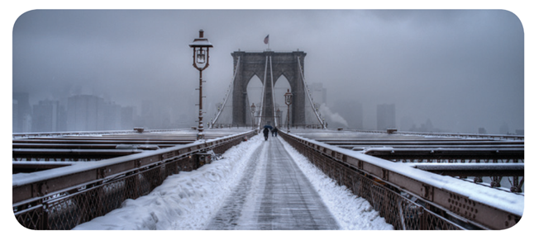
Read and complete.
3. A: ___________ in New York in winter?
B: It’s ________ and snowy.

Slide 23

Read and complete.
4. A: How’s the weather in Tokyo in _______?
B: It’s cool and ________.

Slide 24


SWAP YOUR BOOKS AND LET’S CHECK.

Slide 25

Let’s check.
1. A: How’s the weather in Ha Noi ________?
B: It’s warm and rainy.
in spring

Slide 26

Let’s check.
2. A: ________________ in Ho Chi Minh City in the dry season?
B: It’s hot and sunny.
How’s the weather

Slide 27
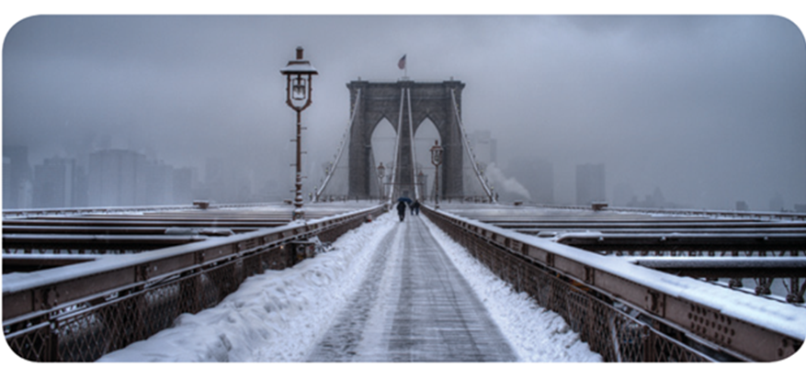
Let’s check.
3. A: ________________ in New York in winter?
B: It’s _____ and snowy.
How’s the weather
cold

Slide 28
Let’s check.
4. A: How’s the weather in Tokyo in ________?
B: It’s cool and ______.
autumn
windy

Slide 29
How’s the weather
in _____?
It’s ___.

Slide 30
04
Let’s sing.

Slide 31


Let’s sing.
How’s the weather in Ha Noi?
How’s the weather in spring?
It’s warm and rainy.
How’s the weather in summer?
It’s hot and sunny.
What’s the weather like in autumn?
It’s cool and cloudy.
What’s the weather like in winter?
It’s cold and dry.

Slide 32

Perform

Slide 33
05
Fun corner and Wrap-up

Slide 34

Matching
Game

Slide 35

Notes:
Nháy vào số để nghe lại âm thanh/

Slide 36
sunny.
the weather
How’s
in summer?
It’s hot and

Slide 37
in autumn?
the weather
It’s cool
How’s
and windy.

Slide 38
in winter?
How’s the weather
cold
It’s
and snowy.

Slide 39
and sunny.
the weather
How’s
in spring?
It’s warm

Slide 41
Website: hoclieu.vn
Fanpage: https://www.facebook.com/tienganhglobalsuccess.vn/

