Slide 1

Unit 16 Seasons and the weather
Lesson 2 - Period 4

Slide 2
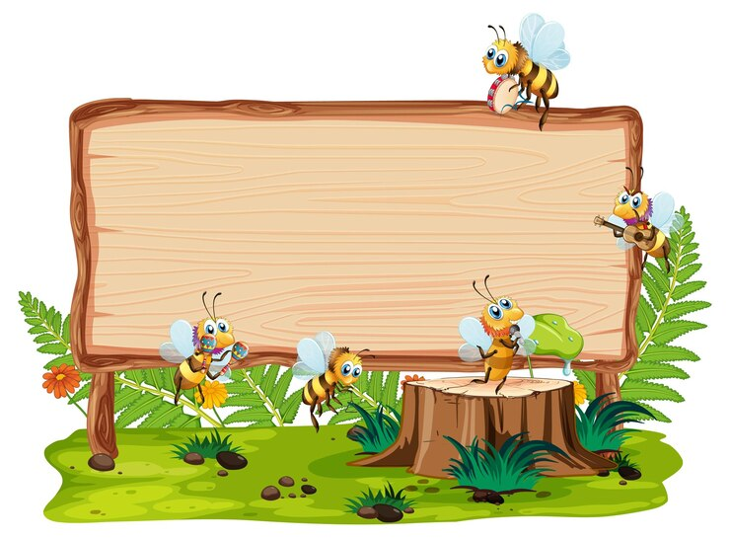
01
Warm-up and Review

Slide 3

What do you usually wear in ______?
I wear _____.

Slide 4


Throw the dice
Game

Slide 5
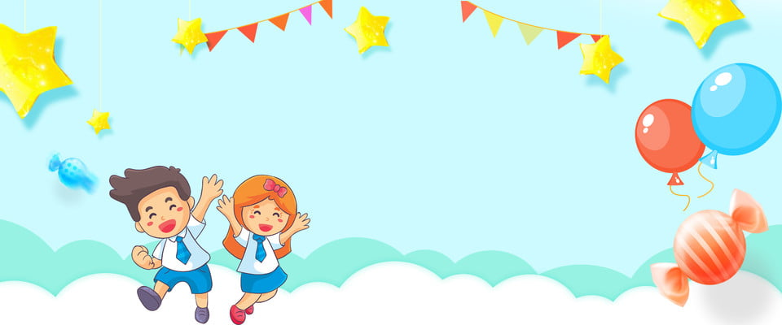


Very Good!

Slide 6
02
Listen and circle.

Slide 7

Listen and circle.
1. A. What season is it in Sydney? – It’s ________.
a. autumn b. summer
B. What does he usually wear? – He wears _______.
a. shorts and a T-shirt b. jeans and a T-shirt
2. A. What season is it in Ha Noi? – It’s ______.
a. winter b. summer
B. What does she usually wear? – She wears _____.
a. a skirt and a jumper b. jeans and a jumper

Slide 8
Listen and circle.
1. A. What season is it in Sydney? – It’s ____.
a. autumn b. summer
B. What does he usually wear? – He wears ____.
a. shorts and a T-shirt b. jeans and a T-shirt

Slide 9
Listen and circle.
2. A. What season is it in Ha Noi? – It’s ____.
a. winter b. summer
B: What does she usually wear? – She wears ___.
a. a skirt and a jumper b. jeans and a jumper

Slide 10


SWAP YOUR BOOKS AND LET’S CHECK.

Slide 11
Listen and check.
1. A: What season is it in Sydney? – It’s ________.
a. autumn b. summer
B: What does he usually wear? – He wears _____.
a. shorts and a T-shirt b. jeans and a T-shirt

Slide 12
Listen and check
2. A: What season is it in Ha Noi? – It’s ________.
a. winter b. summer
B: What does she usually wear? – She wears ___.
a. a skirt and a jumper b. jeans and a jumper

Slide 13
Let’s check.
1. A: What season is it in Sydney? – It’s ____.
a. autumn b. summer
B: What does he usually wear? – He wears ____.
a. shorts and a T-shirt b. jeans and a T-shirt
2. A: What season is it in Ha Noi? – It’s ____.
a. winter b. summer
B: What does she usually wear? – She wears _____.
a. a skirt and a jumper b. jeans and a jumper

Slide 14
03
Read and complete.

Slide 15
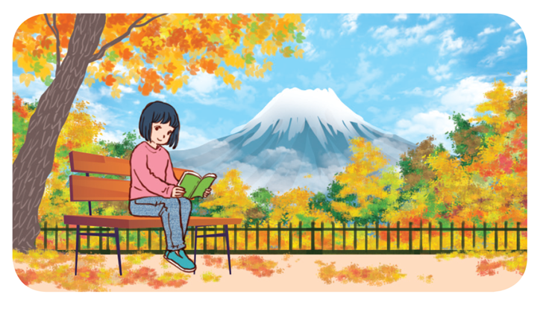
Read and complete.
1. A: How’s ___________ in Japan, Akiko?
B: It’s cool and windy. It’s autumn.
A: What do you usually wear at this time of year?
B: I wear ___________ and a __________.

Slide 16
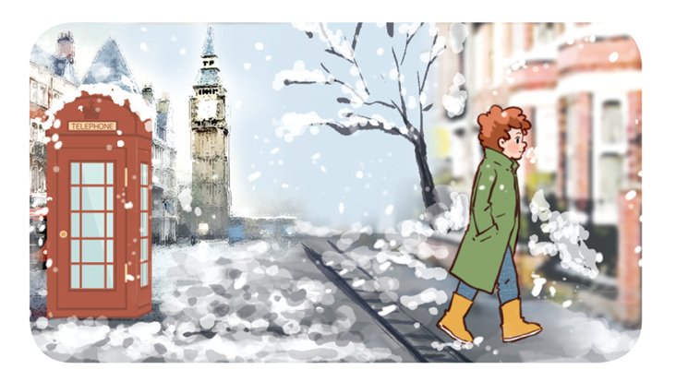
Read and complete.
2. A: What season is it in London now, Tom?
B: It’s ___________. It’s very cold and snowy.
A: What ________________ in winter?
B: I wear ___________ and a coat.

Slide 17
Let’s check.
1. A: How’s ___________ in Japan, Akiko?
B: It’s cool and windy. It’s autumn.
A: What do you usually wear at this time of the year?
B: I wear _______ and a _______.
the weather
jeans
jumper

Slide 18
Let’s check.
2. A: What season is it in London now, Tom?
B: It’s ______. It’s very cold and snowy.
A: What ________________ in winter?
B: I wear _____ and a coat.
winter
do you usually wear
jeans

Slide 19
Let’s check.
the weather
1.A: How’s ___________ in Japan, Akiko?
B: It’s cool and windy. It’s autumn.
A: What do you usually wear at this time of year?
B: I wear _____ and a ______.
2.A: What season is it in London now, Tom?
B: It’s ______. It’s very cold and snowy.
A: What _________________ in winter?
B: I wear ______ and a coat.
winter
do you usually wear
jeans
jeans
jumper

Slide 20
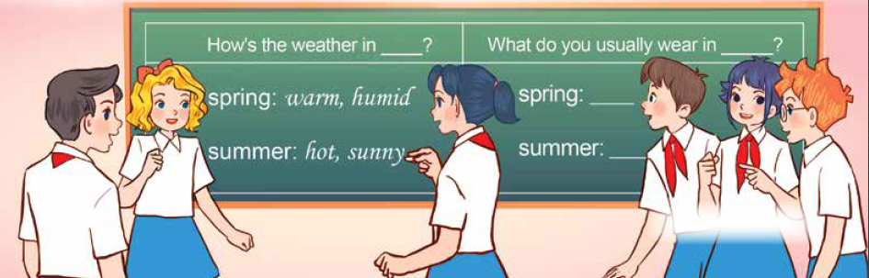
Let’s play.
Who’s faster?

Slide 21

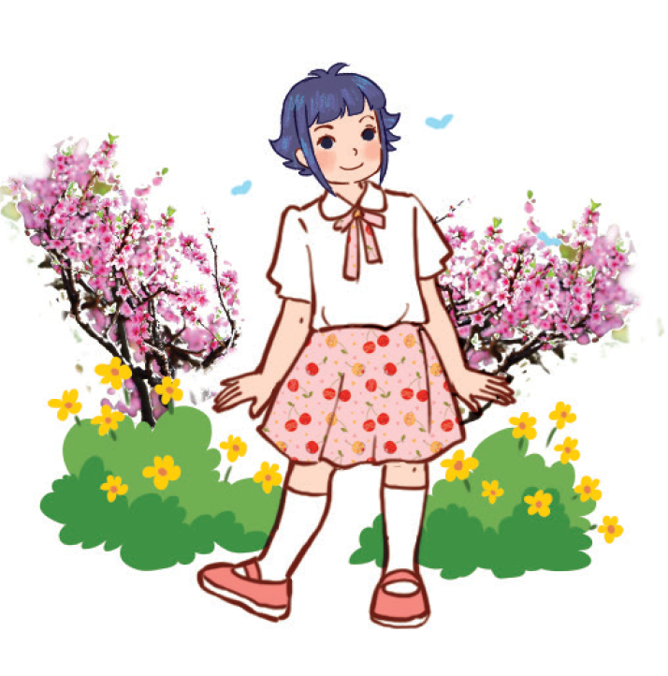
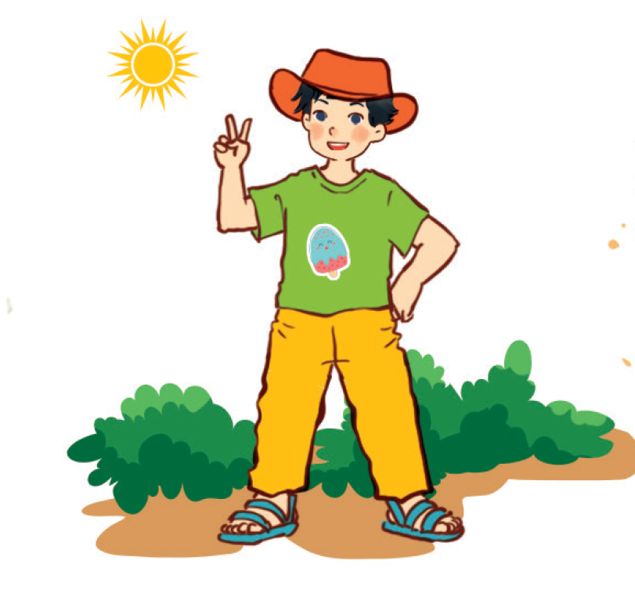
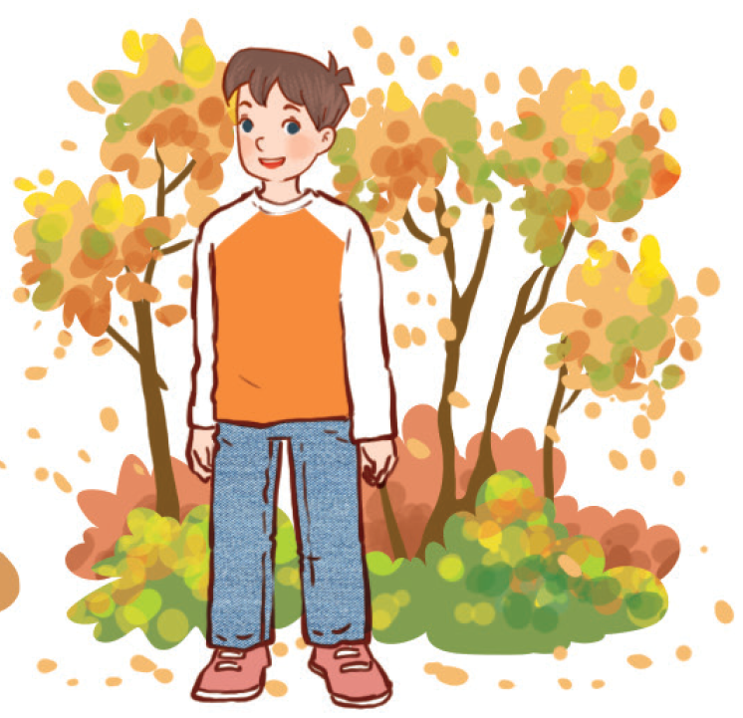
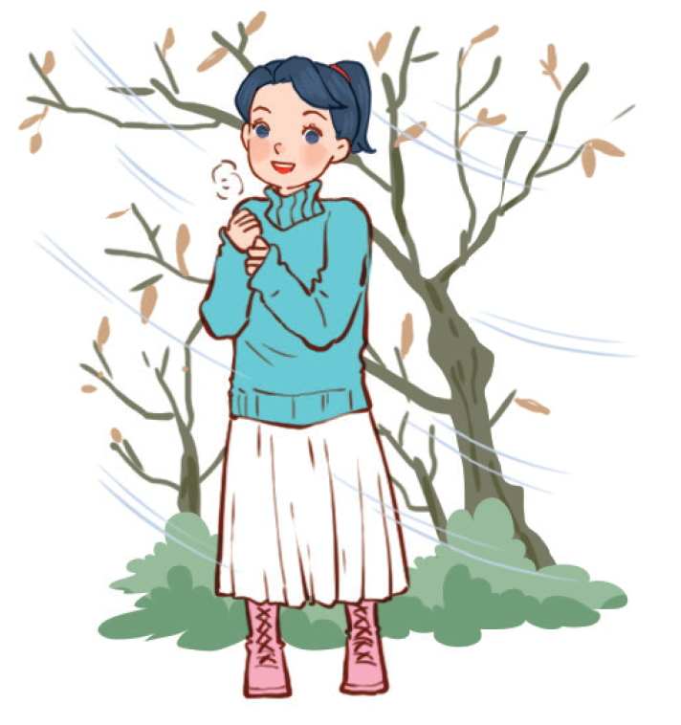
How’s the weather in ____?
What does she / he usually wear in ____?

